Slide 1
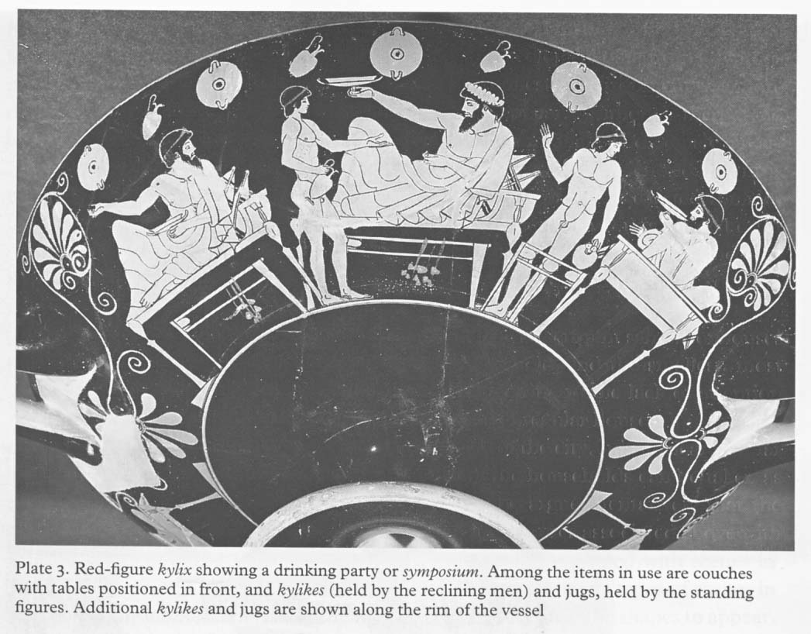

Slide 2
Ξενοφών, Οικονομικός ΙΧ, 2-16
[2] καὶ πῶς δή, ἔφην ἐγώ, ὦ Ἰσχόμαχε, διέταξας αὐτῇ; τί δ᾽, εἰ μὴ τῆς γε οἰκίας τὴν δύναμιν ἔδοξέ μοι πρῶτον ἐπιδεῖξαι αὐτῇ. οὐ γὰρ ποικίλμασι κεκόσμηται, ὦ Σώκρατες, ἀλλὰ τὰ οἰκήματα ᾠκοδόμηται πρὸς αὐτὸ τοῦτο ἐσκεμμένα, ὅπως ἀγγεῖα ὡς συμφορώτατα ᾖ τοῖς μέλλουσιν ἐν αὐτοῖς ἔσεσθαι: ὥστε αὐτὰ ἐκάλει τὰ πρέποντα εἶναι ἐν ἑκάστῳ. [3] ὁ μὲν γὰρ θάλαμος ἐν ὀχυρῷ ὢν τὰ πλείστου ἄξια καὶ στρώματα καὶ σκεύη παρεκάλει, τὰ δὲ ξηρὰ τῶν στεγνῶν τὸν σῖτον, τὰ δὲ ψυχεινὰ τὸν οἶνον, τὰ δὲ φανὰ ὅσα φάους δεόμενα ἔργα τε καὶ σκεύη ἐστί. [4] καὶ διαιτητήρια δὲ τοῖς ἀνθρώποις ἐπεδείκνυον αὐτῇ κεκαλλωπισμένα τοῦ μὲν θέρους ἔχειν ψυχεινά, τοῦ δὲ χειμῶνος ἀλεεινά. καὶ σύμπασαν δὲ τὴν οἰκίαν ἐπέδειξα αὐτῇ ὅτι πρὸς μεσημβρίαν ἀναπέπταται, ὥστε εὔδηλον εἶναι ὅτι χειμῶνος μὲν εὐήλιός ἐστι, τοῦ δὲ θέρους εὔσκιος. [5] ἔδειξα δὲ καὶ τὴν γυναικωνῖτιν αὐτῇ, θύρᾳ βαλανωτῇ ὡρισμένην ἀπὸ τῆς ἀνδρωνίτιδος, ἵνα μήτε ἐκφέρηται ἔνδοθεν ὅ τι μὴ δεῖ μήτε τεκνοποιῶνται οἱ οἰκέται ἄνευ τῆς ἡμετέρας γνώμης. οἱ μὲν γὰρ χρηστοὶ παιδοποιησάμενοι εὐνούστεροι ὡς ἐπὶ τὸ πολύ, οἱ δὲ πονηροὶ συζυγέντες εὐπορώτεροι πρὸς τὸ κακουργεῖν γίγνονται. [6] ἐπεὶ δὲ ταῦτα διήλθομεν, ἔφη, οὕτω δὴ ἤδη κατὰ φυλὰς διεκρίνομεν τὰ ἔπιπλα. ἠρχόμεθα δὲ πρῶτον, ἔφη, ἁθροίζοντες, οἷς ἀμφὶ θυσίας χρώμεθα. μετὰ ταῦτα κόσμον γυναικὸς τὸν εἰς ἑορτὰς διῃροῦμεν, ἐσθῆτα ἀνδρὸς τὴν εἰς ἑορτὰς καὶ πόλεμον, καὶ στρώματα ἐν γυναικωνίτιδι, στρώματα ἐν ἀνδρωνίτιδι, ὑποδήματα γυναικεῖα, ὑποδήματα ἀνδρεῖα. [7] ὅπλων ἄλλη φυλή, ἄλλη ταλασιουργικῶν ὀργάνων, ἄλλη σιτοποιικῶν, ἄλλη ὀψοποιικῶν, ἄλλη τῶν ἀμφὶ λουτρόν, ἄλλη ἀμφὶ μάκτρας, ἄλλη ἀμφὶ τραπέζας. καὶ ταῦτα πάντα διεχωρίσαμεν, οἷς τε ἀεὶ δεῖ χρῆσθαι καὶ τὰ θοινητικά. [8] χωρὶς δὲ καὶ τὰ κατὰ μῆνα δαπανώμενα ἀφείλομεν, δίχα δὲ καὶ τὰ εἰς ἐνιαυτὸν ἀπολελογισμένα κατέθεμεν. οὕτω γὰρ ἧττον λανθάνει ὅπως πρὸς τὸ τέλος ἐκβήσεται. ἐπεὶ δὲ ἐχωρίσαμεν πάντα κατὰ φυλὰς τὰ ἔπιπλα, εἰς τὰς χώρας τὰς προσηκούσας ἕκαστα διηνέγκαμεν. [9] μετὰ δὲ τοῦτο ὅσοις μὲν τῶν σκευῶν καθ᾽ ἡμέραν χρῶνται οἱ οἰκέται, οἷον σιτοποιικοῖς, ὀψοποιικοῖς, ταλασιουργικοῖς, καὶ εἴ τι ἄλλο τοιοῦτον, ταῦτα μὲν αὐτοῖς τοῖς χρωμένοις δείξαντες ὅπου δεῖ τιθέναι, παρεδώκαμεν καὶ ἐπετάξαμεν σῶα παρέχειν: [10] ὅσοις δ᾽ εἰς ἑορτὰς ἢ ξενοδοκίας χρώμεθα ἢ εἰς τὰς διὰ χρόνου πράξεις, ταῦτα δὲ τῇ ταμίᾳ παρεδώκαμεν, καὶ δείξαντες τὰς χώρας αὐτῶν καὶ ἀπαριθμήσαντες καὶ γραψάμενοι ἕκαστα εἴπομεν αὐτῇ διδόναι τούτων ὅτῳ δέοι ἕκαστον, καὶ μεμνῆσθαι ὅ τι ἄν τῳ διδῷ, καὶ ἀπολαμβάνουσαν κατατιθέναι πάλιν ὅθενπερ ἂν ἕκαστα λαμβάνῃ
“‘And how did you arrange things for her, Ischomachus?’ I asked.“‘Why, I decided first to show her the possibilities of our house. For it contains few elaborate decorations, Socrates; but the rooms are designed simply with the object of providing as convenient receptacles as possible for the things that are to fill them, and thus each room invited just what was suited to it. [3] Thus the store-room by the security of its position called for the most valuable blankets and utensils, the dry covered rooms for the corn, the cool for the wine, the well-lit for those works of art and vessels that need light. [4] I showed her decorated living-rooms for the family that are cool in summer and warm in winter.¹ I showed her that the whole house fronts south, so that it was obvious that it is sunny in winter and shady in summer. [5] I showed her the women's quarters too, separated by a bolted door from the men's, so that nothing which ought not to be moved may be taken out, and that the servants may not breed without our leave. For honest servants generally prove more loyal if they have a family; but rogues, if they live in wedlock, become all the more prone to mischief. [6] “‘And now that we had completed the list, we forthwith set about separating the furniture tribe by tribe. We began by collecting together the vessels we use in sacrificing. After that we put together the women's holiday finery, and the men's holiday and war garb, blankets in the women's, blankets in the men's quarters, women's shoes, men's shoes. [7] Another tribe consisted of arms, and three others of implements for spinning, for bread-making and for cooking; others, again, of the things required for washing, at the kneading-trough, and for table use. All these we divided into two sets, things in constant use and things reserved for festivities. [8] We also put by themselves the things consumed month by month, and set apart the supplies calculated to last for a year. For this plan makes it easier to tell how they will last to the end of the time. When we had divided all the portable property tribe by tribe, we arranged everything in its proper place. [9] After that we showed the servants who have to use them where to keep the utensils they require daily, for baking, cooking, spinning and so forth; handed them over to their care and charged them to see that they were safe and sound. [10] The things that we use only for festivals or entertainments, or on rare occasions, we handed over to the housekeeper, and after showing her their places and counting and making a written list of all the items, we told her to give them out to the right servants, to remember what she gave to each of them, and when receiving them back to put everything in the place from which she took it.

Slide 3
. [11] τὴν δὲ ταμίαν ἐποιησάμεθα ἐπισκεψάμενοι ἥτις ἡμῖν ἐδόκει εἶναι ἐγκρατεστάτη καὶ γαστρὸς καὶ οἴνου καὶ ὕπνου καὶ ἀνδρῶν συνουσίας, πρὸς τούτοις δὲ ἣ τὸ μνημονικὸν μάλιστα ἐδόκει ἔχειν καὶ τὸ προνοεῖν μή τι κακὸν λάβῃ παρ᾽ ἡμῶν ἀμελοῦσα, καὶ σκοπεῖν ὅπως χαριζομένη τι ἡμῖν ὑφ᾽ ἡμῶν ἀντιτιμήσεται. [12] ἐδιδάσκομεν δὲ αὐτὴν καὶ εὐνοϊκῶς ἔχειν πρὸς ἡμᾶς, ὅτ᾽ εὐφραινοίμεθα, τῶν εὐφροσυνῶν μεταδιδόντες, καὶ εἴ τι λυπηρὸν εἴη, εἰς ταῦτα παρακαλοῦντες. καὶ τὸ προθυμεῖσθαι δὲ συναύξειν τὸν οἶκον ἐπαιδεύομεν αὐτήν, ἐπιγιγνώσκειν αὐτὴν ποιοῦντες καὶ τῆς εὐπραγίας αὐτῇ μεταδιδόντες. [13] καὶ δικαιοσύνην δ᾽ αὐτῇ ἐνεποιοῦμεν τιμιωτέρους τιθέντες τοὺς δικαίους τῶν ἀδίκων καὶ ἐπιδεικνύοντες πλουσιώτερον καὶ ἐλευθεριώτερον βιοτεύοντας τῶν ἀδίκων: καὶ αὐτὴν δὲ ἐν ταύτῃ τῇ χώρᾳ κατετάττομεν. [14] ἐπὶ δὲ τούτοις πᾶσιν εἶπον, ἔφη, ὦ Σώκρατες, ἐγὼ τῇ γυναικὶ ὅτι πάντων τούτων οὐδὲν ὄφελος, εἰ μὴ αὐτὴ ἐπιμελήσεται ὅπως διαμένῃ ἑκάστῳ ἡ τάξις. ἐδίδασκον δὲ αὐτὴν ὅτι καὶ ἐν ταῖς εὐνομουμέναις πόλεσιν οὐκ ἀρκεῖν δοκεῖ τοῖς πολίταις, ἂν νόμους καλοὺς γράψωνται, ἀλλὰ καὶ νομοφύλακας προσαιροῦνται, οἵτινες ἐπισκοποῦντες τὸν μὲν ποιοῦντα τὰ νόμιμα ἐπαινοῦσιν, ἂν δέ τις παρὰ τοὺς νόμους ποιῇ, ζημιοῦσι. [15] νομίσαι οὖν ἐκέλευον, ἔφη, τὴν γυναῖκα καὶ αὐτὴν νομοφύλακα τῶν ἐν τῇ οἰκίᾳ εἶναι, καὶ ἐξετάζειν δέ, ὅταν δόξῃ αὐτῇ, τὰ σκεύη, ὥσπερ ὁ φρούραρχος τὰς φυλακὰς ἐξετάζει, καὶ δοκιμάζειν εἰ καλῶς ἕκαστον ἔχει, ὥσπερ ἡ βουλὴ ἵππους καὶ ἱππέας δοκιμάζει, καὶ ἐπαινεῖν δὲ καὶ τιμᾶν ὥσπερ βασίλισσαν τὸν ἄξιον ἀπὸ τῆς παρούσας δυνάμεως, καὶ λοιδορεῖν καὶ κολάζειν τὸν τούτων δεόμενον. [16] πρὸς δὲ τούτοις ἐδίδασκον αὐτήν, ἔφη, ὡς οὐκ ἂν ἄχθοιτο δικαίως, εἰ πλείω αὐτῇ πράγματα προστάττω ἢ τοῖς οἰκέταις περὶ τὰ κτήματα, ἐπιδεικνύων ὅτι τοῖς μὲν οἰκέταις μέτεστι τῶν δεσποσύνων χρημάτων τοσοῦτον ὅσον φέρειν ἢ θεραπεύειν ἢ φυλάττειν, χρῆσθαι δὲ οὐδενὶ αὐτῶν ἔξεστιν, ὅτῳ ἂν μὴ δῷ ὁ κύριος: δεσπότου δὲ ἅπαντά ἐστιν †ᾧ ἂν βούληται ἕκαστα† χρῆσθαι.
Λυσίας Ι, 9-11 (Υπέρ του Ερατοσθένους φόνου απολογία)
[9] πρῶτον μὲν οὖν, ὦ ἄνδρες,（δεῖ γὰρ καὶ ταῦθ᾽ ὑμῖν διηγήσασθαι） οἰκίδιον ἔστι μοι διπλοῦν, ἴσα ἔχον τὰ ἄνω τοῖς κάτω κατὰ τὴν γυναικωνῖτιν καὶ κατὰ τὴν ἀνδρωνῖτιν. ἐπειδὴ δὲ τὸ παιδίον ἐγένετο ἡμῖν, ἡ μήτηρ αὐτὸ ἐθήλαζεν: ἵνα δὲ μή, ὁπότε λοῦσθαι δέοι, κινδυνεύῃ κατὰ τῆς κλίμακος καταβαίνουσα, ἐγὼ μὲν ἄνω διῃτώμην, αἱ δὲ γυναῖκες κάτω. [10] καὶ οὕτως ἤδη συνειθισμένον ἦν, ὥστε πολλάκις ἡ γυνὴ ἀπῄει κάτω καθευδήσουσα ὡς τὸ παιδίον, ἵνα τὸν τιτθὸν αὐτῷ διδῷ καὶ μὴ βοᾷ. καὶ ταῦτα πολὺν χρόνον οὕτως ἐγίγνετο, καὶ ἐγὼ οὐδέποτε ὑπώπτευσα, ἀλλ᾽ οὕτως ἠλιθίως διεκείμην, ὥστε ᾤμην τὴν ἐμαυτοῦ γυναῖκα πασῶν σωφρονεστάτην εἶναι τῶν ἐν τῇ πόλει. [11] προϊόντος δὲ τοῦ χρόνου, ὦ ἄνδρες, ἧκον μὲν ἀπροσδοκήτως ἐξ ἀγροῦ, μετὰ δὲ τὸ δεῖπνον τὸ παιδίον ἐβόα καὶ ἐδυσκόλαινεν ὑπὸ τῆς θεραπαίνης ἐπίτηδες λυπούμενον, ἵνα ταῦτα ποιῇ: ὁ γὰρ ἄνθρωπος ἔνδον ἦν
“‘In appointing the housekeeper, we chose the woman whom on consideration we judged to be the most temperate in eating and wine drinking and sleeping¹ and the most modest with men, the one, too, who seemed to have the best memory, to be most careful not to offend us by neglecting her duties, and to think most how she could earn some reward by obliging us. [12] We also taught her to be loyal to us by making her a partner in all our joys and calling on her to share our troubles. Moreover, we trained her to be eager for the improvement of our estate, by making her familiar with it and by allowing her to share in our success. [13] And further, we put justice into her, by giving more honour to the just than to the unjust, and by showing her that the just live in greater wealth and freedom than the unjust; and we placed her in that position of superiority. [14] “‘When all this was done, Socrates, I told my wife that all these measures were futile, unless she saw to it herself that our arrangement was strictly adhered to in every detail. I explained that in well-ordered cities the citizens are not satisfied with passing good laws; they go further, and choose guardians of the laws, who act as overseers, commending the law-abiding and punishing law-breakers. [15] So I charged my wife to consider herself guardian of the laws to our household. And just as the commander of a garrison inspects his guards, so must she inspect the chattels whenever she thought it well to do so; as the Council scrutinises the cavalry and the horses, so she was to make sure that everything was in good condition: like a queen, she must reward the worthy with praise and honour, so far as in her lay, and not spare rebuke and punishment when they were called for. [16] “‘Moreover, I taught her that she should not be vexed that I assigned heavier duties to her than to the servants in respect of our possessions. Servants, I pointed out, carry, tend and guard their master's property, and only in this sense have a share in it; they have no right to use anything except by the owner's leave; but everything belongs to the master, to use it as he will.

Slide 4
Αριστοφάνη, Σφήκες
στ. 126-131: ὁ δ᾽ ἐξεδίδρασκε διά τε τῶν ὑδρορροῶν καὶ τῶν ὀπῶν: ἡμεῖς δ᾽ ὅσ᾽ ἦν τετρημένα ἐνεβύσαμεν ῥακίοισι κἀπακτώσαμεν, ὁ δ᾽ ὡσπερεὶ κολοιὸς αὑτῷ παττάλους ἐνέκρουεν ἐς τὸν τοῖχον, εἶτ᾽ ἐξήλλετο. ἡμεῖς δὲ τὴν αὐλὴν ἅπασαν δικτύοις καταπετάσαντες ἐν κύκλῳ φυλάττομεν.
στ. 139-141: ὁ γὰρ πατὴρ ἐς τὸν ἰπνὸν εἰσελήλυθε καὶ μυσπολεῖ τι καταδεδυκώς. ἀλλ᾽ ἄθρει
κατὰ τῆς πυέλου τὸ τρῆμ᾽ ὅπως μὴ 'κδύσεται: σὺ δὲ τῇ θύρᾳ πρόσκεισο.
στ. 143: Βδελυκλέων: ἄναξ Πόσειδον τί ποτ᾽ ἄρ᾽ ἡ κάπνη ψοφεῖ; οὗτος τίς εἶ σύ;
Φιλοκλέων: καπνὸς ἔγωγ᾽ ἐξέρχομαι.
στ. 152-155: Σωσίας: ὅδε τὴν θύραν ὠθεῖ.
Βδελυκλέων: πιέζέ νυν σφόδρα, εὖ κἀνδρικῶς: κἀγὼ γὰρ ἐνταῦθ᾽ ἔρχομαι καὶ τῆς κατακλῇδος ἐπιμελοῦ, καὶ τοῦ μοχλοῦ φύλατθ᾽ ὅπως μὴ τὴν βάλανον ἐκτρώξεται.
στ. 205: μῦς; οὐ μὰ Δί᾽ ἀλλ᾽ ὑποδυόμενός τις οὑτοσὶ ὑπὸ τῶν κεραμίδων ἡλιαστὴς ὀροφίας.
στ. 379: ἀλλ᾽ ἐξάψας διὰ τῆς θυρίδος τὸ καλῴδιον εἶτα καθίμα δήσας σαυτὸν καὶ τὴν ψυχὴν ἐμπλησάμενος Διοπείθους.

Slide 5
Vitruvius 6.7
1. The Greeks, having no use for atriums, do not build them, but make passage-ways for people entering from the front door, not very wide, with stables on one side and doorkeepers' rooms on the other, and shut off by doors at the inner end. This place between the two doors is termed in Greek θυρωρεῖον. From it one enters the peristyle. This peristyle has colonnades on three sides, and on the side facing the south it has two antae, a considerable distance apart, carrying an architrave, with a recess for a distance one third less than the space between the antae. This space is called by some writers “prostas,” by others “pastas.”
2. Hereabouts, towards the inner side, are the large rooms in which mistresses of houses sit with their wool spinners. To the right and left of the prostas there are chambers, one of which is called the “thalamos,” the other the “amphithalamos.” All round the colonnades are dining rooms for everyday use, chambers, and rooms for the slaves. This part of the house is termed “gynaeconitis.”
3. In connexion with these there are ampler sets of apartments with more sumptuous peristyles, surrounded by four colonnades of equal height, or else the one which faces the south has higher columns than the others. A peristyle that has one such higher colonnade is called a Rhodian peristyle. Such apartments have fine entrance courts with imposing front doors of their own; the colonnades of the peristyles are decorated with polished stucco in relief and plain, and with coffered ceilings of woodwork; off the colonnades that face the north they have Cyzicene dining rooms and picture galleries; to the east, libraries; exedrae to the west; and to the south, large square rooms of such generous dimensions that four sets of dining couches can easily be arranged in them, with plenty of room for serving and for the amusements.
4. Men's dinner parties are held in these large rooms; for it was not the practice, according to Greek custom, for the mistress of the house to be present. On the contrary, such peristyles are called the men's apartments, since in them the men can stay without interruption from the women. Furthermore, small sets of apartments are built to the right and left, with front doors of their own and suitable dining rooms and chambers, so that guests from abroad need not be shown into the peristyles, but rather into such guests' apartments. For when the Greeks became more luxurious, and their circumstances more opulent, they began to provide dining rooms, chambers, and store-rooms of provisions for their guests from abroad, and on the first day they would invite them to dinner, sending them on the next chickens, eggs, vegetables, fruits, and other country produce. This is why artists called pictures representing the things which were sent to guests “xenia.” Thus, too, the heads of families, while being entertained abroad, had the feeling that they were not away from home, since they enjoyed privacy and freedom in such guests' apartments.
5. Between the two peristyles and the guests' apartments are the passage-ways called “mesauloe,” because they are situated midway between two courts; but our people called them “andrones.” This, however, is a very strange fact, for the term does not fit either the Greek or the Latin use of it. The Greeks call the large rooms in which men's dinner parties are usually held ἀνδρῶνες, because women do not go there. There are other similar instances as in the case of “xystus,” “prothyrum,” “telamones,” and some others of the sort. As a Greek term, ξυστός means a colonnade of large dimensions in which athletes exercise in the winter time. But our people apply the term “xysta” to uncovered walks, which the Greeks call παραδρομίδες. Again, πρόθυρα, means in Greek the entrance courts before the front doors; we, however, use the term “prothyra” in the sense of the Greek διάθυρα.
6. Again, figures in the form of men supporting mutules or coronae, we term “telamones”—the reasons why or wherefore they are so called are not found in any story—but the Greeks name them ἄτλαντες. For Atlas is described in story as holding up the firmament because, through his vigorous intelligence and ingenuity, he was the first to cause men to be taught about the courses of the sun and moon, and the laws governing the revolutions of all the constellations. Consequently, in recognition of this benefaction, painters and sculptors represent him as holding up the firmament, and the Atlantides, his daughters, whom we call “Vergiliae” and the Greeks Πλειάδες, are consecrated in the firmament among the constellations.
7. All this, however, I have not set forth for the purpose of changing the usual terminology or language, but I have thought that it should be explained so that it may be known to scholars. I have now explained the usual ways of planning houses both in the Italian fashion and according to the practices of the Greeks, and have described, with regard to their symmetry, the proportions of the different classes. Having, therefore, already written of their beauty and propriety, I shall next explain, with reference to durability, how they may be built to last to a great age without defects.

Slide 6
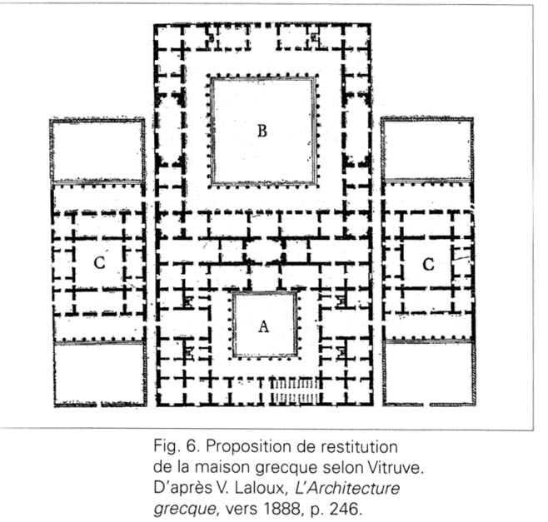

Slide 7
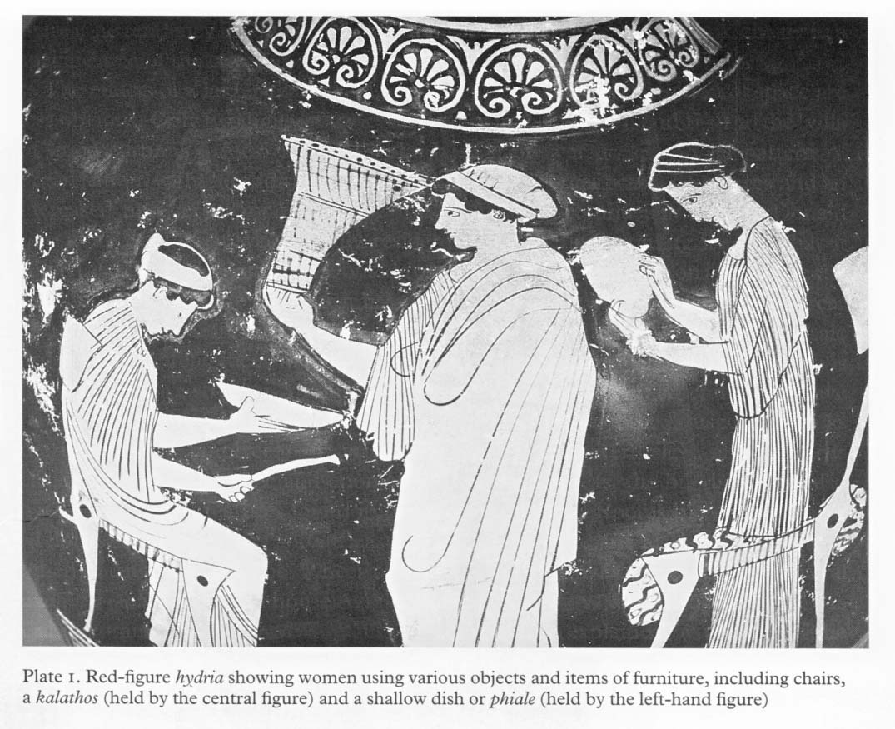

Slide 8
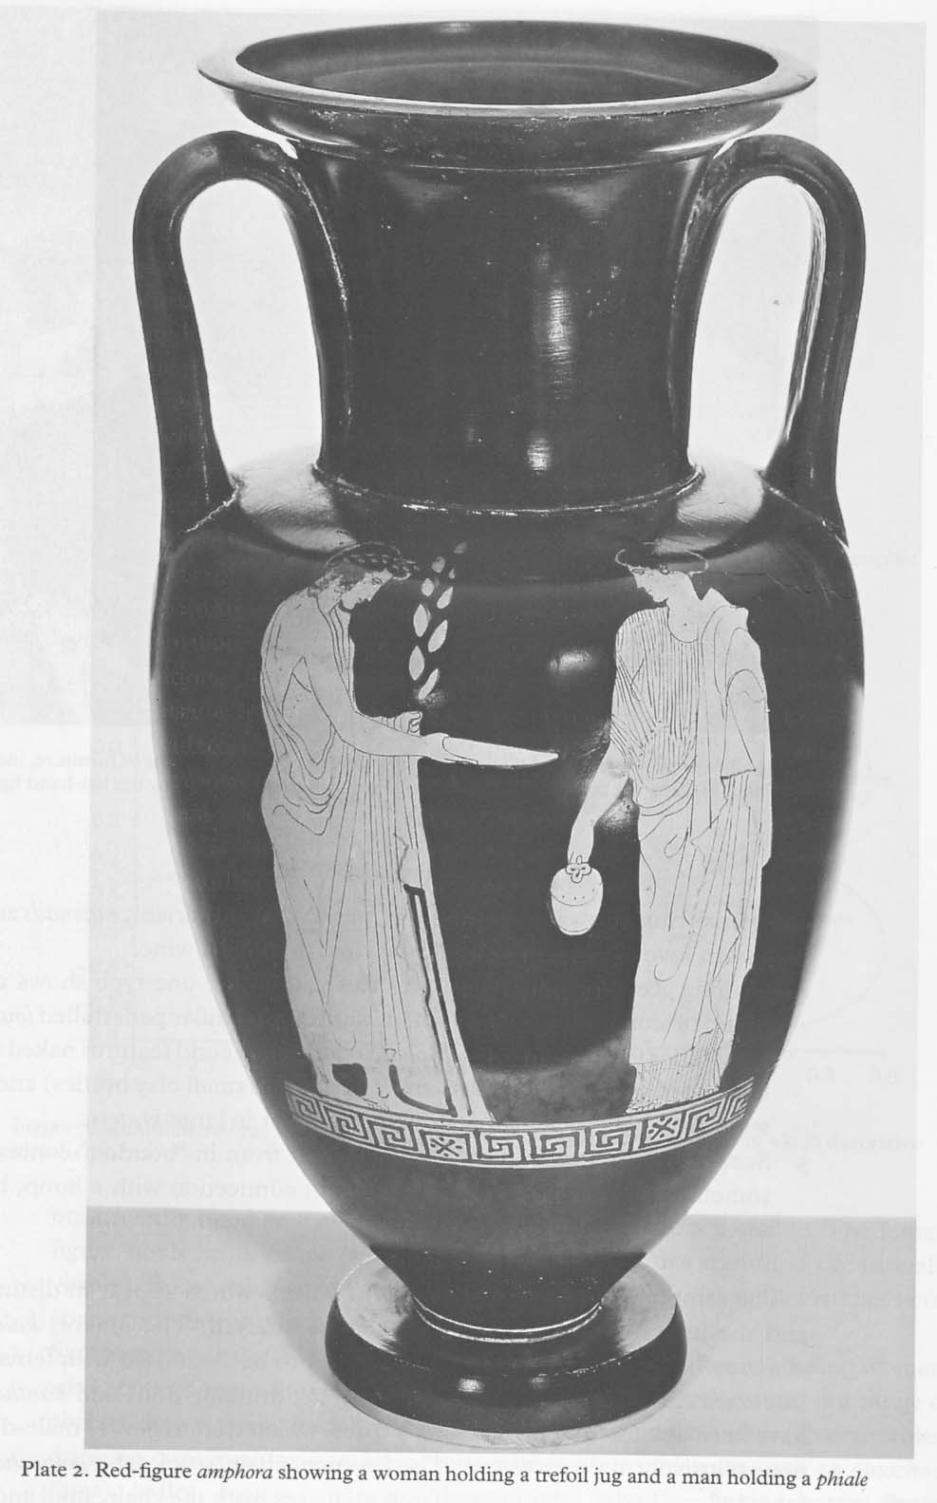

Slide 9
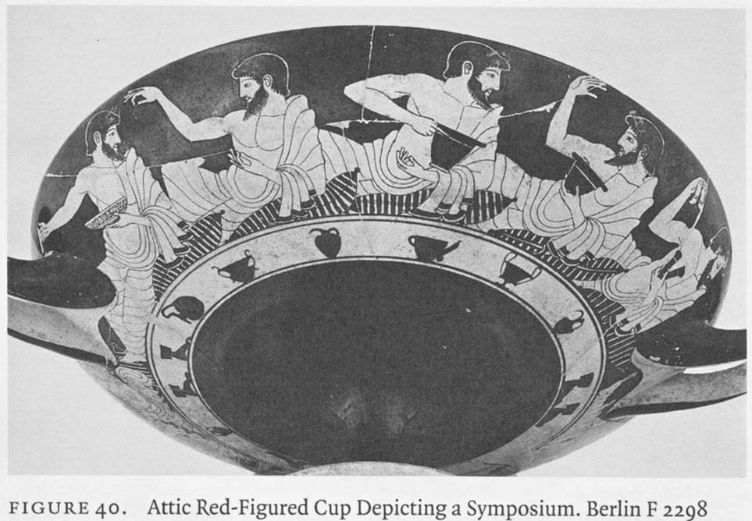

Slide 10
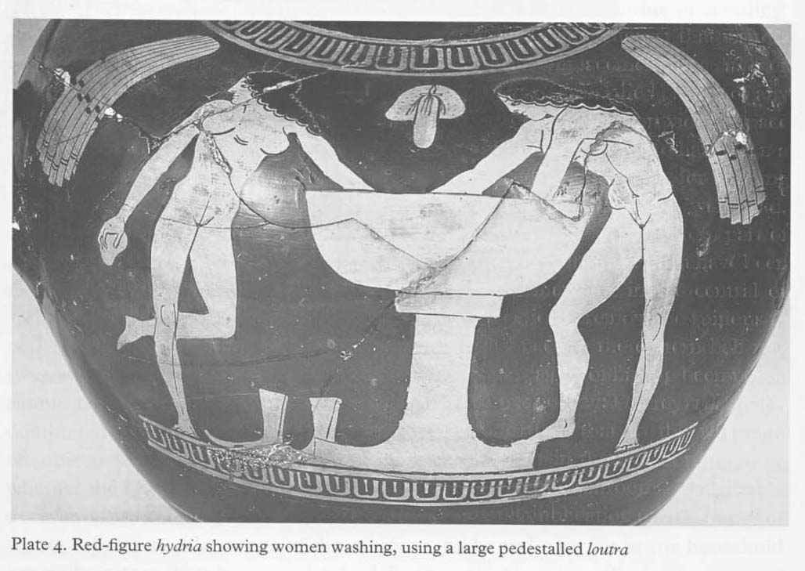

Slide 11
Οι 7 καθοριστικοί παράγοντες του δομημένου οικιστικού χώρου
κατά Sanders 1990
Φυσικά καθορισμένοι | Ευέλικτοι | Πολιτιστικά καθορισμένοι
Κλίμα | Διαθέσιμα υλικά | Λειτουργία
Τοπογραφία | Τεχνολογικό επίπεδο | Πολιτιστικές συμβάσεις
 | Οικονομικές πηγές

Slide 12
Διαδικασίες σχηματισμού αρχαιολογικών συνόλων στα δάπεδα των οικιών (LaMotta & Schiffer 1999)
Στάδιο | Προσθετικές διαδικασίες | Αφαιρετικές διαδικασίες
Κατοίκηση | Πρωτογενής απόθεση απορριμάτων | Δευτερογενής απόθεση απορριμάτων
Εγκατάλειψη | De facto απόθεση απορριμάτων (Τελετουργική απόθεση απορριμάτων) | Διάσωση (Τελετουργική απογύμνωση)
Μετά την εγκατάλειψη | Επανάχρηση απορριμάτων Δευτερογενής απόθεση απορριμάτων Διατάραξη | Λεηλάτηση Διάβρωση Διατάραξη

Slide 13
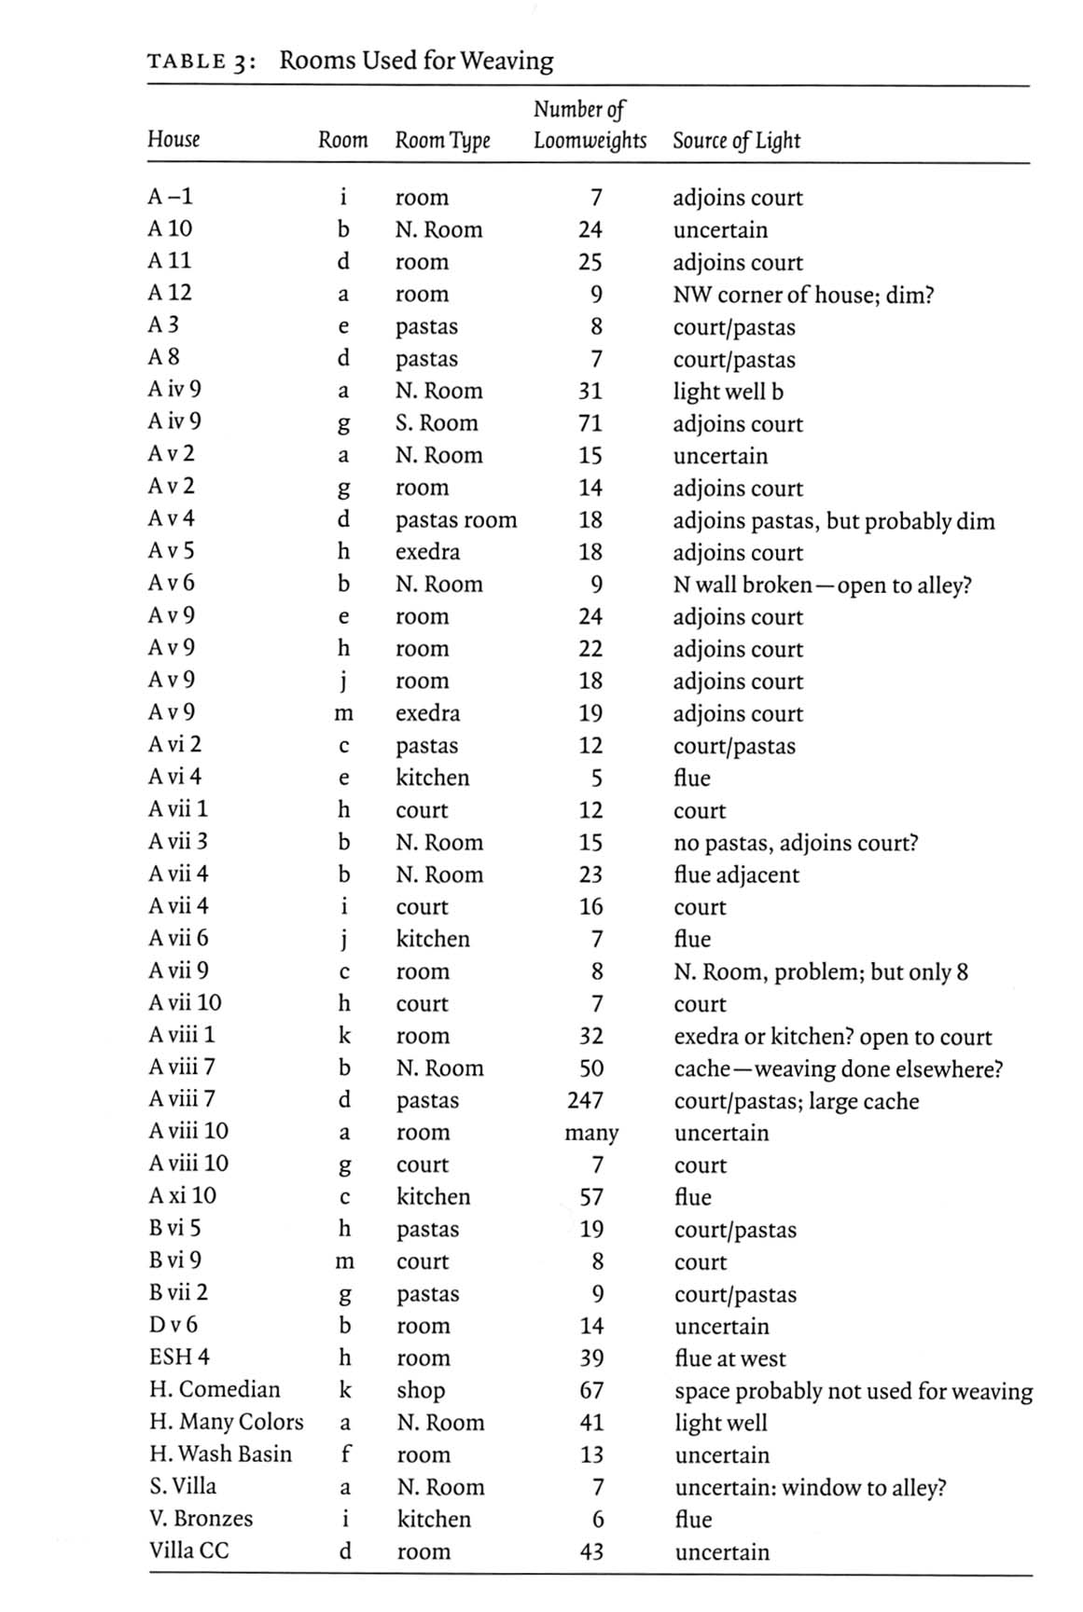

Slide 14
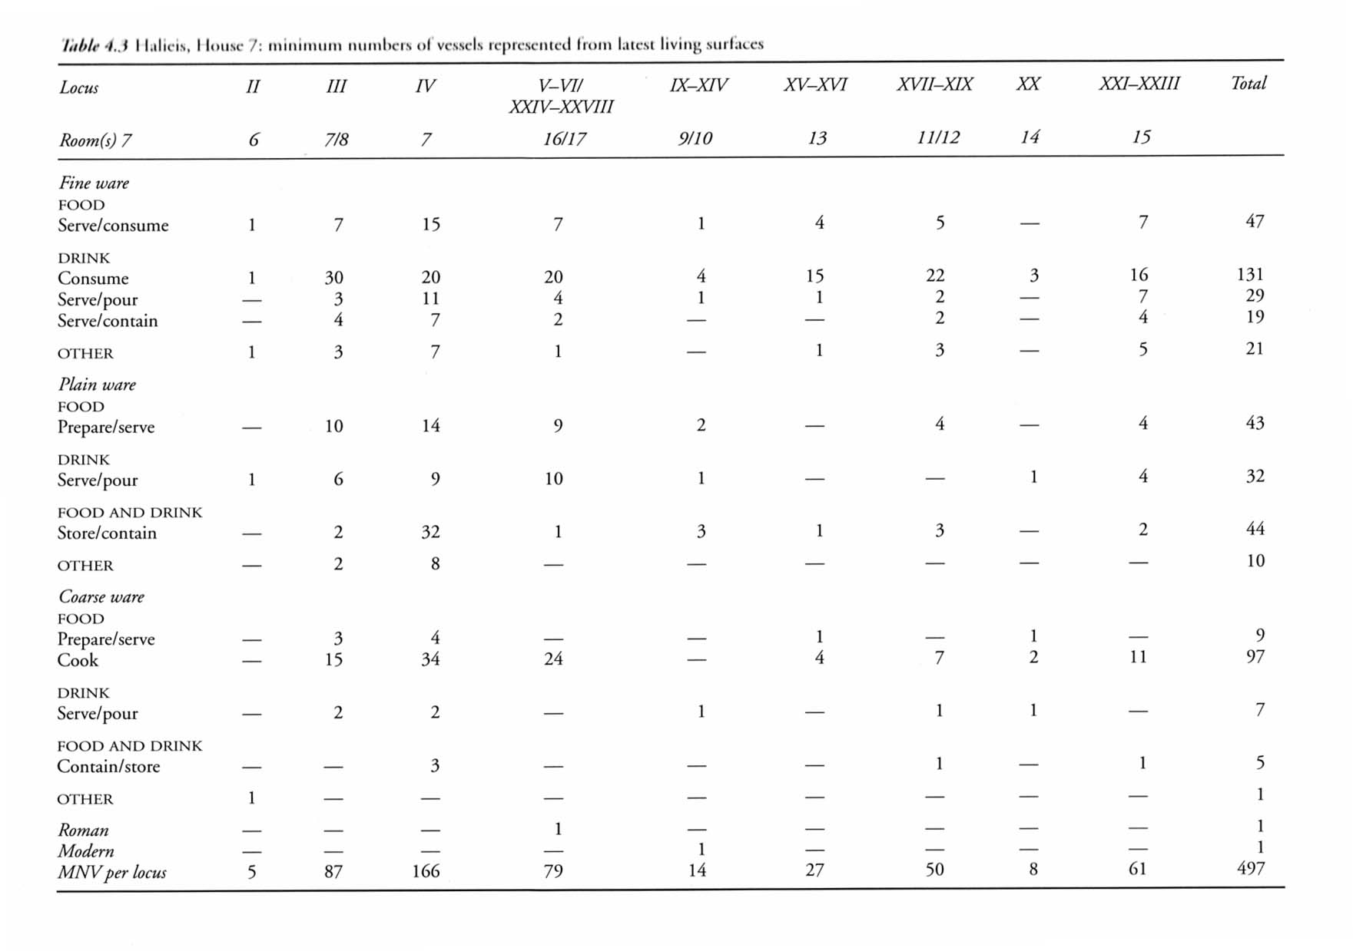

Slide 15
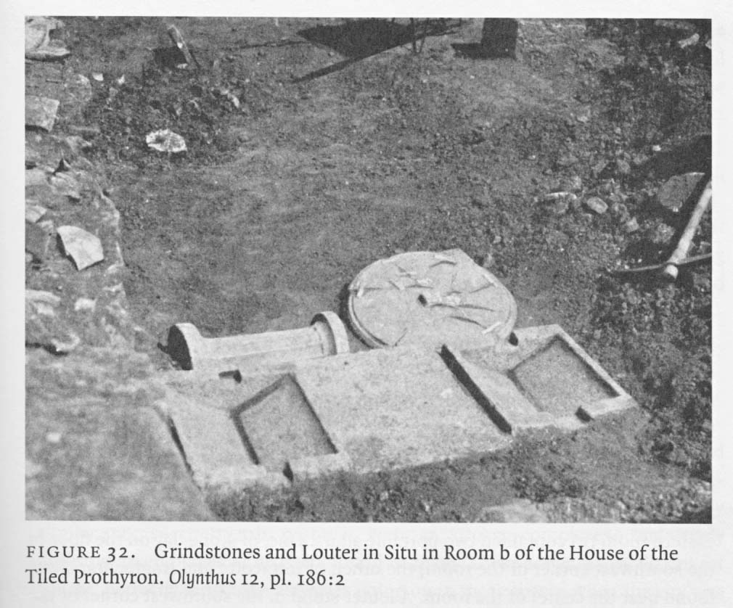

Slide 16
