Slide 1
ΧΡΟΝΙΟΣ ΚΑΛΟΗΘΗΣ ΠΟΝΟΣ, ΠΑΡΑΔΕΙΓΜΑΤΑ, ΑΝΤΙΜΕΤΩΠΙΣΗ
BENIGN CHRONIC PAIN, examples TREATMENT
Κουτσοθυμιου κατερινα
ΑΝΑΙΣΘΗΣΙΟΛΟΓΟΣ-ΕΝΤΑΤΙΚΟΛΟΓΟΣ

Slide 2
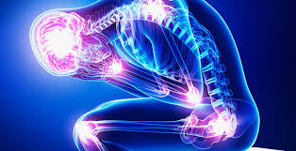
CHRONIC BENING PAIN
DEFINITION: Pain not due to benign disease and persists for more than 3 months

Slide 3
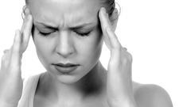
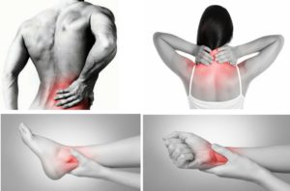
CHRONIC BENING PAIN
Chronic pain syndrome of benign etiology is due to many different ailments.
The therapeutic approach is mainly aimed at relieving pain

Slide 4
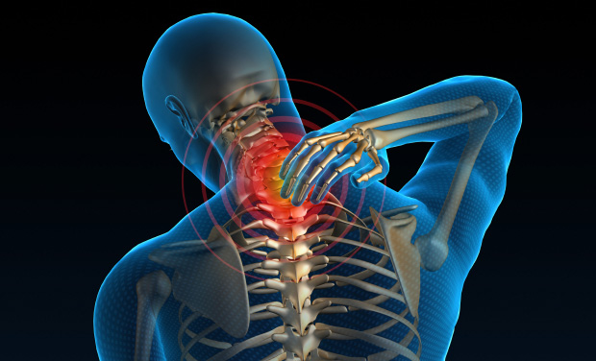
CERVICAL SYNDROME
CERVICAL SYNDROME
Behind a cervical syndrome may hide illnesses like: 1) Muscles (myo-peritoneal syndromes) 2) Root diseases (rhizitis) 3) Diseases of the small joints

Slide 5
CERVICAL SYNDROME-MYOPERITONIAN SYNDROME
MYOPERITONIAN SYNDROME
It is the primary muscular diseases of skeletal muscles due to micro-injuries in the muscle Minor trauma causes vasoconstriction reduction in O2 supply leading to anaerobic metabolism and production of algogenic substances
TRIGGER POINTS
They are small nodes in the muscle that are painful during palpation

Slide 6
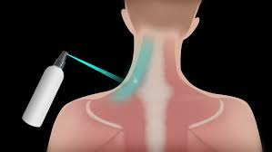
CERVICAL SYNDROME-MYOPERITONIAN SYNDROME
TREATMENT
Stretch and spray: practically first spraying with refrigerant from 20 cm distance and then stretching the affected muscles

Slide 7
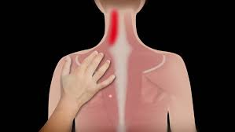
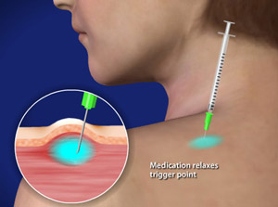
CERVICAL SYNDROME-MYOPERITONIAN SYNDROME
Dry needling : identify the trigger point with fine needle 25G and it remains for 5 min
TREATMENT

Slide 8
CERVICAL SYNDROME-MYOPERITONIAN SYNDROME
Filtration trigger point with a local anesthetic
TREATMENT

Slide 9
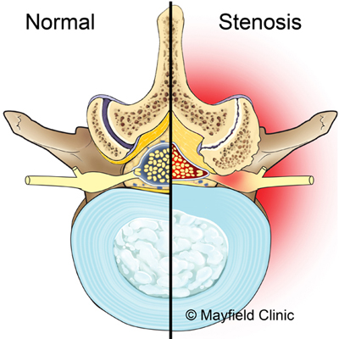
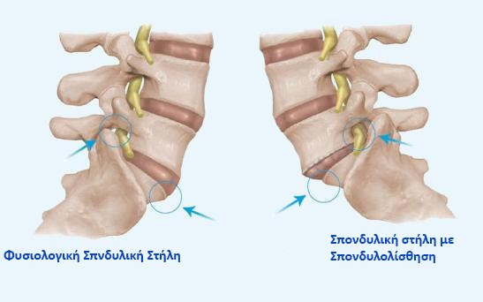
CERVICAL SYNDROME-CERVICAL RHIZITIS
Can be caused by:
1) Intervertebral disc herniation 2) Spinal vertebral stenosis
3) Spondyloloisthisi

Slide 10
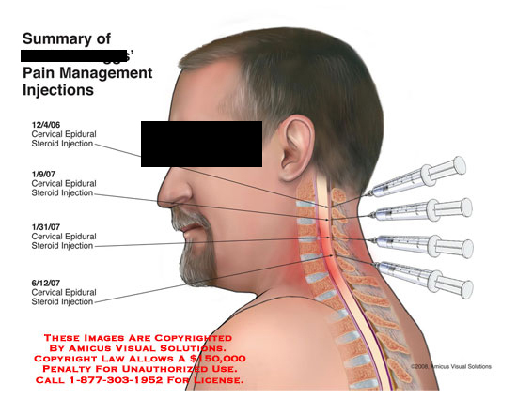
CERVICAL SYNDROME-CERVICAL RHIZITIS
Diagnosis 1) Record 2) Clinical symptomatology 3) Confirm with MRI
Treatment
1) Temporary limitation of neck mobility with collar, NSAIDs , muscle relaxants, analgesics
2) Interventional treatment with cervical epidural

Slide 11
CERVICAL SYNDROME- DISEASES OF THE SMALL JOINTS
Treatment
1)Temporary limitation of neck mobility with collar, non-steroidal anti-inflammatory drugs, muscle relaxants, analgesics
2) Interventional treatment with cervical epidural
Chronic disease causing outbreaks and remissions

Slide 12
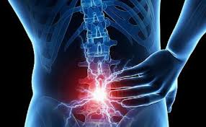
LUMBAGO
Classification of lumbar pain:
Body pain
Radicular pain
Visceral pain
Psychogenic pain

Slide 13
LUMBAGO
BODY PAIN :
It comes from the muscles, ligaments, joints, intervertebral discs and vertebrae
The pain is continuous and well localized
RADICULAR PAIN :
Comes from irritation or inflammation of the spinal root, is sharp, stabbing pain with neuropathic character
The most common cause is herniation

Slide 14
LUMBAGO
VISCERAL PAIN :
Various organs such as the kidney, the uterus, the bladder, the prostate and the aorta can cause pain in the lumbar region.
Possible explanation is the common embryological origin
PSYCHOGENIC PAIN :
Is difficult to say whether psychological disorders due to pain or is the cause of pain.

Slide 15
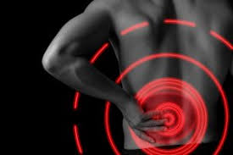
LUMBAGO
DISEASES THAT CAUSE LUMBAGO
Systemic (pathological) etiology
Rheumatic etiology
Infectious etiology
Endocrine disorder
Neurological etiology

Slide 16
LUMBAGO
THERAPEUTIC TREATMENT
Treatment is generally multifactorial
Immobilization not exceed 2-3 days, prolonged immobility causes muscle atrophy
Pharmacotherapy:
1. Acetaminophen and NSAIDs (Movatec,Arcoxia,Celebrex,Xefo) 2. Skeletal Muscle Relaxant (Sirtalud, Norgesic, Stedon)
3. Opioids
4. Antidepressants (Effexor)
5. Antiepileptics (Lyrica, Neurontin)

Slide 17
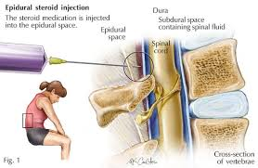
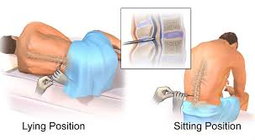
LUMBAGO
THERAPEUTIC TREATMENT
Invasive techniques
1) Epidural infusions 2) Spinal infusions 3) Surgery

Slide 18
MYOSCELETAL PAIN
Ιs a consequence of frequent strain, overuse of the muscles and is related to work activity
It includes:
Inflammatory disease of muscle and joint
non-inflammatory disease of muscle and joint
soft tissue disorders: ligaments, tendons

Slide 19
MYOSCELETAL PAIN
CLINICAL FEATURES:
1. Local pain symptoms or extensive and persistent pain
2. Sensitivity
3. Weakness
4. Limited movement and stiffness
5. Shows a progressive increase in pain
Pain is exacerbated by stress
DIFFERENTIAL DIAGNOSIS:
Rheumatological diseases
Metabolic diseases
Inflammations
Neoplasms

Slide 20
MYOSCELETAL PAIN
THERAPEUTIC TREATMENT
Treatment is generally multifactorial
1) Natural means (cold-hot) 2) Therapeutic exercise - passive movements 3) Reduce workload 4) Placing a splint 5) Acupuncture
6) Physiotherapy

Slide 21
MYOSCELETAL PAIN
THERAPEUTIC TREATMENT
Pharmacotherapy:
1. Acetaminophen and NSAIDs (Movatec,Arcoxia,Celebrex,Xefo) 2. Skeletal Muscle Relaxant (Sirtalud, Norgesic, Stedon)
3. Opioids
4. Antidepressants (Effexor)
5. Antiepileptics (Lyrica, Neurontin)

Slide 22
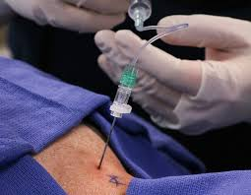
MYOSCELETAL PAIN
THERAPEUTIC TREATMENT
Invasive techniques
1) Epidural infusions 2) Spinal infusions 3) Surgery

Slide 23
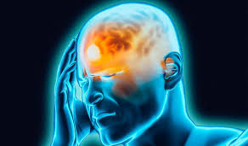
HEADACHE
Chronic headache is a disease but headache is a symptom
in many diseases
Headaches can be distinguished in:
1) organics (due to some organic damage) and
2) functionals or primaries headaches

Slide 24
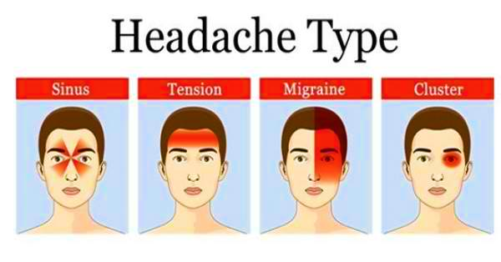
HEADACHE
FUNCTIONALS OR PRIMARIES HEADACHES distinguished in 4 large groups:
Migraine with or without aura,
Tension headache,
Cumulative headache,
Chronic paroxysmal headache

Slide 25
HEADACHE-MIGRAINE
MIGRAINE WITHOUT AURA
Duration: 4-72 hours
Typical features: one-sided localization, pulsing character, medium-high intensity.
Accompanied by: nausea,vomiting photofobia phonophobia
Cerebral blood flow is normal or slightly disordered

Slide 26
HEADACHE-MIGRAIN
MIGRAINE WITH AURA:
Ιs a complex of focal neurological symptoms, before headache and are associated with decreased local cerebral blood flow
Τypical features:
visual and auditory hallucinations
unilateral headache,
nausea, photophobia,
Duration: 5-20 minutes for the aura and 4-72 hours for headache

Slide 27
HEADACHE-MIGRAIN
TREATMENT
Rrophylactic treatment: Propranolol, Flunarizine
Generally drugs: analgetics, antiemetics, iv Xylocaine,
Specially drugs: Ergotamine, Dihydroergotamine and selective agonist of Serotonin

Slide 28
HEADACHE- TENSION HEADACHE
TENSION HEADACHE
Duration: 30 min up to 7 days
Common cause is stress
Typical characteristics: pressing pain, mild intensity, bilateral appearance often with muscle spasms in the cervical
TREATMENT:
Poor response to medication
Better results with physiotherapy, acupuncture
Fight stress
TREATMENT:
Like in migraine , use of 100% O2 for the duration of the crisis

Slide 29
HEADACHE- CUMULATIVE HEADACHE
CUMULATIVE HEADACHE
More common in men
Duration: 15-180 min, 1 up to 8 times per week,
for weeks or months of time, with intervals of months or years without symptoms
Typical features:
Strong heterogeneous pain in the area the eye
Conjunctival hyperemia,
Tearing,
Nasal congestion, rhinorrhea
Eyelid drop, eyelid edema
TREATMENT:
Like in migraine , use of 100% O2 for the duration of the crisis

Slide 30
HEADACHE- CHRONIC CUMULATIVE HEADACHE
CHRONIC CUMULATIVE HEADACHE
Shows the same symptoms as cumulative headache but softer and with a shorter duration of 5-30 min
More frequent in women
TREATMENT
Indomethacin

Slide 31
CONCLUSIONS
The syndromes that cause chronic benign pain are not limited to those mentioned.
The role of the doctor is to deal with the patient, to listen to him, to support him and his family and to cure his pain
The chronic pain exhausts the patient physically, mentally, economically and morally while sometimes leads him sidelined

Slide 32
ΕΥΧΑΡΙΣΤΩ

Slide 33
QUESTIONS
What is the classification of lumbar pain?

Slide 34
QUESTIONS
Whats the classification of lumbar pain?
Body pain
Radicular pain
Visceral pain
Psychogenic pain

Slide 35
QUESTIONS
What are the trigger points?

Slide 36
QUESTIONS
What are the trigger points?
They are small nodes in the muscle that are painful during palpation

Slide 37
QUESTIONS
In what type of headache we have :
pressing pain, mild intensity, bilateral appearance often with muscle spasms in the cervical
Migraine with or without aura,
Tension headache,
Cumulative headache,
Chronic paroxysmal headache

Slide 38
QUESTIONS
In what type of headache we have :
pressing pain, mild intensity, bilateral appearance often with muscle spasms in the cervical
Migraine with or without aura,
Tension headache,
Cumulative headache,
Chronic paroxysmal headache

