Slide 1
Η Ανάπτυξη των συναρτήσεων
Από τι εξαρτάται ο χρόνος που χρειάζεται
για την λύση ενός προβλήματος ?
Αποτελεσματικότητα Αλγόριθμων
Εφικτός αλγόριθμος

Slide 2
Το πλεονέκτημα του μεγάλου Ο ειναι οτι μπορούμε να υπολογίσουμε την ανάπτυξη μίας συνάρτησης.
Χρησιμοποιείται για τον υπολογισμό του πλήθους των πράξεων που χρησιμοποιεί ο αλγόριθμος καθώς μεγαλώνει.

Slide 3
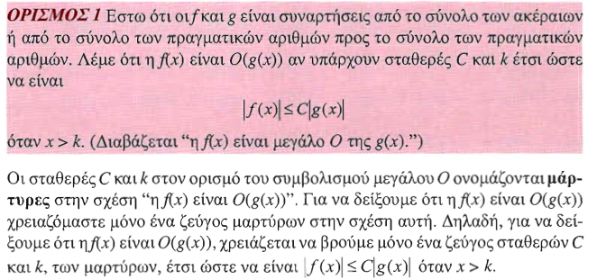

Slide 4
Χρησιμοποίηση μεγάλου Ο

Slide 5
Some Important Points about Big-O Notation
If one pair of witnesses is found, then there are infinitely many pairs. We can always make the k or the C larger and still maintain the inequality .
Any pair C ̍ and k̍ where C < C̍ and k < k ̍ is also a pair of witnesses since whenever x > k̍ > k.
You may see “ f(x) = O(g(x))” instead of “ f(x) is O(g(x)).”
But this is an abuse of the equals sign since the meaning is that there is an inequality relating the values of f and g, for sufficiently large values of x.
It is ok to write f(x) ∊ O(g(x)), because O(g(x)) represents the set of functions that are O(g(x)).
Usually, we will drop the absolute value sign since we will always deal with functions that take on positive values.

Slide 6
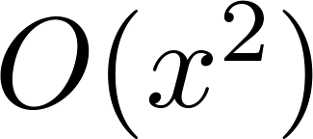
Using the Definition of Big-O Notation
Example: Show that is .
Solution: Since when x > 1, x < x² and 1 < x²
Can take C = 4 and k = 1 as witnesses to show that
(see graph on next slide)
Alternatively, when x > 2, we have 2x ≤ x² and 1 < x². Hence, when x > 2.
Can take C = 3 and k = 2 as witnesses instead.

Slide 7
Illustration of Big-O Notation
is

Slide 8
Big-O Notation
Both and
are such that and .
We say that the two functions are of the same order. (More on this later)
If and h(x) is larger than g(x) for all positive real numbers, then .
Note that if for x > k and if
for all x, then if x > k. Hence, .
For many applications, the goal is to select the function g(x) in O(g(x)) as small as possible (up to multiplication by a constant, of course).

Slide 10
Using the Definition of Big-O Notation
Example: Show that 7x² is O(x³).
Solution: When x > 7, 7x² < x³. Take C =1 and k = 7 as witnesses to establish that 7x² is O(x³).
(Would C = 7 and k = 1 work?)
Example: Show that n² is not O(n).
Solution: Suppose there are constants C and k for which n² ≤ Cn, whenever n > k. Then (by dividing both sides of n² ≤ Cn) by n, then n ≤ C must hold for all n > k. A contradiction!

Slide 13
Big-O Estimates for some Important Functions
Example: Use big-O notation to estimate the sum of the first n positive integers.
Solution:
Example: Use big-O notation to estimate the factorial function
Solution:
Continued →

Slide 14
Big-O Estimates for some Important Functions
Example: Use big-O notation to estimate log n!
Solution: Given that (previous slide)
then .
Hence, log(n!) is O(n∙log(n)) taking C = 1 and k = 1.

Slide 15
Display of Growth of Functions
Note the difference in behavior of functions as n gets larger

Slide 17
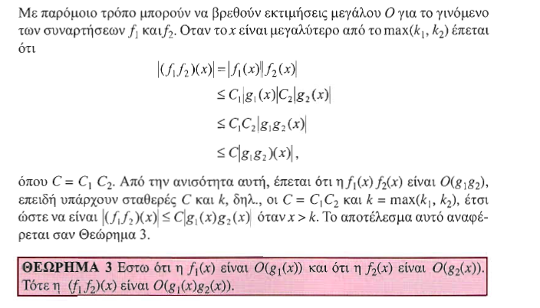

Slide 18
Ordering Functions by Order of Growth
Put the functions below in order so that each function is big-O of the next function on the list.
f₁(n) = (1.5)^{n}
f₂(n) = 8n³+17n² +111
f₃(n) = (log n )²
f₄(n) = 2^{n}
f₅(n) = log (log n)
f₆(n) = n² (log n)³
f₇(n) = 2^{n} (n² +1)
f₈(n) = n³+ n(log n)²
f₉(n) = 10000
f₁₀(n) = n!
We solve this exercise by successively finding the function that grows slowest among all those left on the list.
f₉(n) = 10000 (constant, does not increase with n)
f₅(n) = log (log n) (grows slowest of all the others)
f₃(n) = (log n )² (grows next slowest)
f₆(n) = n² (log n)³ (next largest, (log n)³ factor smaller than any power of n)
f₂(n) = 8n³+17n² +111 (tied with the one below)
f₈(n) = n³+ n(log n)² (tied with the one above)
f₁(n) = (1.5)^{n} (next largest, an exponential function)
f₄(n) = 2^{n} (grows faster than one above since 2 > 1.5)
f₇(n) = 2^{n} (n² +1) (grows faster than above because of the n² +1 factor)
f₁₀(n) = 3^{n} ( n! grows faster than c^{n} for every c)

Slide 19
Big-O gives an upper bound on the growth of a function, while Big-Omega gives a lower bound. Big-Omega tells us that a function grows at least as fast as another.
f(x) is Ω(g(x)) if and only if g(x) is O(f(x)). This follows from the definitions. See the text for details.

Slide 20
Big-Omega Notation
Example: Show that is
where .
Solution: for all positive real numbers x.
Is it also the case that is ?

Slide 22
Big Theta Notation
Example: Show that the sum of the first n positive integers is Θ(n²).
Solution: Let f(n) = 1 + 2 + ∙∙∙ + n.
We have already shown that f(n) is O(n²).
To show that f(n) is Ω(n²), we need a positive constant C such that f(n) > Cn² for sufficiently large n. Summing only the terms greater than n/2 we obtain the inequality
1 + 2 + ∙∙∙ + n ≥ ⌈ n/2⌉ + (⌈ n/2⌉ + 1) + ∙∙∙ + n
≥ ⌈ n/2⌉ + ⌈ n/2⌉ + ∙∙∙ + ⌈ n/2⌉
= (n − ⌈ n/2⌉ + 1 ) ⌈ n/2⌉
≥ (n/2)(n/2) = n²/4
Taking C = ¼, f(n) > Cn² for all positive integers n. Hence, f(n) is Ω(n²), and we can conclude that f(n) is Θ(n²).

Slide 23
Big-Theta Notation
Example: Show that f(x) = 3x² + 8x log x is Θ(x²).
Solution:
3x² + 8x log x ≤ 11x² for x > 1, since 0 ≤ 8x log x ≤ 8x² .
Hence, 3x² + 8x log x is O(x²).
x² is clearly O(3x² + 8x log x)
Hence, 3x² + 8x log x is Θ(x²).

Slide 24
Big-Theta Notation
When it must also be the case that
Note that if and only if it is the case that and .
Sometimes writers are careless and write as if big-O notation has the same meaning as big-Theta.

Slide 26
