Slide 1
https://archaeologynewsnetwork.blogspot.com/2015/09/3000-year-old-skeleton-of-dog-found-in.html#d8rrrj3mIhF6udIz.97 3,000-year-old skeleton of dog found in Van Read more at https://archaeologynewsnetwork.blogspot.com/2015/09/3000-year-old-skeleton-of-dog-found-in.html#QAddVh2PQq0P43mv.99

Slide 2
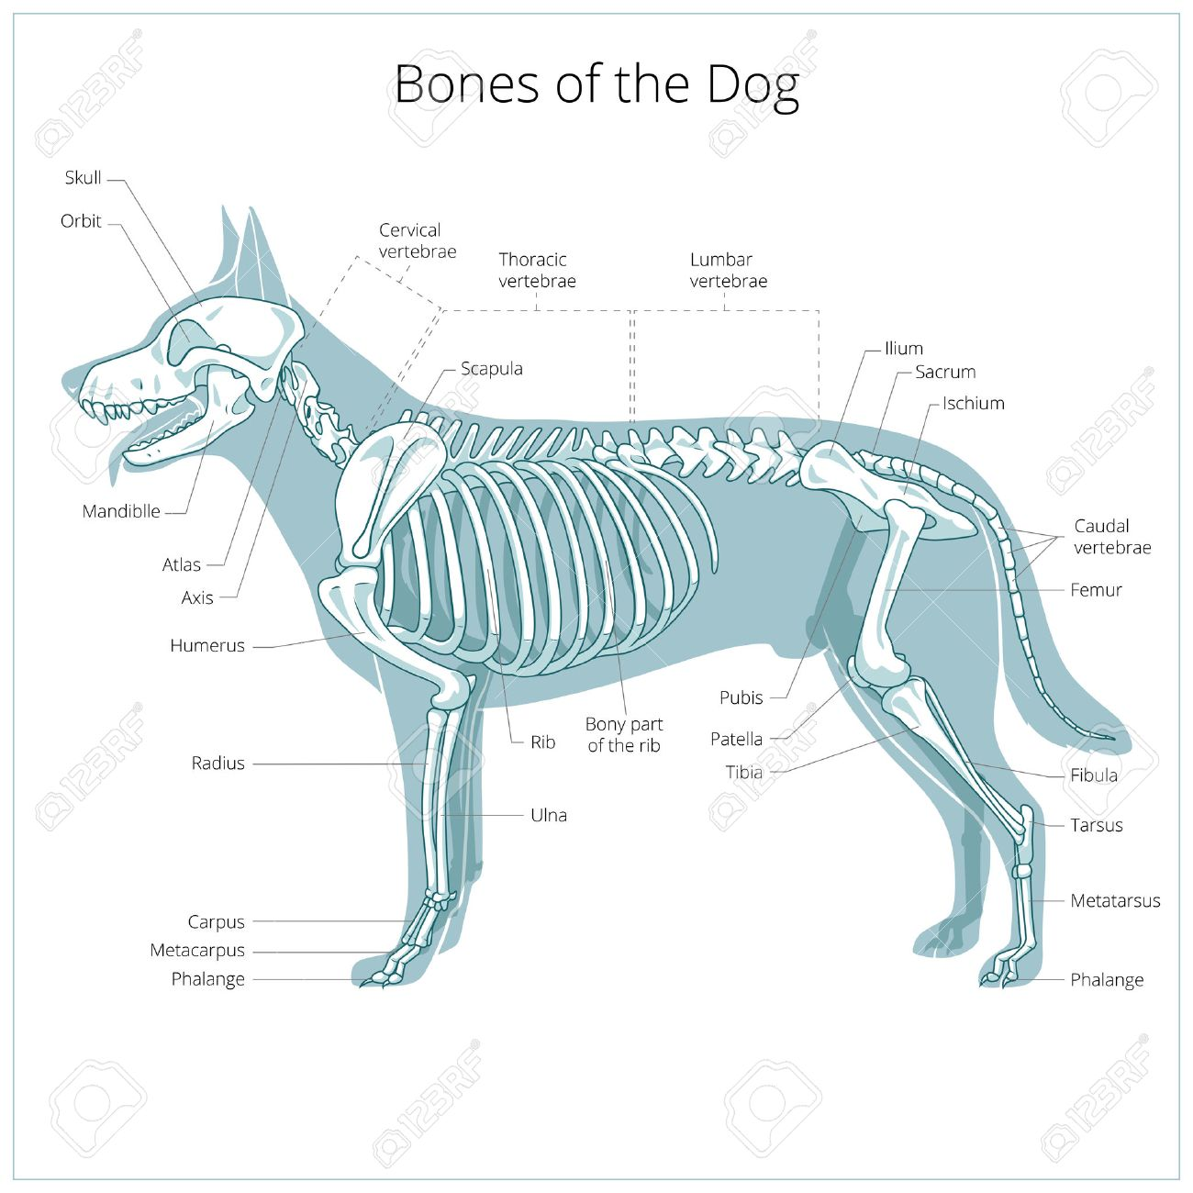
Bones of the Dog https://www.google.com/search?q=Dog+skeleton&tbm=isch&source=iu&ictx=1&fir=WCJQhSmAe2tbTM%253A%252CUUAAQfWGgjEntM%252C_&usg=AI4_-kQRaZo4ntnqUH5kr-qeANaShwtWfQ&sa=X&ved=2ahUKEwix0vuBzIreAhWuhKYKHWVZAbsQ9QEwAXoECAAQBg#imgdii=rzJuudsbPb8mLM:&imgrc=WCJQhSmAe2tbTM:
Skeleton

Slide 3
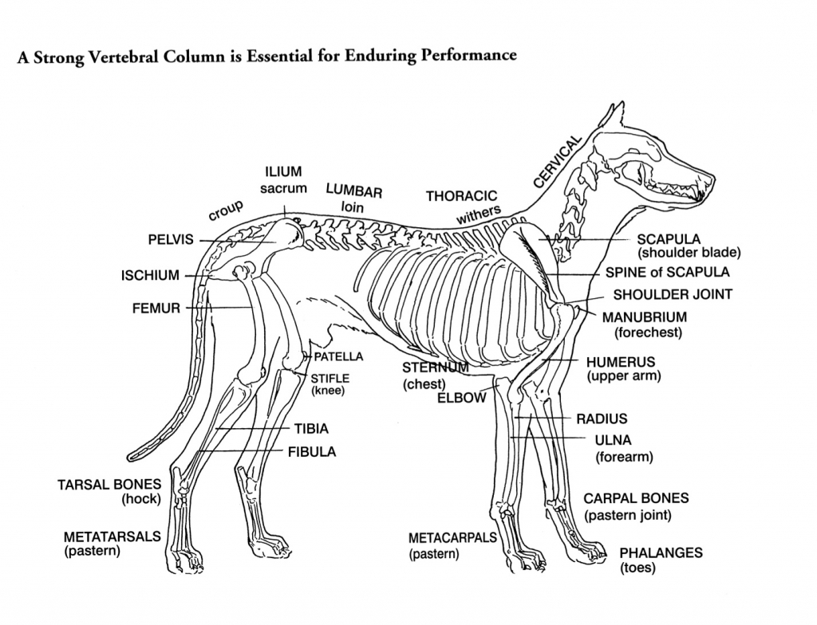

Slide 4
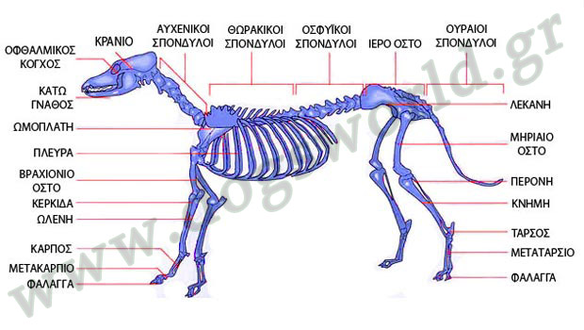

Slide 5
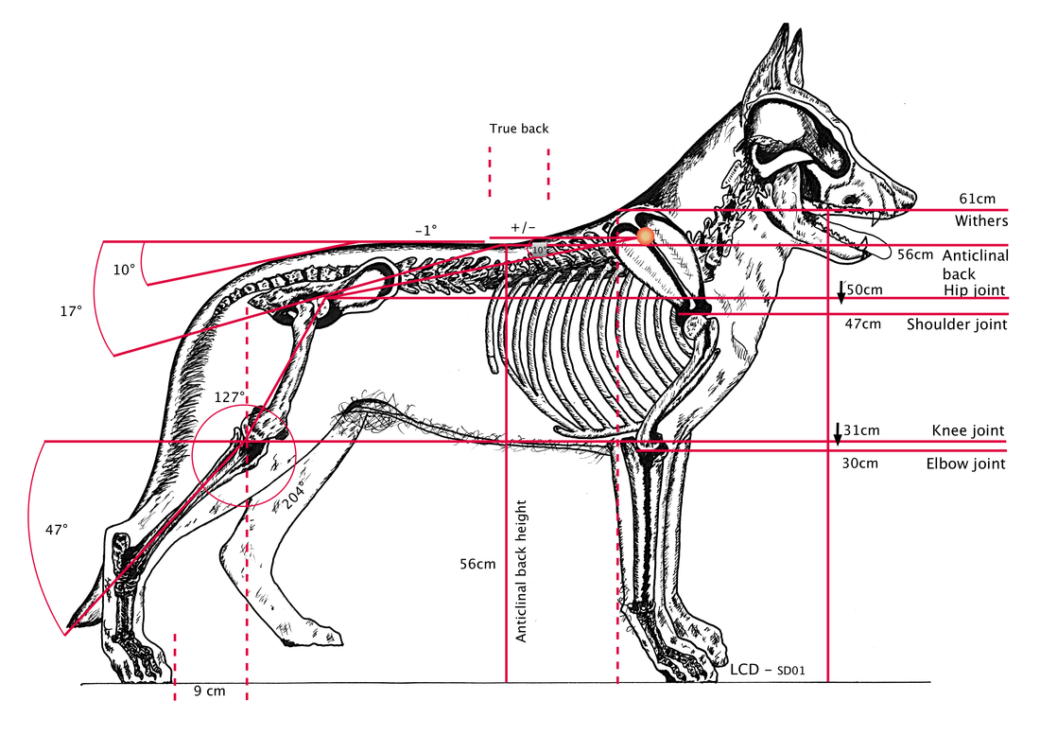
https://www.louisdonald.com/the-evolutionary-development-of-the-german-shepherd-dog-skeleton.html The Evolutionary Development of the German Shepherd Dog Skeleton by: Louis Donald

Slide 6
Source: https://www.google.com/search?q=Cat+Skeleton+Diagram&tbm=isch&source=iu&ictx=1&fir=ApMDA0_qMiF9WM%253A%252CkKn03pFLz6M7nM%252C_&usg=AI4_-kQECPDtdwIwyZbAmQkOD1hhS4i6Hg&sa=X&ved=2ahUKEwian4Ww8KjeAhUMbFAKHfB0CpwQ9QEwB3oECAQQEg#imgrc=Id7tOKrNEZx2tM: DOG SKULL ANATOMY

Slide 7
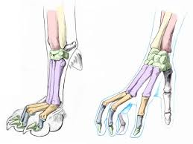
Canine vs Human https://www.google.com/search?q=Dog+skeleton&tbm=isch&source=iu&ictx=1&fir=WCJQhSmAe2tbTM%253A%252CUUAAQfWGgjEntM%252C_&usg=AI4_-kQRaZo4ntnqUH5kr-qeANaShwtWfQ&sa=X&ved=2ahUKEwix0vuBzIreAhWuhKYKHWVZAbsQ9QEwAXoECAAQBg#imgrc=WCJQhSmAe2tbTM: http://www.k9-massageguild.co.uk/canine-versus-human/

Slide 8
Saunders Comprehensive Veterinary Dictionary, Elsevier (2012) DOG: FOOTPADS

Slide 9
Internal Organs of the Dog https://www.google.com/search?q=Internal+organs+of+the+dog&tbm=isch&source=iu&ictx=1&fir=Yx7a1U_HZBSTGM%253A%252Cev3DSWyAq1t_bM%252C_&usg=AI4_-kT7Qh-_6Vpv4u7IKjOXjPFLVBYQOA&sa=X&ved=2ahUKEwjZ8bn004reAhUDiCwKHeTZBsEQ9QEwAnoECAUQCA#imgrc=siVqfLoY7VSOFM:

Slide 10
https://www.ebay.co.uk/itm/A4-Veterinary-Poster-Internal-Organs-of-the-Dog-Animal-Anatomy-Pathology-/322857482392

Slide 11
https://www.google.com/search?q=Internal+organs+of+the+dog&tbm=isch&source=iu&ictx=1&fir=Yx7a1U_HZBSTGM%253A%252Cev3DSWyAq1t_bM%252C_&usg=AI4_-kT7Qh-_6Vpv4u7IKjOXjPFLVBYQOA&sa=X&ved=2ahUKEwjZ8bn004reAhUDiCwKHeTZBsEQ9QEwAnoECAUQCA#imgrc=bKrTZXY1YtqqIM:

Slide 12
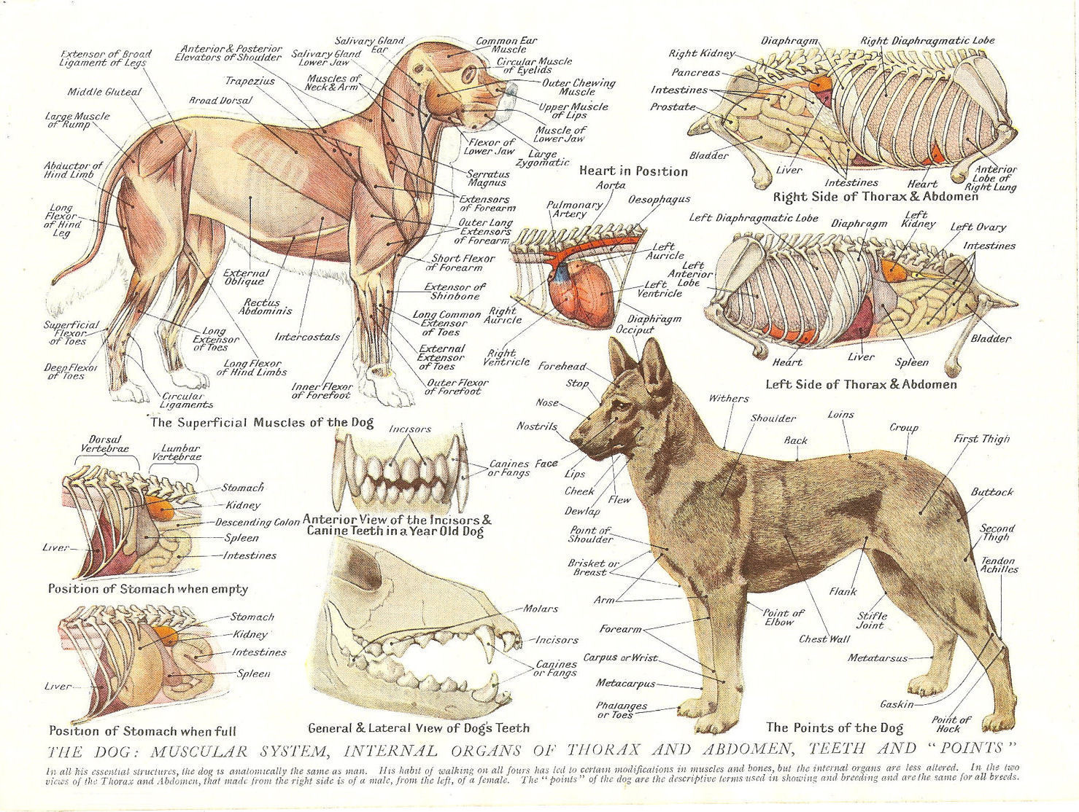

Slide 13
https://www.google.com/search?q=%CE%B1%CE%BD%CE%B1%CF%84%CE%BF%CE%BC%CE%B9%CE%B1+%CF%83%CE%BA%CF%85%CE%BB%CE%BF%CF%85+%CE%B8%CE%B7%CE%BB%CF%85%CE%BA%CE%BF%CF%85&biw=1352&bih=654&tbm=isch&source=iu&ictx=1&fir=OVWqq2pFy0oz8M%253A%252CokCc5nUMDPRGXM%252C_&usg=AI4_-kRW3qiOUSXO-AhX5UvpdprE-cAQGw&sa=X&ved=2ahUKEwin5KW1vaneAhXNZ1AKHQAKCWAQ9QEwAXoECAYQBg#imgrc=AV0D-sV_gZNHSM

Slide 14
https://www.google.com/search?q=Internal+organs+of+the+dog&tbm=isch&tbs=rimg:CboEapnu9N53IjiLCTXgWJbxUdm2k8ecoz8fhSMLZzs6j47afAONEvZCbRkqHxK24pzMGwnbIDJ2phuhLZ3jaBsXvioSCYsJNeBYlvFREdIz50TcWgPbKhIJ2baTx5yjPx8Rt1fYhEbaKH0qEgmFIwtnOzqPjhHmTuzz_18O2yioSCdp8A40S9kJtEWTCBTdW2kLcKhIJGSofErbinMwRRlV9sLTYd08qEgkbCdsgMnamGxGTJyT9fXTTHyoSCaEtneNoGxe-EVfCj3UfyUUE&tbo=u&sa=X&ved=2ahUKEwiX-LW12oreAhWL3SwKHci4BMUQ9C96BAgBEBs&biw=1025&bih=498&dpr=1
Internal Organs of the Dog
See online (see site above):
1. Female Anatomy Stomach Images/ Feline Fallopian Tube Diagram/
Female Dog Reproductive Anatomy
et altera
2. http://nhssc.info/3f3a73/female-dog-reproductive-anatomy
Female-dog Reproductive-anatomy images

Slide 15
https://www.ebay.co.uk/itm/A3-Veterinary-Poster-Muscles-Organs-of-the-Dog-Animal-Anatomy-Pathology/323094763394?_trkparms=aid%3D222007%26algo%3DSIM.MBE%26ao%3D2%26asc%3D20160323102634%26meid%3D12cb2c7866244a2fb37589dd5bf8bffb%26pid%3D100623%26rk%3D1%26rkt%3D6%26mehot%3Dag%26sd%3D322857482392%26itm%3D323094763394&_trksid=p2047675.c100623.m-1
The Dog:
Muscular System
Internal Organs of Thorax and Abdomen
Teeth and “Points”
[following]

Slide 16
https://www.google.com/search?q=Internal+organs+of+the+dog&tbm=isch&source=iu&ictx=1&fir=Yx7a1U_HZBSTGM%253A%252Cev3DSWyAq1t_bM%252C_&usg=AI4_-kT7Qh-_6Vpv4u7IKjOXjPFLVBYQOA&sa=X&ved=2ahUKEwjZ8bn004reAhUDiCwKHeTZBsEQ9QEwAnoECAUQCA#imgdii=AXFe4fQZfsjUQM:&imgrc=WJb7wqzJI2wt8M: DOG: ANATOMY OF THE SKIN

Slide 17
https://www.google.com/search?q=Internal+organs+of+the+dog&tbm=isch&source=iu&ictx=1&fir=Yx7a1U_HZBSTGM%253A%252Cev3DSWyAq1t_bM%252C_&usg=AI4_-kT7Qh-_6Vpv4u7IKjOXjPFLVBYQOA&sa=X&ved=2ahUKEwjZ8bn004reAhUDiCwKHeTZBsEQ9QEwAnoECAUQCA#imgdii=dH9_IZeCHRSAyM:&imgrc=WJb7wqzJI2wt8M:

Slide 18
https://www.google.com/search?q=Internal+organs+of+the+dog&tbm=isch&source=iu&ictx=1&fir=Yx7a1U_HZBSTGM%253A%252Cev3DSWyAq1t_bM%252C_&usg=AI4_-kT7Qh-_6Vpv4u7IKjOXjPFLVBYQOA&sa=X&ved=2ahUKEwjZ8bn004reAhUDiCwKHeTZBsEQ9QEwAnoECAUQCA#imgdii=kvTQKe0ozatjXM:&imgrc=WJb7wqzJI2wt8M:

Slide 19
https://www.google.com/search?q=Internal+organs+of+the+dog&tbm=isch&source=iu&ictx=1&fir=Yx7a1U_HZBSTGM%253A%252Cev3DSWyAq1t_bM%252C_&usg=AI4_-kT7Qh-_6Vpv4u7IKjOXjPFLVBYQOA&sa=X&ved=2ahUKEwjZ8bn004reAhUDiCwKHeTZBsEQ9QEwAnoECAUQCA#imgrc=WJb7wqzJI2wt8M: DOG WHISKERS ANATOMY DIAGRAM

