Slide 1
Pain Assessment-Pain Management General Principles
Alexandros Korakis
Anaesthesiologist
General Hospital Of Trikala

Slide 2
Definition
“An unpleasant sensory and emotional experience
associated with actual or potential tissue damage,
or described in terms of such damage”
International for the Study of Pain: Pain Definition. Bonica JJ. The need of a taxonomy.
Pain 1979;6(3):247-8.
Notes:
μια δυσάρεστη αισθητική και συναισθηματική εμπειρία, που συνδέεται με πραγματική ή δυνητική ιστική βλάβη ή περιγράφεται με ορολογία τέτοιας βλάβης

Slide 3
Bio Psycho Social Culture
Notes:
αλληλεπίδραση μεταξύ των αντικειμενικών, αισθητικών παραμέτρων του πόνου και των υποκειμενικών, συναισθηματικών και ψυχολογικών χαρακτηριστικών του

Slide 4
“pain as the 5th vital sign”
Campbell J. Pain as the 5th vital sign. American Pain Society, November 11, 1996.

Slide 5
Aims of Presentation
Assessment of Pain
Initial Assessment of Pain
Measurement of Pain
Reassessment of Pain

Slide 6
Pain Assessment
Initial Assessment of Pain
Patient History
Physical Examination
Diagnostic Tests

Slide 7
Patient History

Slide 8
Patient History

Slide 9
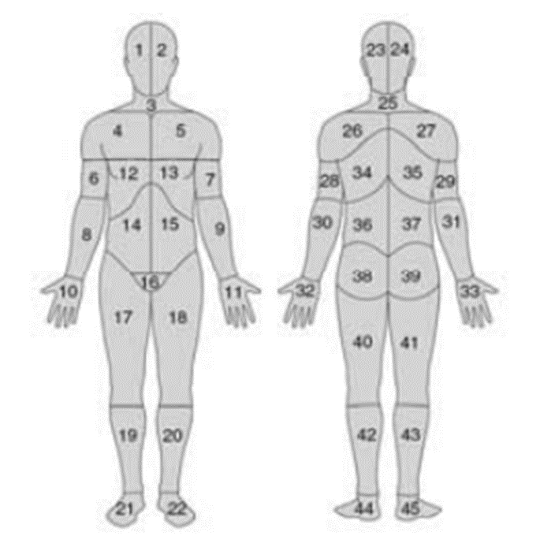
Patient History
Body Pain Diagram

Slide 10
Patient History

Slide 11
Patient History

Slide 12
Pain Assessment
Initial Assessment of Pain
Patient History
Physical Examination
Diagnostic Tests

Slide 13
Physical Examination

Slide 14
Physical Examination

Slide 15
Physical Examination

Slide 16
Physical Examination

Slide 17
Physical Examination

Slide 18
Pain Assessment
Initial Assessment of Pain
Patient History
Physical Examination
Diagnostic Tests

Slide 19
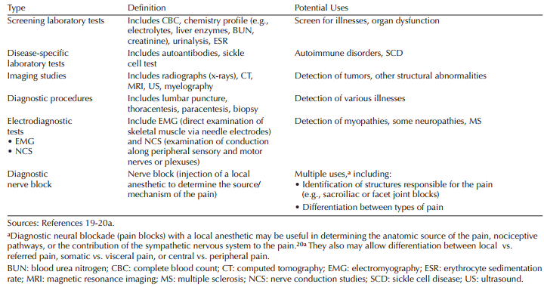
Diagnostic Tests

Slide 20
Pain Assessment
Measurement of Pain
Unidimensional Tools
Multidimensional Tools
Observational Tools
Self Report Tools

Slide 21
Pain Assessment
Measurement of Pain
Unidimensional Tools
Multidimensional Tools
Observational Tools

Slide 22
Unidimensional Tools
NRS
Verbal Descriptor/Rating Scale
VAS
FPS
Faces Pain Scale
IPT
VDS/VRS
Numeric Rate Scale
Visual Analog Scale
IOWA Pain Thermometer

Slide 23
Numeric Rate Scale

Slide 24
Verbal Descriptor/Rating Scale

Slide 25
Visual Analog Scale

Slide 26
Faces Pain Scale

Slide 27
IOWA Pain Thermometer

Slide 28
Unidimensional Tools
Advantages
Easy
Simple
Valid method to assess
Useful in special populations
(children, elderly, patients with difficulty communicating)

Slide 29
Unidimensional Tools
Disadvantages
Limited selection of descriptors
Patients tend to select moderate grades

Slide 30
Pain Assessment
Measurement of Pain
Unidimensional Tools
Multidimensional Tools
Observational Tools

Slide 31
Multidimensional Tools
MPQ
Brief Pain Inventory
NPS
LANSS
Leeds Assessment of Neuropathic Symptoms and Signs
DN4
BPI
Mc Gill Pain Questionnaire
Neuropathic Pain Scale
Douleur Neuropathetique 4 Questions

Slide 32
Mc Gill Pain Questionnaire

Slide 33
Brief Pain Inventory

Slide 34
Neuropathic Pain Scale

Slide 35
Leeds Assessment of Neuropathic Symptoms and Signs

Slide 36
Douleur Neuropathetique 4 Questions

Slide 37
Pain Diary
Notes:
A special multidimensional tool

Slide 38
Pain Assessment
Measurement of Pain
Unidimensional Tools
Multidimensional Tools
Observational Tools

Slide 39
What do they have in common?

Slide 40
Observational Tools
PAINAD
Face, Legs, Activity, Cry, Consolability
CPOT
BPS
Behavioral Pain Scale
FLACC
Pain Assessment in Advanced Dementia Scale
Critical Care Pain Observation Tool

Slide 41
Pain Assessment in Advanced Dementia Scale

Slide 42
Face, Legs, Activity, Cry, Consolability

Slide 43
Critical Care Pain Observation Tool

Slide 44
Behavioral Pain Scale

Slide 45
Pain Assessment in Children
Neonatal Infant Pain Scale(NIPS)

Slide 46
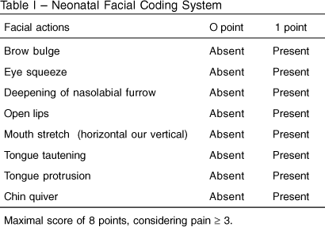
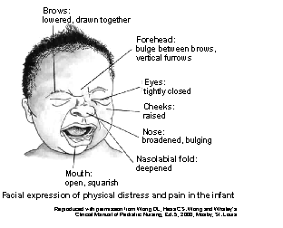
Pain Assessment in Children
Neonatal Facial Coding System(NFCS)

Slide 47
Pain Assessment in Children
3-Year-Old
>12-Year-Old
NRS, MPQ
4-Year-Old
FPS
VAS, VRS, NRS
FPS, IPT
>5-Year-Old

Slide 48
Pain Assessment in Elderly
Healthy
Several Dementia
NRS, MPQ, VAS
VRS, FPS, BPS

Slide 49
Pain Assessment
Reassessment of Pain
Within 30 minutes of parenteral drug administration
Within one hour of oral drug administration
With each report of new or changed pain

Slide 52
Aims of Presentation
Pain Management
Treatment Plan
Pharmacologic Therapy
Non-Pharmacologic Therapy

Slide 53
Pain Management
Treatment Plan
Goals of Treatment
Possible constituents of the treatment plan
Patient/Health Care Provider Interaction

Slide 54
Goals Of Treatment
Expectations
The degree of improvement in pain
The degree of improvement in function

Slide 55
Pain Management
Treatment Plan
Goals of Treatment
Possible constituents of the treatment plan
Patient/Health Care Provider Interaction

Slide 56
Possible constituents of the treatment plan
Which therapies and how…
Pharmacologic Therapies
Non Pharmacologic Therapies

Slide 57
Pain Management
Treatment Plan
Goals of Treatment
Possible constituents of the treatment plan
Patient/Health Care Provider Interaction

Slide 58
Patient/Health Care Provider Interaction
Patient responsibilities, Compliance with the plan
Responsibilities of the prescriber and health care team
Plans for reviewing functional goals
Supplemental immediate release opioids for intermittent increases in pain
Informed consent/patient provider agreements

Slide 59
Pain Management
Pharmacologic Therapy
Non-opioid analgesics
Opioid analgesics
Adjuvant analgesics

Slide 60
Non-opioid analgesics
Acetaminophen
Aspirin
Ibuprofen
Indomethacin
Piroxicam
Diclofenac
Ketorolac
Celecoxib

Slide 61
Non-opioid analgesics

Slide 62
Non-opioid analgesics

Slide 63
Non-opioid analgesics

Slide 64
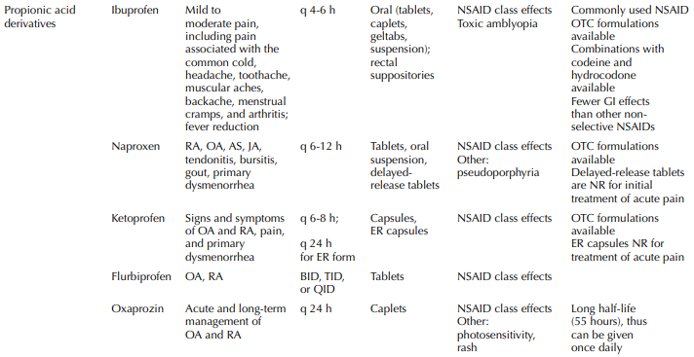
Non-opioid analgesics

Slide 65
Non-opioid analgesics

Slide 66
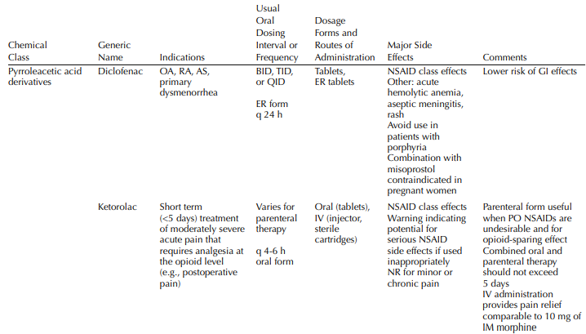
Non-opioid analgesics

Slide 67
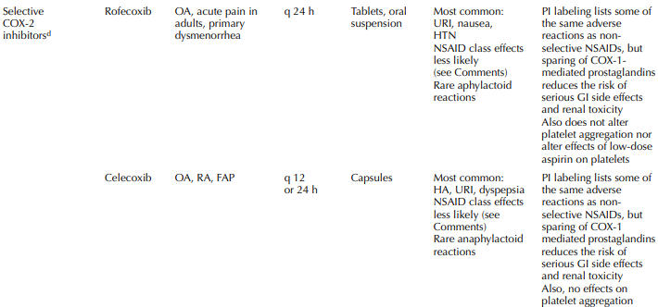
Non-opioid analgesics

Slide 68
Pain Management
Pharmacologic Therapy
Non-opioid analgesics
Opioid analgesics
Adjuvant analgesics

Slide 69
Opioid analgesics

Slide 70
Opioid analgesics

Slide 71
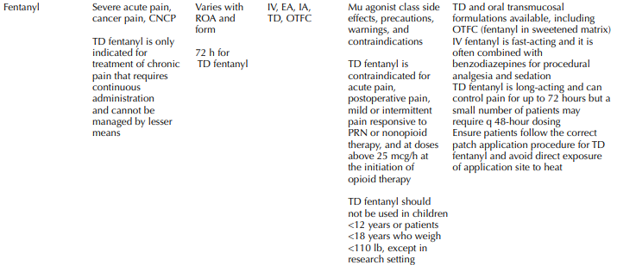
Opioid analgesics

Slide 72
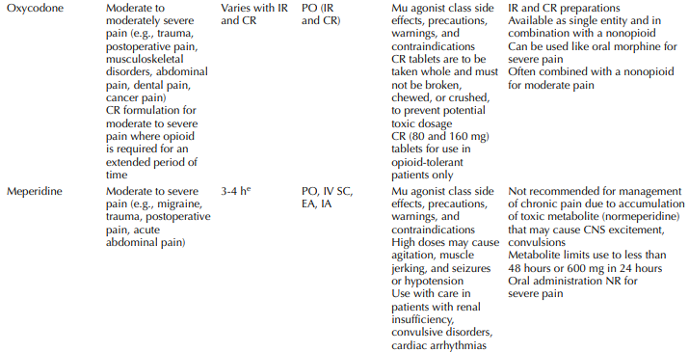
Opioid analgesics

Slide 73
Opioid analgesics

Slide 74
Opioid analgesics

Slide 75
Pain Management
Managing Opioid Side Effects

Slide 76
Pain Management
Pharmacologic Therapy
Non-opioid analgesics
Opioid analgesics
Adjuvant analgesics

Slide 77
Adjuvant analgesics
Antiepileptic drugs
Antidepressants
Local anesthetics
Ketamine, a₂-agonists, Dexamethasone

Slide 78
Adjuvant analgesics

Slide 79
Adjuvant analgesics

Slide 80
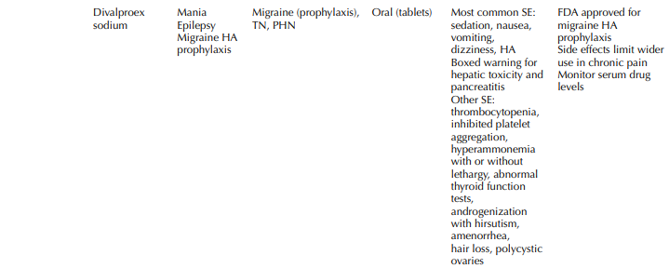
Adjuvant analgesics

Slide 81
Adjuvant analgesics

Slide 82
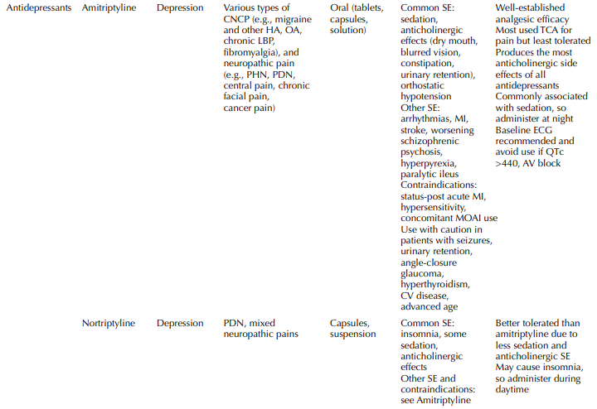
Adjuvant analgesics

Slide 83
Adjuvant analgesics

Slide 84
Adjuvant analgesics

Slide 85
Adjuvant analgesics

Slide 86
Adjuvant analgesics

Slide 87
Adjuvant analgesics

Slide 88
General Principles of Analgesic Therapy
Identify and treat the source of the pain
Select the simplest approach to pain management
Select an appropriate drug
Establish a management plan
Select a route of administration

Slide 89
General Principles of Analgesic Therapy
Titrate the dose
Optimize administration
Watch for and manage side effects
Differentiate among tolerance, physical dependence and addiction and appropriately modify therapy
Avoid use of placebos to treat pain

Slide 90
WHO’s Pain Relief Ladder

Slide 91
Pain Management

Slide 92
Pain Management
Non-pharmacologic Therapy
Psychological Approaches
Physical Rehabilitative Approaches
Surgical Approaches

Slide 93
Psychological Approaches
Patient education
Psychotherapy
Cognitive-behavioral therapy
Hypnosis
Relaxation with imagery
Distraction
Biofeedback

Slide 94
Psychological Approaches

Slide 95
Psychological Approaches

Slide 96
Pain Management
Non-pharmacologic Therapy
Psychological Approaches
Physical Rehabilitative Approaches
Surgical Approaches

Slide 97
Physical Rehabilitative Approaches
Stretching
Exercise
Massage
Immobilization
TENS
Acupuncture
Applied heat or cold

Slide 98
Physical Rehabilitative Approaches

Slide 99
Physical Rehabilitative Approaches

Slide 100
Pain Management
Non-pharmacologic Therapy
Psychological Approaches
Physical Rehabilitative Approaches
Surgical Approaches

Slide 101
Surgical Approaches
Orthopedic Approaches
(total joint replacement, laminectomy, spinal fusion)
Neurosurgical Procedures
(neurolysis, removal of neural structures associated with pain)

Slide 104
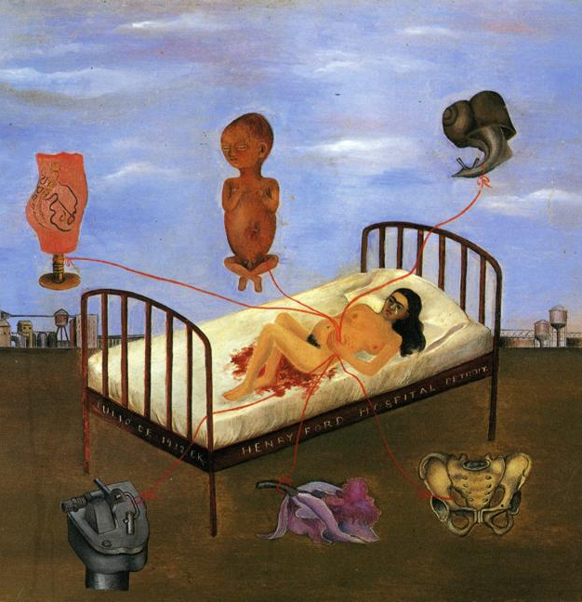

Slide 105
http://algologia.org/pdf/SEA/SEA-1-2017.pdf
http://www.npcnow.org/system/files/research/download/Pain-Current-Understanding-of-Assessment-Management-and-Treatments.pdf
https://www.fda.gov/downloads/Drugs/NewsEvents/UCM557071.pdf
for further information please contact: korakis.alexandros@gmail.com

Slide 108
Pain Assessment-Pain Management General Principles(MCQs)
In caring for a young child with pain, which assessment tool is the most useful?
Simple description pain intensity scale
0-10 numeric pain scale
Faces Pain Scale
Mc Gill Pain Questionnaire

Slide 109
Pain Assessment-Pain Management General Principles(MCQs)
Which pain scale would be the most appropriate for a patient who is unable to communicate their pain or in an unconscious state?
FLACC
Faces
Numerical
Verbal

Slide 110
Pain Assessment-Pain Management General Principles(MCQs)
Which pain scale is the most sensitive to gender and ethnic differences?
Visual
Verbal
Numerical
FLACC

Slide 111
Pain Assessment-Pain Management General Principles(MCQs)
Place the examples of drugs in the order of usage according to the World Health Organization (WHO) analgesic ladder.
Morphine, Hydromorphone, Acetaminophen and Lorazepam
NSAIDs and Corticosteroids
Codeine, Oxycodone and Diphenhydramine
_____, _____, _____

Slide 112
Pain Assessment-Pain Management General Principles(MCQs)
The following are psychological and cognitive interventions for pain. Which one of them is not?
TENS
Music
Biofeedback
Imagery
Education

