Slide 1
A multi-modal Route Planning approach: a case-study of the city of Trikala
ΠΑΝΕΠΙΣΤΗΜΙΟ ΘΕΣΣΑΛΙΑΣ
Ενότητα 7: Παρουσίαση 2
Γεώργιος Κ.Δ. Σαχαρίδης
Βασιλεία Πανταζώνα, Χριστόδουλος Ματσίγκος, Λάζαρος Ταταλόπουλος, Φίλιππος Χατζηιωάννου
Τμήμα Μηχανολόγων Μηχανικών

Slide 2
PRESENTATION STRUCTURE
1
2
3
City Bus Network
Problem Description
Case of Trikala

Slide 3
PRESENTATION STRUCTURE
1
2
3
City Bus Network
Problem Description
Case of Trikala

Slide 4
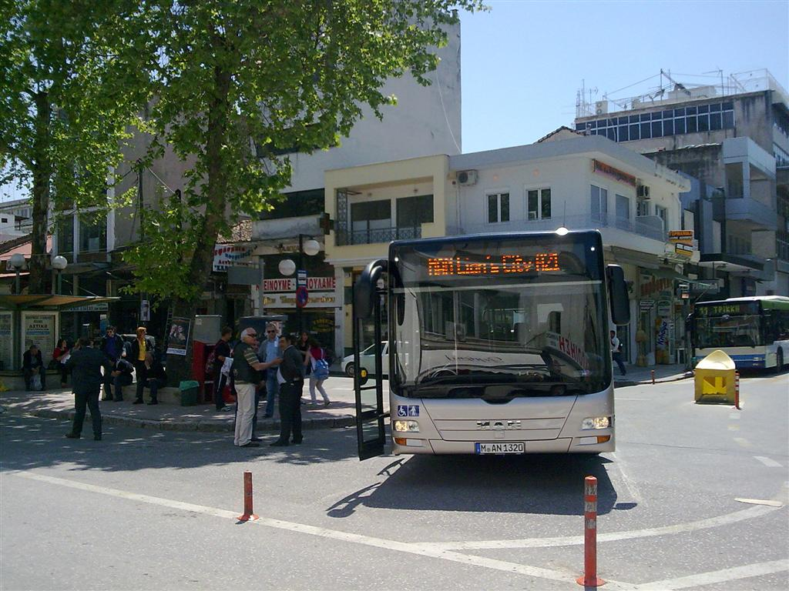
CITY BUS NETWORK
A city bus system is composed of :
stops (points)
lines (strings)
bus network
routes (start and return)
network users
tickets

Slide 5
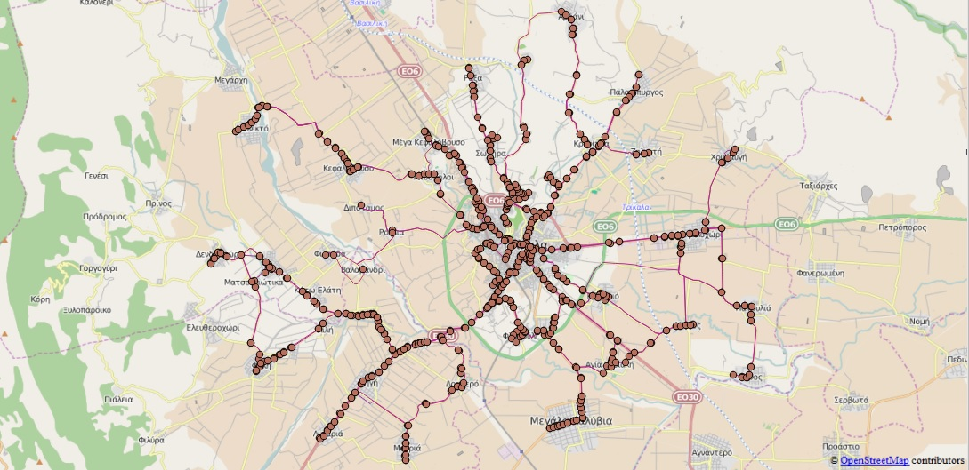
CITY BUS NETWORK

Slide 6
PRESENTATION STRUCTURE
1
2
3
City Bus Network
Problem Description
Case of Trikala

Slide 7
PRESENTATION STRUCTURE
1
2
3
City Bus Network
Problem Description
Case of Trikala

Slide 8
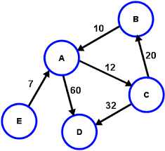
PROBLEM DESCRIPTION
Multi-Modal Routing: Route Planning involving different modes of transportation.
Route Planning: Modeled by finding the shortest path on a directed weighted graph.
Route Planning in public transportation network
Time-dependent (smaller graph sizes→ faster)
Time-expanded (flexible constraints)
Multi-criteria optimization

Slide 9
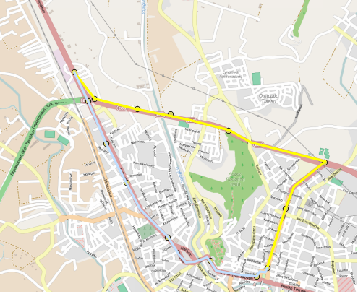
How it works
PROBLEM DESCRIPTION
Start Point (Departure)
End Point (Arrival)
Route
Means of transport used
Goal: Minimization of cost or time !

Slide 10
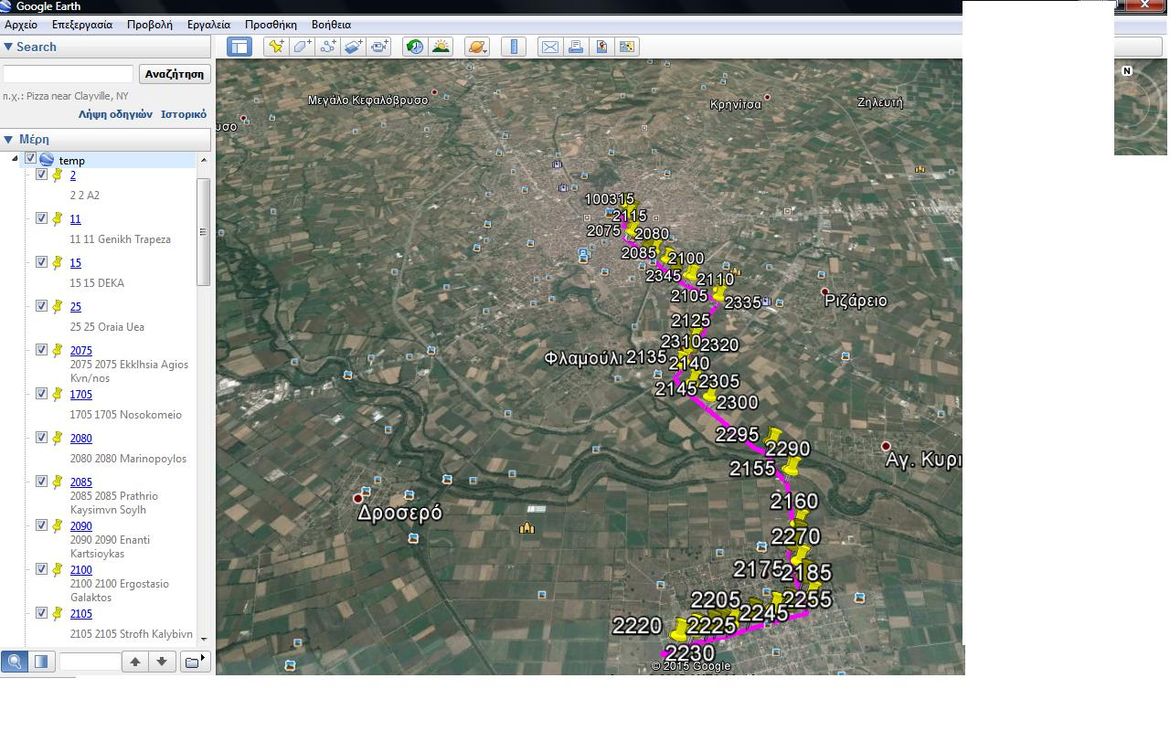
Problem Description
Finding Data
Analyzing
Process with QGIS
stops’ names
lines
time
Four Layers of data
Purpose

Slide 11
PRESENTATION STRUCTURE
1
2
3
City Bus Network
Problem Description
Case of Trikala

Slide 12
PRESENTATION STRUCTURE
1
2
3
City Bus Network
Problem Description
Case of Trikala

Slide 13
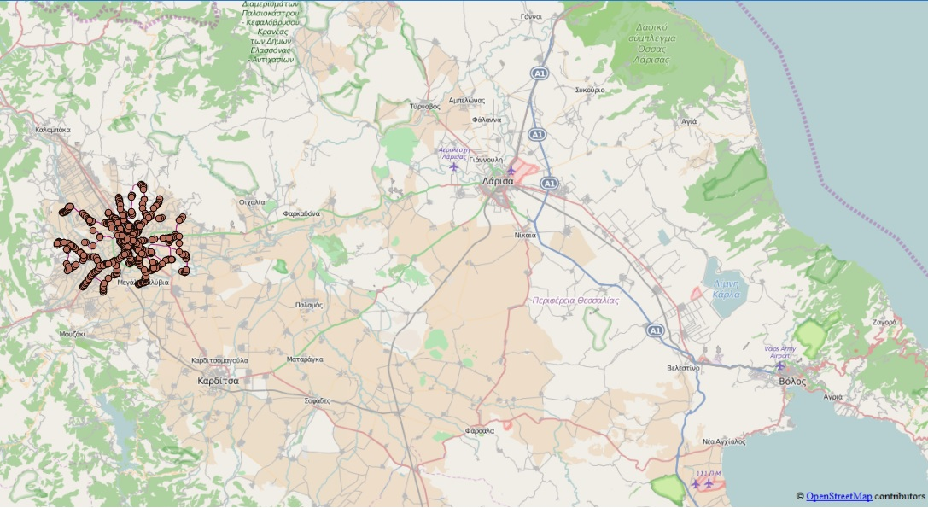
CASE OF TRIKALA
Population: 81.355
Area: 608,48km²
Number of itineraries: 39
Means of transport: Bus

Slide 14
EXAMPLE
points
lines
ROUTE: TRIKALA-KALYVIA

Slide 15
BIBLIOGRAPHY
Ziliaskopoulos, A. and W. Wardell, An intermodal optimum path algorithm for multimodal networks with dynamic arc travel times and switching delays. European Journal of Operational Research 125 (2000).
Dominik Schultes, Route Planning in Road Networks. PhD thesis, Universitat Karlsruhe (TH), Fakultat fur Informatik, February 2008.
Desmond Rainsford and William A. Mackaness, Mobile Journey Planning for Bus Passengers, Geography Department, The University of Edinburgh (2002).

Slide 16
Questions

