Slide 1
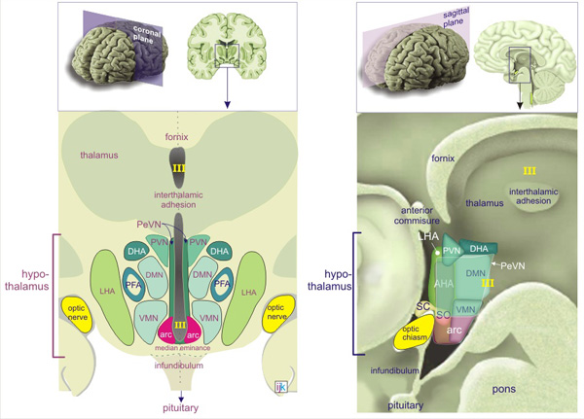

Slide 2
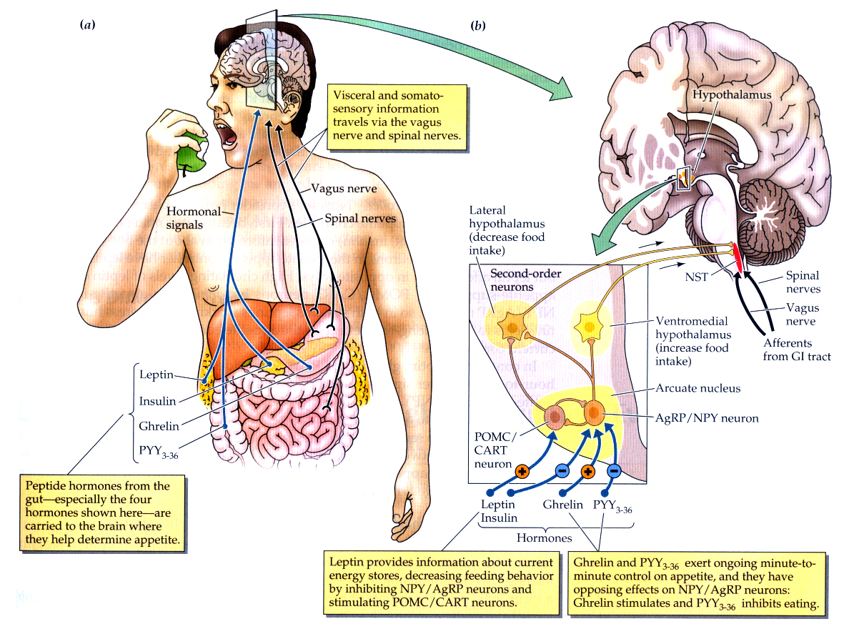

Slide 3
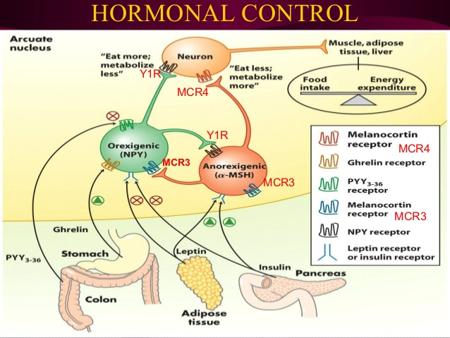
AgRP
POMC
CART

Slide 4
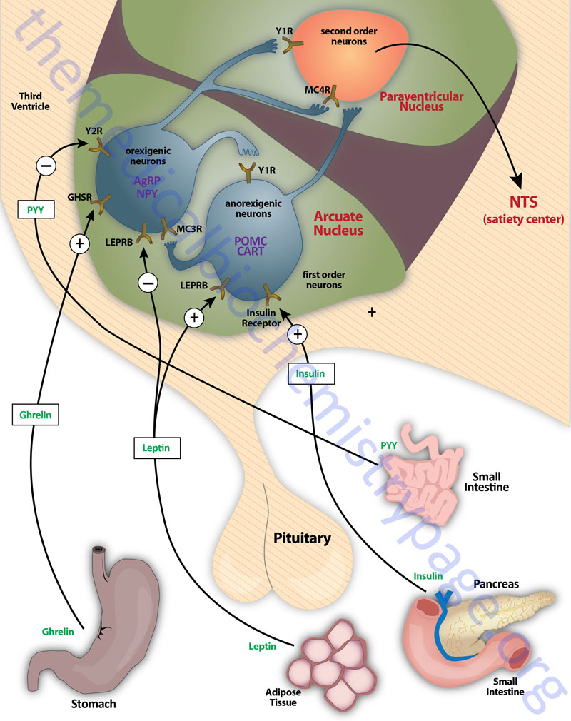
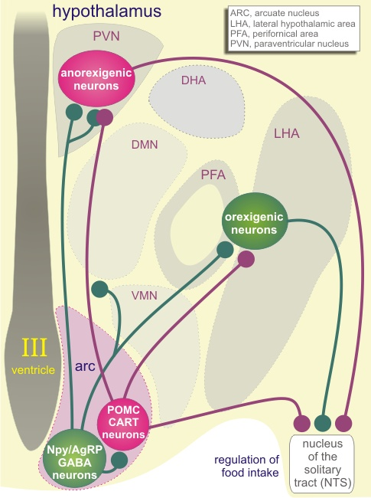

Slide 5
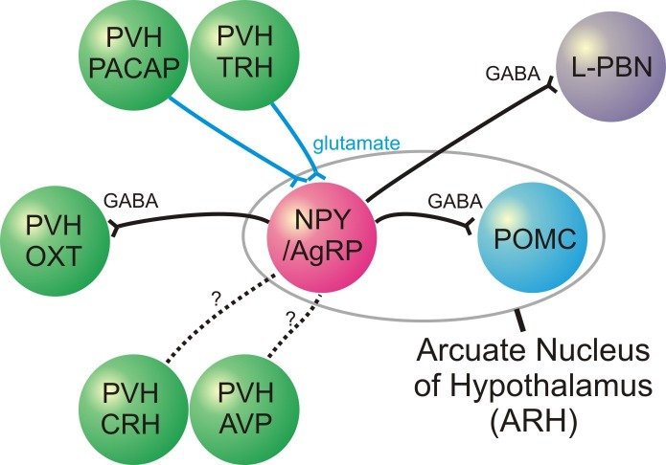

Slide 6
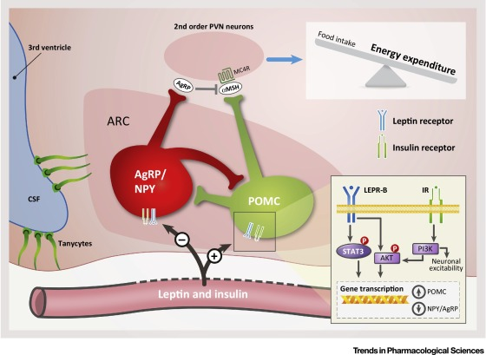

Slide 7
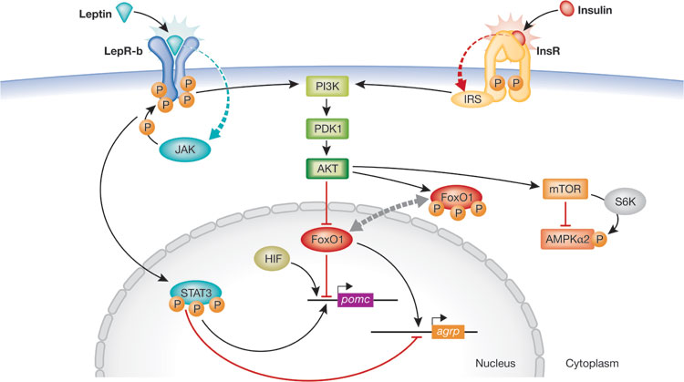

Slide 8
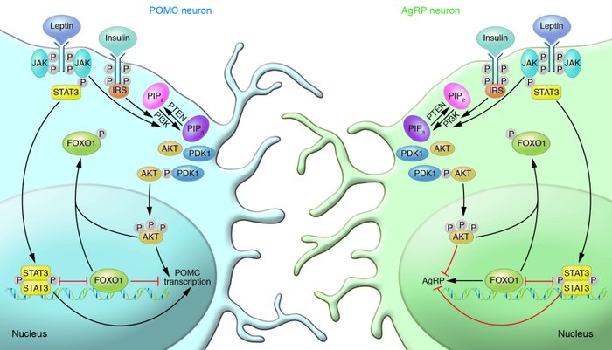

Slide 9
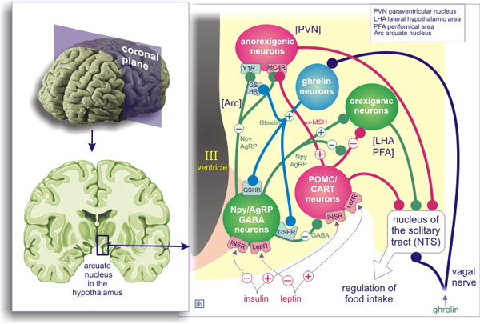

Slide 10
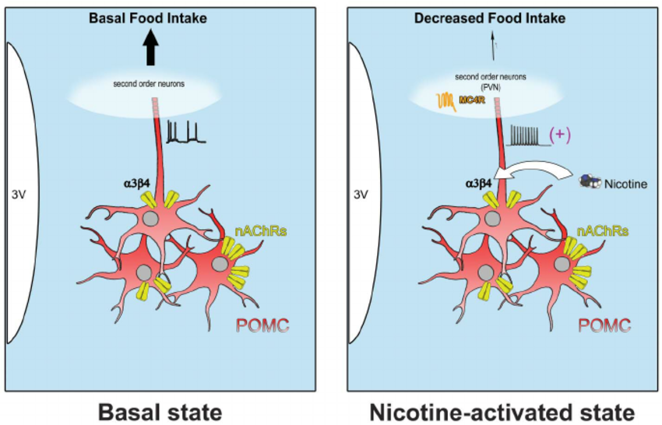

Slide 11
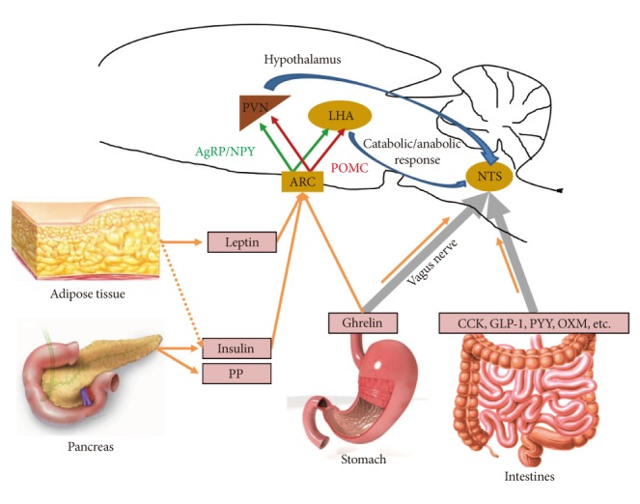

Slide 12
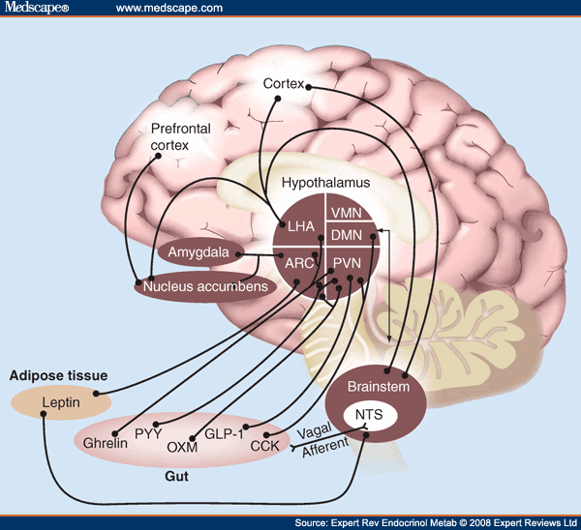
NTS = Nucleus tractus solitarius

Slide 13
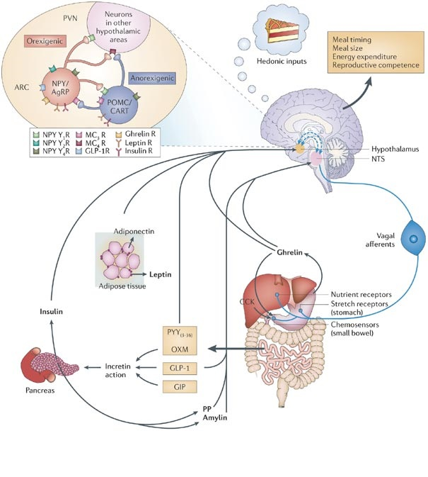
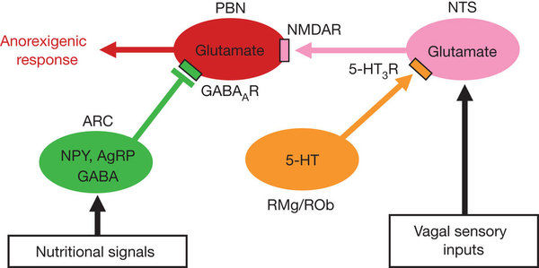

Slide 14
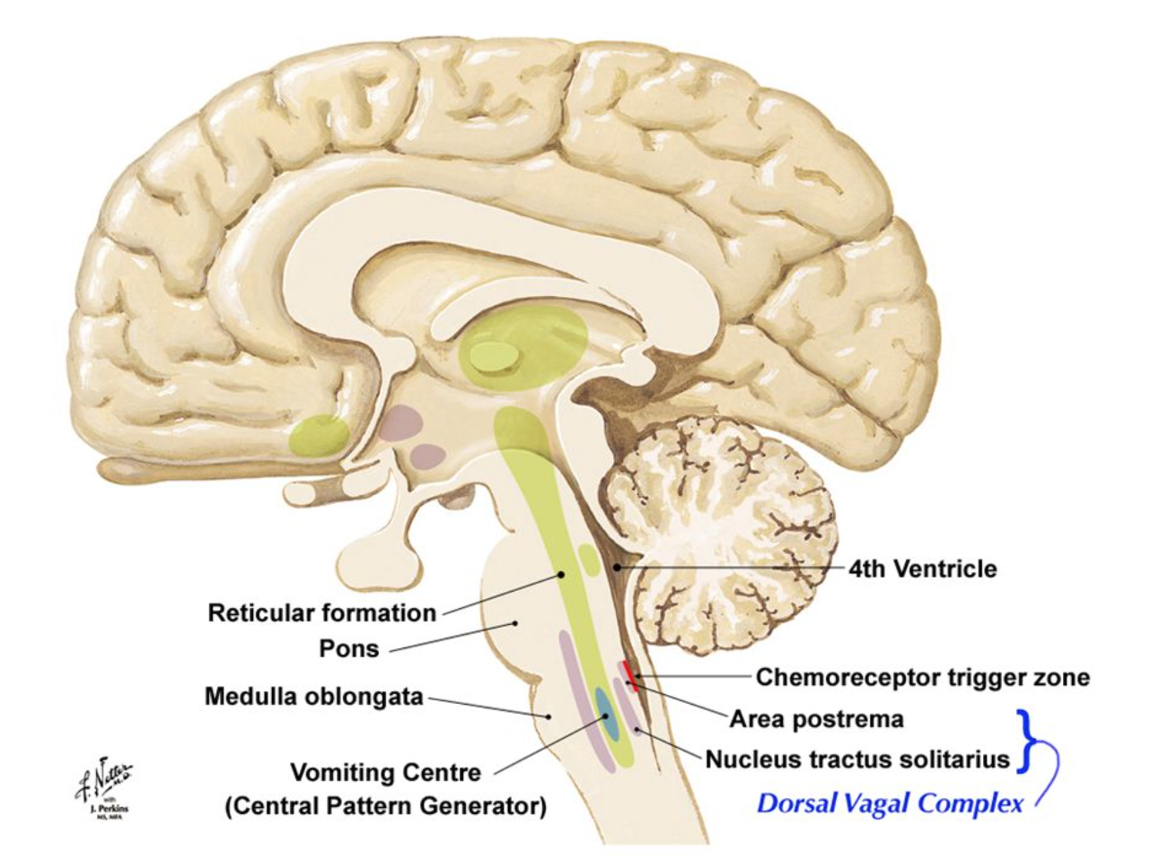

Slide 15
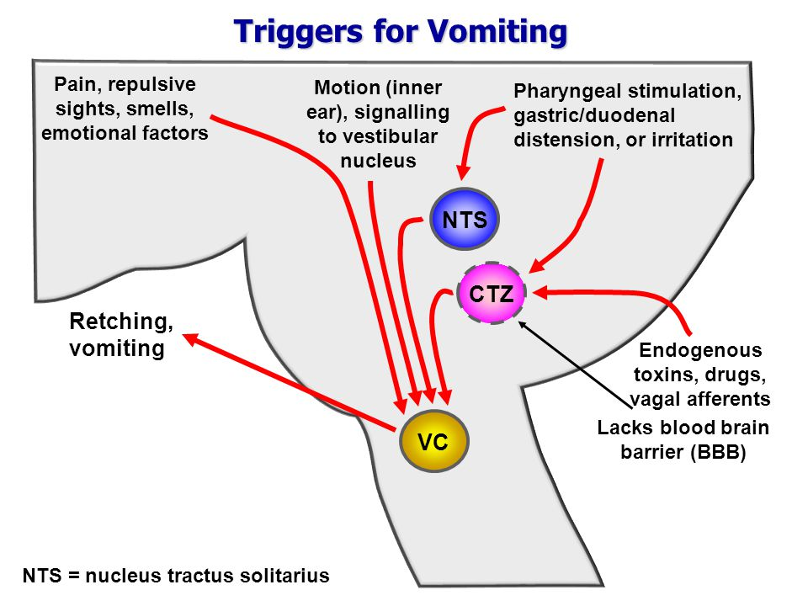

Slide 16
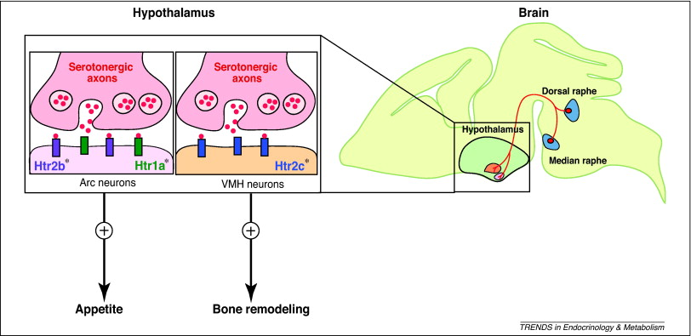
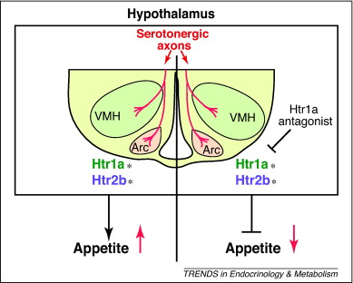

Slide 17
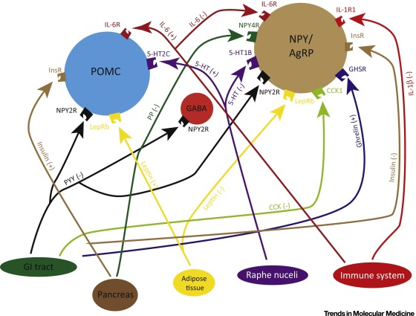

Slide 18
The arcuate nucleus of the hypothalamus contains an appetite controller governed by hormones, like insulin. Other peripheral peptide hormones are leptin, ghrelin, and PYY_{3–36}.
Ghrelin is released into the blood by endocrine cells in the stomach. Ghrelin is an appetite stimulant. Levels of ghrelin rise during fasting and fall after a meal, except in obese subjects where ghrelin levels remain high.
PYY_{3–36} is secreted by cells in the intestines. Its levels are low before eating but rise rapidly after a meal. It also acts in opposition to ghrelin, acting as an appetite suppressor.
The arcuate appetite system relies on two sets of neurons with opposing effects:
NPY/AgRP neurons produce neuropeptide Y (NPY) and agouti-related peptide (AgRP). These neurons stimulate appetite and lower metabolism, promoting weight gain.
POMC/CART neurons produce pro-opiomelanocortin (POMC) and cocaine- and amphetamine-related transcript (CART). These neurons inhibit appetite and raise metabolism, promoting weight loss. Two main functions of POMC/CART and NPY/AgRP neurons:
Some projections stay in the arcuate and influence each other’s activity.
Other projections leave the arcuate and make connections in the hypothalamus, ultimately modulating food intake.
Peripheral hormones also interact with the arcuate.
Leptin activates POMC/CART neurons but inhibits NPY/AgRP neurons, so leptin works to suppress hunger. Leptin’s effects on the arcuate are long-lasting.
Ghrelin and PYY_{3–36}, acting mainly on NPY/AgRP neurons, work in opposition to provide short term appetite control.
Ghrelin stimulates the cells, leading to an increase in appetite.
PYY_{3–36} inhibits the cells, reducing appetite.
Hypothalamic mechanisms integrate appetite signals.
The paraventricular nucleus (PVN) and the lateral hypothalamus (LH) are primary targets of the arcuate nucleus.
Orexigenic neurons of the lateral hypothalamus act to increase appetite and food intake, whereas anorexigenic neurons of the PVN act to decrease appetite and feeding.
The appetite-suppressing POMC/CART neurons project to the LH, releasing α-melanocyte-stimulating hormone (α-MSH). α-MSH is a melanocortin, an endogenous opiate peptide. Acting on the melanocortin type-4 receptors (MC4Rs) on LH neurons, α-MSH inhibits the LH’s appetite-stimulating activity, resulting in less feeding.
NPY/AgRP neurons are essential for increased feeding, exerting effects through the PVN and LH.
Orexin is a peptide produced in the LH that also causes increased feeding.

Slide 19
ΟΡΜΟΝΕΣ ΚΑΙ ΠΕΠΤΙΔΙΑ που εμπλέκονται στην ρύθμιση της όρεξης/πρόσληψης τροφής
Ορεξιγόνα
Nευροπεπτίδιο Υ (NPY)
Grelin
Galamin
Νορεπινεφρίνη
Orexin
Melanin-concentrating hormone (MCH)
Αgouti-related peptide (AgRP)
Νευρoπεπτίδιο W
Πεπτίδιο που μοιάζει με την γαλανίνη (GALP)
Cocaine and amphetamine regulated transcript (CART)
Ανορεξιγόνα
Παγκρεατικό πεπτίδιο ΥΥ (ΡΥΥ)
Ορμόνη απελευθέρωσης κορτικοτροπίνης (CRH)
Ντοπαμίνη
Σεροτονίνη
Λεπτίνη
Ινσουλίνη
Χολοκυστοκινίνη (CKK)
Ορμόνη διέγερσης των μελανοκυττάρων (α-MSH )
Ωκυτοκίνη

Slide 20
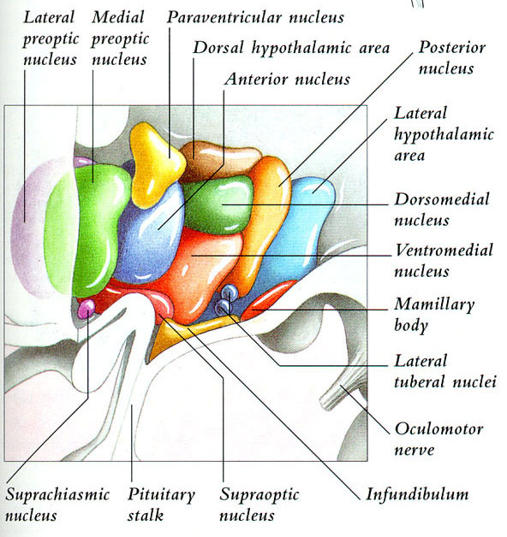
Οπίσθιος
Υποθάλαμος
PLH: ορεξίνη
Εγρήγορση
Πρόσθιος
Υποθάλαμος
VLPO: GABA, γαλανίνη
Ύπνος

Slide 21
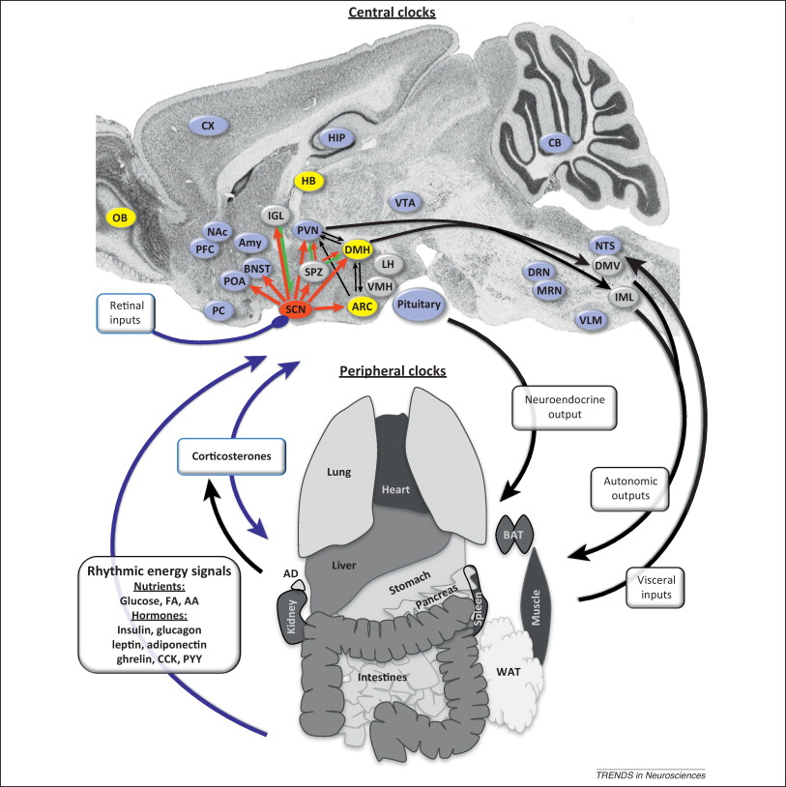
Many neural feeding centers in the brain receive imputs from SCN, but also exhibit local capacity for clock function (robust semiautonomous circadian oscillators are shown in yellow, weak oscillators in purple).
This neural clock network sculpts major output systems from the brain, including autonomic projections and neuroendocrine-driven hormone release, to drive rhythms in feeding. It also synchronises peripheral clocks across the body to feeding and modulates the sensitivity of organs to nutrient or hormonal signals.
Neuronal and hormonal messages from the peripheral organ systems feed back to the brain and can act as entraining cues for neural clocks. Corticosterone is a major entraining signal for both central and peripheral clocks.

Slide 22
Psychiatrist August Forel (1910)
Οι μέλισσες επέστρεφαν στο τραπέζι την ίδια ώρα ακόμα και όταν δεν υπήρχε φαγητό
Hey Fred,
where’s the
jam?
Οι μέλισσες επέστρεφαν στο τραπέζι με τη μαρμαλάδα την ίδια ώρα κάθε μέρα

