Slide 1
Airway management
Foreign body obstruction
Maria P. Ntalouka

Slide 2
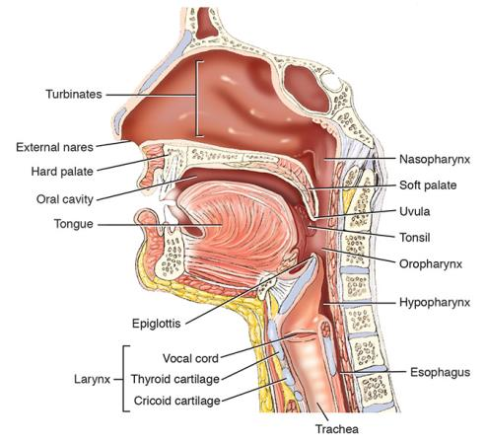
Airway Anatomy
Upper airway
Nasal passage
Turbinates
Oral cavity
Epiglottis
Vocal cord
Esophagus
Notes:
Instructor Notes
Expand on the following points:
Briefly review the anatomy of the upper airway and its relationship to airway management.
A patent airway is the first component in the delivery pathway of oxygen to the cells.
Oxygen is needed for cellular metabolism and energy production.
The tongue is the most common cause of airway obstruction.
The components of the upper airway include:
Nasal passage
Turbinates
Oral cavity
Epiglottis
Vocal cord
Esophagus

Slide 3
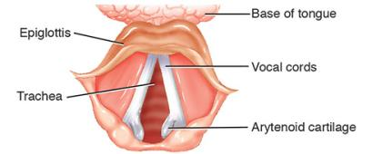
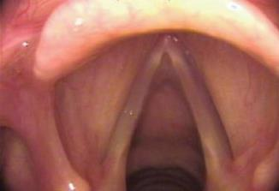
Anatomy of the Glottis
Posterior tongue
Epiglottis
Vocal cords
True
False
Esophagus
Prehospital care providers who perform endotracheal intubation must know this anatomy
Courtesy of James P. Thomas, M.D., www.voicedoctor.net
Notes:
Instructor Notes
Expand on the following points:
The figures on screen illustrate the laryngoscopic view of the glottis.
Prehospital care providers who perform endotracheal intubation must know the anatomy of the glottis, including:
Posterior tongue
Epiglottis
Leaf-shaped structure
Acts as a gate or flapper valve
Directs air into the trachea and solids and liquids into the esophagus
Vocal cords
True
Folds of tissue that meet in the midline
False
Also called vestibular folds
Direct the airflow through the vocal cords
Esophagus

Slide 4
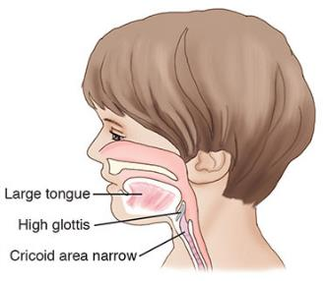
Pediatric Airway Considerations
Larger head and tongue
Greater potential for airway obstruction
Special attention to proper positioning
Epiglottis
Proportionally larger
Floppier than adult
Trachea
Shorter and conical shape
Greater potential for main bronchus intubation
Notes:
Instructor Notes
Expand on the following points:
Review the differences in the anatomy of the pediatric patient and potential areas of difficulty in maintaining a patent airway.
Pediatric airway considerations include:
A larger head and tongue as compared to an adult
There is a greater potential for airway obstruction in a pediatric patient.
Special attention to the proper positioning of the pediatric patient is required to maintain a patent airway.
The epiglottis is proportionally larger and floppier than in an adult.
The trachea is shorter and conical shape, which leads to a greater potential for main bronchus intubation.

Slide 5
Airway Assessment (1 of 5)
If the patient is talking normally, the airway is open
Further assessment is still required
Assessment of the airway requires the provider to:
Look
Listen
Feel
Notes:
Instructor Notes
Expand on the following points:
Even if the trauma patient is talking normally, still assess the airway.
While the talking patient is demonstrating that the airway is open now, further assessment is still required.
The assessment of the airway requires the prehospital care provider to:
Look, listen, and feel
This technique will be discussed in the following slides.

Slide 6
Airway Assessment (2 of 5)
Look for findings that may indicate airway obstruction or injury or may lead to pulmonary aspiration
Examples may include:
Blood and secretions
Fractured teeth
Foreign bodies
Notes:
Instructor Notes
Expand on the following points:
During the airway assessment, look for findings that may indicate airway obstruction or injury or may lead to pulmonary aspiration.
Examples may include:
Blood and secretions
Fractured teeth
Foreign bodies

Slide 7
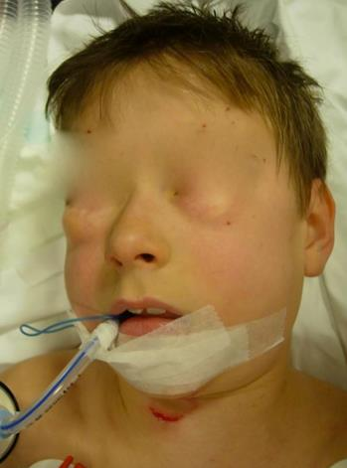
Airway Assessment (3 of 5)
Examples may include (cont’d):
Vomitus
Hematomas/contusions (e.g., tongue, neck)
Gross subcutaneous emphysema
Photograph provided courtesy of J.C. Pitteloud M.D., Switzerland
Notes:
Instructor Notes
Expand on the following points:
During the airway assessment, look for findings that may indicate airway obstruction or injury or may lead to pulmonary aspiration.
Examples may include (continued):
Vomitus
Hematomas/contusions (e.g. tongue, neck)
Gross subcutaneous emphysema
The photo on this screen illustrates contusion over the trachea and gross subcutaneous emphysema (note the air-filled swollen eyelids) in a patient with a ruptured trachea.
It is courtesy of J. C. Pitteloud, MD, PHTLS Switzerland.

Slide 8
Airway Assessment (4 of 5)
Listen for abnormal sounds indicating airway compromise
Examples include:
Snoring
Stridor (inspiratory)
Gurgling (expiratory)
Hoarseness
Notes:
Instructor Notes
Expand on the following points:
Listen for abnormal sounds indicating airway compromise.
Examples include:
Snoring
Stridor (upon inhalation)
Gurgling (upon exhalation)
Hoarseness
Of all of the abnormal airway sounds, stridor is the most concerning because it indicates a high degree of airway obstruction and the need for immediate intervention.

Slide 9
Airway Assessment (5 of 5)
Feel for abnormal masses and signs of airway injury
Examples include:
Hematomas
Subcutaneous emphysema in the neck
Additional consideration
Measure oxygen saturation
Notes:
Instructor Notes
Expand on the following points:
Feel for abnormal masses and signs of airway injury.
Examples include:
Hematomas
It is critical to note the presence of an expanding hematoma involving the neck.
May distort the normal anatomy and compromise the ability to manage the airway if necessary
Subcutaneous emphysema in the neck
The presence of subcutaneous emphysema indicates disruption of the pulmonary system.
The exact location of the air leak may not be apparent in the field.
Additional consideration during this phase:
Measure oxygen saturation.

Slide 10
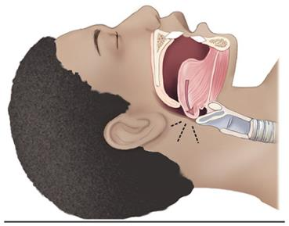
Airway Obstruction (1 of 2)
Causes of airway obstruction
Tongue
Most common cause
Falls back, obstructing the airway with decreased mental status
Snoring — clinical finding
Notes:
Instructor Notes
Expand on the following points:
Causes of airway obstruction:
Tongue
The tongue obstructing the airway is the primary reason for death in the head-injured patient prior to EMS arrival.
With decreased mental status, the tongue falls back, obstructing the airway.
Snoring is a clinical finding indicating this obstruction.

Slide 11
Airway Obstruction (2 of 2)
Causes of airway obstruction (cont’d)
Foreign body
Blood
Vomit
Teeth
Notes:
Instructor Notes
Expand on the following points:
Additional causes of airway obstruction in the trauma patient are (continued):
A foreign body
Blood
Vomit
Teeth

Slide 12
Airway Trauma (1 of 2)
Blunt injuries
Examples of findings may include:
Swelling and edema
Fractured larynx
Subcutaneous emphysema
Hematoma
Notes:
Instructor Notes
Expand on the following points:
Examples of clinical findings of blunt trauma may include:
Swelling and edema
Fractured larynx
Subcutaneous emphysema
Hematoma
Note that this list is not inclusive of all possible findings.

Slide 13
Airway Trauma (2 of 2)
Penetrating injuries
Examples of findings may include (cont’d):
Bleeding into the airway
Subcutaneous emphysema
Hematoma
Notes:
Instructor Notes
Expand on the following points:
Examples of clinical findings of penetrating trauma may include (continued):
Bleeding into the airway
Subcutaneous emphysema
Hematoma
Note that this list is not inclusive of all possible findings.

Slide 14
Inhalation Injuries of the Airway
Examples of causes
Dry
Steam
Chemical
Signs and symptoms of airway burns
Swelling/edema
Stridor
Notes:
Instructor Notes
Expand on the following points:
Inhalation injuries of the airway may be the result of smoke inhalation (dry), steam, or chemicals.
The signs and symptoms of airway burns include swelling/edema and stridor.
While the burn is of concern, the primary risk is the development of tissue edema obstructing the airway.
Early and aggressive management of the burned airway is recommended before swelling develops and further complicates airway management.
If the prehospital care provider cannot secure an airway, the patient needs to be immediately transported to a facility that can provide the needed airway.
This facility may not necessarily be a trauma or burn center since the patient can be transferred as appropriate after the airway has been managed.
The use of supraglottic airways in these cases may not secure the airway due to the increase in swelling of the upper airway.
Endotracheal intubation and rarely surgical airway management techniques are required.

Slide 15
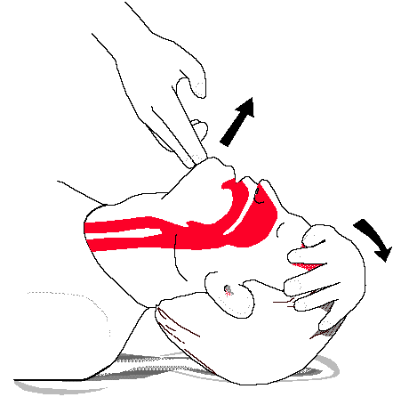
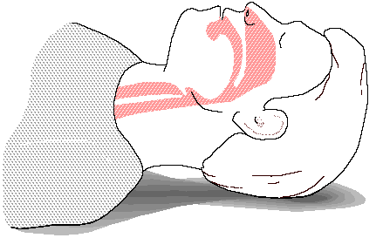
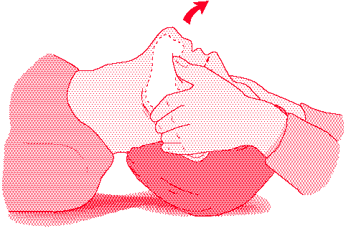
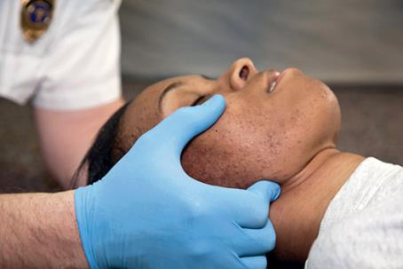

Slide 16
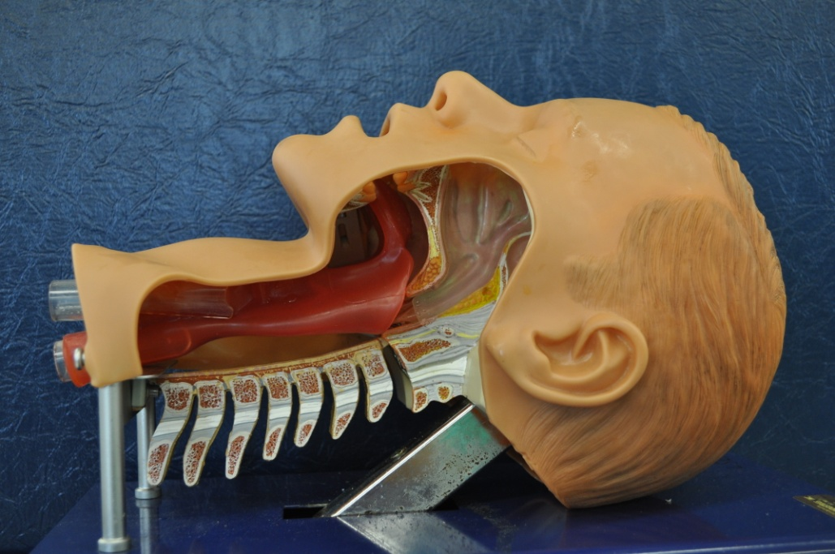
Aligning the Axes
(creates a more direct approach for ventilation during BVM and improved visualization of vocal cords during intubation)
Oral axis
Pharyngeal axis
Laryngeal axis
Head on bed, neutral position

Slide 17
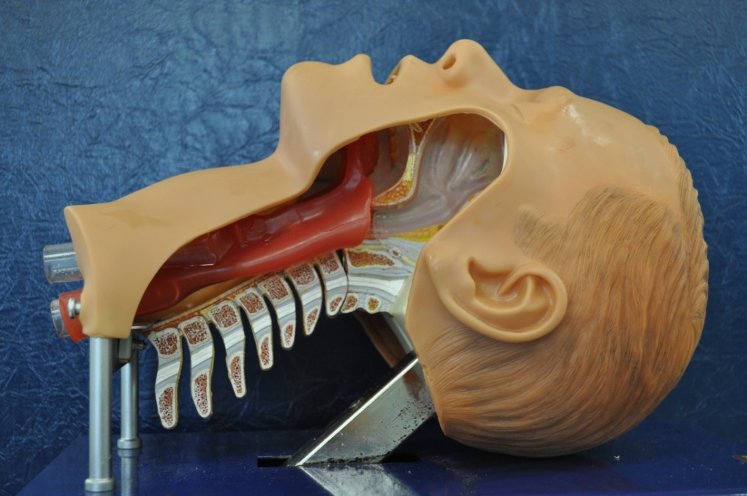
Aligning the Axes
Oral axis
Pharyngeal axis
Laryngeal axis
Head Elevated, neutral position

Slide 18
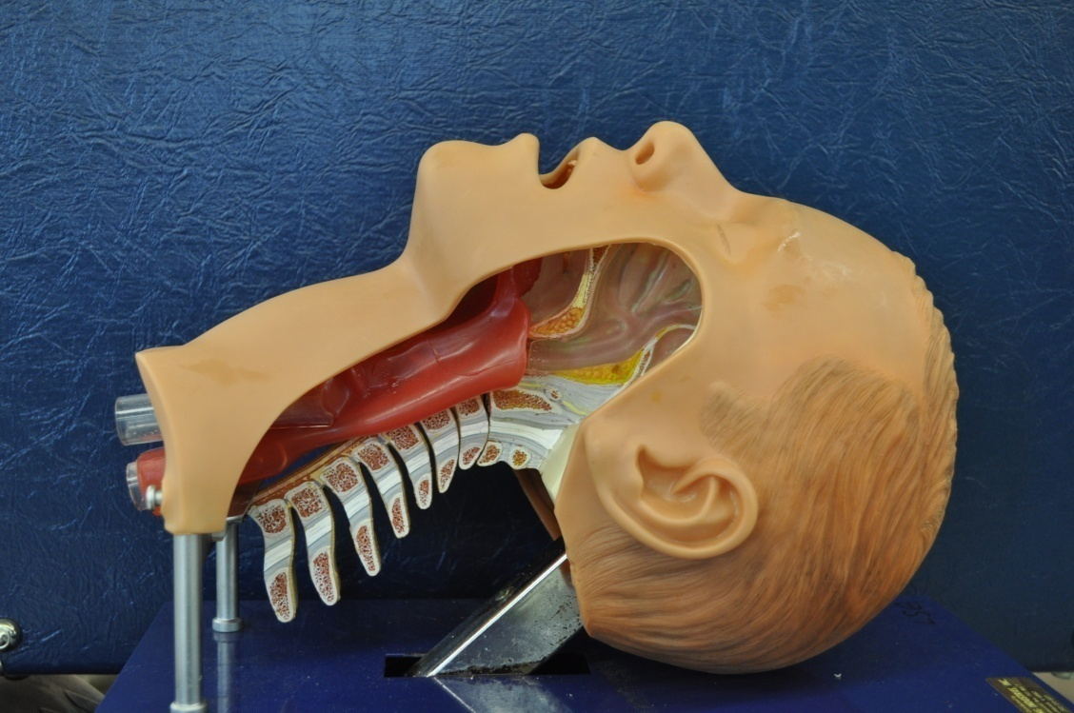
Aligning the Axes
Oral axis
Pharyngeal axis
Laryngeal axis
Head elevated and extended

Slide 20
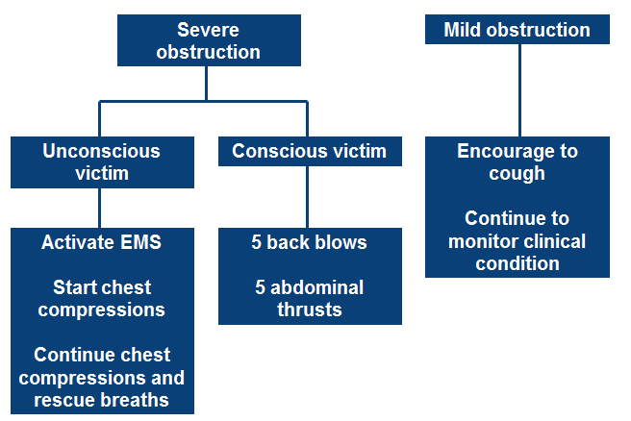
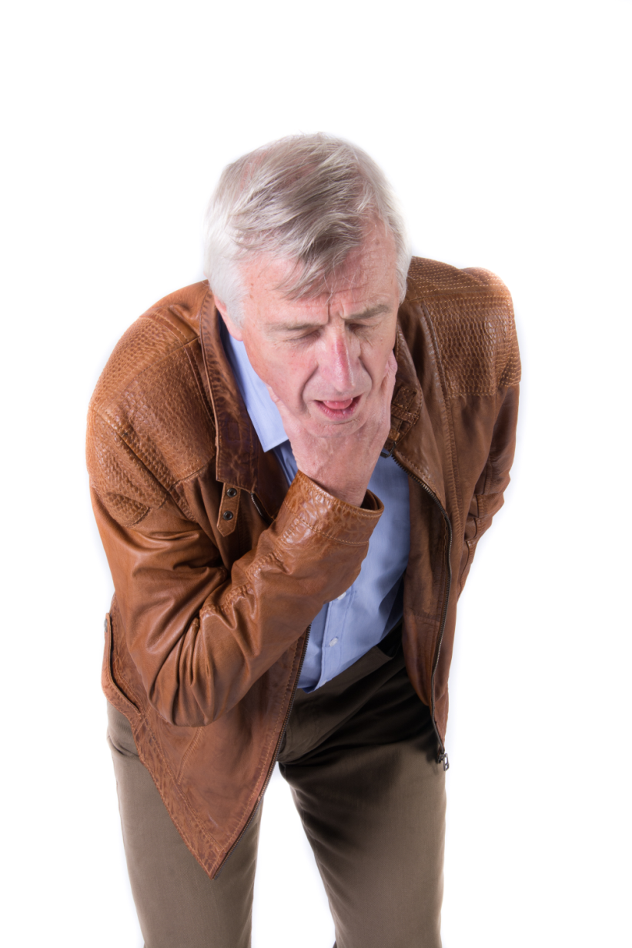
FBAO - Choking: Algorithm

Slide 21
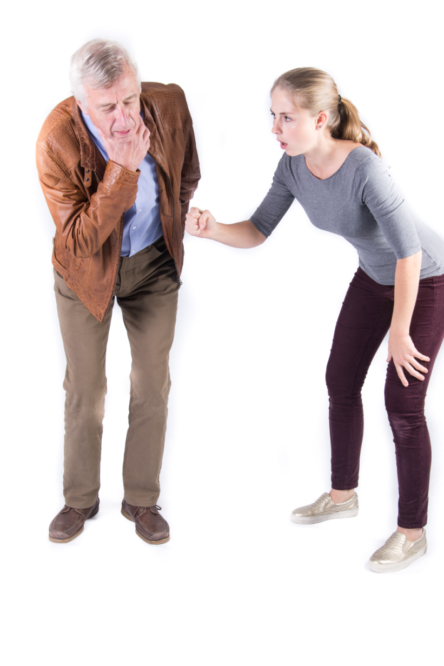
FBAO - Choking: Algorithm

Slide 22
FBAO - Choking: Algorithm

Slide 23
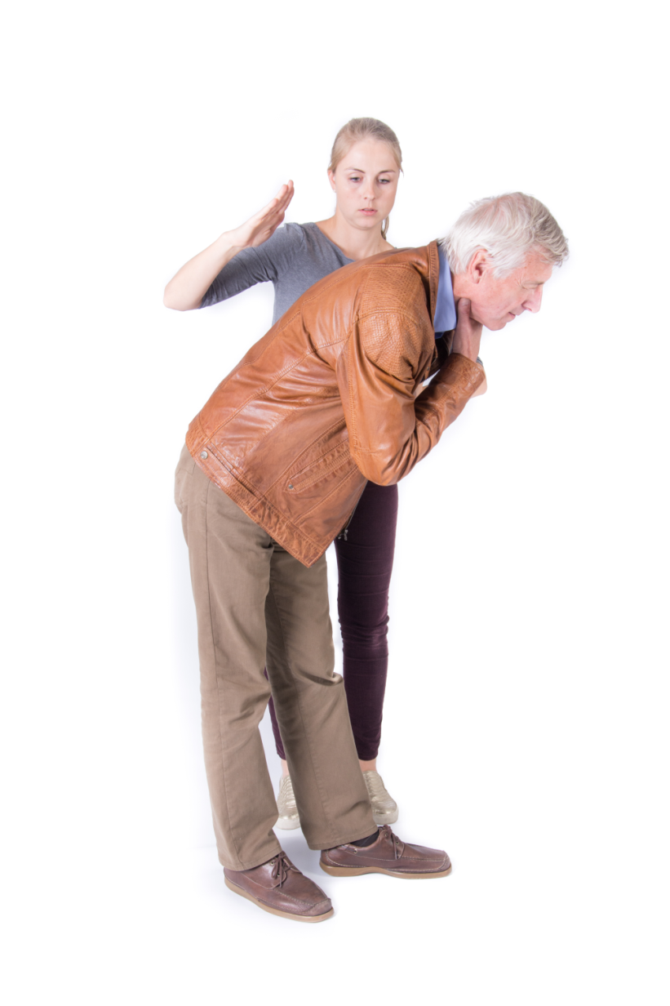
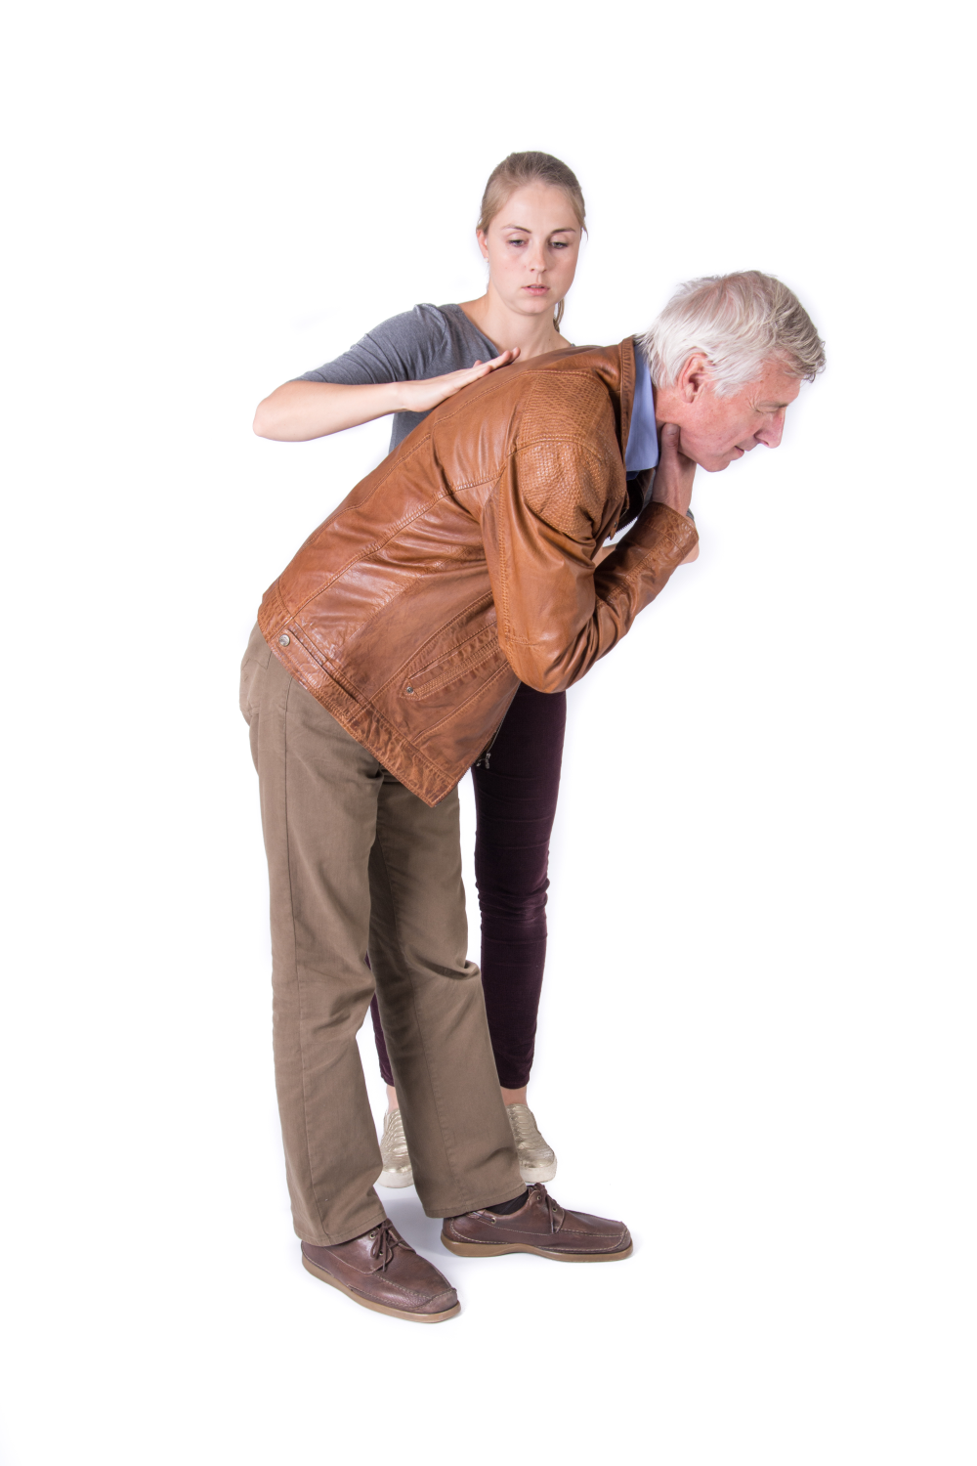
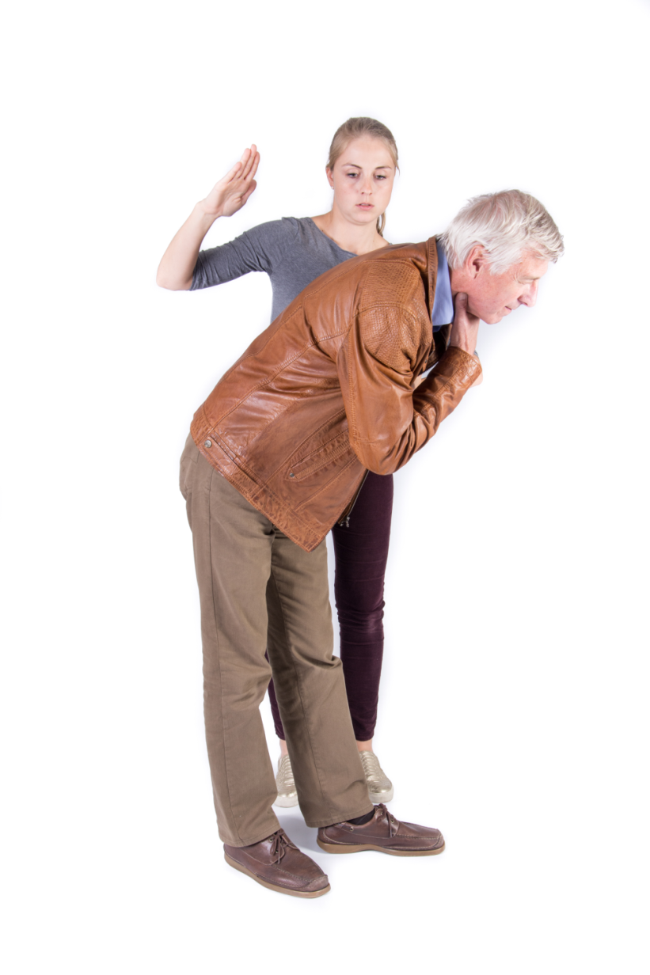
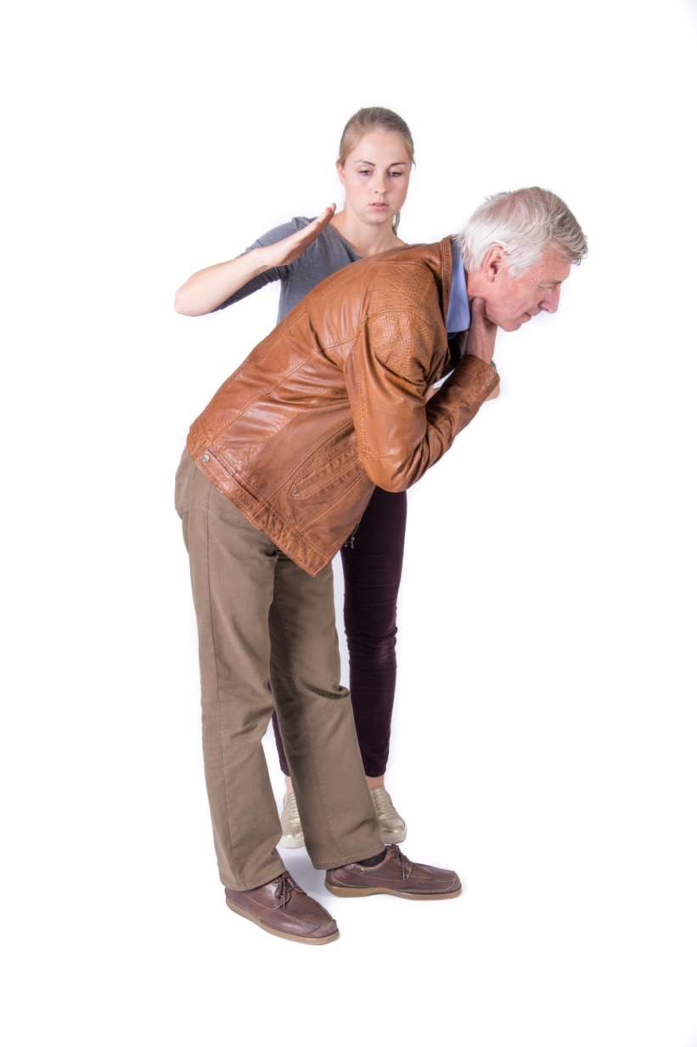
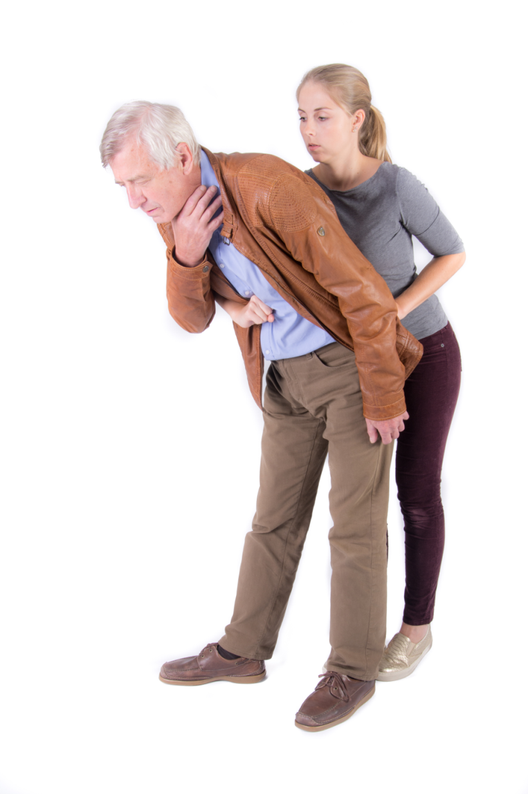
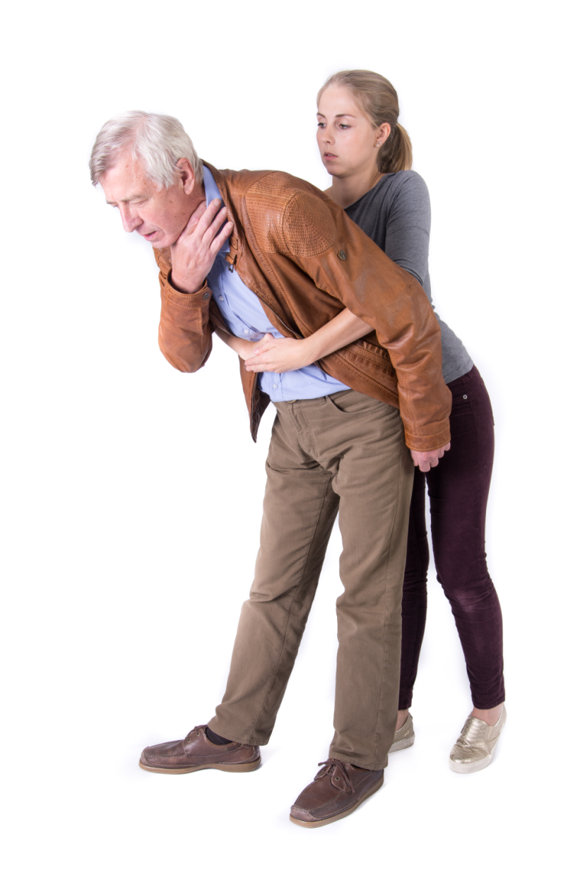
FBAO - Choking: severe obstruction
Abdominal thrusts: position of first hand
Abdominal thrusts: position of second hand
Back Blows

Slide 24
FBAO - Choking: Algorithm

Slide 25
Indications for Intubation
Failure to maintain or protect the airway
Failure of ventilation
Failure of oxygenation
Therapy / Evaluation is required that mandates intubation

Slide 26
Failure to protect or maintain airway
Altered mental status
Excessive Secretions
Bleeding
Hematoma
Angioedema
Others

Slide 27
Failure to Ventilate
Inability to remove pCO2
COPD
Narcotic OD
Myasthenia Gravis
Stroke
Other

Slide 28
Failure to Oxygenate
Inability to maintain pO2 > 60
CHF
Pneumonia
ARDS
Pulmonary Embolism
Other

Slide 29
Therapy is required that mandates intubation
Severe Head Injury – Hyperventilation
Combative – Need to evaluate/treat
Other

Slide 30
Evaluating the airway
Dentition
prominent upper incisors, receding chin
Distortion
edema, blood, vomitus, tumor, infection
Disproportion
short chin-to-larynx distance, bull neck, large tongue, small mouth
Dysmobility
TMJ and cervical spine immobility

Slide 31
Neck Mobility
Extension of the neck at the atlanto-occipital joint brings the oral, pharyngeal, and laryngeal axes into alignment.

Slide 32
Bag Valve Mask
Make sure it is the right size
Adult
Child
Infant
Facial Landmarks
Bridge of nose
Malar eminences
Mandibular alveolar ridge

Slide 33
Bag Valve Mask
What type of bag
Duckbill inspiratory valves
One way expiratory valves
Delivers 90 to 97% oxygen
Spontaneously breathing
Ventilated

Slide 34
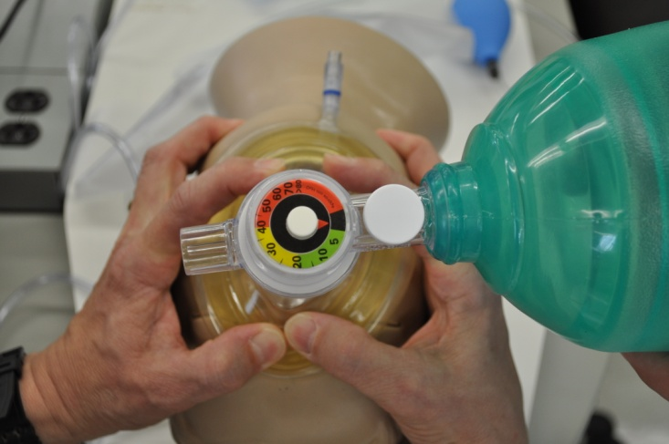
Bag valve mask
Use both hands to make a seal (two operators)
Lift the jaw
Align the axes

Slide 35
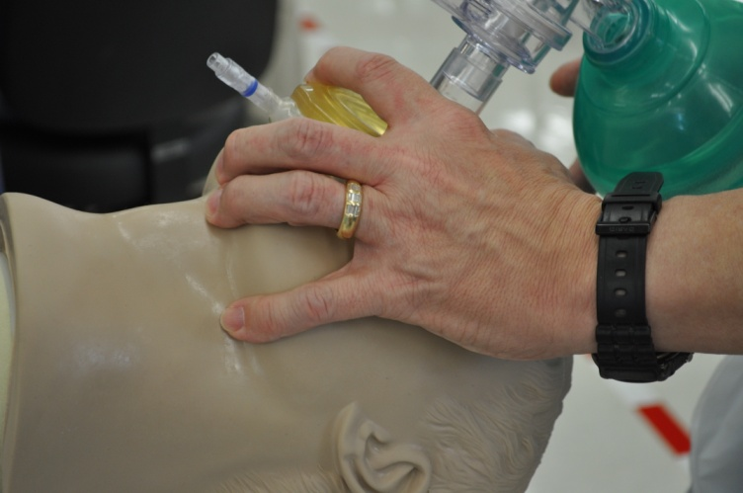
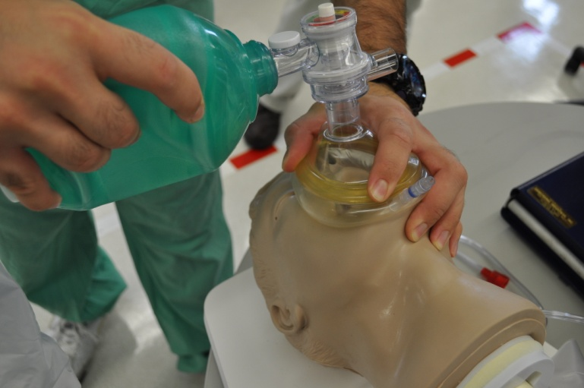
Single-operator BVM
Use one hand to make a seal
Use other hand to deliver breaths
Lift the jaw
Align the axes
Note: always observe universal precautions, including gloves,
when delivering patient care

Slide 36
Bag Valve Mask
Continuous Firm Pressure
Want to minimize barotrauma
Allow time to exhale
Watch Chest
Listen for exhalation
Cadence
Time with breaths

Slide 37
BVM Assessment
Simple tools for airway assessment in the emergency setting, including BVM assessment
Example: MOANS*
*The Difficult Airway CourseTM
*Walls RM, Murphy MF (2008). Manual of Emergency Airway Management; 3rd edition. Philadelphia: Lippincott Williams and Wilkins.

Slide 38
MOANS*
BVM difficulty is anticipated if these factors are present:
M: Mask seal difficulty
(Beards and facial injuries)
O: Obesity, obstruction
A: Age (>55)
N: No teeth
S: Stiff (also sleep apnea and snoring)
Decreased lung compliance
*Walls RM, Murphy MF (2008). Manual of Emergency Airway Management; 3rd edition. Philadelphia: Lippincott Williams and Wilkins.
*The Difficult Airway CourseTM

Slide 39
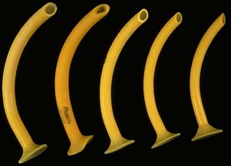
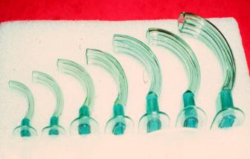
Bag Valve Mask
Use adjuncts
Nasopharyngeal Airway
Oropharyngeal Airway

Slide 40
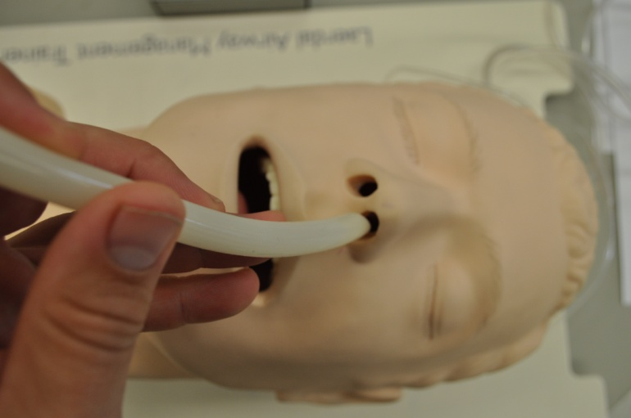
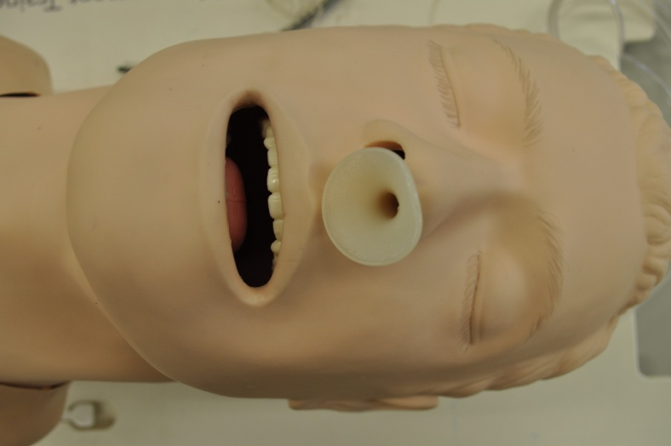
Adjuncts
Nasopharyngeal Airway
Advance until airflow heard
Can be used in semi-conscious patient
Note: always observe universal precautions, including gloves, when delivering patient care

Slide 41
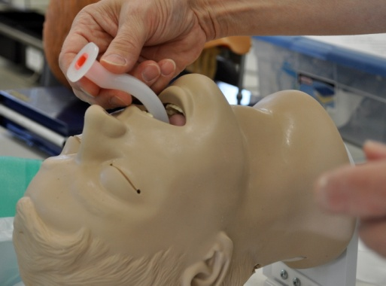
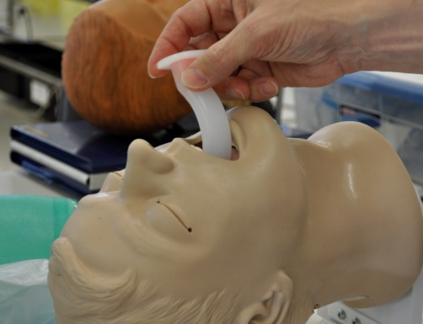
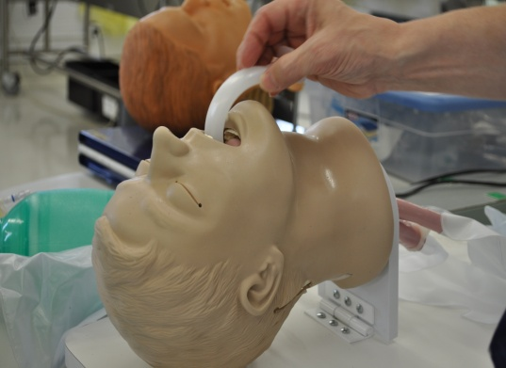
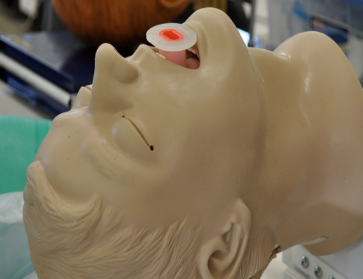
BVM adjuncts
Oropharyngeal Airway
Unconscious / No gag
Insert with tongue blade or rotate
Note: always observe universal precautions, including gloves, when delivering patient care

Slide 42
Difficult to Bag Valve Mask
Facial Hair
Obesity
Edentulous (leave dentures in)
Upper airway obstruction
Small Chin
Large tongue

Slide 43
Lemon Law*
Look Externally
Evaluate the 3-3-2 Rule
Mallampati
Obstruction
Neck Mobility
*Walls RM, Murphy MF (2008). Manual of Emergency Airway
Management; 3rd edition. Philadelphia: Lippincott Williams and
Wilkins.

Slide 44
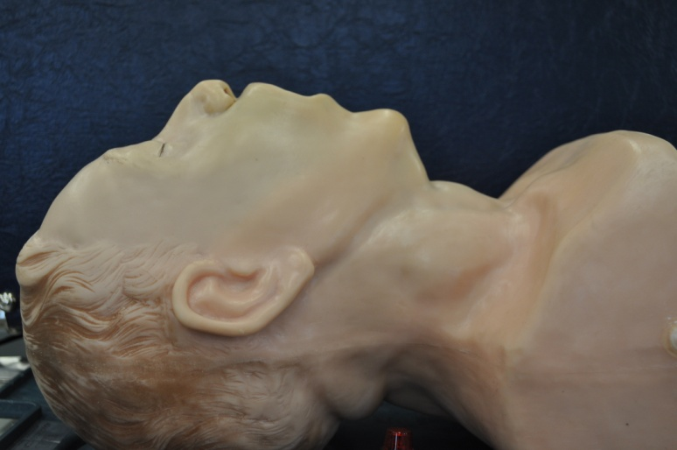
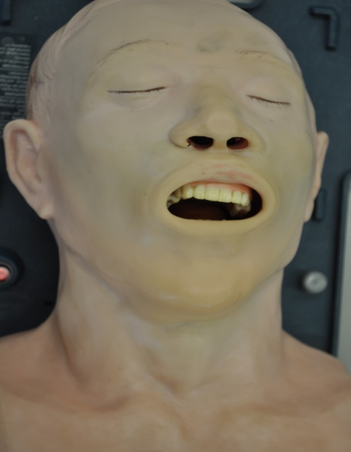
Look Externally
abnormal face shape
sunken cheeks
edentulous
"buck teeth"
receding mandible
"bull-neck"
narrow mouth
obesity
face or neck pathology

Slide 45
Dentition
Overbite can impose a variable degree of limitation on alignment of axes during intubation
Remove teeth that might dislodge during laryngoscopy
Remove dentures

Slide 46
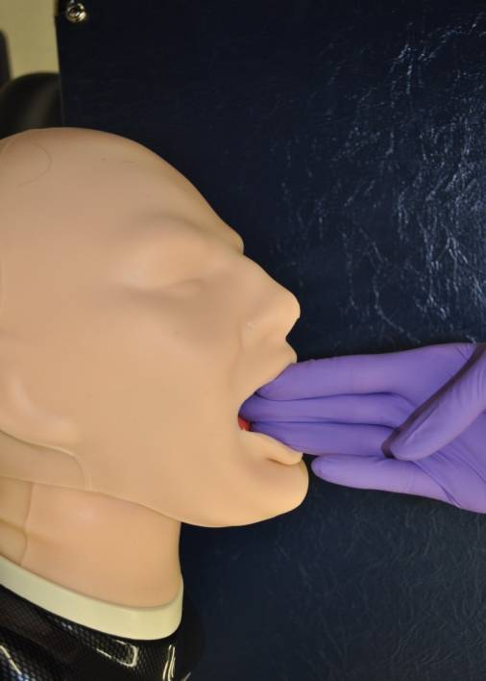
Evaluate the 3-3-2 Rule
Mouth opening > 3F
(F=fingerbreadths)

Slide 47
Evaluate the 3-3-2 Rule
Hyoid-chin distance > 3F
(F=fingerbreadths)

Slide 48
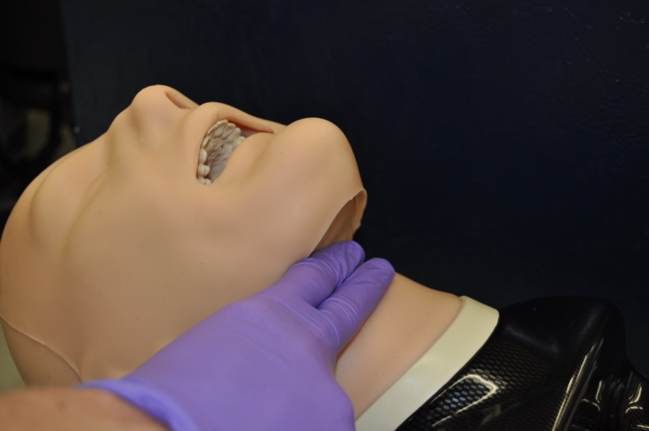
Evaluate the 3-3-2 Rule
Thyroid cartilage - mouth floor distance > 2F
(F=fingerbreadths)

Slide 49
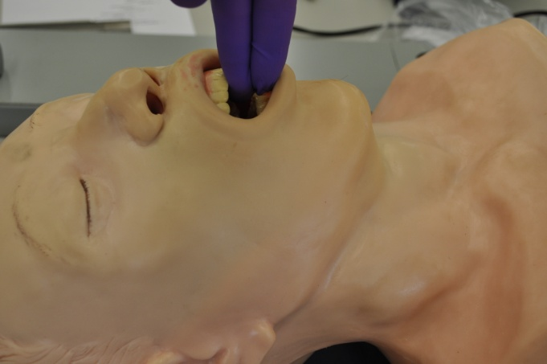
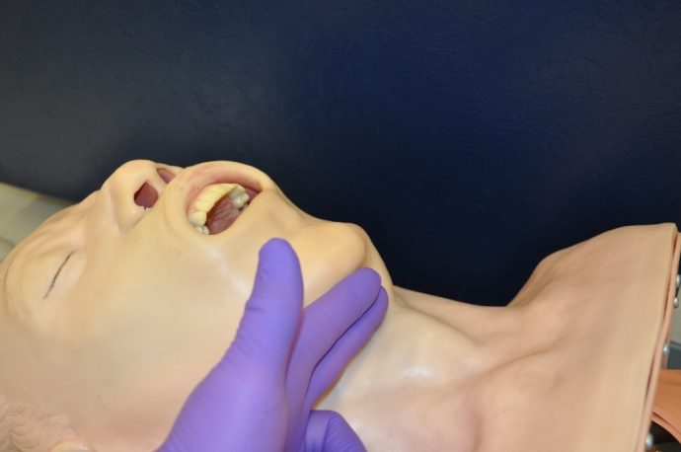
3-3-2 rule not met, anticipate challenging anatomy
< 3F
< 3F

