Slide 1
A multi-modal Route Planning approach: a case-study of the city of Trikala
ΠΑΝΕΠΙΣΤΗΜΙΟ ΘΕΣΣΑΛΙΑΣ
Ενότητα 7: Παρουσίαση 6
Γεώργιος Κ.Δ. Σαχαρίδης
Χριστόδουλος Ματσίγκος, Λάζαρος Ταταλόπουλος
Τμήμα Μηχανολόγων Μηχανικών

Slide 2
PRESENTATION STRUCTURE
1
2
3
Problem Description
Mathematical Model
Application of the Mathematical Model on simulated Data
MATSIGKOS-TATALOPOULOS 20/4/2015

Slide 3
PRESENTATION STRUCTURE
1
2
3
Mathematical Model
Application of the Mathematical Model on simulated Data
Problem Description
MATSIGKOS-TATALOPOULOS 20/4/2015

Slide 4
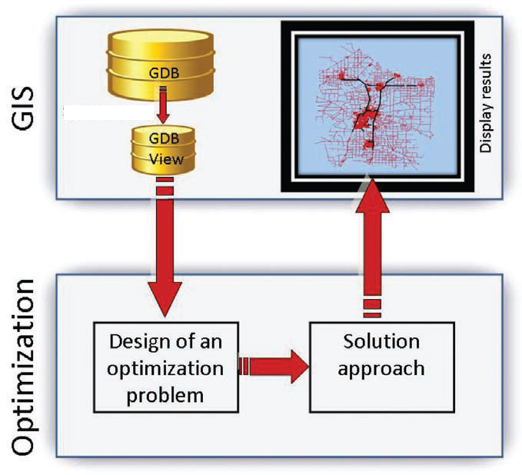
PROBLEM DESCRIPTION
The process of decision making:
MATSIGKOS-TATALOPOULOS 20/4/2015

Slide 5
PRESENTATION STRUCTURE
1
2
3
Introduction
Mathematical Model
Application of the Mathematical Model on simulated Data
MATSIGKOS-TATALOPOULOS 20/4/2015

Slide 6
MATHEMATICAL MODEL
1ST APPROACH:
Input Parameters:
Cost between two stations (Distance or Time)
End Point
Start Point
Subscripts and Sets:
All the Bus stops
Total Buses
MATSIGKOS-TATALOPOULOS 20/4/2015

Slide 7
MATHEMATICAL MODEL
Decision Variable:
Binary variable (0-1) which is equal to 1
if path from i to j using bus k is shortest from path using a bus ≠ than k
Equal to 0 if not
MATSIGKOS-TATALOPOULOS 20/4/2015

Slide 8
MATHEMATICAL MODEL
Constraints:
1. Only one bus should be chosen for a specific path
2. Binary
MATSIGKOS-TATALOPOULOS 20/4/2015

Slide 9
MATHEMATICAL MODEL
Objective Function:
Minimize the cost between station i and station j
by selecting one of the available buses:
MATSIGKOS-TATALOPOULOS 20/4/2015

Slide 10
MATHEMATICAL MODEL
2nd APPROACH:
CREATION OF A NETWORK MODEL G(V,E)
where
V: Vertices
E: Edges E=(i,j), i,j∈V, i≠j
B: Buses
INPUT PARAMETERS
BR: Bus Routes (connectivity of vertices of G)
TS (or DT): Time spent or distance travelled between two bus stops
O: Origin(Initial location)
D: Destination (Final location)
ILBS: Initial&last bus stop (1 for initial stop,-1 for last stop , 0 other)
MATSIGKOS-TATALOPOULOS 20/4/2015

Slide 11
MATHEMATICAL MODEL
DECISION VARIABLES
U: Edge Used (binary) 1 if edge (i,j) is part of the route
0 otherwise
IBS: Initial bus stop (binary) 1 if bus stop is the starting stop
0 otherwise
LBS: Last bus stop (binary) 1 if bus stop is the final stop
0 otherwise
MATSIGKOS-TATALOPOULOS 20/4/2015

Slide 12
MATHEMATICAL MODEL
Algorithm function for Route Planning
Computation of initial and final bus stop
Route Computation minimizing the travelling time or distance
Route Planning from a starting point to a finishing point
MATSIGKOS-TATALOPOULOS 20/4/2015

Slide 13
MATHEMATICAL MODEL
Computation of initial and final bus stop
Objective function
Constraints
MATSIGKOS-TATALOPOULOS 20/4/2015

Slide 14
MATHEMATICAL MODEL
Route Computation minimizing the travelling time or distance
Objective function
Constraints
MATSIGKOS-TATALOPOULOS 20/4/2015

Slide 15
PRESENTATION STRUCTURE
1
2
3
Introduction
Mathematical Problem
Application of the Mathematical Model on simulated Data
MATSIGKOS-TATALOPOULOS 20/4/2015

Slide 16
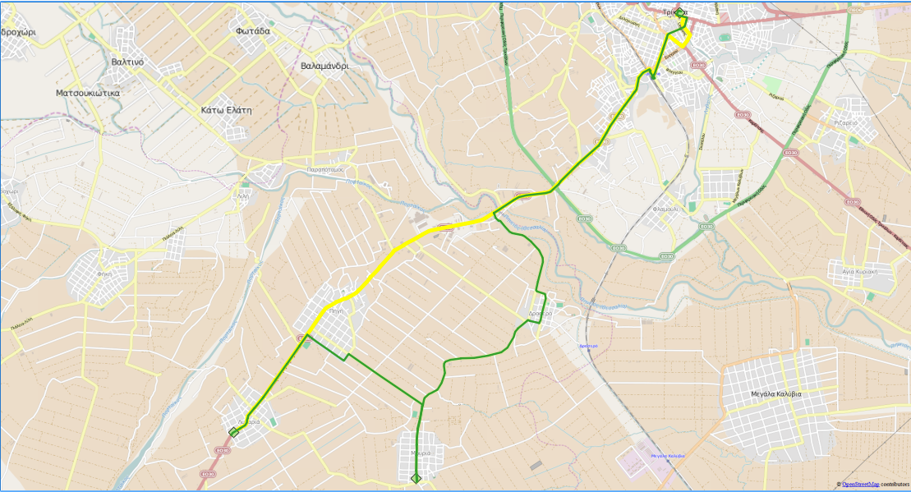
Application of the Mathematical Model on simulated Data
1st Approach
Data:
1
Buses available: 2
Paths: 12
Time or Space required for transportation
Point of origin
Point of destination
Nodes: 3
2
MATSIGKOS-TATALOPOULOS 20/4/2015
3

Slide 17
Application of the Mathematical Model on simulated Data
Data:
Distance between i and j using bus k in Km:
1: Trikala
2: Ligaria
3: Mouria
Cijk | jk=11 | 21 | 31 | 12 | 22 | 32
i=1 | N.C. | 15 | 12 | N.C. | 14 | 11
2 | 15 | N.C | 2 | 14 | N.C. | 3
3 | 12 | 2 | N.C. | 11 | 3 | N.C.
MATSIGKOS-TATALOPOULOS 20/4/2015

Slide 18
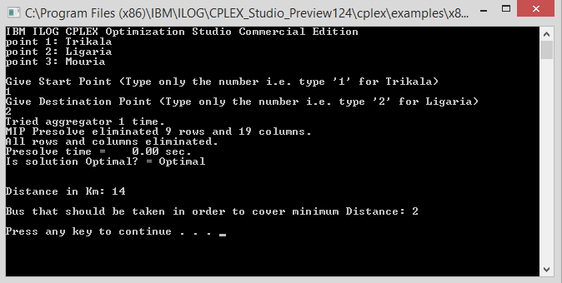
Application of the Mathematical Model on simulated Data
Results:
Using C++, CPLEX:
Shortest path to go from Trikala to Ligaria is by using bus 2 (14Km)
MATSIGKOS-TATALOPOULOS 20/4/2015

Slide 19
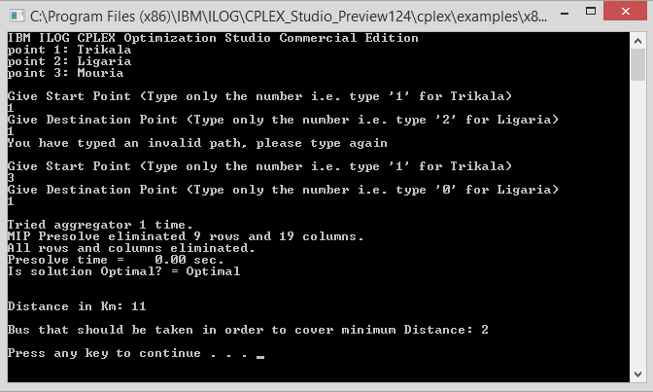
Application of the Mathematical Model on simulated Data
Results:
Using C++, CPLEX:
No connection between two same points:
MATSIGKOS-TATALOPOULOS 20/4/2015

Slide 20
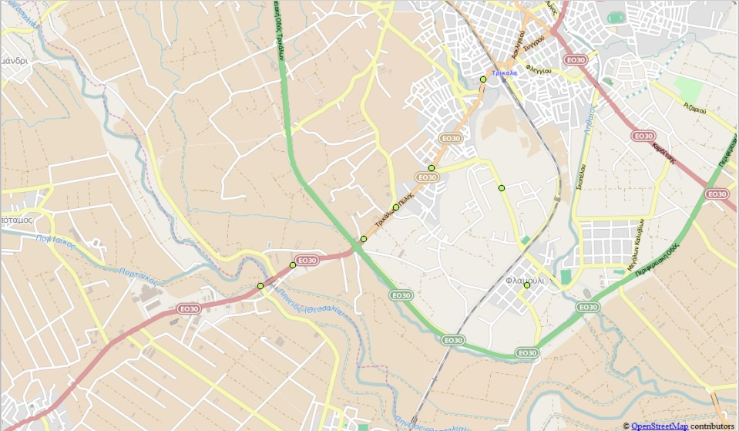
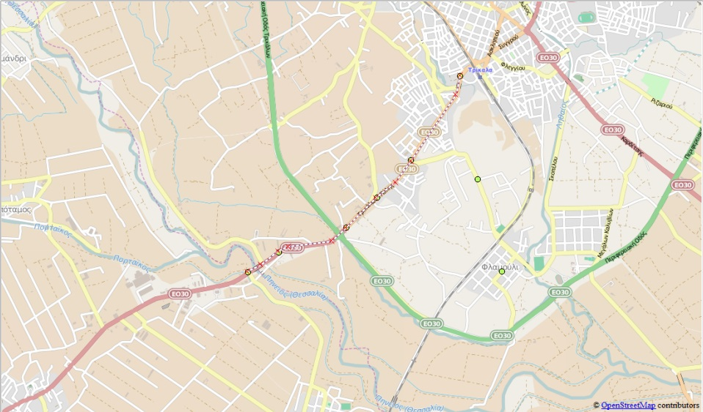
Application of the Mathematical Model on simulated Data
2nd Aproach
0
1
Bus 2
2
Bus 1
4
5
6
7
3
..\..\..\..\..\..\Drop box\Matsigkos Ch-Tatalopoulos Laz\Coding\Route Planning v.4.xlsx
MATSIGKOS-TATALOPOULOS 20/4/2015

Slide 21
BIBLIOGRAPHY
Crainic T.G. (2002) “A Survey of Optimization Models for Long-Haul
Freight Transportation” R.W. Hall (Ed. 2), Kluwer.
Faiz S. & Krichen S. (2013) “Geographical Information Systems and Spatial Optimization” CRC Press (Ed. 1) Boca Raton.
MATSIGKOS-TATALOPOULOS 20/4/2015

Slide 22
Questions
MATSIGKOS-TATALOPOULOS 20/4/2015

