Slide 1
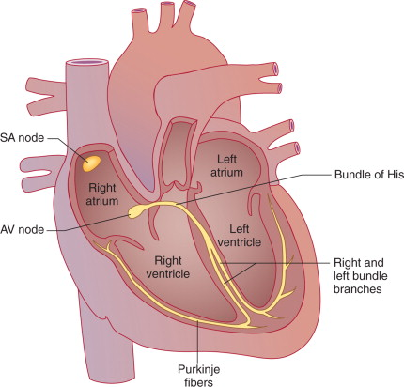
Cardiac conduction system. The normal conducting system consists of pacemaker cells in the sinoatrial (SA) nodal complex, specialized intra-atrial conducting tracts (including Bachmann's bundle), the atrioventricular (AV) node, the His-Purkinje system, and working atrial and ventricular myocardium.

Slide 2
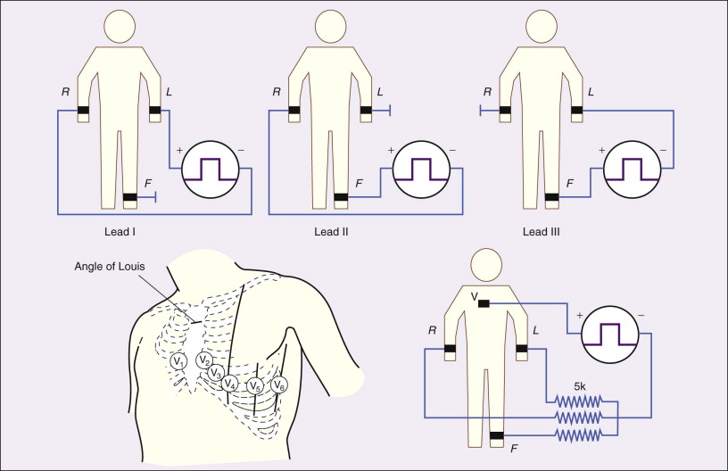
Top, Electrode connections for recording the standard limb leads I, II, and III.
R, L, and F indicate locations of electrodes on the right arm, left arm, and left foot, respectively.
Bottom, Electrode locations and electrical connections for recording a precordial lead.
Left, The positions of the exploring electrode (V) for the six precordial leads.
Right, Connections to form the Wilson central terminal for recording a precordial (V) lead.

Slide 3
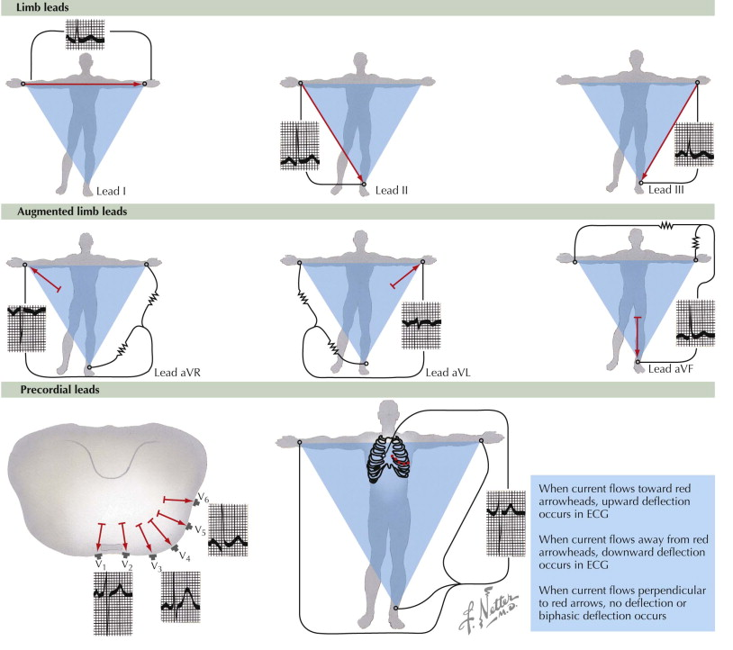
Electrocardiographic leads and reference lines. ECG, electrocardiogram.

Slide 4
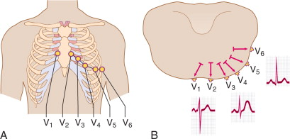
Precordial leads
A, Positioning of the precordial leads on the chest wall.
B, Normal cardiac activation as manifested in the precordial leads. Note the small r wave and deep S wave in lead V1, the transition at around V3 or V4, and the “septal” q wave and large R wave in lead V6.

Slide 5
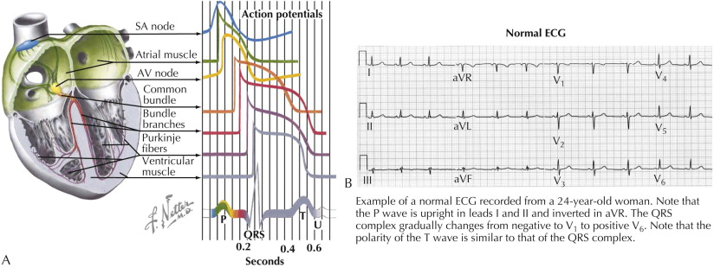
Relation of action potential from the various cardiac regions to the body surface electrocardiogram
Normal ECG.

Slide 6
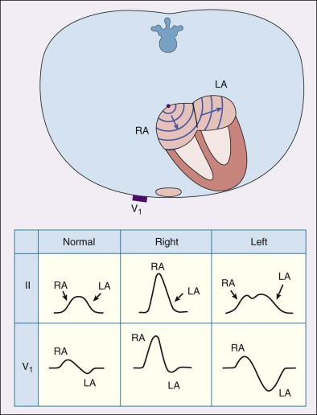
Schematic representation of atrial depolarization (diagram) and P wave patterns associated with normal atrial activation (left panel) and with right (middle panel) and left (right panel) atrial abnormalities.

Slide 7
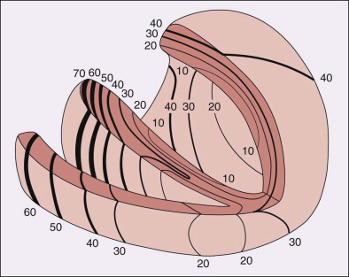
Activation sequence of the normal right and left ventricles.
Portions of the left and right ventricles have been removed so that the endocardial surfaces of the ventricles and the interventricular septum can be seen.
Isochrone lines connect sites that are activated at equal instants after the earliest evidence of ventricular activation.

Slide 8
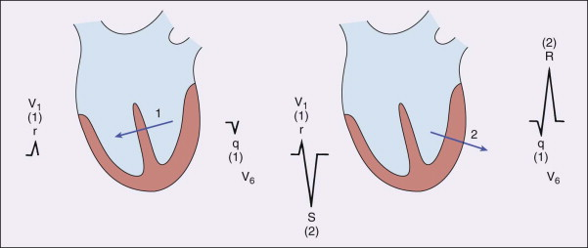
Schematic representation of ventricular depolarization as two sequential vectors representing septal (left) and left ventricular free wall (right) activation.
QRS waveforms generated by each stage of activation in leads V1 and V6 are shown.

Slide 9
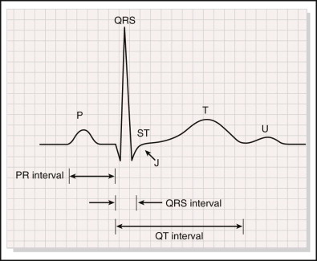
The waves and intervals of a normal electrocardiogram.

Slide 10
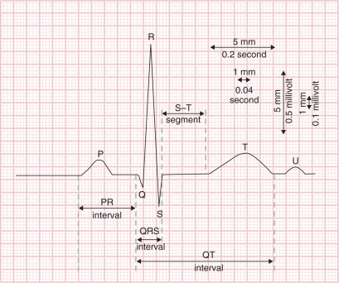
Inscription of a normal electrocardiogram (ECG). Sinoatrial nodal depolarization is not visible on the surface ECG; the P wave corresponds to atrial mechanical contraction. The PR interval denotes conduction through the atrial muscle, atrioventricular node, and His-Purkinje system. The QRS complex reflects ventricular muscle depolarization. The ST segment and T wave correspond to ventricular repolarization. Atrial repolarization also occurs, but the signal is of low amplitude and buried underneath the QRS complex. Note the gridlines. On the horizontal axis, each 1-mm line (“small” box) denotes 0.04 second (40 msec); a “big” box denotes 0.2 second (200 msec). On the vertical axis, 1 mm (“small” box) corresponds to 0.1 mV; 10 mm (two “big” boxes) therefore denotes 1 mV.

Slide 11
Normal Values for Durations of Electrocardiographic Waves and Intervals in Adults
WAVE OR INTERVAL | DURATION (msec)
P wave duration | <120
PR interval | <200
QRS duration | <110-120*
QT interval (corrected) | ≤440-450*

Slide 12
Common Diagnostic Criteria for Left and Right Atrial Abnormalities
LEFT ATRIAL ABNORMALITY | RIGHT ATRIAL ABNORMALITY*
Prolonged P wave duration > 120 msec in lead II | Peaked P waves with amplitudes in lead II > 0.25 mV (P pulmonale)
Prominent notching of P wave, usually most obvious in lead II, with interval between notches of 0.40 msec (P mitrale) | Prominent initial positivity in lead V or V > 0.15 mV
Ratio between the duration of the P wave in lead II and duration of the PR segment > 1.6 | Increased area under initial positive portion of the P wave in lead V to > 0.06 mm-sec
Increased duration and depth of terminal- negative portion of P wave in lead V (P terminal force) so that area subtended by it > 0.04 mm-sec | Rightward shift of mean P wave axis to more than +75 degrees
Leftward shift of mean P wave axis to between −30 and −45 degrees

Slide 13
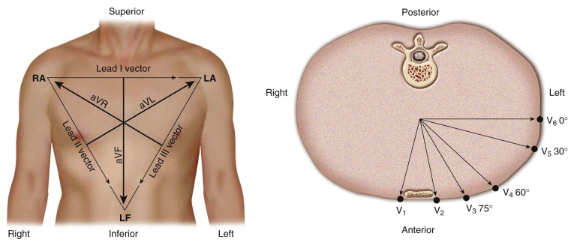
Lead vectors for the three standard limb leads, the three augmented limb leads (left), and the six unipolar precordial leads (right).

Slide 14
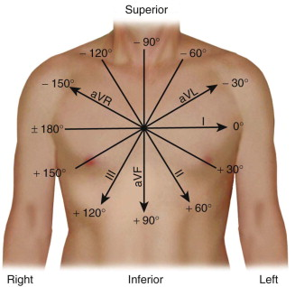
The hexaxial reference system constructed from the lead axes of the six frontal plane leads. The lead axes of the six frontal plane leads have been rearranged so that their centers overlay one another. These axes divide the plane into 12 segments, each subtending 30 degrees. Positive ends of each axis are labeled with the name of the lead.

Slide 15
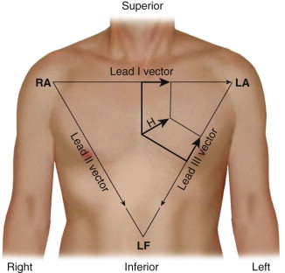
The heart vector H and its projections on the lead axes of leads I and III.
Voltages recorded in lead I will be positive and potentials in lead III will be negative.

Slide 16
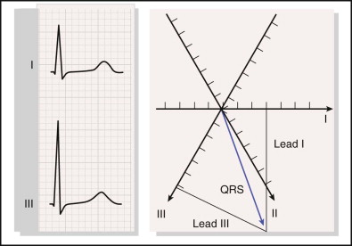
Calculation of the mean electrical axis during the QRS complex from the areas under the QRS complex in leads I and III. Magnitudes of the areas of the two leads are plotted as vectors on the appropriate lead axes, and the mean QRS axis is the sum of these two vectors.

Slide 17
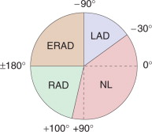
Chart of frontal plane axes.
Normal (NL) = −30 to +100 degrees; left axis deviation (LAD) = −30 to −90 degrees; right axis deviation (RAD) = +100 to +180 degrees; extreme right axis deviation (ERAD) = −90 to ±180 degrees.
Mild RAD is considered normal in children, adolescents, and young adults.

Slide 18
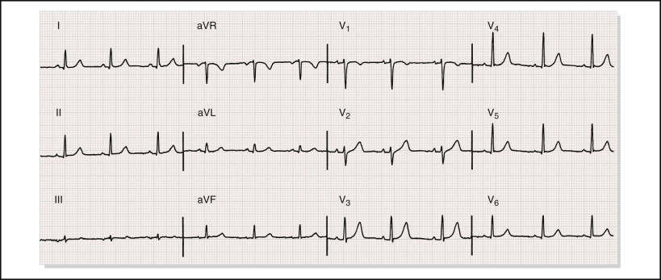
Normal electrocardiogram recorded from a 48-year-old woman. The vertical lines of the grid represent time, with lines spaced at 40-msec intervals. Horizontal lines represent voltage amplitude, with lines spaced at 0.1-mV intervals. Every fifth line in each direction is typically darkened. The heart rate is approximately 72 beats/min, the PR interval, QRS, and QTc durations measure about 140, 84, and 400 msec, respectively, and the mean QRS axis is approximately +35 degrees.

