Slide 1
ΠΑΝΕΠΙΣΤΗΜΙΟ ΘΕΣΣΑΛΙΑΣ ΤΜΗΜΑ ΕΠΙΣΤΗΜΗΣ ΦΥΣΙΚΗΣ ΑΓΩΓΗΣ ΚΑΙ ΑΘΛΗΤΙΣΜΟΥ ENGLISH SPORTS TERMINOLOGY
Supervisor: Athanasios Tzamurtas
Teacher: Stella Papavaggeli
Phone: 2431047051 Fax: 2431047042
*e-mail: papavaggelistella@gmail.com
Module details: B Semester

Slide 2
AIMS& OBJECTIVES
To acquaint students in the Department of Science Physical Education & Sports with the English Sports Terminology;
To familiarize them with the specific terminology in the fields of Sports, Health, Nutrition, Physical Education and Teaching.
Focus is also given on the grammatical and syntactical structures of the English Language

Slide 3
ASSESSMENT:
Final written exams (80%)
Mid-term assignments (20%)
REFERENCE BOOK : An English course for the students of physical education part 2
Εκδόσεις: Χριστοδουλίδη ,Θεσσαλονίκη

Slide 4
PARTS OF THE BODY
Stella
Papavaggeli
Teacher of English Language
Email: papavaggelistella@gmail.com

Slide 36
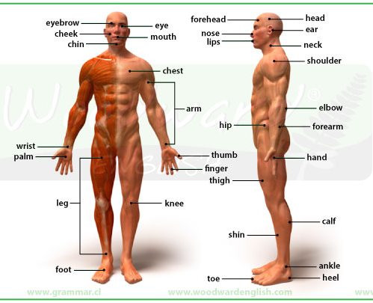

Slide 69
Internal organs
Heart
Brain
Pharynx
Larynx
Lymph nodes
Veins
Lungs
Stomach
Bone marrow
Muscles
Arteries
Gallbladder
Skeleton
Liver
Kidneys
Intestines
Spleen
Pancreas
Urinary Bladder

Slide 70
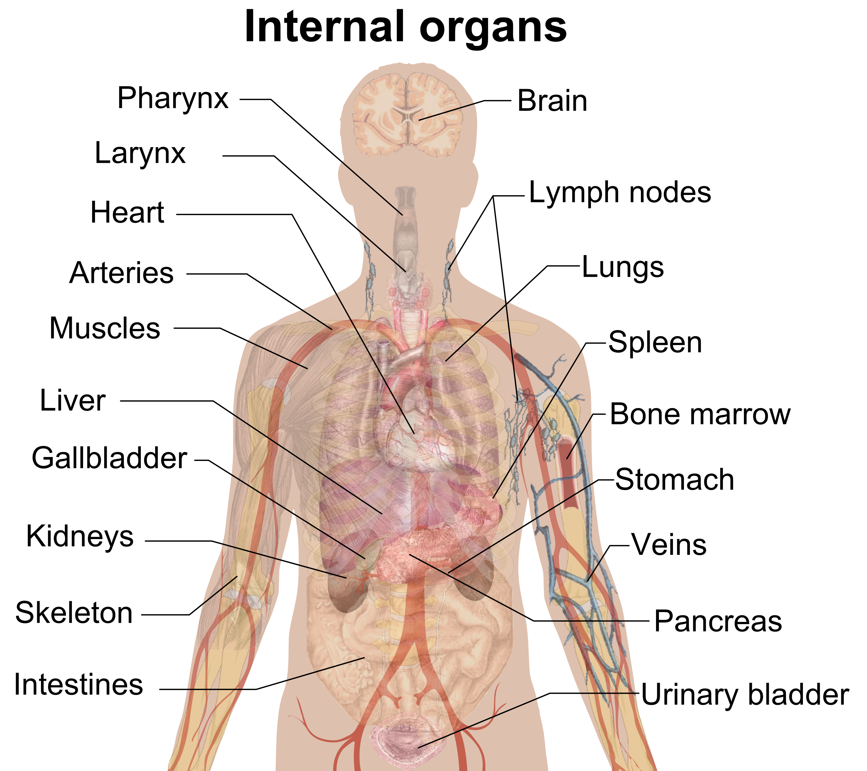

Slide 71
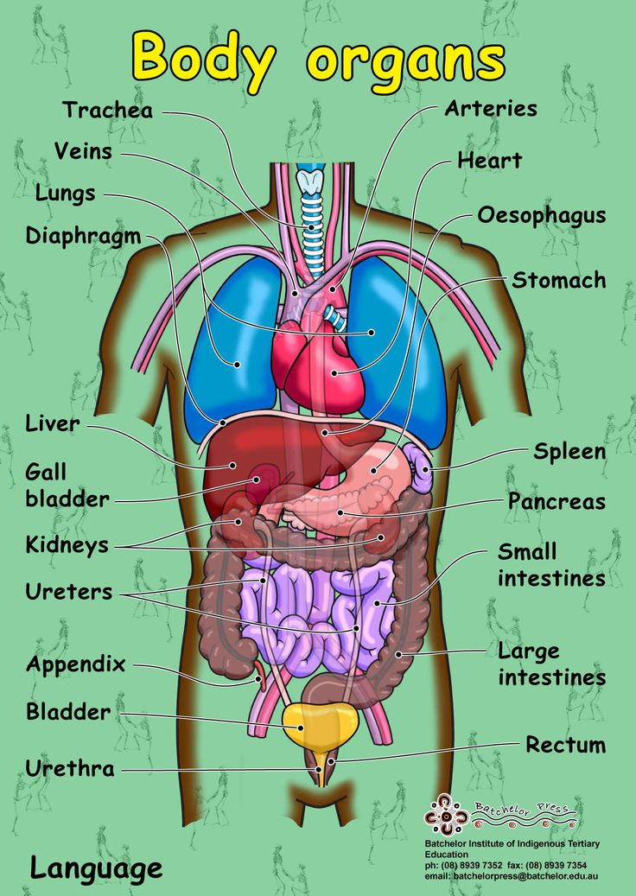

Slide 72
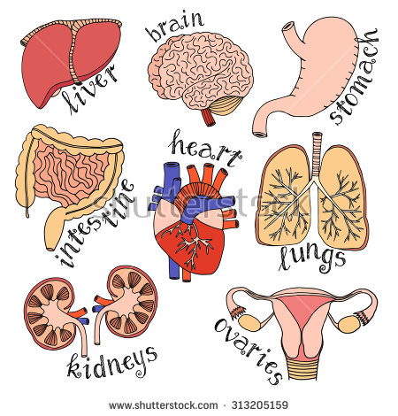

Slide 73
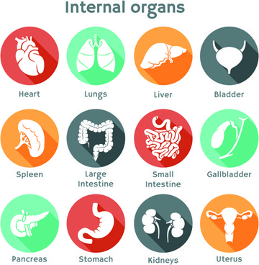

Slide 74
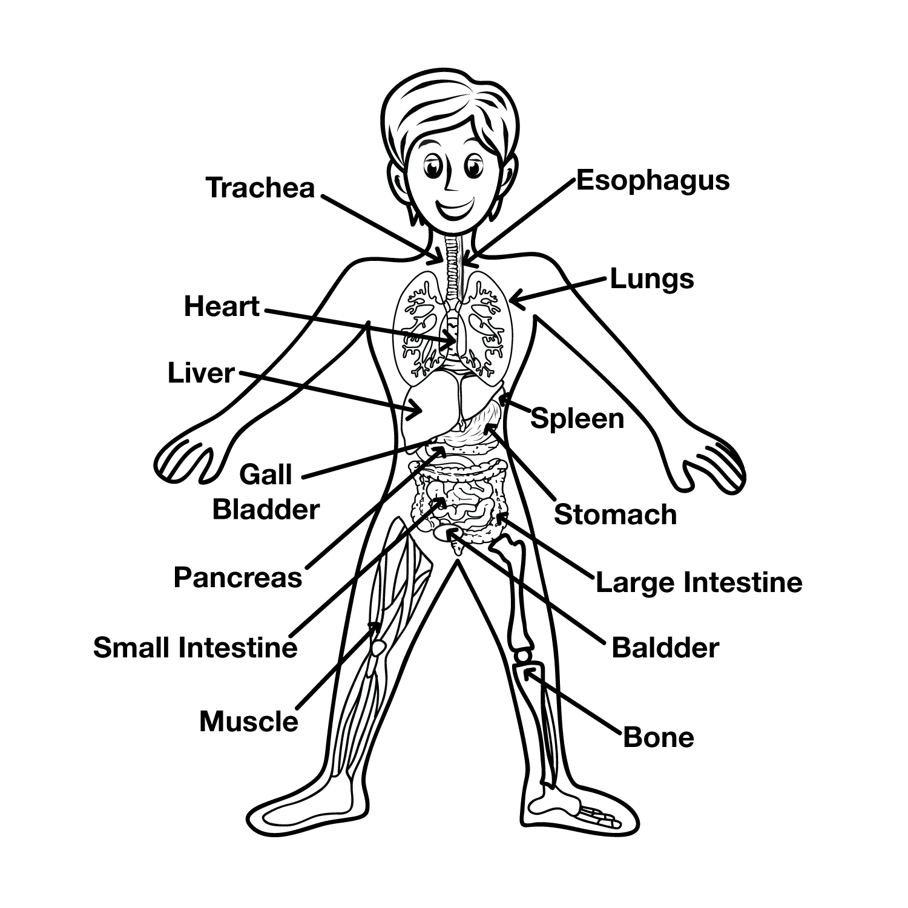

Slide 75
Internal Parts of the Body
heart - your heart pumps your blood around your body.
lungs - when you breathe, the air goes into your lungs.
veins - these transport blood through your body. They are like little tubes.

Slide 76
Internal Parts of the Body
brain - this is your 'thinking machine' inside your head.
throat - food goes down this to get to your stomach.
liver - the organ that cleans your blood.

Slide 77
Internal Parts of the Body
stomach - your food goes here when you swallow it.
kidneys - the organs that process all your body waste.
skeleton - all of the bones in your body.

Slide 78
Internal Parts of the Body
ribs - these are the bones that protect the organs in your chest.
bones - your skeleton consists of many bones. There are about 206 in your body.
skin - it covers almost the entire body and helps keep all the organs and muscles in place.

Slide 79
The Leg and Foot
knee
Leg
shin
calf (muscle)
heel
foot
toe
Ankle
the joint between your leg and your foot.

Slide 80
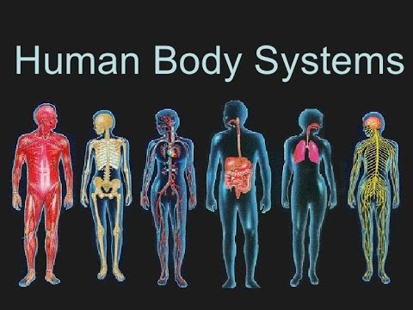

Slide 81
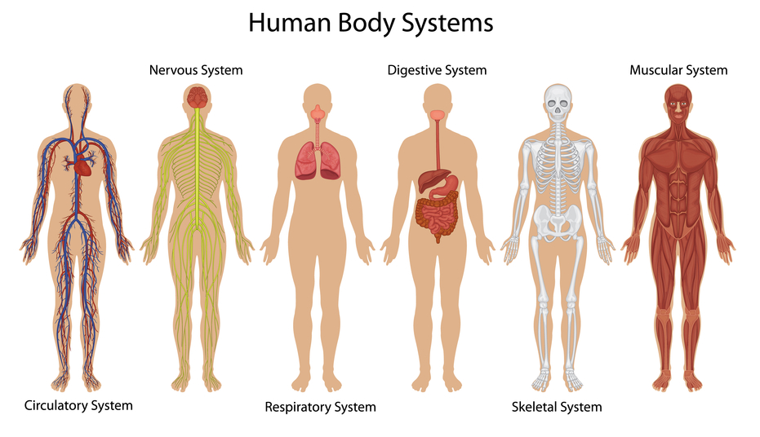

Slide 82
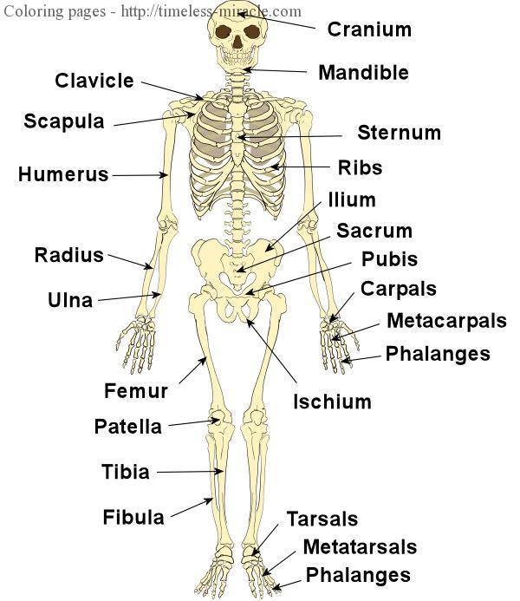

Slide 83
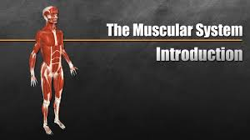

Slide 84
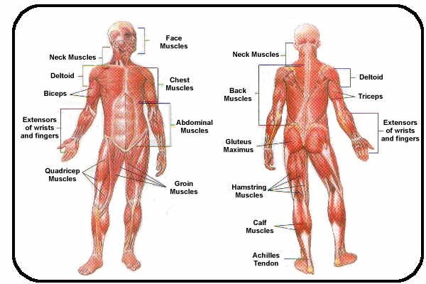

Slide 85
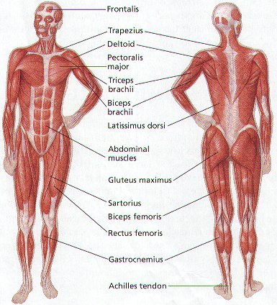

Slide 86
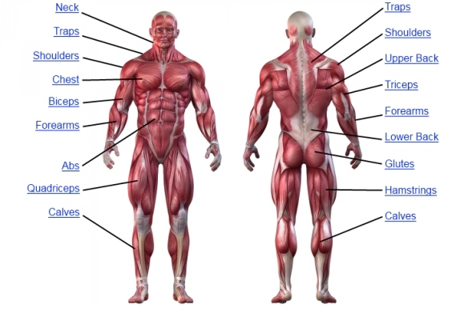

Slide 87
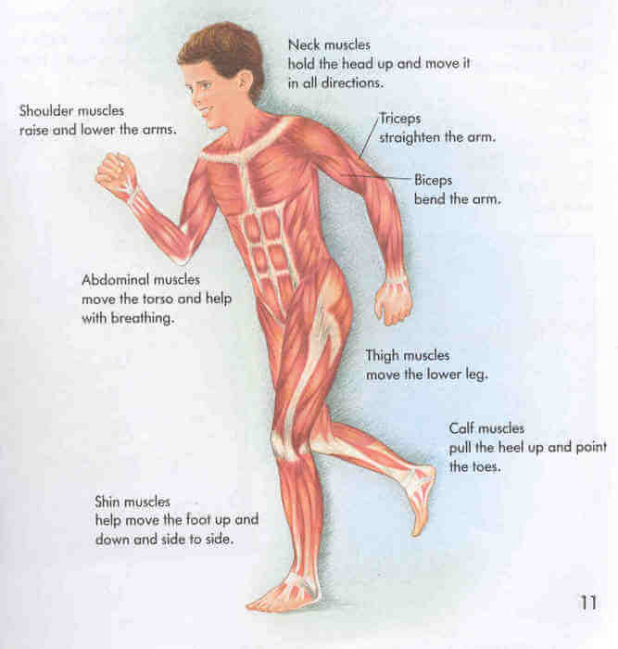

Slide 88
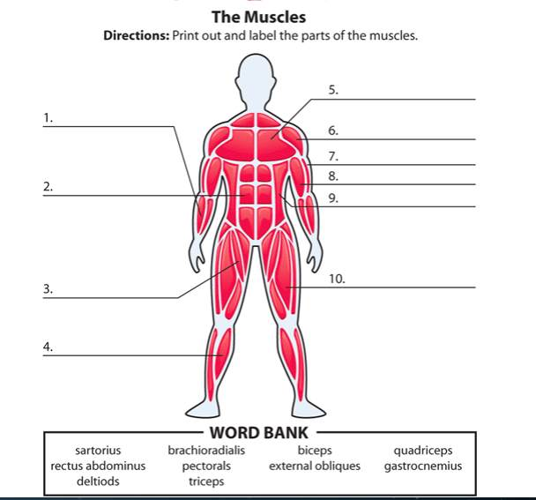

Slide 89
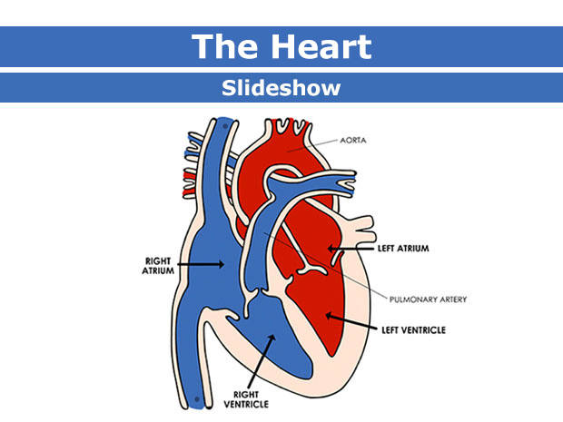

Slide 90
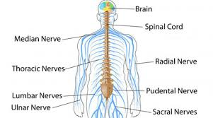

Slide 91
