Slide 1
Sequences and Summations
Section 2.4

Slide 2
Section Summary
Sequences.
Examples: Geometric Progression, Arithmetic Progression
Recurrence Relations
Example: Fibonacci Sequence
Summations
Special Integer Sequences (optional)

Slide 3
Introduction
Sequences are ordered lists of elements.
1, 2, 3, 5, 8
1, 3, 9, 27, 81, …….
Sequences arise throughout mathematics, computer science, and in many other disciplines, ranging from botany to music.
We will introduce the terminology to represent sequences and sums of the terms in the sequences.

Slide 4
Sequences
Definition: A sequence is a function from a subset of the integers (usually either the set {0, 1, 2, 3, 4, …..} or {1, 2, 3, 4, ….} ) to a set S.
The notation a_{n} is used to denote the image of the integer n. We can think of a_{n} as the equivalent of f(n) where f is a function from {0,1,2,…..} to S. We call a_{n} a term of the sequence.

Slide 5
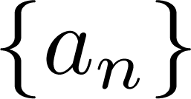
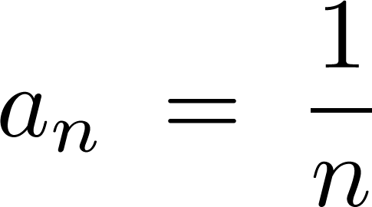
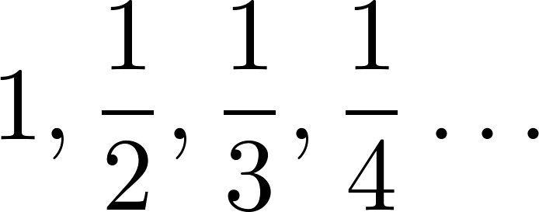
Sequences
Example: Consider the sequence where

Slide 6
Geometric Progression
Definition: A geometric progression is a sequence of the form:
where the initial term a and the common ratio r are real numbers.
Examples:
Let a = 1 and r = −1. Then:
Let a = 2 and r = 5. Then:
Let a = 6 and r = 1/3. Then:

Slide 7
Arithmetic Progression
Definition: A arithmetic progression is a sequence of the form:
where the initial term a and the common difference d are real numbers.
Examples:
Let a = −1 and d = 4:
Let a = 7 and d = −3:
Let a = 1 and d = 2:

Slide 8
Strings
Definition: A string is a finite sequence of characters from a finite set (an alphabet).
Sequences of characters or bits are important in computer science.
The empty string is represented by λ.
The string abcde has length 5.

Slide 9
Recurrence Relations
Definition: A recurrence relation for the sequence {a_{n}} is an equation that expresses a_{n} in terms of one or more of the previous terms of the sequence, namely, a₀, a₁, …, a_{n-1}, for all integers n with n ≥ n₀, where n₀ is a nonnegative integer.
A sequence is called a solution of a recurrence relation if its terms satisfy the recurrence relation.
The initial conditions for a sequence specify the terms that precede the first term where the recurrence relation takes effect.

Slide 10
Questions about Recurrence Relations
Example 1: Let {a_{n}} be a sequence that satisfies the recurrence relation a_{n} = a_{n-1} + 3 for n = 1,2,3,4,…. and suppose that a₀ = 2. What are a₁ , a₂ and a₃?
[Here a₀ = 2 is the initial condition.]
Solution: We see from the recurrence relation that
a₁ = a₀ + 3 = 2 + 3 = 5
a₂ = 5 + 3 = 8
a₃ = 8 + 3 = 11

Slide 11
Questions about Recurrence Relations
Example 2: Let {a_{n}} be a sequence that satisfies the recurrence relation a_{n} = a_{n-1} – a_{n-2} for n = 2,3,4,…. and suppose that a₀ = 3 and a₁ = 5. What are a₂ and a₃?
[Here the initial conditions are a₀ = 3 and a₁ = 5. ]
Solution: We see from the recurrence relation that
a₂ = a₁ - a₀ = 5 – 3 = 2
a₃ = a₂ – a₁ = 2 – 5 = –3

Slide 12
Fibonacci Sequence
Definition: Define the Fibonacci sequence, f₀ ,f₁ ,f₂,…, by:
Initial Conditions: f₀ = 0, f₁ = 1
Recurrence Relation: f_{n} = f_{n-1} + f_{n-2}
Example: Find f₂ ,f₃ ,f₄ , f₅ and f₆ .
Answer:
f₂ = f₁ + f₀ = 1 + 0 = 1,
f₃ = f₂ + f₁ = 1 + 1 = 2,
f₄ = f₃ + f₂ = 2 + 1 = 3,
f₅ = f₄ + f₃ = 3 + 2 = 5,
f₆ = f₅ + f₄ = 5 + 3 = 8.

Slide 13
Solving Recurrence Relations
Finding a formula for the nth term of the sequence generated by a recurrence relation is called solving the recurrence relation.
Such a formula is called a closed formula.
Various methods for solving recurrence relations will be covered in Chapter 8 where recurrence relations will be studied in greater depth.
Here we illustrate by example the method of iteration in which we need to guess the formula. The guess can be proved correct by the method of induction (Chapter 5).

Slide 14
Iterative Solution Example
Method 1: Working upward, forward substitution
Let {a_{n}} be a sequence that satisfies the recurrence relation a_{n} = a_{n-1} + 3 for n = 2,3,4,…. and suppose that a₁ = 2.
a₂ = 2 + 3
a₃ = (2 + 3) + 3 = 2 + 3 ∙ 2
a₄ = (2 + 2 ∙ 3) + 3 = 2 + 3 ∙ 3
.
.
.
a_{n} = a_{n-1} + 3 = (2 + 3 ∙ (n – 2)) + 3 = 2 + 3(n – 1)

Slide 15
Iterative Solution Example
Method 2: Working downward, backward substitution
Let {a_{n}} be a sequence that satisfies the recurrence relation a_{n} = a_{n-1} + 3 for n = 2,3,4,…. and suppose that a₁ = 2.
a_{n} = a_{n-1} + 3
= (a_{n-2} + 3) + 3 = a_{n-2} + 3 ∙ 2
= (a_{n-3} + 3 )+ 3 ∙ 2 = a_{n-3} + 3 ∙ 3
.
.
.
= a₂ + 3(n – 2) = (a₁ + 3) + 3(n – 2) = 2 + 3(n – 1)

Slide 16
Financial Application
Example: Suppose that a person deposits $10,000.00 in a savings account at a bank yielding 11% per year with interest compounded annually. How much will be in the account after 30 years?
Let P_{n} denote the amount in the account after 30 years. P_{n} satisfies the following recurrence relation:
P_{n} = P_{n-1} + 0.11P_{n-1} = (1.11) P_{n-1}
with the initial condition P₀ = 10,000
Continued on next slide →

Slide 17
Financial Application
P_{n} = P_{n-1} + 0.11P_{n-1} = (1.11) P_{n-1}
with the initial condition P₀ = 10,000
Solution: Forward Substitution
P₁ = (1.11)P₀
P₂ = (1.11)P₁ = (1.11)²P₀
P₃ = (1.11)P₂ = (1.11)³P₀
:
P_{n} = (1.11)P_{n-1} = (1.11)^{n}P₀ = (1.11)^{n} 10,000
P_{n} = (1.11)^{n} 10,000 (Can prove by induction, covered in Chapter 5)
P₃₀ = (1.11)³⁰ 10,000 = $228,992.97

Slide 18
Useful Sequences

Slide 19
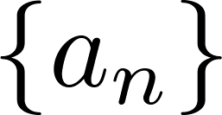
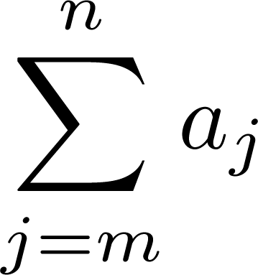
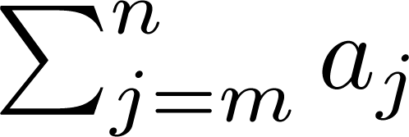
Summations
Sum of the terms
from the sequence
The notation:
represents
The variable j is called the index of summation. It runs through all the integers starting with its lower limit m and ending with its upper limit n.

Slide 20
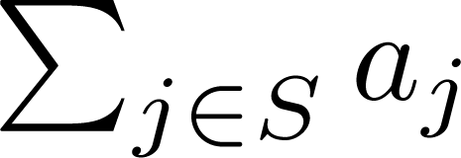
Summations
More generally for a set S:
Examples:

Slide 21
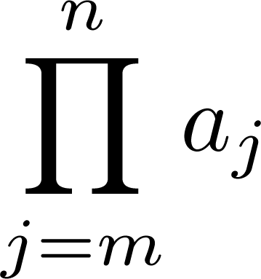
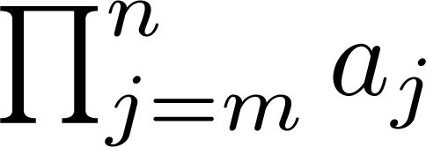
Product Notation (optional)
Product of the terms
from the sequence
The notation:
represents

Slide 22
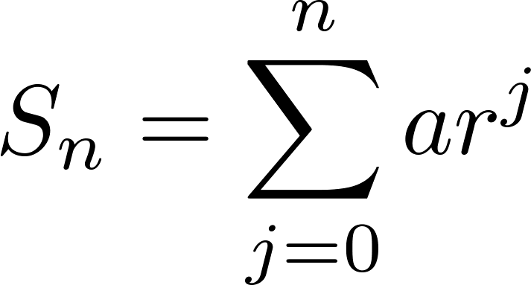
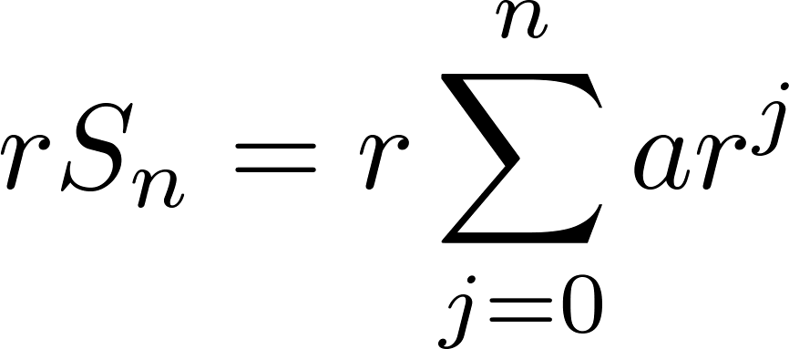
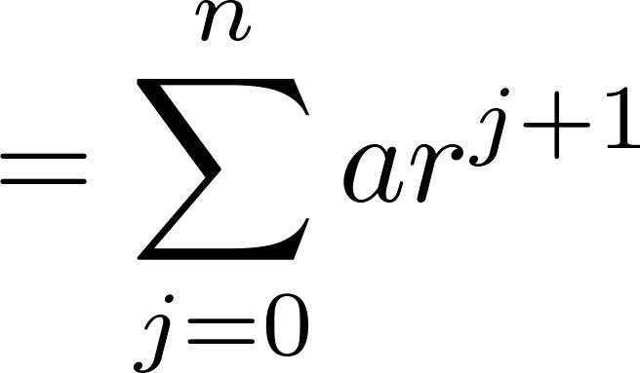
Geometric Series
Sums of terms of geometric progressions
To compute S_{n} , first multiply both sides of the equality by r and then manipulate the resulting sum as follows:
Proof:
Let
Continued on next slide →

Slide 23
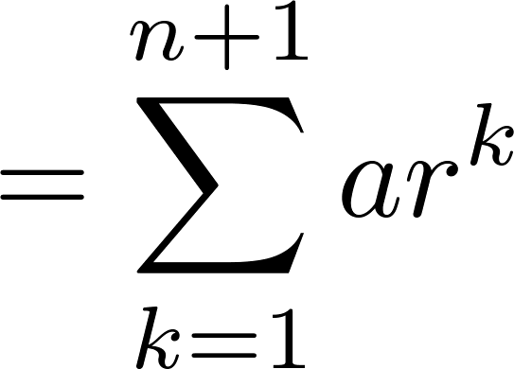
Geometric Series
From previous slide.
Shifting the index of summation with k = j + 1.
Removing k = n + 1 term and
adding k = 0 term.
Substituting S for summation formula
∴
if r ≠1
if r = 1

Slide 24
Some Useful Summation Formulae
Geometric Series: We just proved this.
Later we will prove some of these by induction.
Proof in text
(requires calculus)

Slide 25
Cardinality of Sets
Section 2.5

Slide 26
Section Summary
Cardinality
Countable Sets
Computability

Slide 27
Cardinality
Definition: The cardinality of a set A is equal to the cardinality of a set B, denoted
|A| = |B|,
if and only if there is a one-to-one correspondence (i.e., a bijection) from A to B.
If there is a one-to-one function (i.e., an injection) from A to B, the cardinality of A is less than or the same as the cardinality of B and we write |A| ≤ |B|.
When |A| ≤ |B| and A and B have different cardinality, we say that the cardinality of A is less than the cardinality of B and write |A| < |B|.

Slide 28
Cardinality
Definition: A set that is either finite or has the same cardinality as the set of positive integers (Z⁺) is called countable. A set that is not countable is uncountable.
The set of real numbers R is an uncountable set.
When an infinite set is countable (countably infinite) its cardinality is ℵ₀ (where ℵ is aleph, the 1st letter of the Hebrew alphabet). We write |S| = ℵ₀ and say that S has cardinality “aleph null.”

Slide 29
Showing that a Set is Countable
An infinite set is countable if and only if it is possible to list the elements of the set in a sequence (indexed by the positive integers).
The reason for this is that a one-to-one correspondence f from the set of positive integers to a set S can be expressed in terms of a sequence a₁,a₂,…, a_{n} ,… where a₁ = f(1), a₂ = f(2),…, a_{n} = f(n),…

Slide 30
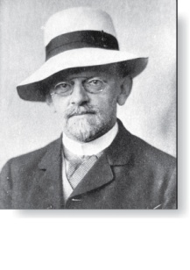
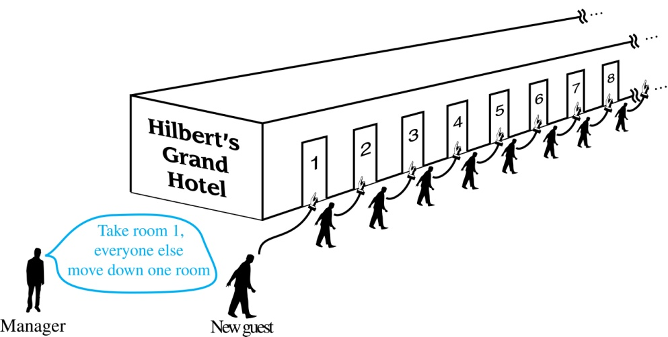
Hilbert’s Grand Hotel
David Hilbert
The Grand Hotel (example due to David Hilbert) has countably infinite number of rooms, each occupied by a guest. We can always accommodate a new guest at this hotel. How is this possible?
Explanation: Because the rooms of Grand Hotel are countable, we can list them as Room 1, Room 2, Room 3, and so on. When a new guest arrives, we move the guest in Room 1 to Room 2, the guest in Room 2 to Room 3, and in general the guest in Room n to Room n + 1, for all positive integers n. This frees up Room 1, which we assign to the new guest, and all the current guests still have rooms.
The hotel can also accommodate a countable number of new guests, all the guests on a countable number of buses where each bus contains a countable number of guests (see exercises).

Slide 31
Showing that a Set is Countable
Example 1: Show that the set of positive even integers E is countable set.
Solution: Let f(x) = 2x.
1 2 3 4 5 6 …..
2 4 6 8 10 12 ……
Then f is a bijection from N to E since f is both one-to-one and onto. To show that it is one-to-one, suppose that f(n) = f(m). Then 2n = 2m, and so n = m. To see that it is onto, suppose that t is an even positive integer. Then t = 2k for some positive integer k and f(k) = t.

Slide 32
Showing that a Set is Countable
Example 2: Show that the set of integers Z is countable.
Solution: Can list in a sequence:
0, 1, − 1, 2, − 2, 3, − 3 ,………..
Or can define a bijection from N to Z:
When n is even: f(n) = n/2
When n is odd: f(n) = −(n−1)/2

Slide 33
The Positive Rational Numbers are Countable
Definition: A rational number can be expressed as the ratio of two integers p and q such that q ≠ 0.
¾ is a rational number
√2 is not a rational number.
Example 3: Show that the positive rational numbers are countable.
Solution:The positive rational numbers are countable since they can be arranged in a sequence:
r₁ , r₂ , r₃ ,…
The next slide shows how this is done. →

Slide 34
The Positive Rational Numbers are Countable
First row q = 1.
Second row q = 2.
etc.
Constructing the List
First list p/q with p + q = 2.
Next list p/q with p + q = 3
And so on.
1, ½, 2, 3, 1/3,1/4, 2/3, ….

Slide 35
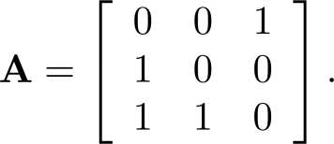
Boolean Powers of Zero-One Matrices
Example: Let
Find A^{n} for all positive integers n.
Solution:

