Slide 1
ORGANS’ TOXICOLOGY LIVER
Χαριτίνη Νέπκα
Κυτταροπαθολόγος, Επιμελήτρια ΠΓΝΛ

Slide 2
Στόχοι
Να γίνει κατανοητή η ιστομορφολογία και η λειτουργικότητα του ήπατος σε σχέση με την δομή του
Να γίνει κατανοητός ο τρόπος εκτίμησης της ηπατοτοξικότητας στις προκλινικές μελέτες
Να γίνει κατανοητή η ιστοπαθολογία του ήπατος και οι μορφές της σε σχέση με τα πιθανά αίτια και μηχανισμούς δράσης των ξενοβιοτικών ουσιών

Slide 3
Liver functions
Biotransformation of xenobiotics, endogenous compounds, including hormones
Carbohydrate metabolism and storage
Synthesis of blood proteins (albumin, lipoproteins)
Urea formation
Fat metabolism
Bile formation

Slide 4
Liver structure / blood flow

Slide 5
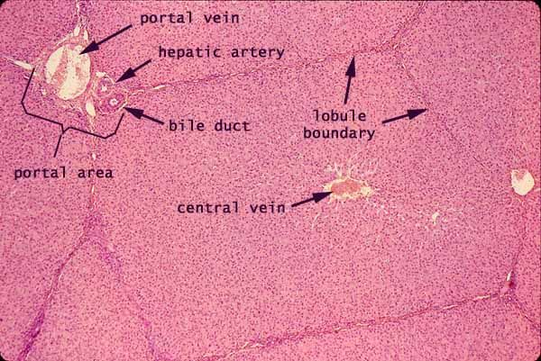
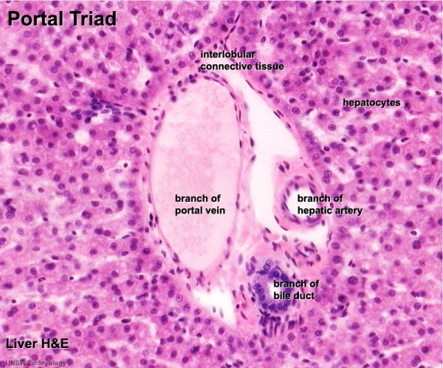
Normal liver
Is divided into lobules
The center of the lobule is the central vein
At the periphery of the lobule are portal triads

Slide 6
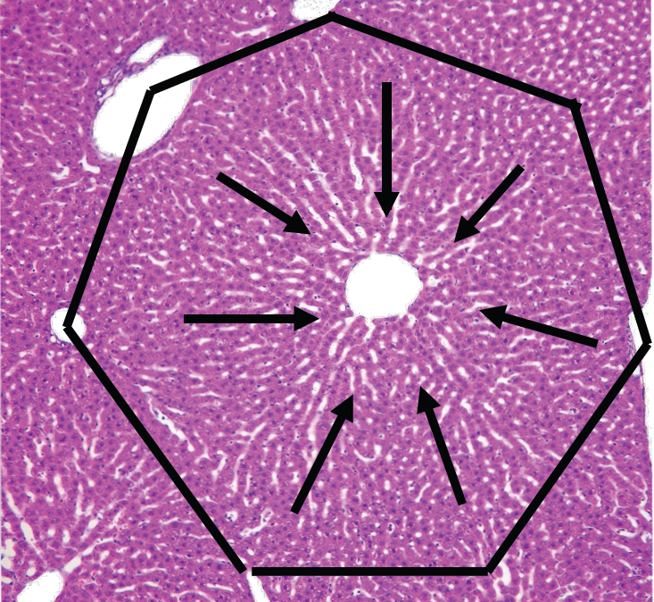

Slide 7
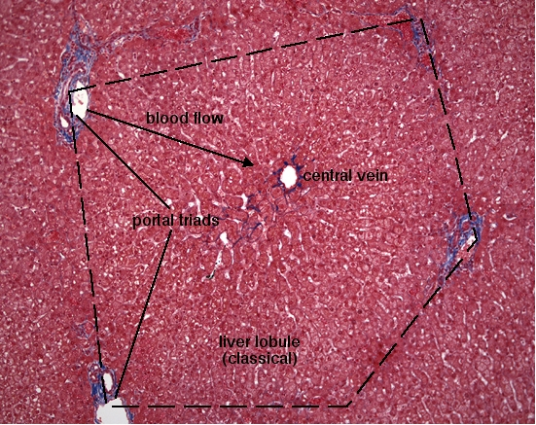

Slide 8
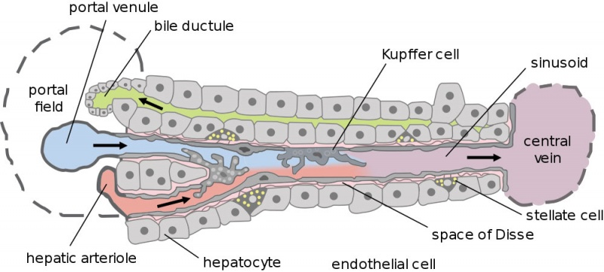

Slide 9
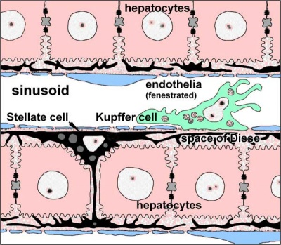

Slide 10
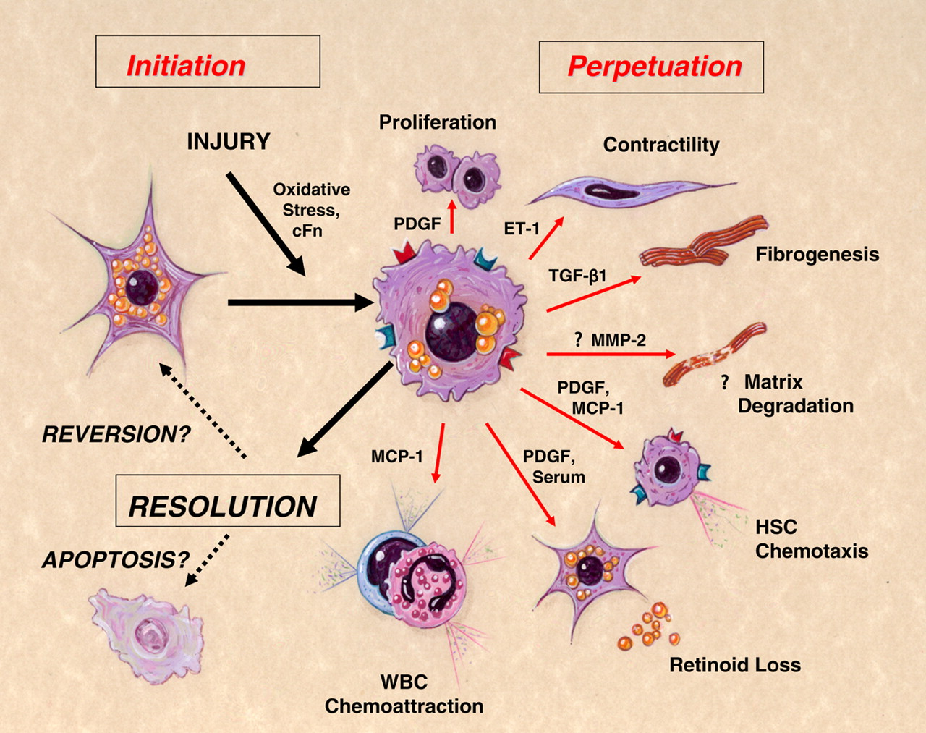
Pathways of stellate cell activation and resolution.
Pathways of stellate cell activation and resolution. Following liver injury, hepatic stellate cells undergo “activation,” which connotes a transition from quiescent vitamin A-rich cells into proliferative, fibrogenic, and contractile myofibroblasts. The major phenotypic changes after activation include proliferation, contractility, fibrogenesis, matrix degradation, chemotaxis, retinoid loss, and WBC chemoattraction. Key mediators underlying these effects are shown. The fate of activated stellate cells during resolution of liver injury is uncertain but may include reversion to a quiescent phenotype and/or selective clearance by apoptosis. [From Friedman]
Scott L. Friedman Physiol Rev 2008;88:125-172
©2008 by American Physiological Society
Notes:
Pathways of stellate cell activation and resolution. Following liver injury, hepatic stellate cells undergo “activation,” which connotes a transition from quiescent vitamin A-rich cells into proliferative, fibrogenic, and contractile myofibroblasts. The major phenotypic changes after activation include proliferation, contractility, fibrogenesis, matrix degradation, chemotaxis, retinoid loss, and WBC chemoattraction. Key mediators underlying these effects are shown. The fate of activated stellate cells during resolution of liver injury is uncertain but may include reversion to a quiescent phenotype and/or selective clearance by apoptosis. [From Friedman (165).]

Slide 11
Normal Liver
Functionally the liver can be divided into 3 zones, based on oxygen supply
Zone 1 encircles the portal tracts where the oxygenated blood from hepatic arteries enters and mixes with portal blood
Zone 2 is the area between zone 1 and zone 3
Zone 3 is located around central veins where blood exits, oxygenation is low

Slide 12
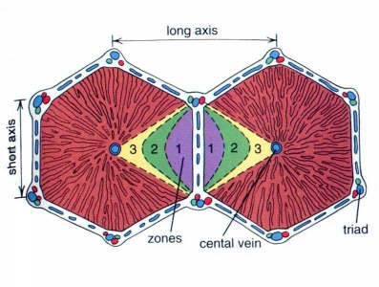
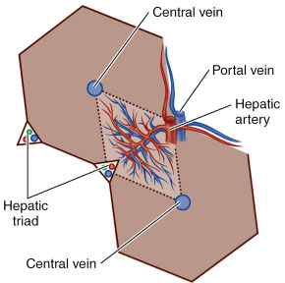
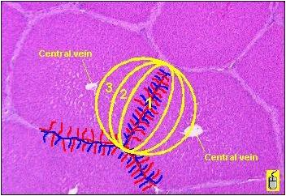

Slide 13
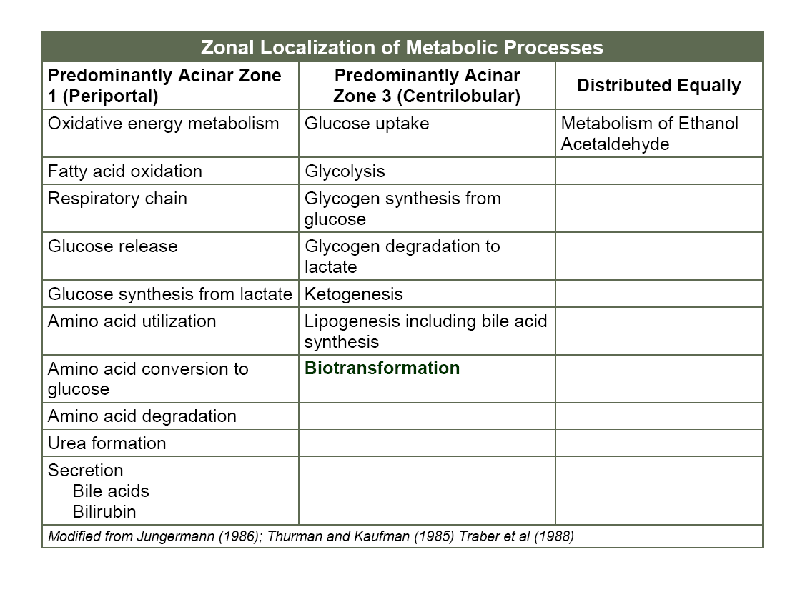

Slide 14
Hepatotoxicity
Extrinsic (Predictable hepatotoxins)
Acetaminophen
Allyl alcohol
Carbon tetrachloride
Intrinsic (Idiosyncratic hepatotoxins)
Traglitazone
Bromfenac

Slide 19
Assessment of hepatotoxicity
Nausea
Vomiting
Hepatomegaly
Jaundice
Clinical signs
Clinical chemistry
Gross pathology
Organ weight
Histopathology
Serum hepatic enzymes
ALT alanin aminotransferase
AST aspartate aminotransferate
GGT gamma glutamyl transpeptidase
Clotting times
Bilirubin

Slide 20
Gross pathology
Increased cell size (hypertrophy)
Increased number of cells (hyperplasia)
Increased blood

Slide 21
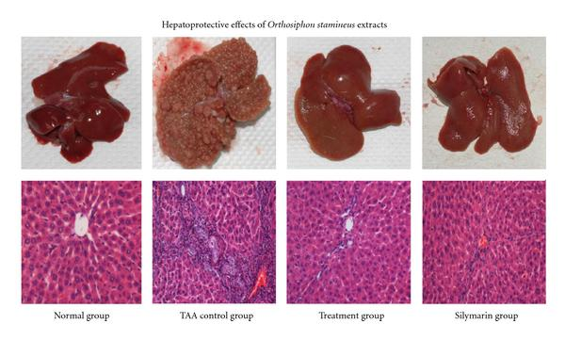
Figure 1: Effect of TAA, Silymarin, and 200 mg/kg O. stamineus ethanolic extract on liver gross and histology in TAA-Induced liver cirrhosis rats after two-month treatments. Eight animals of each group were investigated.

Slide 22
Weights
Liver weight changes are sensitive indicators of liver toxicity

Slide 24
Techniques for histologic examination
Optical microscopy
Electron microscopy (especially for assessment of liver weight increases because it allows characterization of SER or peroxisomes proliferation and lysosomal alterations and assessment of mitochondrial integrity)
Enzyme cytochemistry
Immunohistochemistry
Various molecular biological methods (toxicogenomics)

Slide 25
Histologic lesions
Cytologic Alterations
Cell death
Inflammation
Vascular changes
Angiectasis
Infarction
Cystic change
Cystic degeneration
Billiary cysts
Fatty change
Clear cell change
Hypertrophy Enzyme induction
Peroxisome proliferation
Karyomegaly
Pigmentation/Cholestasis
Often xenobiotic induced and may be associated with other forms of liver damage
Proliferative lesions
Foci, hyperplasia
Cholangiofibrosis
Neoplastic lesions

Slide 26
Fatty change
Macrovesicular (large, single vacuoles): relatively benign change seen in nutritional, metabolic or hormonal alterations
Microvesicular (fine vacuoles): has traditionally been the hallmark of more serious hepatic dysfunction or toxicity. Toxicity ensues when the capacity of hepatocytes to utilize, store and export lipids is overwhelmed.
In humans is seen in association with drugs (valproic acid, tetracyclines), nucleoside analog (fialuridine). Possible mechanism for microvesicular steatosis is related with the mitochondion (through inhibition of β-oxidation or damage of mitochondrion DNA)
In animals is seen in hepatocellular toxicity with other features of cell damage.

Slide 27
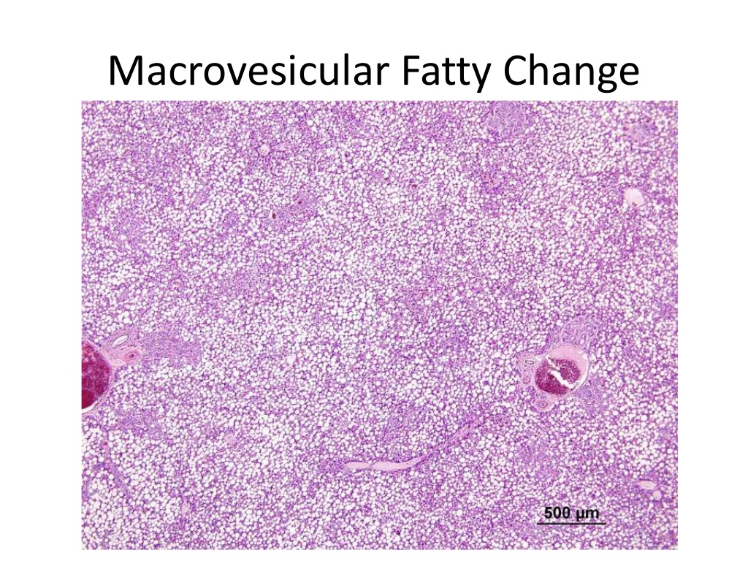

Slide 28
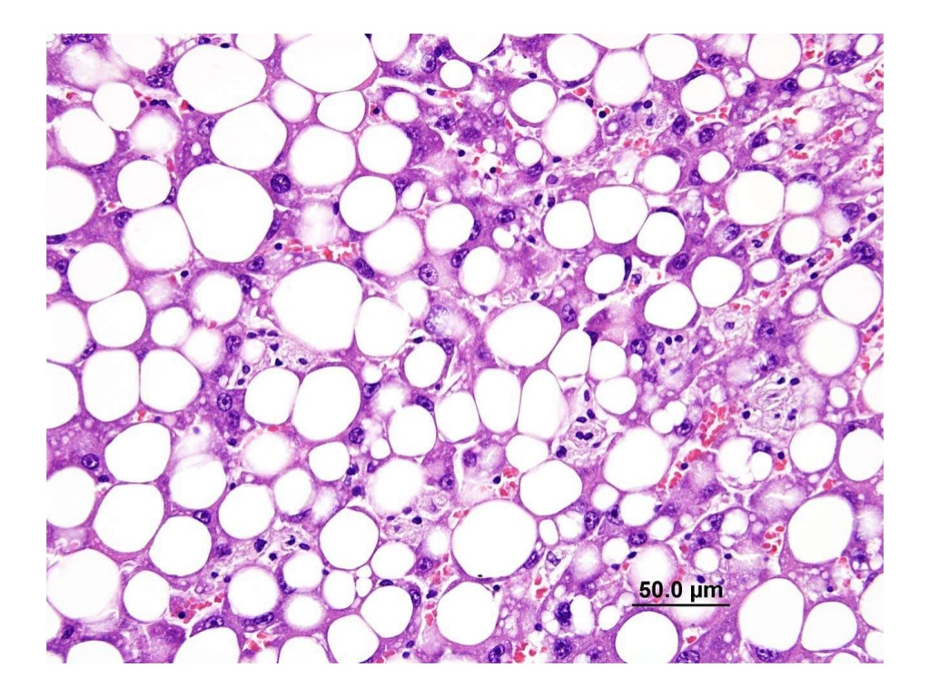
Macrovesicular fatty change

Slide 29
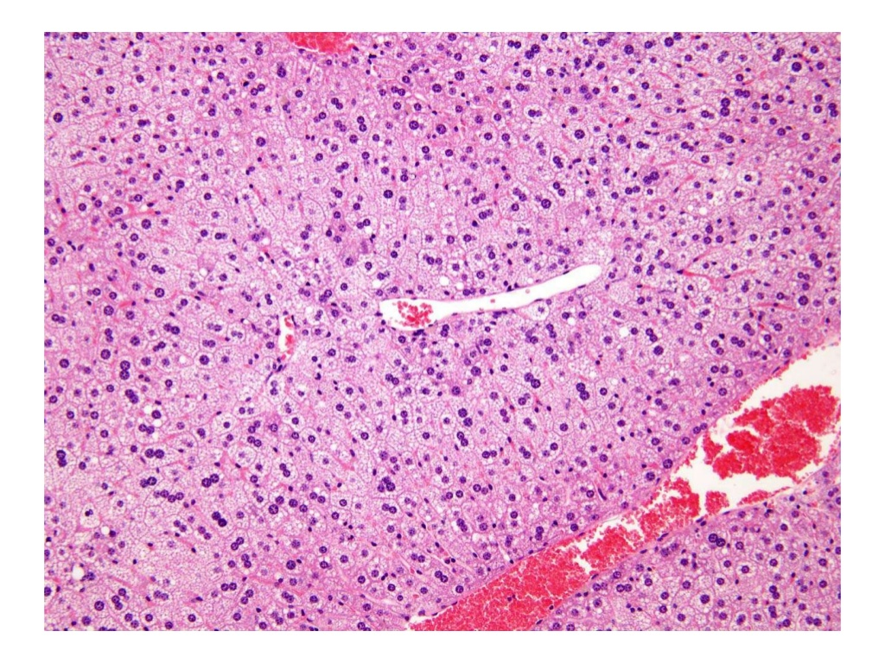
Microvesicular fatty change

Slide 30
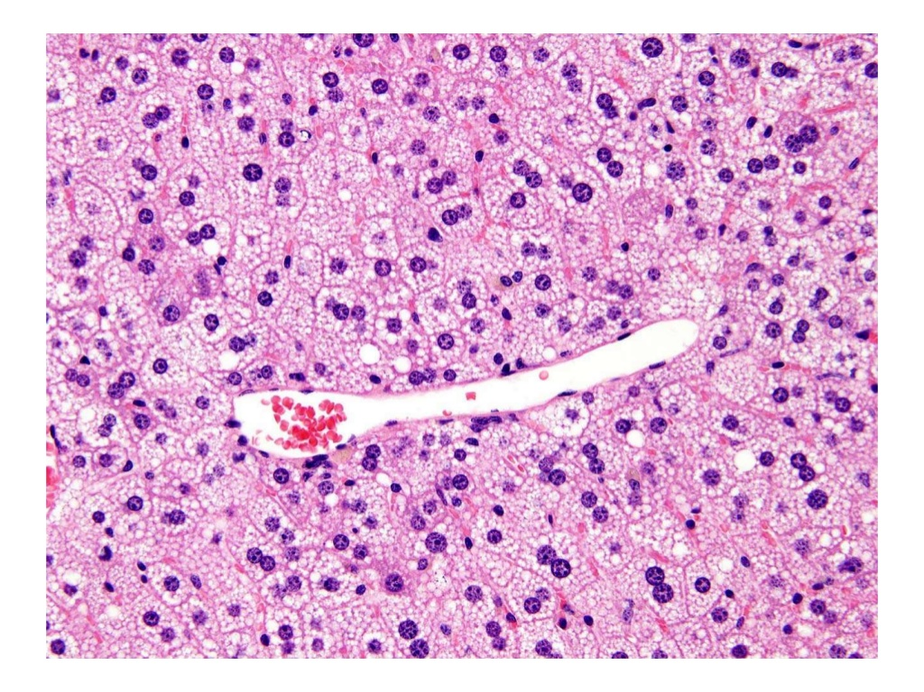

Slide 31
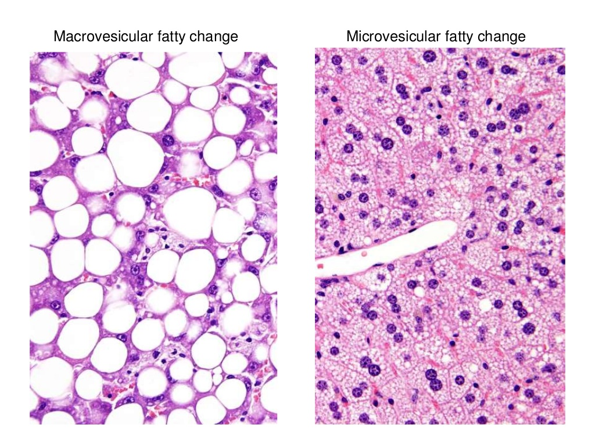

Slide 32
Clear cell change
Presence of clear cytoplasm with centrally placed nuclei proven to be accumulation of glycogen by special stains.
Is commonly seen in well fed, not fasted animals. Often prominent in larger animals (dogs, primates) in normal state
Corticosteroids produce marked glycogen accumulation in dog liver!!! Relevance to humans but reversible

Slide 33
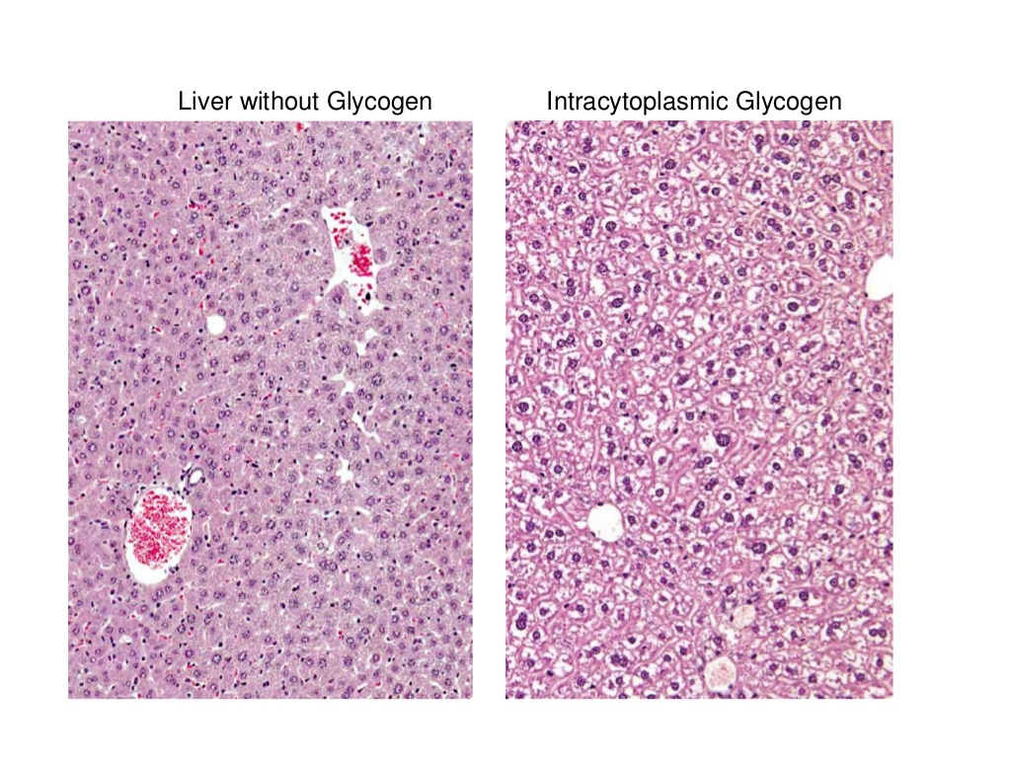

Slide 34
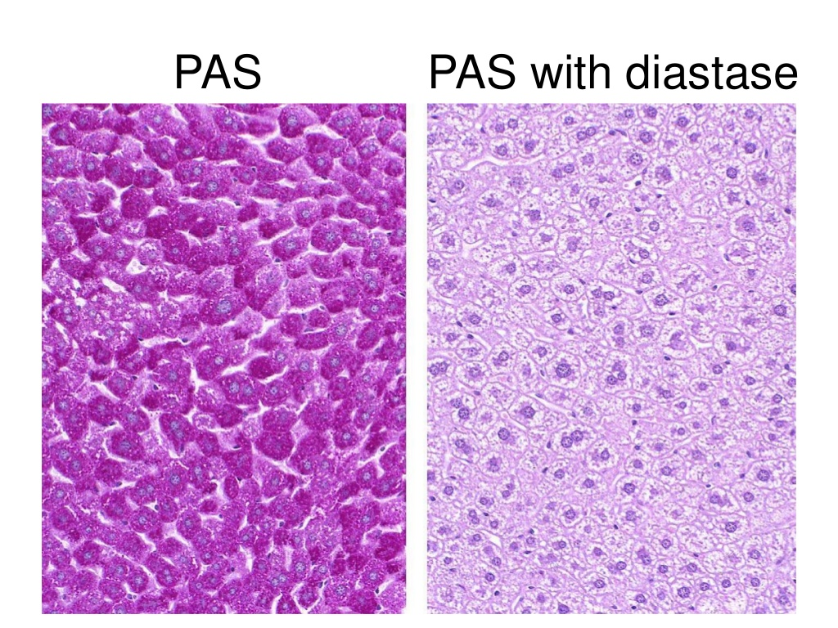

Slide 35
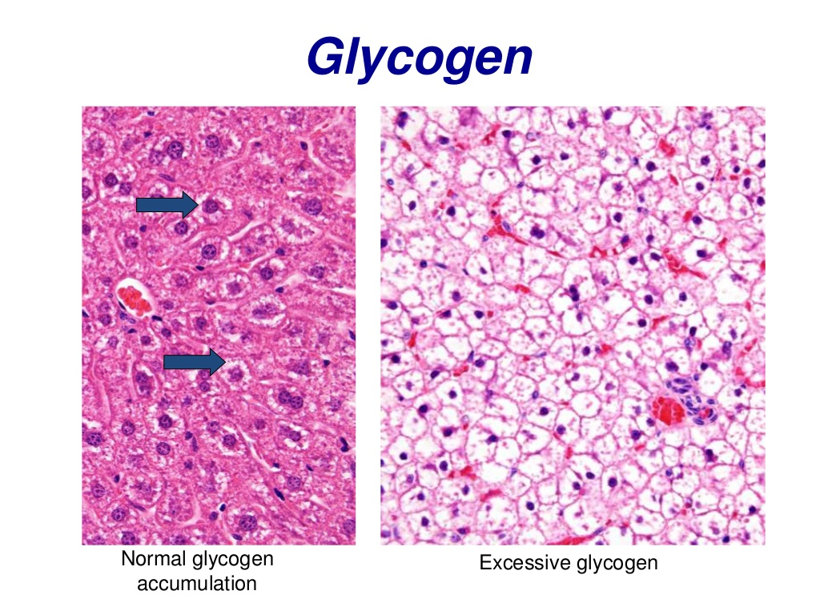

Slide 36
Hypertrophy
Hypetrophy: increase in cell volume
Hyperplasia: increase in cell number
Liver enlargers
Enzyme inducers
Peroxisomal proliferators
Other liver enlargers

Slide 37
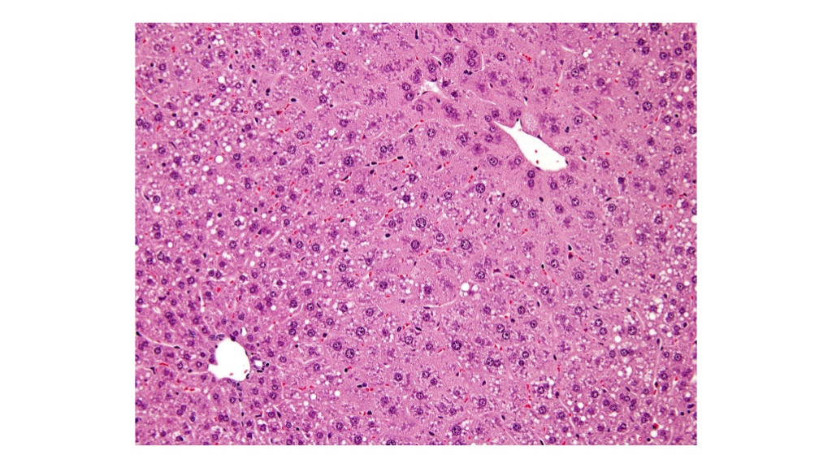

Slide 38
Enzyme inducers
In cell biology, microsomes are vesicle-like artifacts re-formed from pieces of the endoplasmic reticulum(ER) when eukaryotic cells are broken-up in the laboratory; microsomes are not present in healthy, living cells
In many instances we see hypertrophy with an increase in activity of microsomal drug metabolizing enzymes (reversible), in the absence of any morphological evidence of hepatocellular damage
In rodents 5 classes:
CYP1A. polycyclic hydrocarbons, benzo-a-pyrene
CYP2B. phenobarbitone, DDT
CYP2E. isoniazid, ethanol, acetone
CYP3A. dexamethasone, pregnenolone-16a-carbonitrile
CYP4A. Hypolipidemic agents (clofibrate, ciprofibrate etc)
There is usually proliferation of SER (eosinophilic, ground glass cytoplasm)

Slide 39
Enzyme inducers (cont)
It is suggested that in rodents the differences in long term activity of enzyme inducers depend on the enzyme class
CYP2B usually leads to formation of inactive metabolites
CYP 1A generally convert the xenobiotics to reactive electrophiles giving rise to cellular toxicity and carcinogenicity
BY CONTRAST in humans very rare drugs are significant enzyme inducers for example rifampicin

Slide 40
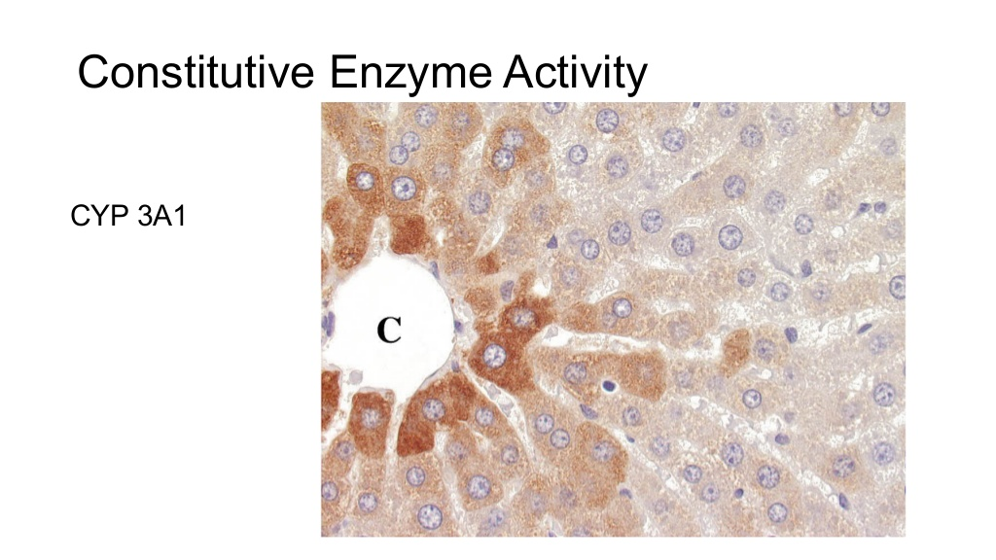

Slide 41
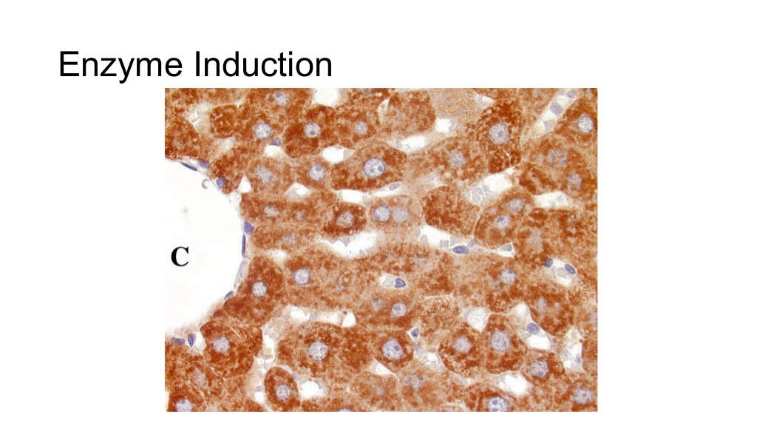

Slide 42
Toxicologic significance of enzyme inducers
Increased degradation of hormones
Increased deactivation or activation of xenobiotics
One of the biggest problems in humans is altered metabolism of drugs
increase of the risk of drug drug interactions and
variability of exposure

Slide 43
Peroxisome proliferators
Rodents: clofibrate produce liver enlargement , proliferation of SER and increases of p450 enzymes activity AND PEROXISOMES proliferation in rodents (not in humans).
In rodents peroxisome proliferation is mediated through the nuclear receptor PPAR-α.

Slide 44
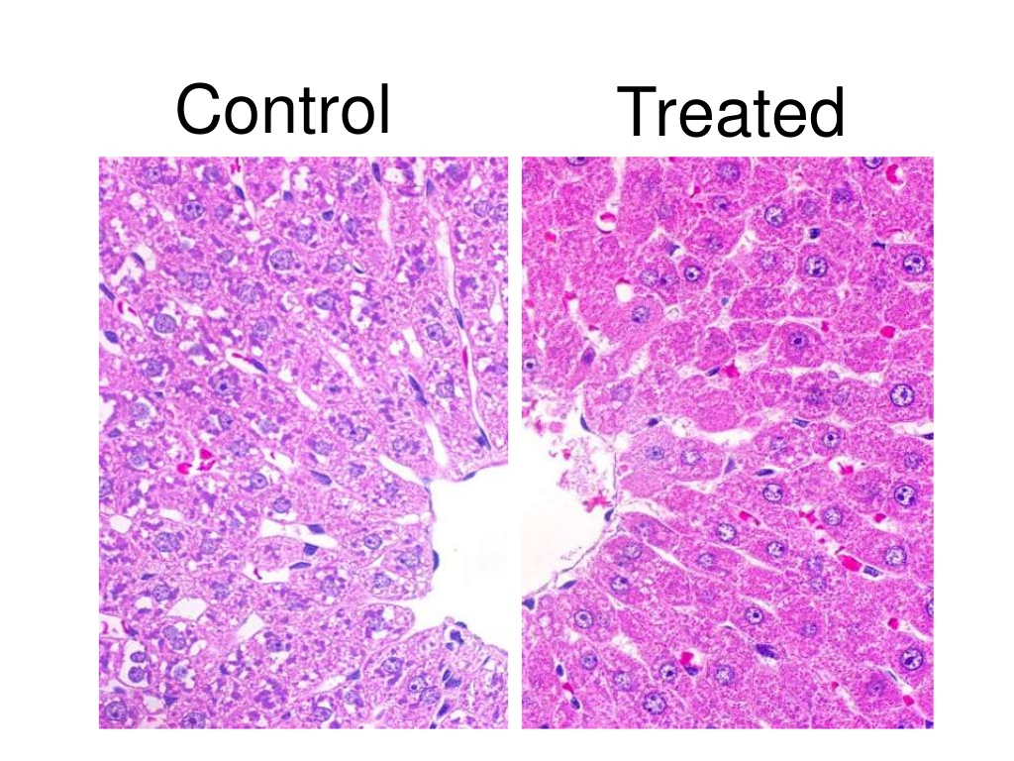

Slide 46
Peroxisome proliferators
IS THIS RELEVANT TO HUMANS???
There are considerable species differences in sensitivity to peroxisomal proliferation that are generally attributed to the expression of PPAR-α receptor.
Humans have low sensitivity because they have far lower levels of PPAR-α expression than mice
However, in order to make a reasonable risk assessment for human patients we should carefully assess every new drug causing peroxisome proliferation in other animals.

Slide 47
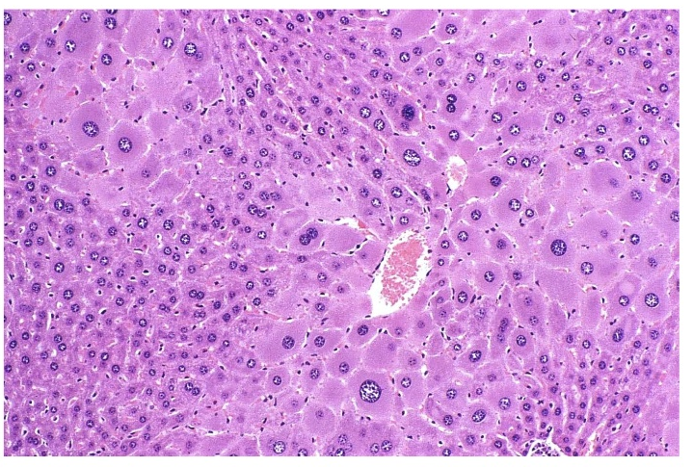
Karyomegaly

Slide 48
Pigmentation
Bile (cholestasis)
Lipofuscin
Hemoglobin
Thoratrast / other drugs

Slide 49
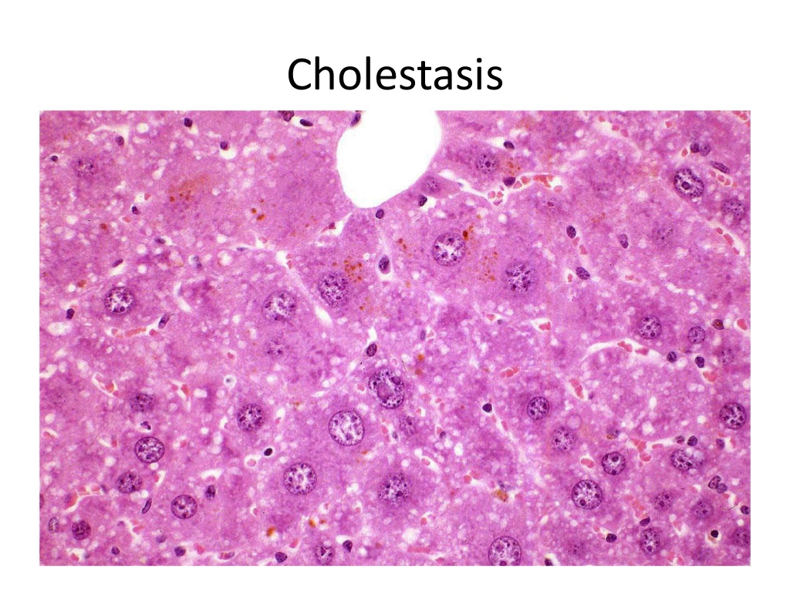

Slide 50
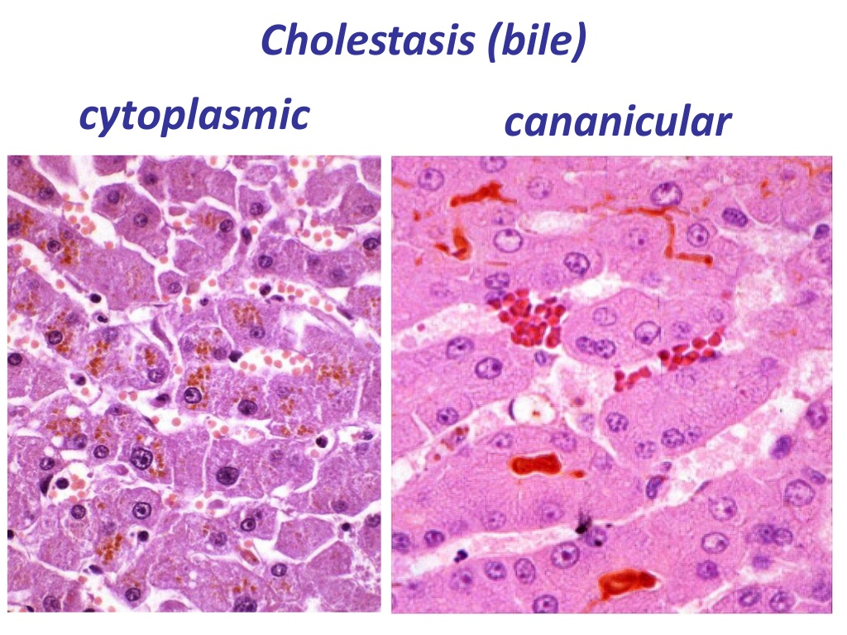

Slide 51
Necrosis
Zonal,
Centrilobular,
Is related to the administration of drugs and chemicals.
Zone III is particularly vulnerable to
ischemic damage (due to oxygen gradient)
Formation of reactive metabolites (due to increased drug metabolising capacities)
disturbance of hepatic blood supply
Periportal,
α-naphthylisocyanate and allyl alcohol

Slide 52
METABOLIC ACTIVATION
Drug
CYP
Reactive metabolite
Parent drug or metabolite act as hapten by combining with macromolecules rendering them antigenic
Extensive
covalent
binding with vital organelles
Promotion of lipid peroxidation of membrane associated fatty acids
Immune reactions
Direct toxicity
Indirect toxicity

Slide 55
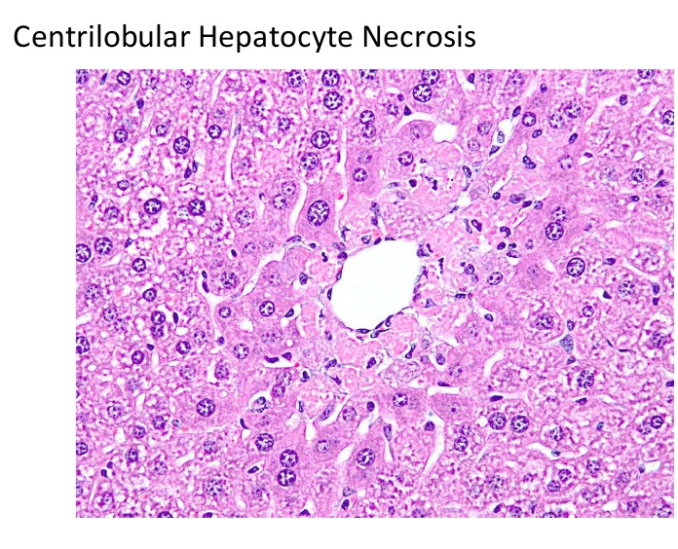

Slide 56
Necrosis
Focal,
sporadic occurrence of well defined foci of necrotic hepatocytes. / Is it a real phenomenon /relevant) to the xenobiotic administration?

Slide 57
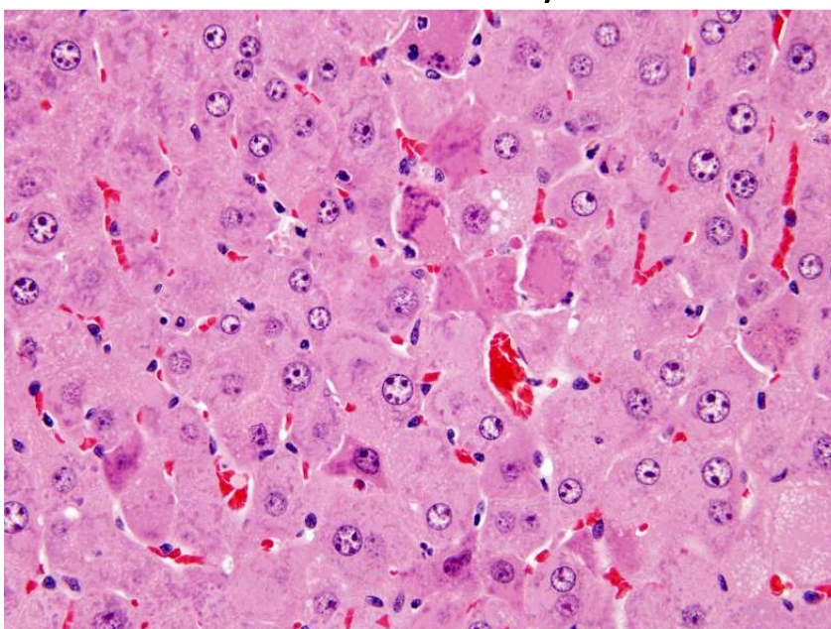
Necrosis
Single cell necrosis,
affect individual hepatocytes (apoptosis) seen as isolated dense eosinophilic bodies sometimes with pyknotic nuclear fragments, without inflammation. In liver it is a common and quite normal phenomenon.

Slide 58
Factors related to increased apoptosis:
viral infections,
immunological disorders,
Xenobiotics (alcohol, cocaine, cycloheximide, anticancer drugs (mitomycin C),
Withdrawal of liver enlargers

Slide 59
Inflammation
Spontaneous inflammation,
mild focal aggregates of acute or chronic inflammatory cells grouped around small zones of necrotic or degenerated eosinophilic hepatocytes
In general are not associated with to treatment with drugs and chemicals
Induced inflammation
Acute
Chronic (the features of chronic hepatitis found in humans are uncommonly found in laboratory animals).
In humans is seen with HBV, HCV, autoimmune hepatitis and with drugs such as methydopa, nitrofurantoin, sulfonamides, isoniazid, nitroimidazole.
Chronic active
Granulomatous (if particulate forms of drug or metabolite precipitate in the liver)

Slide 60
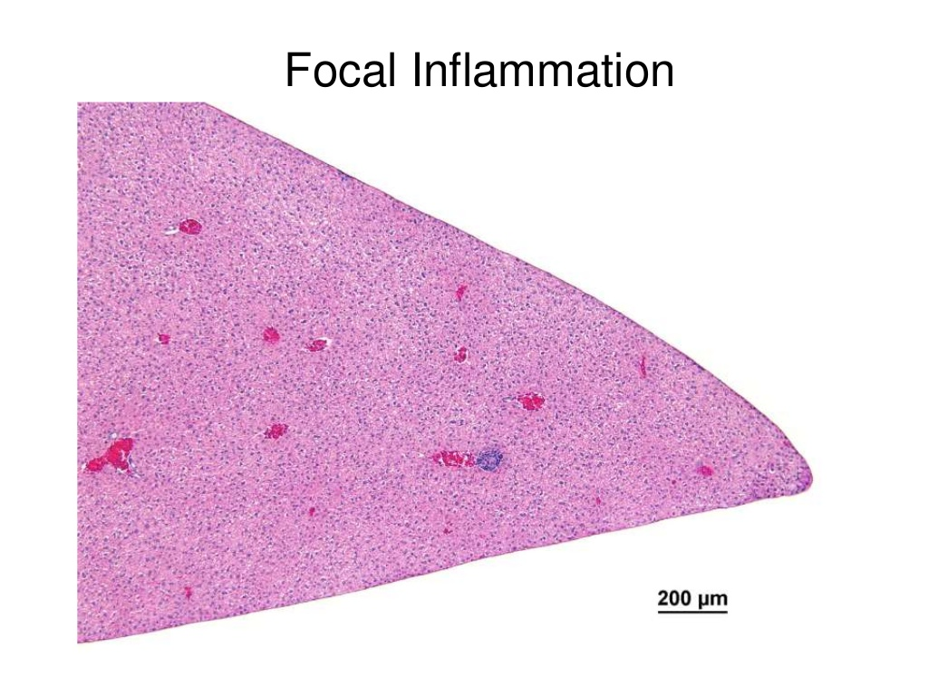

Slide 61
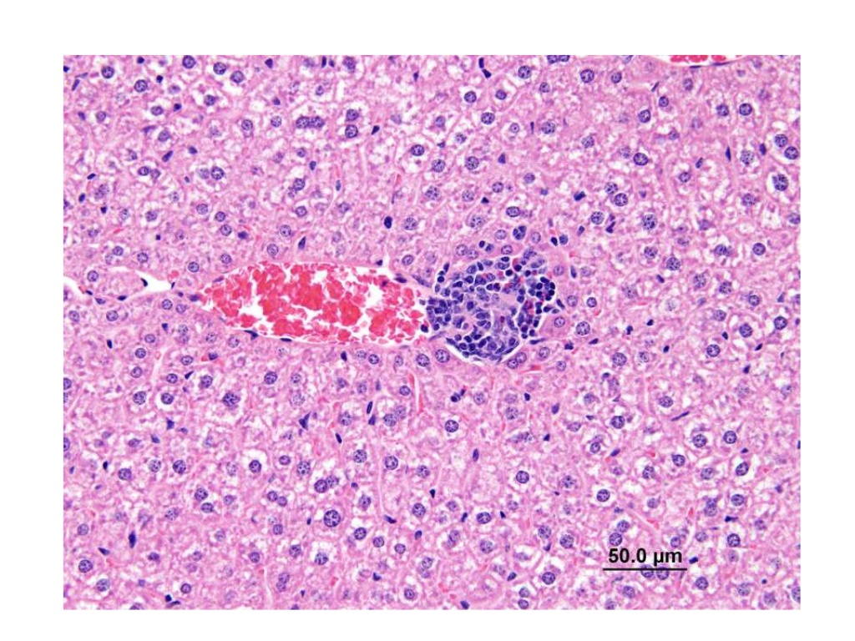

Slide 62
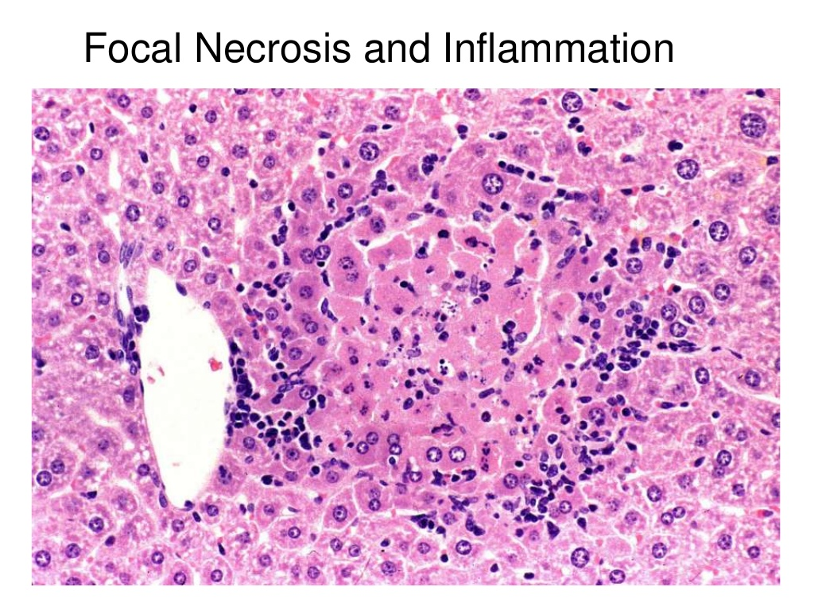

Slide 64
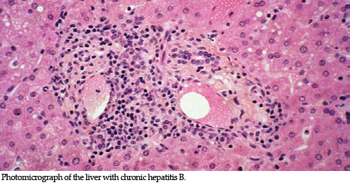
Chronic inflammation

Slide 65
Proliferative lesions in rodents
Foci of cellular alteration
Hepatocellular adenoma
Hepatocellular carcinoma
Regenerative Hyperplasia/ cirrhosis
In humans liver neoplasms are associated with an underlying chronic liver disease / liver cirrhosis (chronic viral hepatitis B or C, chronic alcohol consumption, non-alcoholic steatohepatitis, congenital disorders)
In carcinogenicity studies the pattern of tumor development is seldom associated with an underlying chronic inflammatory process.

Slide 66
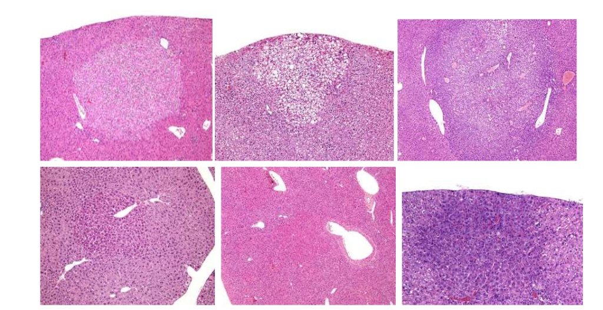
Basophilic focus
Eosinophilic focus
Clear cell focus
Mixed focus

Slide 67
Foci of cellular alteration
Are characterized by groups of hepatocytes with cytological features distinctive from adjacent liver cells but with little alteration in architectural pattern
Have no connection to cirrhosis
They are common in rodent studies greater than duration of twelve months and may be seen in short duration toxicity studies following exposure to certain xenobiotics.
They are regarded as preneoplastic lesions by many because they are induced by many known hepatocarcinogens and temporally occur before liver tumors develop

Slide 68
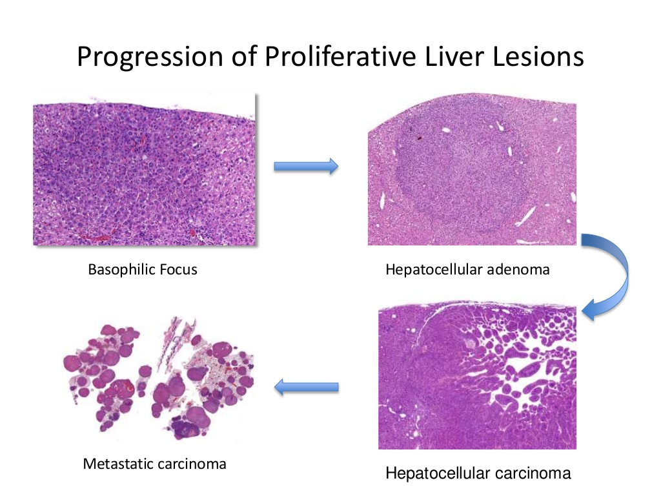
They are considered unequivocally preneoplastic, although a very small percentage of foci actually progress to hepatocellular neoplasia.
The above assumption has led to the erroneous conclusion that drug induced foci represent carcinogenetic risk for humans.

Slide 69
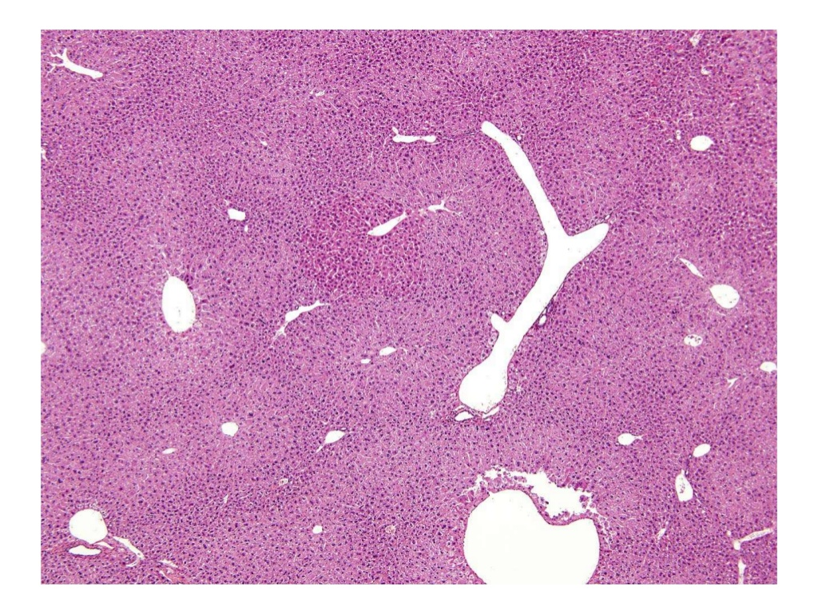

Slide 70
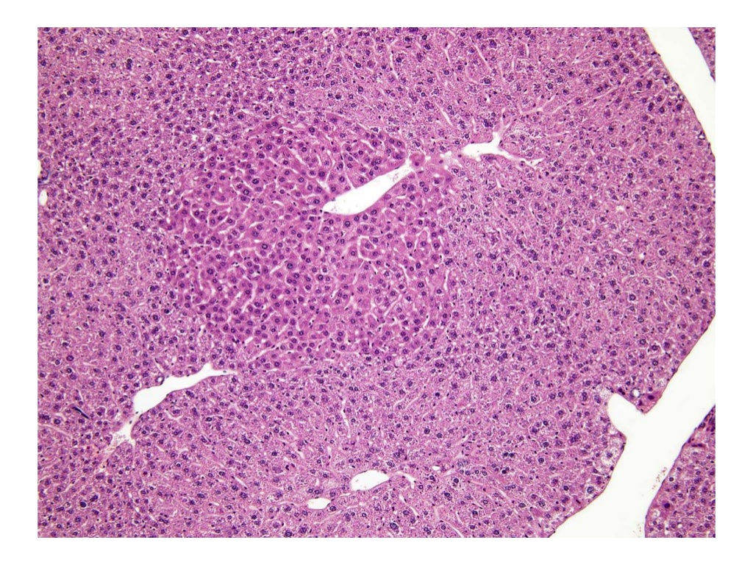

Slide 71
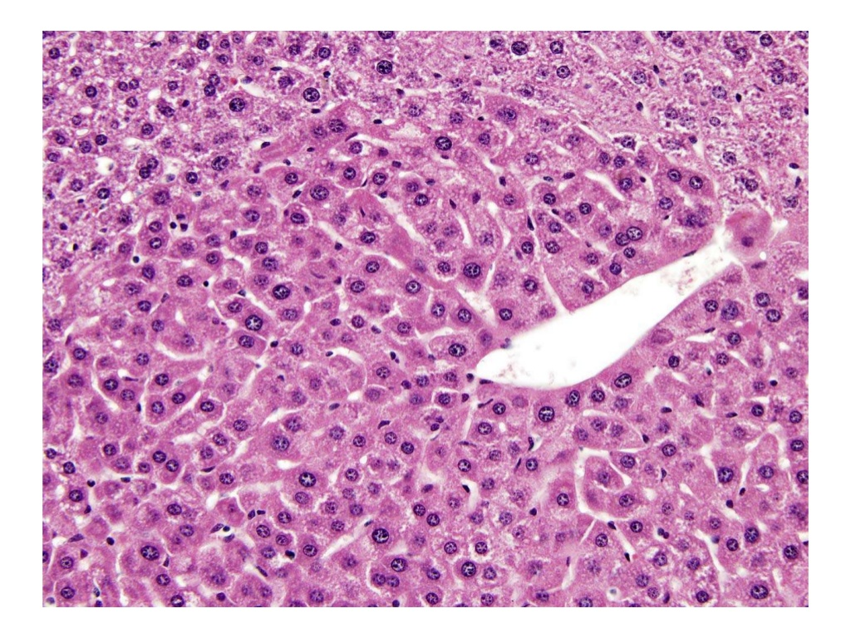

Slide 72
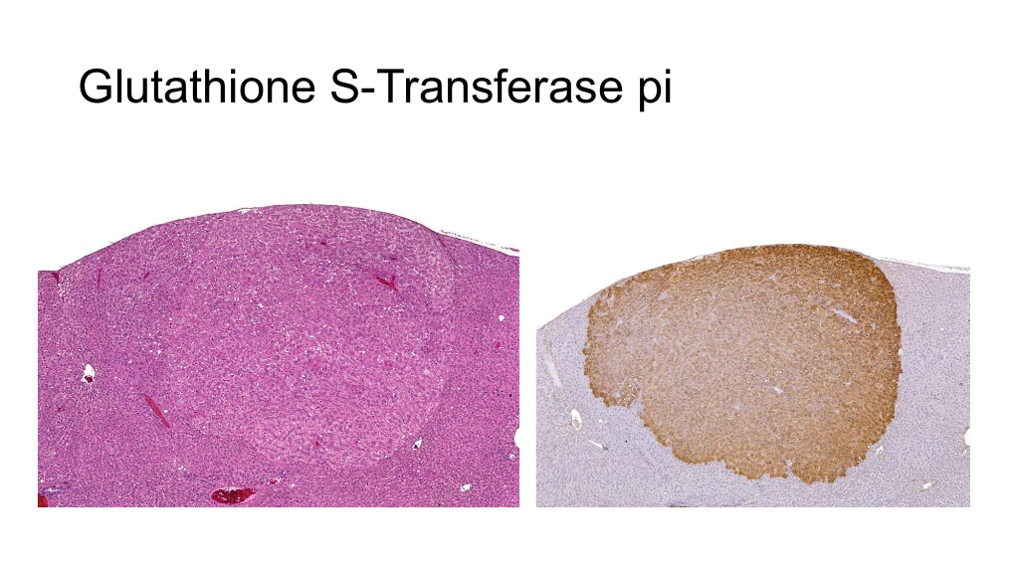
The placental form of glutathione S-transferase has been used as a marker of foci in the rat liver treated with genotoxic carcinogens and permits quantification of foci

Slide 73
Hepatocellular adenomas and carcinomas
Adenomas
Loss of normal architecture and compression of the surrounding parenchyma.
Carcinomas
Plus infiltration, cellular pleomorphism, mitoses, anaplasia, metastases.

Slide 74
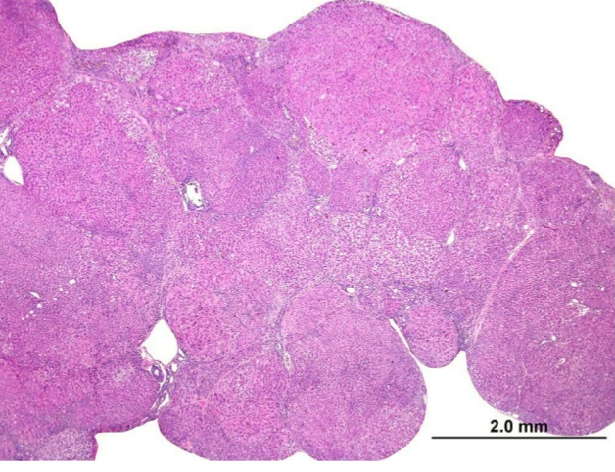
Regenerative Hyperplasia
Focal or multifocal process with Discrete nodules and distortion of normal plate architecture

Slide 75
Other types of hyperplasia
Kupffer cell hyperplasia
Ito cell hyperplasia
Bile duct hyperplasia
Oval cell hyperplasia

Slide 76
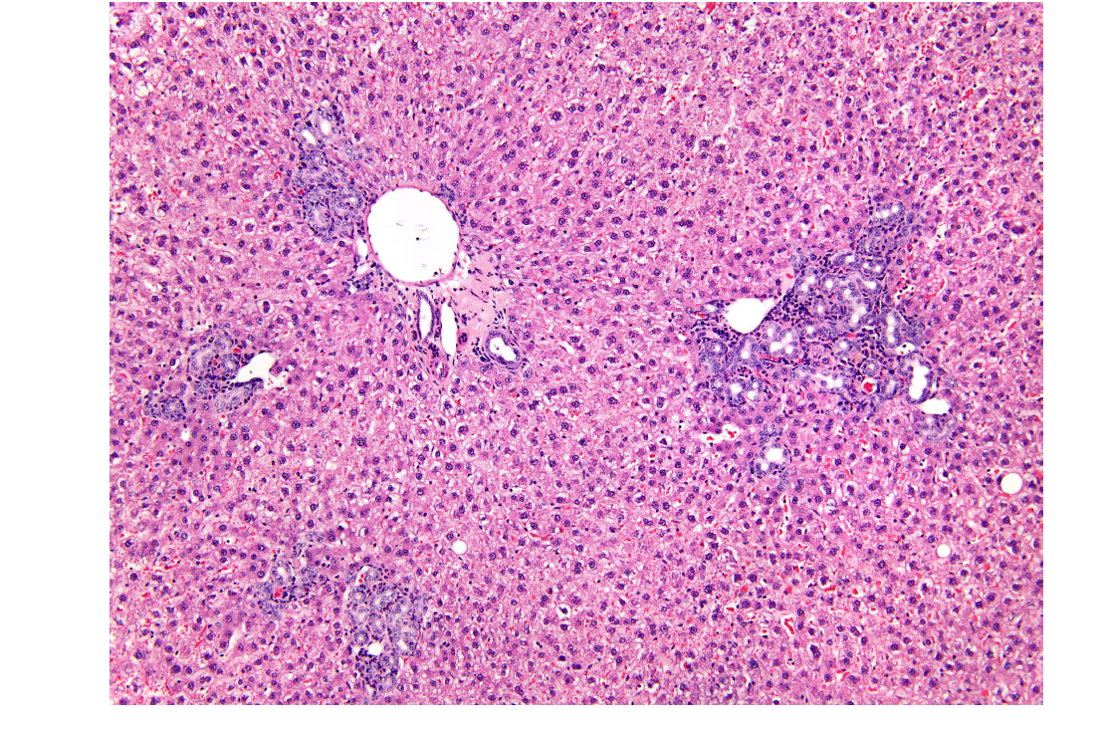
Bile duct hyperplasia: a spontaneous change in portal areas of aged animals, may be exacerbated by treatment

Slide 77
Relevance of toxicity between preclinical toxicity studies and toxicity in humans
There is a reasonable correlation between hepatotoxicity in humans and animals (70%)
False negative preclinical studies were uncommon, there were however a significant number of false positive.
The relation however between humans and animals for hepatic carcinogenicity is not reasonable
All human carcinogens can produce neoplasms in the rodent carcinogenicity studies but the converse is not true for therapeutic agents.
In a study among 241 drugs at least 11 produced hepatic neoplasms in
the rat, 14 in the mouse and two in both species. None of these (apart
from oral contraceptive and anabolic steroids) were associated with any
neoplastic risk for humans.

Slide 78
Γιατί τα είπαμε όλα αυτά?
Να περάσουμε ευχάριστα την ώρα μας
Να σας κάνουμε να μισήσετε την τοξικολογία
Να επεκτείνουμε τις γνώσεις σας
Να σας σπάσουμε τα νεύρα

Slide 79
Δυσμενής αλλοίωση
Μια βιοχημική, μορφολογική ή αλλαγή της φυσιολογίας, που είτε μεμονωμένα είτε σε συνδυασμό, επηρεάζει αρνητικά την απόδοση ολόκληρου του οργανισμού ή μειώνει την ικανότητά του να ανταποκρίνεται σε μια πρόσθετη περιβαλλοντική πρόκληση

Slide 80
Δυσμενής αλλοίωση
Μπορεί να θεωρηθεί ως μια αλλαγή (βιοχημική, λειτουργική ή δομική) που μπορεί να επηρεάσει αρνητικά την απόδοση και έχει γενικά αρνητικές επιπτώσεις στον πολλαπλασιασμό, την ανάπτυξη ή τη διάρκεια ζωής ενός μη κλινικού τοξικολογικού μοντέλου
Πιο συγκεκριμένα, η ανεπιθύμητη αντίδραση σε μια μη κλινική τοξικολογική μελέτη θα πρέπει να θεωρείται το αποτέλεσμα εκείνο που εάν εμφανιζόταν σε μια κλινική δοκιμή στον άνθρωπο θα θεωρούνταν απαράδεκτο (FDA Guidance, 2002).

Slide 81
Are some findings non-adverse?
Bile duct hyperplasia
Microsomal enzyme induction
Decreased serum ALT and AST
Extramedullary hemopoiesis in liver
Όταν τα ευρήματα δεν θέτουν σε κίνδυνο την φυσιολογία των ιστών ή οργάνων, δεν βλάπτουν τη λειτουργική ικανότητα και δεν αυξάνουν την ευαισθησία σε άλλες επιδράσεις, τότε μπορούν να θεωρηθούν ως μη δυσμενείς.

Slide 82
MTD, NOEL, NOAEL
MTD = Maximum tolerated dose
NOEL = No observable effect level.
Highest dose administered that does not produce toxic effects
NOAEL = No observable adverse effect level.
Highest dose administered that does not produce an adverse effect

Slide 83
NOAEL
Η υψηλότερη δόση ή έκθεση που δεν προκαλεί τοξικολογικά σχετική αύξηση στην ΣΥΧΝΟΤΗΤΑ ή στην ΣΟΒΑΤΟΤΗΤΑ των αλλοιώσεων μεταξύ των εκτεθειμένων ομάδων και των ομάδων ελέγχου, στη βάση μιας προσεκτικής βιολογικής και στατιστικής ανάλυσης
Ελάχιστες τοξικά σχετικές αλλοιώσεις μπορεί να παρατηρούνται στην δόση NOAEL αλλά δεν θέτουν σε κίνδυνο την ανθρώπινη υγεία ή είναι δεν μπορεί να προκαλέσουν σοβαρές επιπλοκές σε συνεχιζόμενη έκθεση στην ουσία

Slide 84
Προσαρμογή
Εξελικτική στρατηγική για την εξασφάλιση της επιβίωσης, χωρίς απώλεια της λειτουργίας, σε ένα νέο περιβάλλον όπου υπάρχει η ξενοβιοτική ουσία
Η προσαρμογή μπορεί να είναι δυσμενής
Μεταπλασία του βρογχικού δένδρου
Οι προσαρμοστικές αλλαγές μπορεί να χαρακτηρίζονται από αναστρεψιμότητα, αλλά δεν είναι πάντα αναστρέψιμες
Ηπατική ίνωση

Slide 85
Αναστρεψιμότητα
Εξαφανίζεται μετά τη διακοπή της θεραπείας/χορήγησης
Συνήθως προσδιορίζεται με τη χρήση ειδικών γι’ αυτό το σκοπό ομάδων ζώων σε μελέτες τοξικότητας

Slide 86
Έξαρση
Είναι η αύξηση του αριθμού ή/και της σοβαρότητας εμφάνισης μιας κοινής βλάβης υποβάθρου που σχετίζεται με την ηλικία ή/και την συγκεκριμένη φυλή πειραματόζωων

Slide 87
STP Recommendations
Εάν το αποτέλεσμα της επίδρασης της ουσίας υπο διερεύνηση θεωρείται δυσμενές ή μη δυσμενές πρέπει να αναφέρεται σαφώς στην έκθεση της μελέτης
Η δυσμενής επίδραση που αναφέρεται αφορά μόνο στο πειραματικό μοντέλο που χρησιμοποιήθηκε στην μελέτη αυτή
Ο καθορισμός μιας NOAEL δόσης για την υπο διερεύνηση ουσία θα πρέπει να δηλώνεται σε ένα έγγραφο επισκόπησης με βάση δεδομένα από πολλαπλές μελέτες
Ο προσδιορισμός πιθανής τοξικότητας και η πρόβλεψη του κινδύνου για τον άνθρωπο θα πρέπει να γίνεται αφού αξιολογηθούν από κοινού όλα τα διαθέσιμα δεδομένα από μη κλινικές μελέτες

Slide 88
ADVERSE

Slide 89
NON ADVERSE
Billiary duct hyperplasia
Bile ducts

Slide 92
When is hepatic enzyme induction adverse?
Necrosis / apoptosis
Hyperplasia
Steatosis / lipidosis
Cholestasis
Karyomegaly

Slide 93
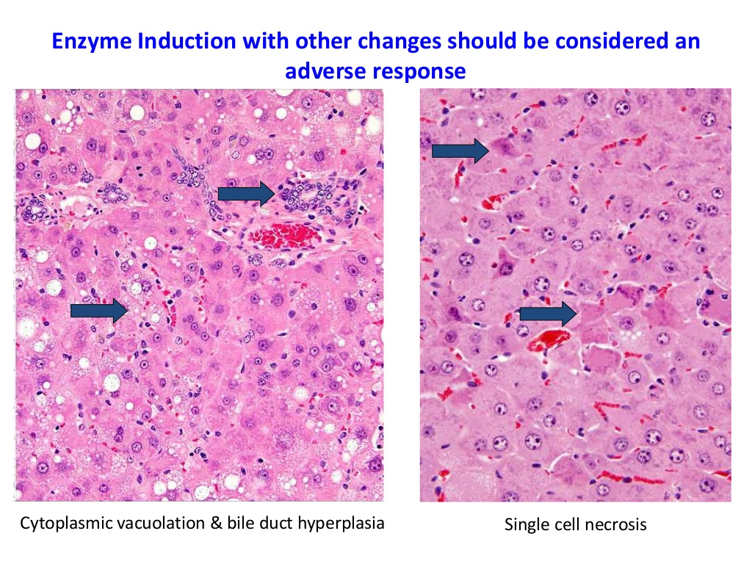

Slide 97
HYPERTROPHY CONSIDERED ADAPTIVE
Typical low severity centrilobular hypertrophy & no cytotoxicity or hepatocellular degeneration
Liver weight increased up to 35%
FATTY CHANGE CONSIDERED ADVERSE (alteration to lipid metabolism)
ALT & AST increased 2,6 to 4,5 at 2 highest doses
Plasma cholesterol increased 25-40% at 3 highest doses

Slide 98
NOAEL???

Slide 100
Hypertrophy and vacuolation considered Adaptive
Degeneration / necrosis and increased mitoses considered Adverse

Slide 101
NOAEL????

