Slide 1
Basics of the Respiratory System
outline and educational goals
Why humans are breathing?
What is respiration?
The Respiratory Tree
What is the function of the lower respiratory tract?
Functional “compartments” of ventilation
Ventilation / perfusion ratio
Shunt
Causes & differential diagnosis of hypoxia

Slide 2
Basics of the Respiratory System
Why humans are breathing?
to oxygenate their tissues
[wrong]
(for normal conditions)
to get rid carbon dioxide
[correct]
respiration center
sensor
lungs
CO₂ exhalation
minute ventilation
in an
“input-output”
principal manner
venous blood
arterial blood
tissues
CO₂ production
(metabolism)

Slide 3
Basics of the Respiratory System
Why humans are breathing?
to oxygenate their tissues
[wrong]
(for normal conditions)
to get rid carbon dioxide
[correct]
respiration center
Important for anesthesiologists
decreased drive by opioids
sensor
lungs
Important for anesthesiologists
minute ventilation
site of action for muscle relaxants
mechanical ventilation
anesthesia for patients with lung disease
venous blood
arterial blood
modified during anesthesia
tissues
Important for anesthesiologists

Slide 4
Basics of the Respiratory System
What is respiration?
the series of exchanges that leads to the uptake of oxygen by the cells and the release of carbon dioxide to the lungs
Step 1 = ventilation
Inspiration & expiration
Step 2 = exchange between alveoli and pulmonary capillaries
Referred to as External Respiration
Step 3 = transport of gases in blood
Step 4 = exchange between blood and cells
Referred to as Internal Respiration
Cellular respiration = use of oxygen in ATP synthesis

Slide 5
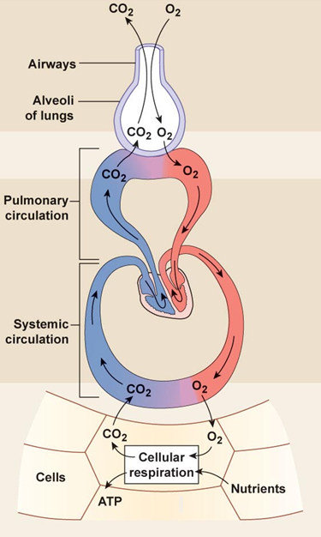
Basics of the Respiratory System
What is respiration?
the series of exchanges that leads to the uptake of oxygen by the cells and the release of carbon dioxide to the lungs
Step 1 = ventilation
Inspiration & expiration
Step 2 = exchange between alveoli and pulmonary capillaries
Referred to as External Respiration
Step 3 = transport of gases in blood
Step 4 = exchange between blood and cells
Referred to as Internal Respiration
Cellular respiration = use of oxygen in ATP synthesis

Slide 6
Partial pressure (tension) O₂ (mmHg)
inspired air
760 Χ 0,20 ≈ 150 mmHg
alveolar air = 102mmHg
PAO₂ + PACO₂ + PAN₂ + PH₂O
PAO₂ =(760 – 47)FiO₂ – PaCO₂ X k
arterial blood = 96-98 mmHg
P(A-a)O₂ = 2,5 + 0,21 Age (yrs)
tissues = 15-40 mmHg
mitochondria = 1 mmHg
venous blood =
depends on tissue flow & metabolism
mixed venous = 55-65 mmHg
O₂=150
O₂=100
O₂=40
O₂=98
O₂=98
O₂=98
O₂=30
O₂=1

Slide 7
Partial pressure (tension) CO₂ (mmHg)
inspired air
0 mmHg
alveolar air = 40 mmHg
PAO₂ + PACO₂ + PAN₂ + PH₂O
PAO₂ =(760 – 47)FiO₂ – PaCO₂ X k
arterial blood = 40 mmHg
P(A-a)O₂ = 2,5 + 0,21 Age (yrs)
tissues = 15-40 mmHg
mitochondria = 1 mmHg
venous blood =
depends on tissue flow & metabolism
mixed venous = 46 mmHg
O₂=150
CO₂=0
O₂=100
O₂=40
CO₂=40
CO₂=46
O₂=98
CO₂=40
O₂=98
CO₂=40
O₂=98
CO₂>40
CO₂=40
O₂=30
O₂=1

Slide 8
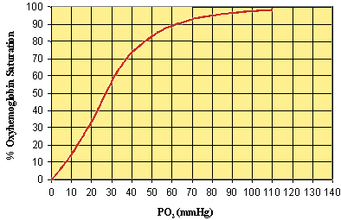
EtCO₂<40
O₂=150
Values of extreme clinical relevance
in Anesthesiology,
Intensive Care Medicine
and Emergency Medicine
CO₂=0
O₂=100
O₂=40
CO₂=40
FiO₂ (can be modified)
blood gas analysis
pulse oxymetry (saturation)
SVO₂ (by SG catheter)
BGA (by SG catheter)
capnometry
CO₂=46
O₂=98
CO₂=40

Slide 9
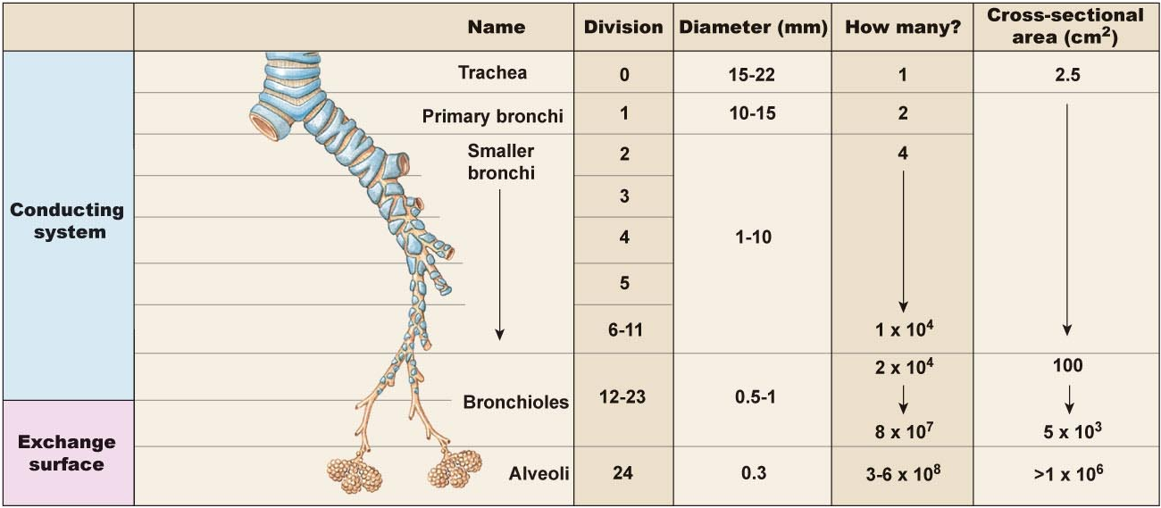
The Respiratory Tree
Upper respiratory tract is for all intensive purposes a single large conductive tube
The lower respiratory tract starts after the larynx and divides again and again…and again to eventually get to the smallest regions which form the exchange membranes
anatomical dead space
[no gas exchange]
2 X BW (adults)
150 ml (each breath)
reduced after tracheal intubation
depending on tube’s dimensions
in exchange zone, practically air velocity is almost zero and gases are moving by diffusion
Q = V/t
Q = S u

Slide 10
What is the function of the lower respiratory tract?
- Exchange of gases …. due to
Huge surface area = 1x10⁵ m² of type I alveolar cells
Associated network of pulmonary capillaries
80-90% of the space between alveoli is filled with blood in pulmonary capillary networks
Exchange distance is approx 1 um from alveoli to blood!
- Protection
Free alveolar macrophages (dust cells)
Surfactant produced by type II alveolar cells (septal cells)
in exchange zone, practically air velocity is almost zero and gases are moving by diffusion
Q = V/t
Q = S u

Slide 11
What is the function of the lower respiratory tract?
- Exchange of gases …. due to
Huge surface area = 1x10⁵ m² of type I alveolar cells
Associated network of pulmonary capillaries
80-90% of the space between alveoli is filled with blood in pulmonary capillary networks
Exchange distance is approx 1 um from alveoli to blood!
- High volume of blood through huge capillary network results in
Fast circulation through lungs
Pulmonary circulation = 5L/min through lungs….
Systemic circulation = 5L/min through entire body!
in exchange zone, practically air velocity is almost zero and gases are moving by diffusion
Q = V/t
Q = S u

Slide 12
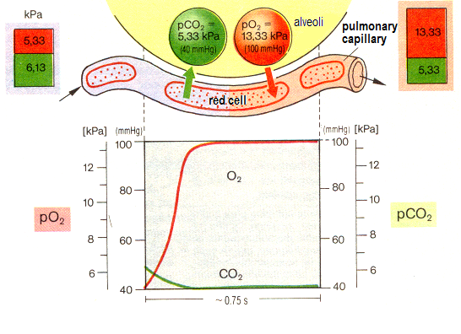
What is the function of the lower respiratory tract?

Slide 13
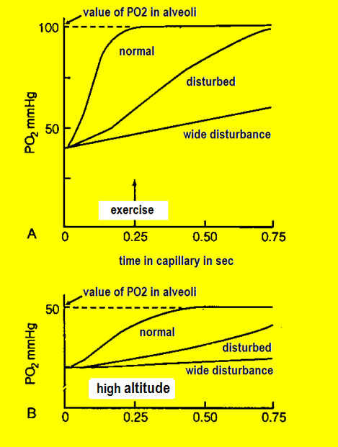
What is the function of the lower respiratory tract?
value of PO₂ in alveoli:
depends on FiO₂ (inspiratory fragment of oxygen) and atmospheric pressure
Time depends on cardiac output and “wideness” of pulmonary capillary network. Normally, the huge in-crease in cardiac output during exercise is followed by a recruitment of capillaries compensating time, and hypoxemia is avoided.

Slide 14
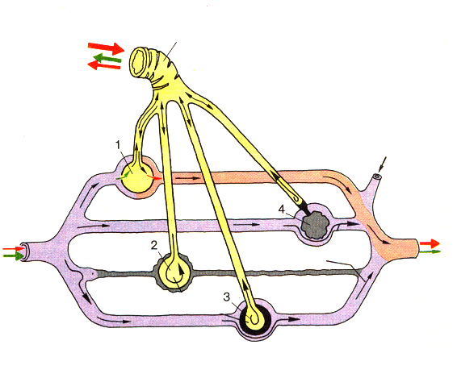
Functional “compartments” of ventilation
1
MV = VT X RR
MV, minute ventilation
VT, tital volume
RR, respiratory rate
2
6
MV
Ůd (anatomical)
5
normal exchange
(Va / Q = 1)
3
Ůd (functional)
(waste ventilation)
(Va / Q ⇒ ∞)
4
Ůd (functional)
(Va / Q >> 1)
Venous admixture
The more this compartment is taking from pulmonary flow, arterial blood tends to be similar to mixed venous blood. The distance of PaO₂ from PAO₂ is increased. PaO₂ tends to be similar to PvO₂.
Functional dead space
The more this compartment is increased, exhaled air tends to be similar to inhaled air. The gap between end-tidal CO₂ (EtCO₂) and arterial (PaCO₂) is increased.
Venous admixture
(Va / Q << 1)
shunt
(Va / Q ⇒ 0 )

Slide 15
CARBON DIOXIDE IN ALVEOLI
( ŮA και PaCO₂ )
VCO2=0,4 L/min
VCO2=0,3 L/min
VCO2=0,2 L/min

Slide 16
Tidal Volume X Respiratory Rate = Minute Ventilation
PaCO2 = 50 EtCO2 = 28
PaCO2 = 40 EtCO2 = 36
PaCO2 = 32 EtCO2 = 30
(VT-VD) = Alveolar Ventilation
DEAD SPACE = 150 ml

Slide 17
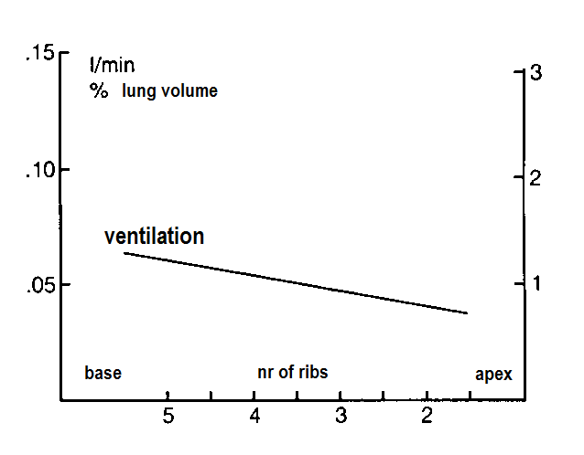
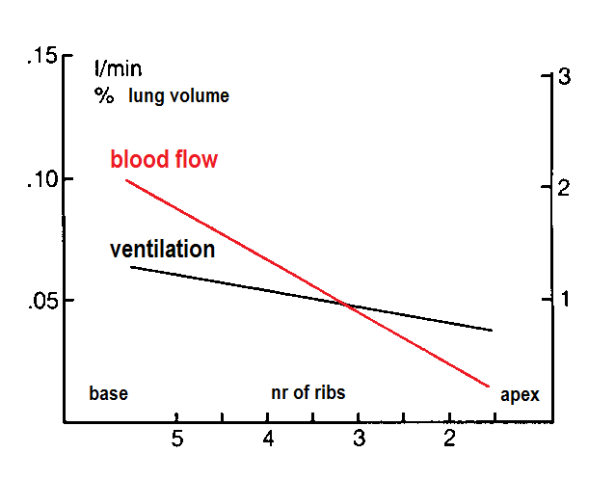
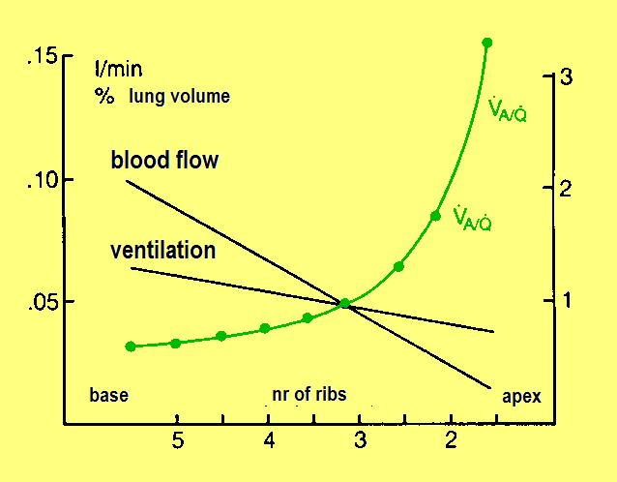
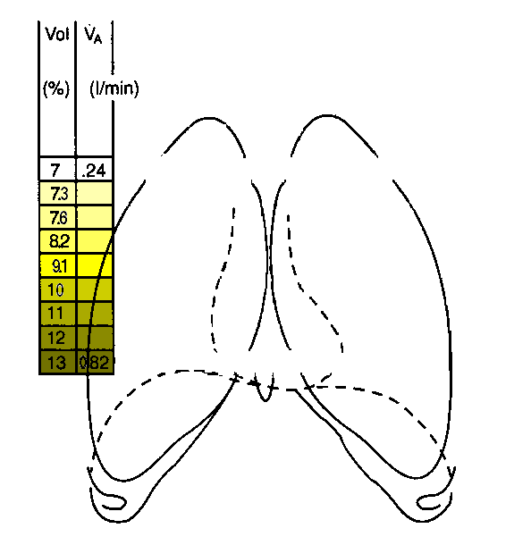
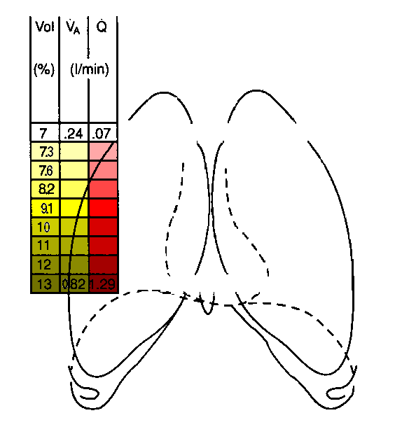
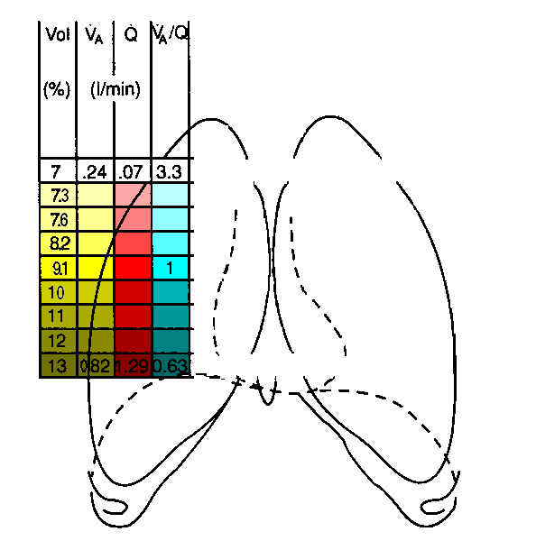
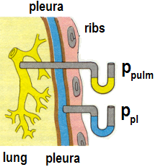
Distribution of ventilation in the lungs
Distribution of blood flow in the lungs
Gravitational forces due to blood and lung fluids make pleura pressure (P_{pl}) more negative in apex than base. Alveoli in apex areas are greater and less distendable compared to alveoli near base. During normal inspiration (near FRC level), ventilation is distributed
more in areas near the bases. During inspiration from RV level, in the begin-ning, ventilation is distributed to the apex. Respiration in the level of TLC results an almost equal distribution of ventilation through out the lungs.
Ventilation / Perfusion ratio

Slide 18
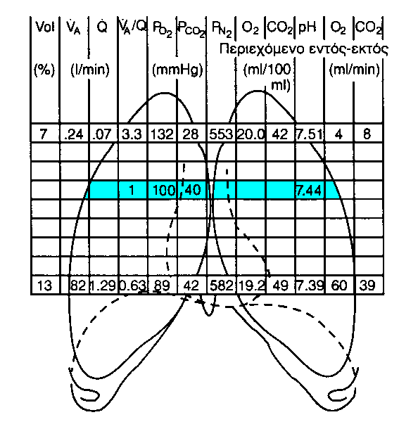
Distribution of ventilation in the lungs
Distribution of blood flow in the lungs
Areas with alveolar and capillary gases resembling to dead space
Areas with alveolar and capillary gases resembling to mixed venous

Slide 19
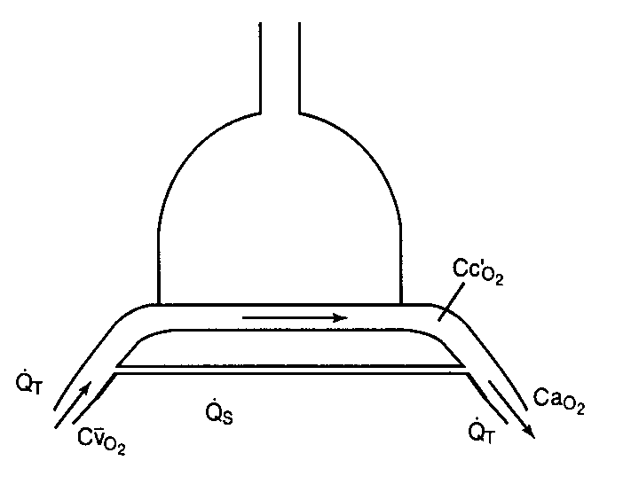
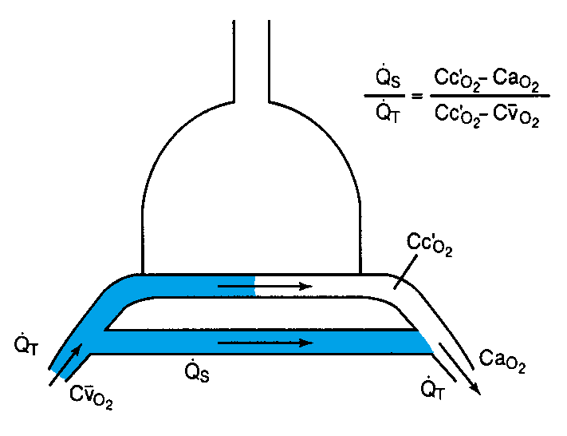
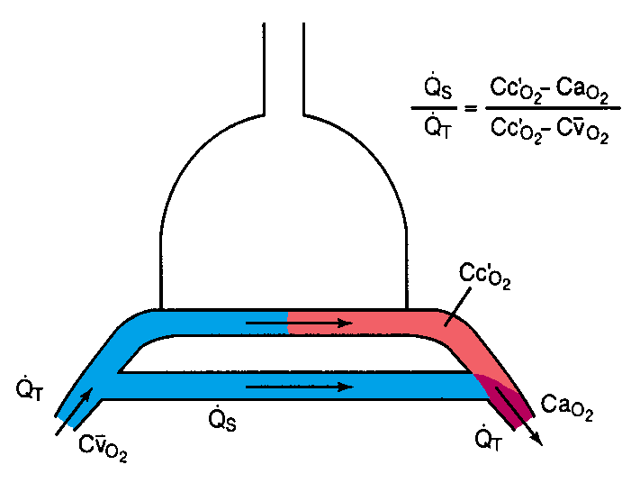
Distribution of ventilation in the lungs
Distribution of blood flow in the lungs
Shunt
FiO₂
100%
Normally, the percentage of Qs is very low and concerns extracapillary shunting (Thebesian, bronchial circulation)
The percentage of Qs is increased in:
esophageal intubation (incorrect)
bronchial intubation (incorrect)
bronchial stop/block/foreign bodies
atelectasis
congenital heart disease
and the result is
low paO₂ (hypoxia)
SaO₂ = 82, PaO₂ = 55, 62,4% shunt
Qs denotes percentage of pulmonary flow (cardiac output) mixing with oxygenated blood
SaO₂ = 93, PaO₂ = 70, 34,7% shunt
SaO₂ = 99, PaO₂ =112, 19,8% shunt

Slide 20
Causes of HYPOXIA [low PaO₂]
of extreme
clinical importance
in Anesthesiology
Intensive Care Medicine
and Emergency Medicine
INSPIRATION OF HYPOXIC MIXTURE (low FiΟ₂)
Correction of ΡaΟ₂ by increasing FiO₂
HYPOVENTILATION
Increased PaCO₂
Normal alveo-capillary O₂ difference
Correction of ΡaΟ₂ by increasing MV & FiO₂
VA/Q mismatch (usually decrease)
Increased alveo-capillary O₂ difference
Correction of ΡaΟ₂ by increasing FiO₂
SHUNT
Increased alveo-capillary O₂ difference
Resistant in increasing FiO₂
Improving with increasing Cardiac Output
DIFFUSION DISTURBANCES

Slide 21
ΕΡΩΤΗΣΕΙΣ – ΑΠΑΝΤΗΣΕΙΣ
(εφαρμοσμένη φυσιολογία κυκλοφορικού και αναπνευστικού συστήματος)
Ασθενής (άρρην, 45 ετών, 72 Kg, ελεύθερο ιστορικό) χειρουργείται υπό γενική αναισθησία και μηχανικό αερισμό για ανοικτή επέμβαση κάτω κοιλίας. Το αναπνευστικό ψιθύρισμα είναι συμμετρικό. Λαμβάνει VT =1000ml, RR=12/min, FiO₂=30% και ο κορεσμός του αρτηριακού αίματος είναι SaO₂=100%. Το τελοεκπνευστικό του διοξείδιο (EtCO₂) αναμένεται :
Να είναι φυσιολογικό (EtCO₂ μεταξύ 34-36 mmHg)
Να είναι αυξημένο (EtCO₂ >50 mmHg)
Να είναι ελαττωμένο (EtCO₂ <30 mmHg)
Η ταχυκαρδία έχει καταστρεπτικό αποτέλεσμα στους ασθενείς με στεφανιαία νόσο γιατί :
αυξάνεται η χρονική διάρκεια της συστολής και αυξάνεται έτσι η κατανάλωση οξυγόνου από το μυοκάρδιο
αυξάνεται η χρονική διάρκεια της διαστολής και αυξάνεται έτσι η κατανάλωση οξυγόνου από το μυοκάρδιο
αυξάνεται υπέρμετρα η κατανάλωση οξυγόνου από το ερεθισματαγωγό σύστημα
ελαττώνεται ο χρόνος άρδευσης της καρδιάς
τίποτε από τα παραπάνω
Η ανταλλαγή αερίων στον μηχανικό αερισμό κατά την καρδιακή ανακοπή εμπίπτει στο μοντέλο:
Κυψελιδικού υποαερισμού
Διαταραχής (ελάττωσης) της σχέσης αερισμού/αιμάτωσης
Shunt
Αύξησης του νεκρού χώρου (VD)
Διαταραχής διάχυσης

Slide 22
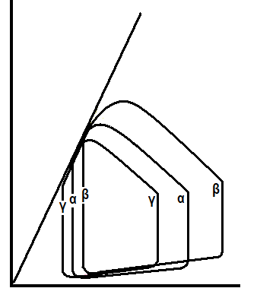
Στο παράπλευρο σχήμα, ενδοφλέβια χορήγηση νιτρογλυκε-ρίνης σε συνήθη δόση (ταχείας δράσης αγγειοδιαστολή, κυ-ρίως φλεβοδιαστολή) στον φυσιολογικό άνθρωπο (καμπύλη α) έχει σαν αποτέλεσμα :
την καμπύλη β
την καμπύλη γ
δεν αναμένεται μεταβολή
Στο παράπλευρο σχήμα, οι τρεις καμπύλες αντιπροσωπεύ-ουν τρεις διαφορετικές καταστάσεις του κυκλοφορικού
με την ίδια, όμως, καρδιακή παροχή. Σε ποια κατάσταση η συχνότητα σφύξεων είναι μεγαλύτερη ;
1. στην καμπύλη α
στην καμπύλη β
στην καμπύλη γ

