Slide 1
Network Formation Games
Εργασία στο μάθημα
«ΠΡΟΧΩΡΗΜΕΝΑ ΘΕΜΑΤΑ ΔΙΚΤΥΩΝ»
Μεταπτυχιακοί φοιτητές :
Σοφία Κατή
Διονύσης Πλακιάς
Διδάσκων :
Ιορδάνης Κουτσόπουλος

Slide 2
Network Formation Games
NFGs model distinct ways in which selfish agents might create and evaluate networks
Agents aim to:
to minimize the expenses
to ensure high quality of service
*Nissan, Roughgarden, Tardos, Vazirani(2007)

Slide 3
Articles
[1] A contract-based model for directed network formation (2005)
Johari R, Mannor S, Tsitsiklis J
[2] A game for Ad Hoc Network Connectivity in the presence of Malicious users (2006)
Theodorakopoulos G, Baras J
[3] On a Network Creation Game (2003) Fabrikant A, Luthra A, Maneva E, Papadimitriou C, Shenker S
[4] Network Formation: Bilateral Contracting and Myopic Dynamics (2007) Arcaute E, Johari R, Mannor S

Slide 4
1st Article
A contract-based model for directed network formation(2005)
Johari R, Mannor S, Tsitsiklis J

Slide 5
The model
Multiple players (nodes) interact to form a graph with directed links
Bilateral negotiation aiming to result in a contractual agreement between two nodes to form a directed link ( flow of goods from the upstream node to the downstream node).

Slide 6
The model
The upstream node
benefits from the improved connectivity
however
the downstream node
suffers a cost due to the additional flow sent through it.

Slide 7
The model
The resolution to this tradeoff
a contract
where the upstream node compensates the downstream node.

Slide 8
The game
Players The nodes, each of whom wishes to route a given amount of traffic between themselves.
Actions Node i’s set of action is the set of its possible bid s to the other nodes, to form a link and the minimum acceptance value from the other nodes.
Preferences Each node wishes to send a given amount of traffic to some of the other nodes with the minimum cost

Slide 9
Some definitions
Given the strategies of all the nodes, denoted by the vector s = (p_{ij} ,q_{ji} i, j V, j ≠ i), a directed graph G(s) = (V,A(s)) is formed, where: A(s) ={(i, j ): i ≠ j, pij ≥qij}

Slide 10
Some definitions
The cost to node i
where,
c_{i} the cost that is incurred in node i for each unit of traffic which either passes through or terminates at i.
f_{i}(A) is the amount of flow passing through or terminating at node I
a_{i} a cost proportional to the traffic bij that i wishes to send j that is incurred in node i, if destination j is unreachable from node I
w_{i}(A) the set of nodes j ≠I which are unreachable from node i, given the set of links A.

Slide 11
Some definitions
The payoff to node i

Slide 12
Link stable equilibria
A strategy vector s is link stable equilibrium if for every possible link (i, j ) E the following conditions hold:
(1) For any s’_{(i,j)} = (p’_{ij} ,q_{ji}) :
R_{i}(s’_{(i,j)}, s_{E\{(i,j)}})≤ R_{i}(s)
(2) For any s’_{(i,j)} = (p_{ij} ,q’_{ji}) :
R_{j}(s’_{(i,j)}, s_{E\{(i,j)}})≤ R_{j}(s)
(3) For any s’_{(i,j)} = (p’_{ij} ,q’_{ji}), at least one of the following holds :
R_{i}(s’_{(i,j)}, s_{E\{(i,j)}})≤ R_{i}(s)
R_{j}(s’_{(i,j)}, s_{E\{(i,j)}})≤ R_{j}(s)

Slide 13
Some thoughts
Parallel and distributed computing
Local network

Slide 14
Some thoughts
Parallel and distributed computing
Internet

Slide 15
Some thoughts
Parallel and distributed computing
Internet

Slide 16
2nd Article
A game for Ad Hoc Network Connectivity in the presence of Malicious users (2006)
Theodorakopoulos G, Baras J

Slide 17
The model
G=(V,E): undirected graph
V=V_{G}UV_{B} , where
V_{G} , the set of good users
V_{B} , the set of bad users
Each user has a choice between cooperating (C) to activate the adjacent links, or defecting (D), which effectively kills all adjacent links.
A link (i, j) is considered to be active if and only if both users i and j choose to cooperate (C).
Each user chooses only one action (C or D) for all links, not one action per link.

Slide 18
The model
The game is played repeatedly in rounds
Good users
follow the fictitious play process.
are cooperative, as long as their neighbors are cooperative.
Bad users
know everything that has ever happened in the network, and are also aware of the decision algorithm that the Good use
aim to disrupt the network and waste the energy of the Good users.

Slide 19
Payoff matrices
 |  | Bad
 |  | C | D
Good | C | N-E , E-N | -E , E
 | D | 0 , 0 | 0 , 0
N≥E
 |  | Good
 |  | C | D
Good | C | N-E , N-E | -E , 0
 | D | 0 , -E | 0 , 0
N≥E

Slide 20
How Good users play
So, a Good player’s action is determined as follows ( = 1 for C, 0 for D):
*( the estimated probability that player j will play C in round t+1)

Slide 21
How Bad users play
 |  | Bad
 |  | C | D
Good | C | N-E , E-N | -E , E
 | D | 0 , 0 | 0 , 0
N≥E
D is a weakly dominating action for the Bad
Is “Always D” the definite strategy for the Bad ?

Slide 22
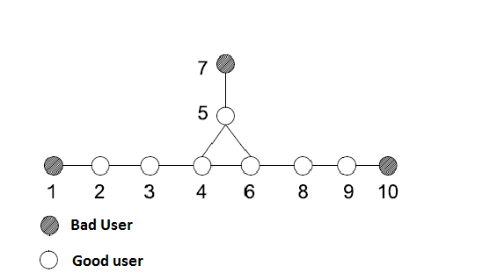
An example

Slide 23
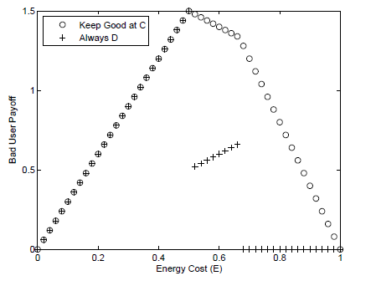
An example

Slide 24
An example
Is the “Keep the Good at C” strategy always better than “Always D” for every topology?

Slide 25
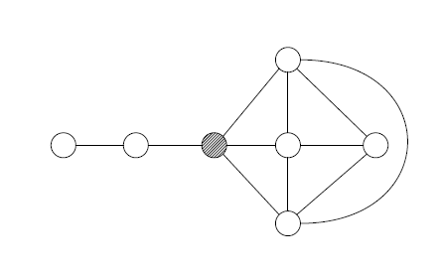
A second example

Slide 26
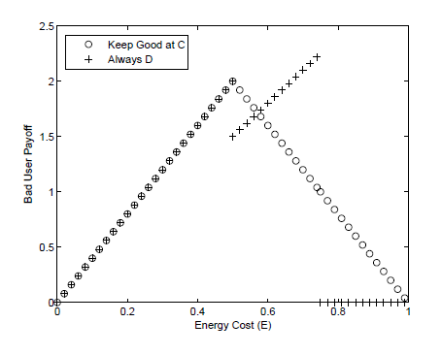
A second example

Slide 27
Work for the future
Is there an exact connection between the topology and the optimal strategy that the Bad users can play against the simple fictitious play of the Good ones?
Not found yet!!

Slide 28
3rd Article
On a Network Creation Game (2003) Fabrikant A, Luthra A, Maneva E, Papadimitriou C, Shenker S

Slide 29
The model
Strategy for player i is the set of undirected edges that i will build
The constructed network will be G(S), where S is the strategy space

Slide 30
Utility function
The cost incurred by a player i is defined
α is the cost of each edge
d(i,j) is the distance between nodes i and j
n_{i} is the number of edges bought by node i

Slide 31
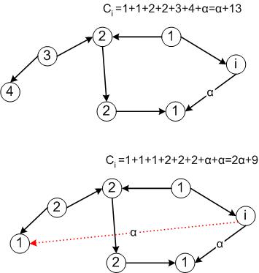
Example

Slide 32
Solution
Nash equilibrium theory is used as the solution concept
Starting from one strategy combination, replace (repeatedly) a player’s strategy by its best response
The final resulting graph should be stable
The overall quality of network is evaluated by Social Cost

Slide 33
Social Cost
To evaluate the overall quality of the network consider social cost
In social cost each term d_{G}(i,j) contributes to the overall quality twice
In a stable network each edge (i,j) is bough at most by one player
Because the distance d_{G}(i,j) is infinite whenever i and j are not connected, any stable network must be connected

Slide 34
Equilibria
For α<1 the complete graph is the only N.E.
For 1≤ α<2, the complete graph is a social optimum (it is no longer a N.E)
For a≥2 then star is a N.E.

Slide 35
Upper – Lower Bound
Upper Bound
For α<n² the price of anarchy is
Lower Bound
For any ε>0, there exists a N.E. with price of anarchy greater than 3-ε

Slide 36
Tree conjecture
There exists a constant A, such that for all α>A, all non-transient Nash equilibria are trees
It has been disproved by [*]
[*] On Nash equilibria for a network creation game. Albers et al (2006)

Slide 37
Transient Nash Equilibrium
Weak Nash Equilibrium
At least one player can change its strategy without affecting its cost
Transient N.E.
It is weak equilibrium from which there exists a sequence of single-player strategy changes, which do not alter the changer’s payoff leading eventually to a non-equilibrium position

Slide 38
Article
They showed that for any positive integer n₀, there exists a graph built by n≥ n₀ players that contain cycles and forms a strong N.E.
Also, they proved that if α≥12nlogn then every N.E. is a tree

Slide 39
Problems
Stars are efficient for Internet but are problematic due to congestion
Internet is not strictly a star or a connected graph
Usually the networks are dynamical (time)

Slide 40
Our thoughts for improvement for paper [1]
When congestion appears give penalty to user
Introduce time using stochastic process
If a user bought many links make better pricing, so that cost α not to be stable for each link

Slide 41
Similarities – Differences between two articles
SIMILARITIES
Application on topology formation in ad hoc networks
They belong to Local Connection Games
They construct an undirected graph
DIFFERENCES
[1] → consider Nash equilibria
[2] → consider pairwise stability between nodes

Slide 42
4th Article
Network Formation: Bilateral Contracting and Myopic Dynamics (2007) Arcaute E, Johari R, Mannor S

Slide 43
Applications
Mobile ad-hoc Networks
The internet at the ISP level

Slide 44
What bad with N.E.
The set of equilibria can be quite large
Equilibria is not always efficient
Depending on the model formulation, N.E. may fail to exist

Slide 45
The model
The players (strategic agents) interact to choose their connections. Particularly, there is a bilateral contracting
Nodes are only aware of local interactions and can only be connected through local connections
Links is the result of bilateral contract between their endpoints (also, edges are undirected)
There is a dynamic process of network formation

Slide 46
Terminology
The outcome arising from strategic decisions of the nodes is posed with triplet (G, Γ, P)
Where P is the Payment Matrix which keeps track of payments
Γ is an directed graph which keeps tracks of contracts

Slide 47
Dynamics
Dynamics are designed so that each stage consists of a unilateral deviation followed by a bilateral deviation
This two-stage dynamics (but, one-time step in the dynamics) fits the solution concept of pairwise stability
Dynamics describe the myopic behavior of a strategic agent

Slide 48
Pairwise Stability
A network is pairwise stable if no coalition of at most 2 nodes can profitably deviate
Specifically,
Pairwise stability requires that no unilateral deviations by a single node are profitable, and that no bilateral deviations by any pair of nodes are profitable

Slide 49
Myopic behavior
Strategic agents only myopically react to the last play of their competitors
They never look ahead in determining their best action

Slide 50
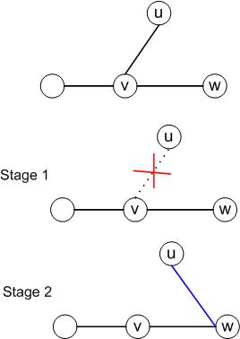
Example

Slide 51
Application - Traffic routing in networks
Nodes incur a cost which consists of
Routing cost,
Link maintenance cost,
Disconnection cost,

Slide 52
Routing Cost
c_{i}≥0 is the routing cost per unit of traffic
f_{i}(G) is the total traffic that transits through plus the total traffic received by

Slide 53
Link maintenance cost
d_{i}(G) is the degree of node i in the graph G
π>0 is the maintenance cost that is incurred by the endpoints of each link

Slide 54
Disconnection cost
n is the number of nodes
n_{i}(G) is the number of nodes I can reach
λ>0 is the cost per unit of traffic not sent because the network is not connected

Slide 55
Convergence
Given any initial outcome, the dynamics converge if there exists K such that, for k>K (k is a round)

Slide 56
Theorem
For any activation process, the dynamics initiated at any outcome converge.
Further, if the activation process is a uniform activation process, then the expected number of rounds to convergence is O(n⁵)

Slide 57
Theorem (continuing)
Given an activation sequence, the limiting state is such that:
The network topology is a tree
It is a pairwise stable outcome

Slide 58
Activation process- Activation sequence
Activation process
Any discrete-time stochastic process {(u_{k},v_{k})} where the pairs (u_{k},v_{k}) are i.i.d. random pairs of distinct nodes
Activation sequence
A realization of an activation process

Slide 59
Limitations
Parameter λ (disconnection cost) is identical for all nodes
Parameter π (formation cost) is identical for all links
Nodes are required to have global information about the network (which is not realistic in most modern data-networks)
Dynamics are in a very restricted version (first stage1 then stage2)

Slide 60
Our thoughts for improvement for paper [2]
Apply Bayesian inference methods for evaluation of λ and π
Use Unilateral decisions which are more flexible
Allow the elimination of one stage, e.g. stage1, for flexibility

Slide 61
Thank you for your attention!!!

Slide 62
Questions
?

