Slide 1
Basics of the Circulatory System
outline and educational goals
Vascular System
fluids in motion, flow-resistance-viscosity
peripheral network, resistance regulation
The Heart
Frank-Starling law of contraction
determinants of cardiac output
preload
afterload
contractility
cardiac cycle
pressure-volume loops of LV
ejection fraction
mechanical work, oxygen consumption
management of low flow states
what shows SvO₂

Slide 2
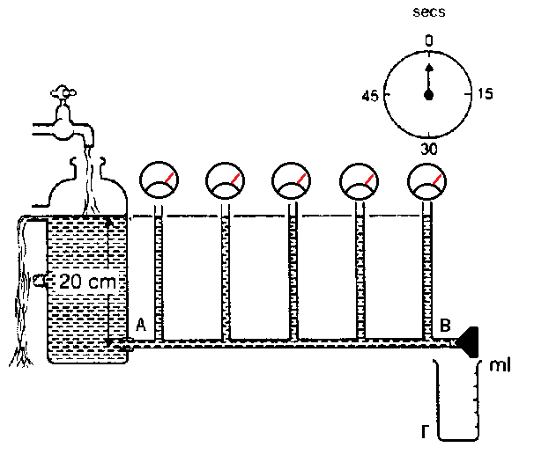
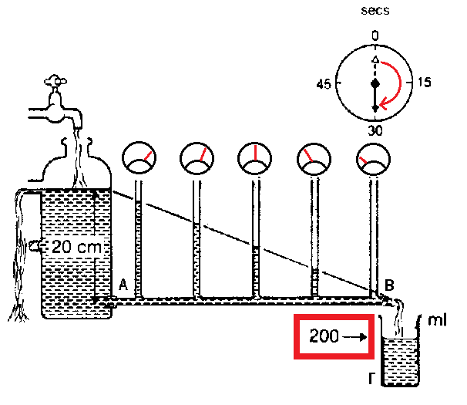
FLUID AT REST
HYDROSTATIC PRESSURE
(dynamic energy)
Vascular System
FLUID IN MOTION
PRESSURE GRADIENT
(transition of dynamic energy to mechanical work)
OUTPUT / FLOW
Q = V / t
Q = ΔΡ / R
In non-ideal fluids, internal molecular forces resist in motion
For non-ideal fluids, motion (in other words flow) always consumes energy
Flow is a result of pressure gradient
This feature of non-ideal fluids to resist in motion is viscosity

Slide 3
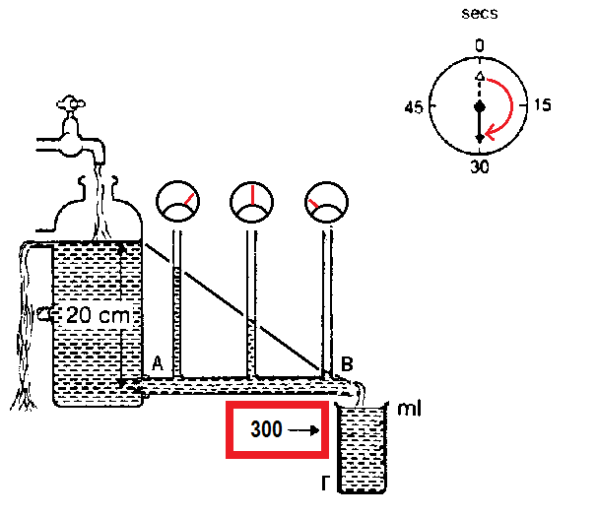
Q = V / t
Q = ΔΡ / R
Q = V / t
Q = ΔΡ / R
π r ⁴
Q = ΔΡ
8 n l
pressure gradient : ΔP=P_{A}-P_{B}
shorter
increased radius
Poiseuille’s law
INCREASED
OUTPUT

Slide 4
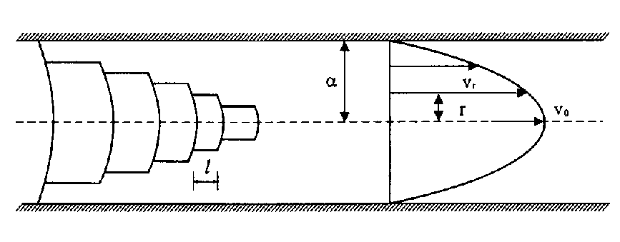
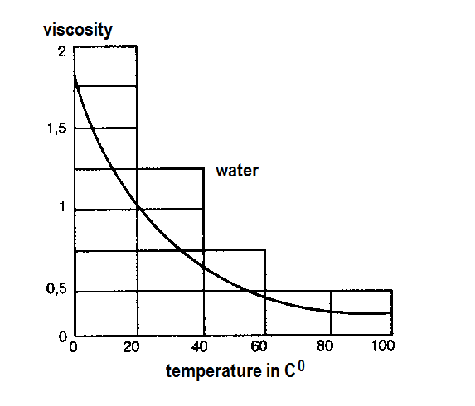
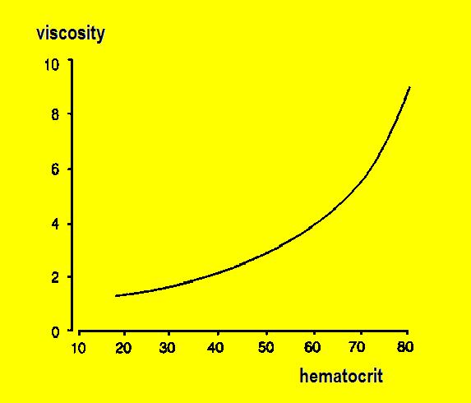
Q = V / t
Q = ΔΡ / R
viscosity
Q = V / t
Q = ΔΡ / R
π r ⁴
Q = ΔΡ
8 n l
BLOOD
Important for anesthesiologists
Flow depends on the geometrical configuration of the network
Flow depends on the rheological characteristics of the fluid

Slide 5
Q = V / t
Q = ΔΡ / R
Q = V / t
Q = ΔΡ / R
π r ⁴
Q = ΔΡ
8 n l
turbulence
all these form resistance to flow
Flow depends on the geometrical configuration of the network
Flow depends on the rheological characteristics of the fluid
Flow and particularly consumed energy during motion
depend on the kind of flow

Slide 6
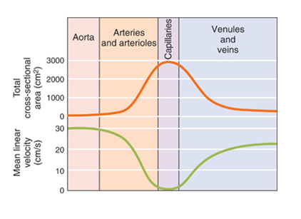
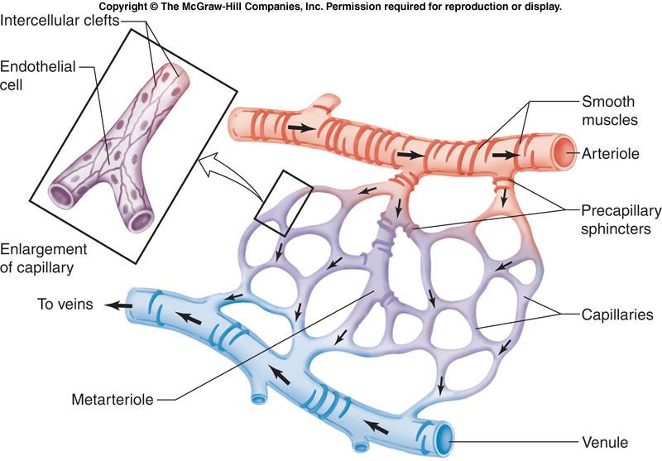
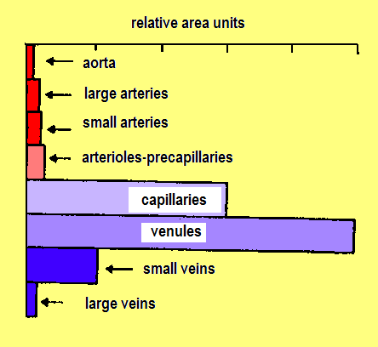
Relationship between total cross-sectional area and flow velocity
aorta 4 %
large arteries 5 %
middle arteries 10 %
small arteries 6 %
arterioles 41 %
capillaries 27 %
venules 4 %
small veins 0,3 %
veins 0,7 %
large veins 0,5 %
venae cavae 1,5 %
ARTERIAL RESISTANCE
93%
VEIN RESISTANCE
7%

Slide 7
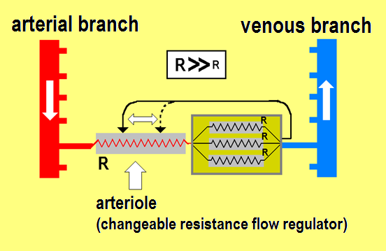
Neural controls Hormonal controls Local controls

Slide 8
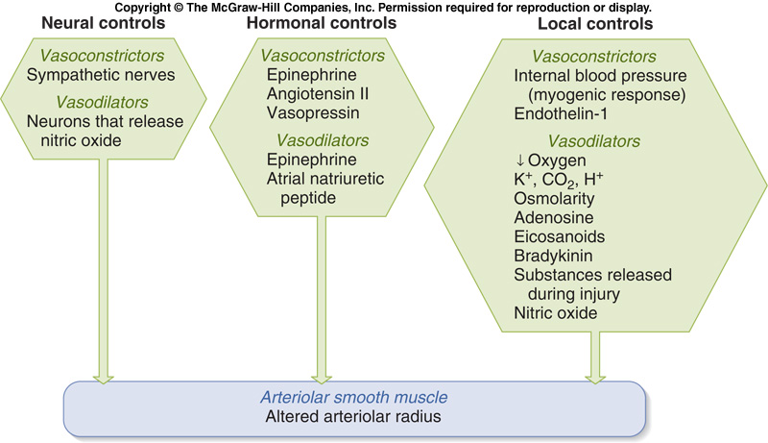
Major factors affecting arteriolar radius
Major factors affecting SYSTEMIC VASCULAR RESISTANCE
Diversity among signals that influence contraction/relaxation in vascular circular smooth muscle implies a diversity of receptors and transduction mechanisms.

Slide 9
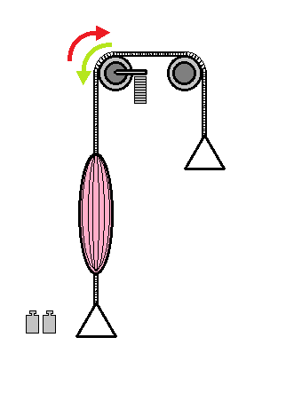
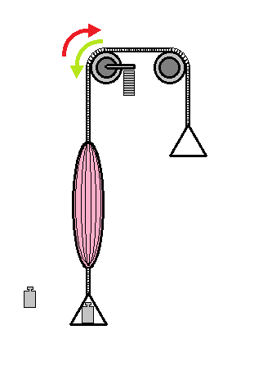
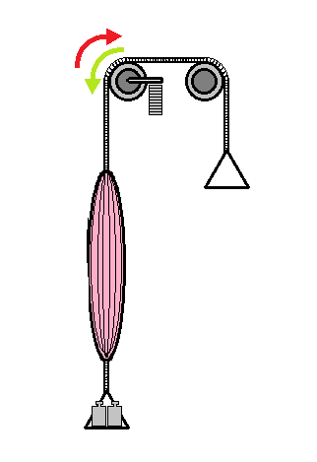
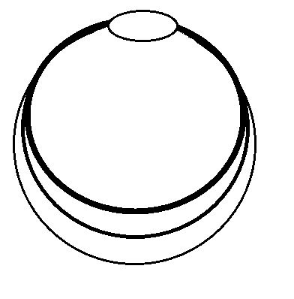
Frank-Starling law of contraction
what is prerload ?
heart pumps whatever returns
and fills it
during diastole
fiber length
before contraction
power of contraction depends proportionally on pre-contraction fiber length
preload is the volume of the left ventricle before contraction (LVEDV)

Slide 10
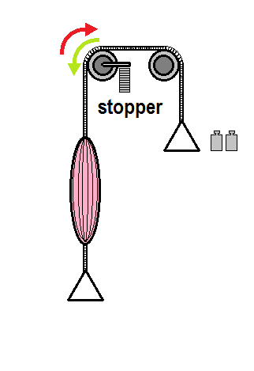
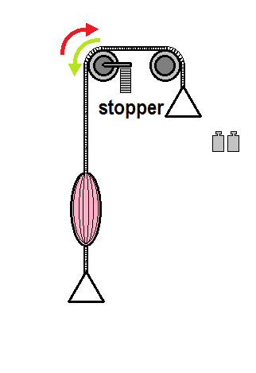
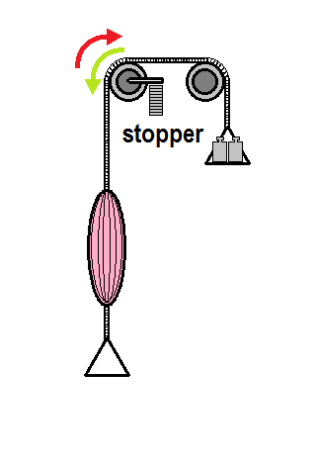
Frank-Starling law of contraction
what is afterload ?
due to the stopper, heart “sees” after-load only when contraction starts
before contraction and with aortic valve closed, heart is “unaware” of how much the afterload is
fiber length after contraction depends on the amount of afterload
fiber length
after contraction
power of contraction depends proportionally on pre-contraction fiber length
preload is the volume of the left ventricle before contraction (LVEDV)

Slide 11
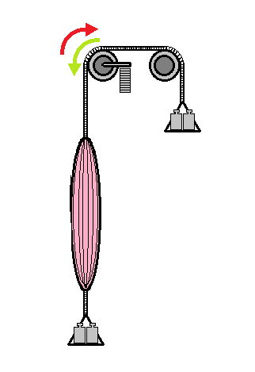
Frank-Starling law of contraction
what is stroke volume
what is cardiac output
SV = EDV - ESV
CO = SV x HR
Stroke Volume is a result of :
the amount of preload (increased preload results greater SV)
the amount of afterload (increased afterload results smaller SV)
the strength of contraction (depends on intrinsic and extrinsic factors)
CARDIAC OUTPUT is a result of :
the amount of preload (increased preload results greater SV)
the amount of afterload (increased afterload results smaller SV)
the strength of contraction (depends on intrinsic and extrinsic factors)
heart rate

Slide 12
Frank-Starling law of contraction
what is stroke volume
SV = EDV - ESV
CO = SV x HR
what is cardiac output
EVERY OF THESE CAN BE MODIFIED DURING ANESTHESIA
hemorrhage, loss of fluid, urine production, vasodilatation, allergic reaction, central block, mechanical ventilation, pain, awareness, vasoconstriction, hypothermia,
electrolyte disturbance, infarction, drugs, mesenteric traction, other reflexes
EVERYTHING CAN BE MODIFIED BY THE ANESTHESIOLOGIST
CARDIAC OUTPUT is a result of :
the amount of preload (increased preload results greater SV)
the amount of afterload (increased afterload results smaller SV)
the strength of contraction (depends on intrinsic and extrinsic factors)
heart rate

Slide 13
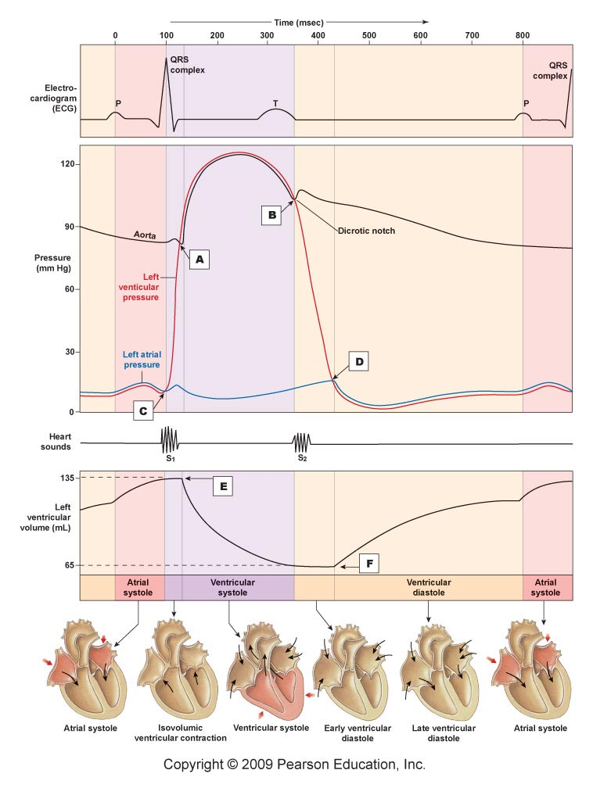
aortic valve closure
early diastole, isovolumic relaxation
great reduction of pressure
no volume change
mitral valve opening
further reduction of pressure
quick volume increase
RAPID FILLING PHASE (RFP)
late diastole
RFP

Slide 14
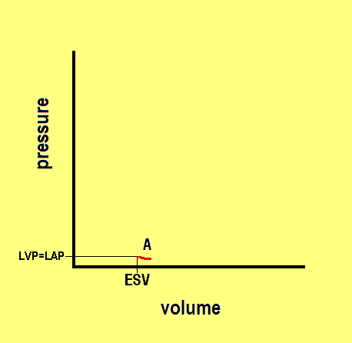
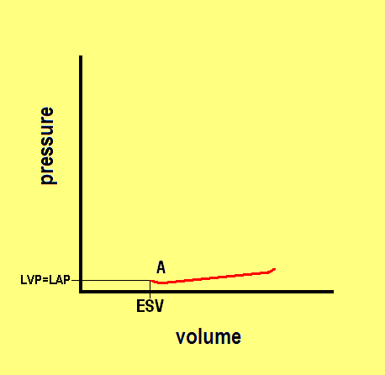
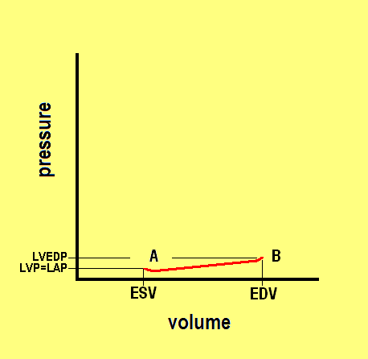
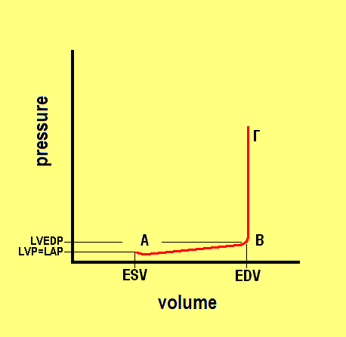
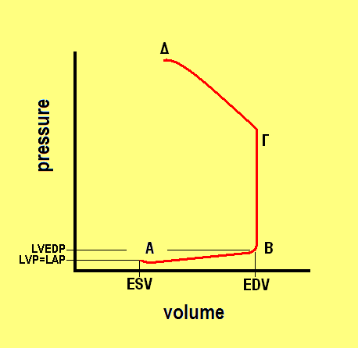
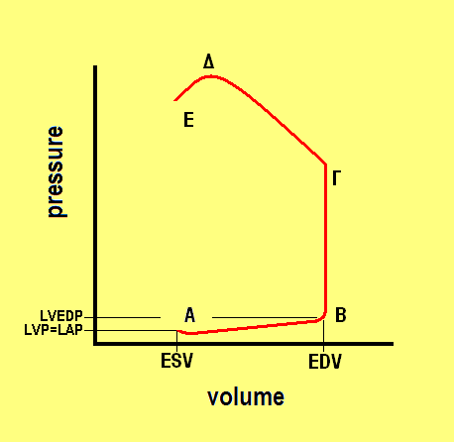
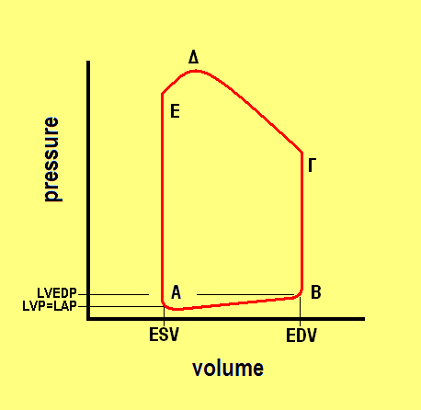
aortic valve
closure
systolic pressure
diastolic
pressure
aortic valve
opening
mitral valve
opening
mitral valve
closure

Slide 15
systolic pressure
ejection
relaxation
diastolic
pressure
stroke volume
contraction
filling
SV = EDV - ESV
EF = SV / EDV

Slide 16
Mechanical Function of Left Ventricle - Cardiac Output
C.O. = SV X HR
C.O. (cardiac output)
SV (stroke volume)
HR (heart rate)
heart pumps whatever returns
during diastole
preload
systolic pressure
afterload
E = aortic valve
closure
volume
(effective arterial elastance)
Ea = Pes / SV
diastolic
pressure
contractility
pressure

Slide 17
Mechanical Function of Left Ventricle - Cardiac Output
WHAT DETERMINES CARDIAC OUTPUT ?
tissue metabolism determines cardiac output*
heart pumps whatever returns
during diastole
* (between limits)
Neural controls
Hormonal controls
Local controls
VENOUS RETURN
(PRELOAD)
volume
TISSUE METABOLISM
pressure

Slide 18
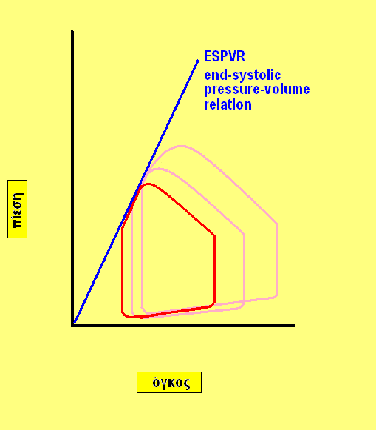
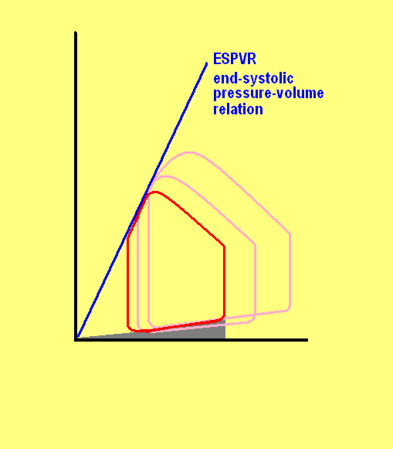
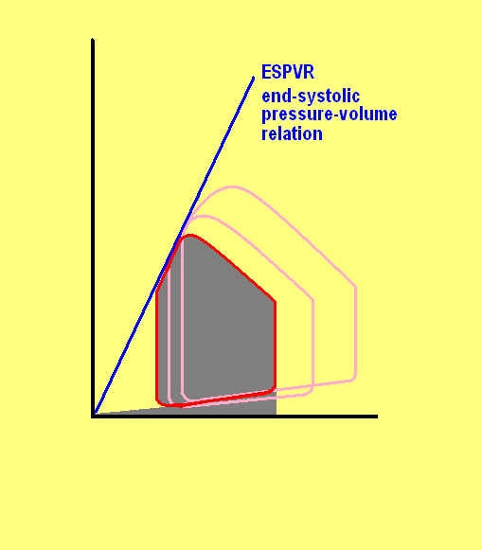
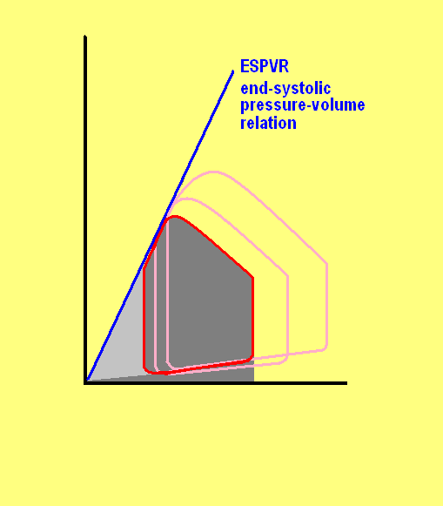
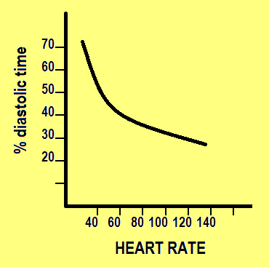
Mechanical WORK of Left Ventricle
mechanical WORK is directly related to OXYGEN CONSUMPTION
cardiac output (CO) is a poor indicator of mechanical work
as the latest depends on the pressure level
the product: pressure (P=Force/Surface) X volume (V=SurfaceXlengh)
has dimensions of work (W=FXl)
any increase in mechanical work
is accompanied by increased oxygen consumption,
and in patients with coronary artery disease,
it has detrimental effects
BASAL METABOLISM
EXTERNAL WORK (SV)
DYNAMIC ENERGY
HEART (LV) IS PERFUSED DURING DIASTOLE
volume
pressure

Slide 19
Mechanical WORK of Left Ventricle
mechanical WORK is directly related to OXYGEN CONSUMPTION
cardiac output (CO) is a poor indicator of mechanical work
as the latest depends on the pressure level
the product: pressure (P=F/S) X volume (V=SXl)
has dimensions of work (W=FXl)
any increase in mechanical work
is accompanied by increased oxygen consumption,
and in patients with coronary artery disease,
it has detrimental effects
HEART (LV) IS PERFUSED DURING DIASTOLE
tachycardia reduces more diastolic time than systolic time
tachycardia reduces oxygen delivery to the left ventricle
tachycardia increases the work of left the ventricle
tachycardia increases heart’s oxygen consumption
for the anesthesiologist
avoiding tachycardia
and increased work of left ventricle
is “must”
especially for patients with CAD

Slide 20
Effect of Regional Dyskinesis on Global LV Function
induced by apical administration of Esmolol
140
120
Baseline
Apical
Esmolol
100
β-1 cardioselective blocker
decreasing HR
negative inotropic effect
80
reduced contractility
ESPVR shifts downward and to the right
SV2
LV Pressure (mm Hg)
the effect on
Cardiac Output
is augmented by both the decrease in SV
and in HR
60
SV1
40
20
0
0
10
20
30
40
50
60
LV Volume (mL)
Strum & Pinsky. Anesth Analg 90: 252-261, 2000

Slide 21
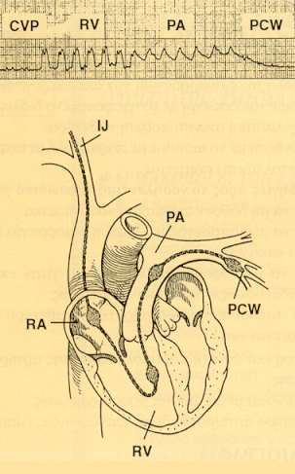
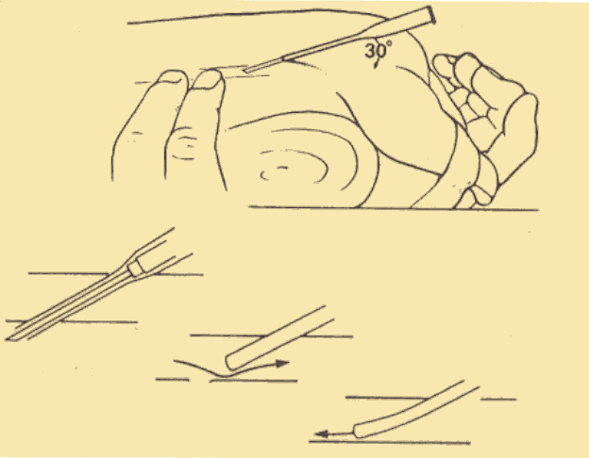
Management of low flow states
A variety of clinical conditions lead to, or are accompanied by
a decrease in cardiac output (insufficient for tissue needs)
(myocardial infarction, other causes of cardiogenic shock, pulmonary edema, hypovolemia, dehydration, hemorrhage, allergic reactions, drug toxicity, sepsis etc)
Management of these life threading situations is based on :
knowledge of the above individual parameters determining cardiac performance, and, in general, circulatory function
getting information from the patient (monitoring)
applying special (intensive) treatment

Slide 22
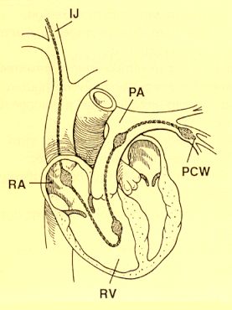
Management of low flow states
Estimation of RV preload (CVP, RAP, RVEDP)
Estimation of LV preload (PCWP)
Measurement of Cardiac Output (CO, CI)
Measurement of Stroke Volume (SV=CO/HR)
Estimation of systemic vascular resistance (SVR=(MAP-RAP)/CO)
Continuous measurement of saturation of mixed venous blood (SvO₂)
getting information from the patient (monitoring)

Slide 23
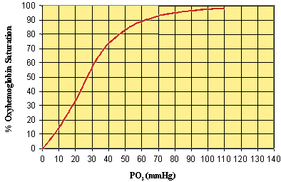
Management of low flow states
What is SvO₂ ?
SaO₂
SvO₂
Continuous measurement of saturation of mixed venous blood (SvO₂)
PvO₂
PaO₂
Important especially in Cardiac Anesthesia and Intensive Care for the management of low flow states

Slide 24
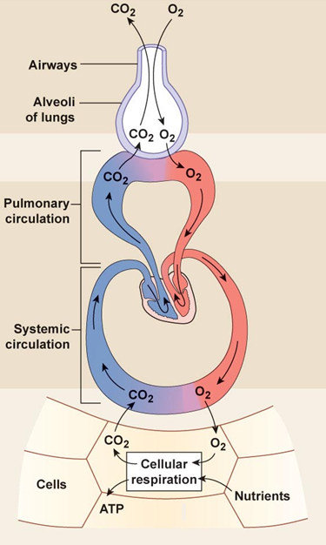
Management of low flow states
Continuous measurement of saturation of mixed venous blood (SvO₂)
What is SvO₂ ?
What shows SvO₂ ?
Arterial oxygen content CaO₂≈SaO₂ X Hg X 1,34
Tissue oxygen delivery DaO₂=CaO₂ X CO
Mixed venous oxygen content ≈ SvO₂ X Hg X 1,34
Oxygen return DvO₂=CvO₂ X CO
Oxygen consumption VO₂ = DaO₂ - DvO₂
DvO₂
DaO₂
VO₂ = DaO₂ - DvO₂
= (CaO₂ – CvO₂) X CO
= (SaO₂ - SvO₂) X CO X Hg X 1,34
SvO₂ = SaO₂ – (VO₂ / [CO X Hg X 1,34])
VO₂

Slide 25
Management of low flow states
Continuous measurement of saturation of mixed venous blood (SvO₂)
What is SvO₂ ?
What shows SvO₂ ?
Arterial oxygen content CaO₂≈SaO₂ X Hg X 1,34
Tissue oxygen delivery DaO₂=CaO₂ X CO
Mixed venous oxygen content ≈ SvO₂ X Hg X 1,34
Oxygen return DvO₂=CvO₂ X CO
Oxygen consumption VO₂ = DaO₂ - DvO₂
DvO₂
DaO₂
Determinants of SvO₂
SaO₂
Hg
CO
VO₂
with SaO₂, Hg, VO₂ relatively constant
SvO₂
is a continuous indicator of Cardiac Output
VO₂

Slide 26
ΕΡΩΤΗΣΕΙΣ –ΑΠΑΝΤΗΣΕΙΣ
Σε ένα κλειστό σύστημα σταθερής ροής, η ταχύτητα ροής:
αυξάνεται όσο αυξάνεται η επιφάνεια διατομής
ελαττώνεται όσο αυξάνεται η επιφάνεια διατομής
τίποτε από τα παραπάνω (η ταχύτητα ροής είναι ανεξάρτητη από την επιφάνεια διατομής)
Κυκλώστε την λανθασμένη έκφραση από τις παρακάτω:
κατά την υποθερμία, οι περιφερικές αντιστάσεις αυξάνονται
οξεία ελάττωση του αιματοκρίτη (πχ: αιμοαραίωση από χορήγηση υγρών) έχει σαν αποτέλεσμα την αύξηση των περιφερικών αντιστάσεων
στις περιφερικές αντιστάσεις αντανακλούν τα γεωμετρικά χαρακτηριστικά του αγγειακού δικτύου (αγγειοσύσπαση-αγγειοδιαστολή), τα ρεολογικά χαρακτηριστικά του αίματος (ιξώδες) και τα χαρακτηριστικά της ροής (ομαλή-νηματώδης, στροβιλώδης)
Οι περιφερικές αντιστάσεις εξαρτώνται κυρίως από τη διέγερση του συμπαθητικού και λιγότερο από τη διέγερση του παρασυμπαθητικού
Η ταχυκαρδία έχει καταστρεπτικό αποτέλεσμα στους ασθενείς με στεφανιαία νόσο γιατί :
αυξάνεται η χρονική διάρκεια της συστολής και αυξάνεται έτσι η κατανάλωση οξυγόνου από το μυοκάρδιο
αυξάνεται η χρονική διάρκεια της διαστολής και αυξάνεται έτσι η κατανάλωση οξυγόνου από το μυοκάρδιο
αυξάνεται υπέρμετρα η κατανάλωση οξυγόνου από το ερεθισματαγωγό σύστημα
ελαττώνεται ο χρόνος άρδευσης της καρδιάς
τίποτε από τα παραπάνω

Slide 27
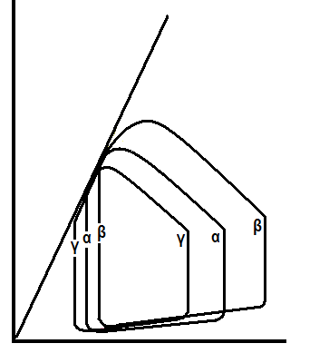
Στο παράπλευρο σχήμα, ενδοφλέβια χορήγηση νιτρογλυκε-ρίνης σε συνήθη δόση (ταχείας δράσης αγγειοδιαστολή, κυ-ρίως φλεβοδιαστολή) στον φυσιολογικό άνθρωπο (καμπύλη α) έχει σαν αποτέλεσμα :
την καμπύλη β
την καμπύλη γ
δεν αναμένεται μεταβολή
Στο παράπλευρο σχήμα, οι τρεις καμπύλες αντιπροσωπεύ-ουν τρεις διαφορετικές καταστάσεις του κυκλοφορικού
με την ίδια, όμως, καρδιακή παροχή. Σε ποια κατάσταση η συχνότητα σφύξεων είναι μεγαλύτερη ;
1. στην καμπύλη α
στην καμπύλη β
στην καμπύλη γ

