Slide 1
ASTHMA

Slide 2
ASTHMA

Slide 3
ASTHMA

Slide 4
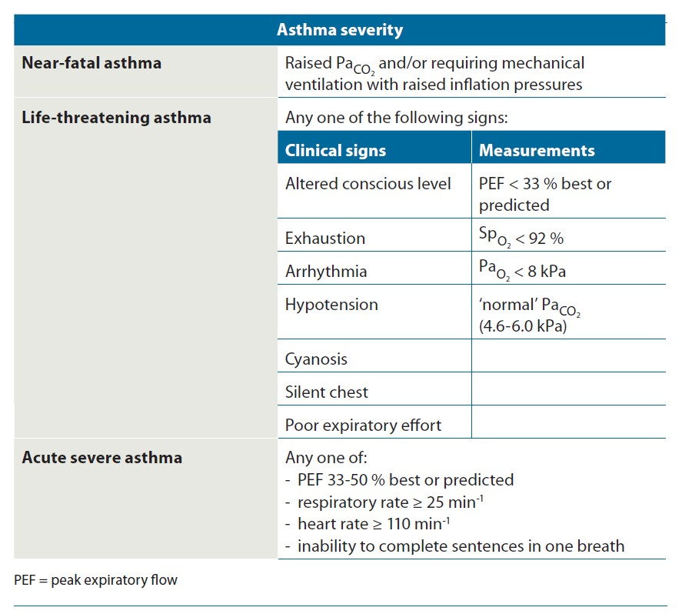
ASTHMA

Slide 5
ASTHMA

Slide 6
ASTHMA

Slide 7
ASTHMA

Slide 8
ASTHMA

