Slide 1
Ιατρική Σχολή Πανεπιστημίου Θεσσαλίας
Αναισθησιολογική κλινική Π.Γ.Ν. Λάρισας
Ακαδημαϊκό έτος 2017 - 2018
Επιλεγόμενο μάθημα: Διαχείριση του πόνου
Acute pain management
ΚΩΝ/ΝΟΣ Γ ΣΤΑΜΟΥΛΗΣ
ΑΝΑΙΣΘΗΣΙΟΛΟΓΟΣ ΕΠΙΜ. Α’
Π.Γ.Ν.ΛΑΡΙΣΑΣ

Slide 2
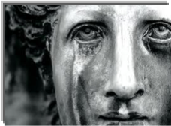
Acute pain management
P atients
A re
I n
N eed

Slide 3
Acute pain management
International Association for the Study of Pain (IASP)
Pain is an unpleasant sensory and emotional experience
associated with actual or potential tissue damage,
or described in terms of such damage
Acute pain: pain of recent onset and probable limited duration.

Slide 4
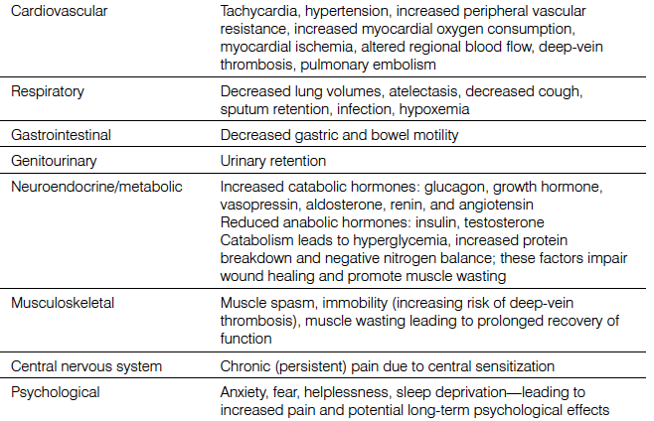
Acute pain management
Untreated acute pain side effects

Slide 5
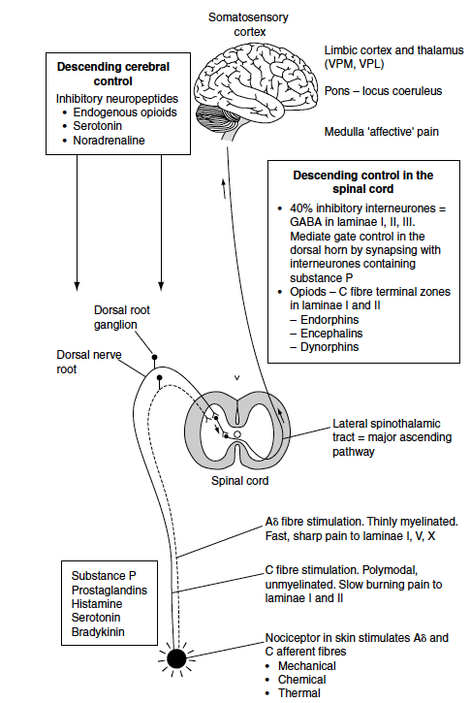
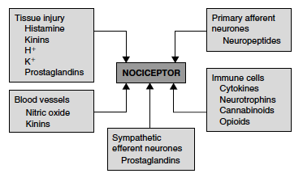
Acute pain management
Nociception / Nociceptors

Slide 6
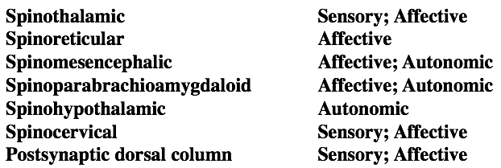
Acute pain management

Slide 7
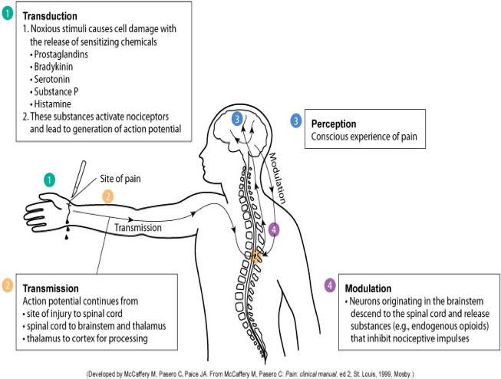
Acute pain management

Slide 8
Acute pain management
Types of acute pain

Slide 9
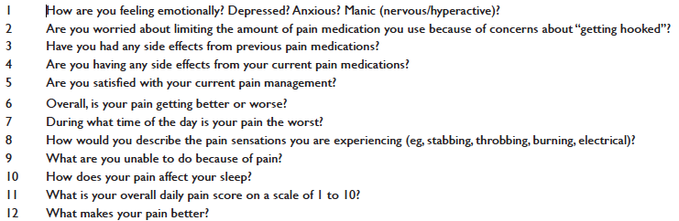
Acute pain management
Assessment questions

Slide 10
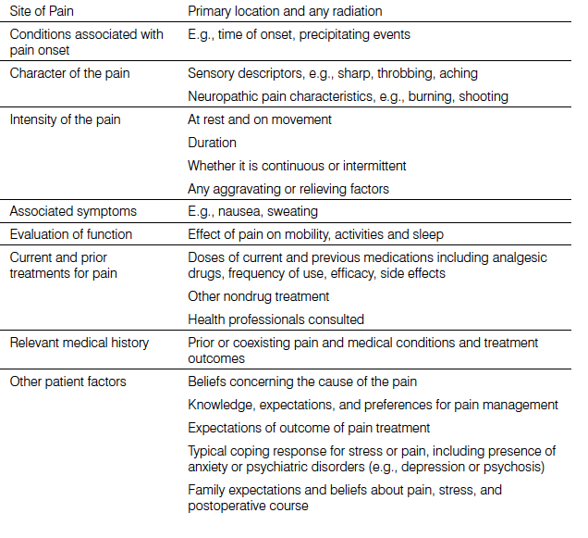
Acute pain management
Assessment and monitoring

Slide 11
Acute pain management
Assessment and monitoring
Unidimensional measures
A 30-50% pain intensity reduction could be rated as clinically significant
Visual analog scale
Numerical rating scale
Verbal numerical rating scale
Verbal descriptor scale
Specific scales for children and patients having difficulties with
communication
Assessment of function

Slide 12
Acute pain management
Pain management strategies
Pharmacological
Systemic administration
Acetamenophene
NSAID’S
Opioids
Adjuvants
Intervational
Regional techniques
Peripheral nerve block
Non pharmacological
Information
Relaxation and attentional strategies
Transcutaneous electrical nerve stimulation
Acupuncture

Slide 13
Acute pain management

Slide 14
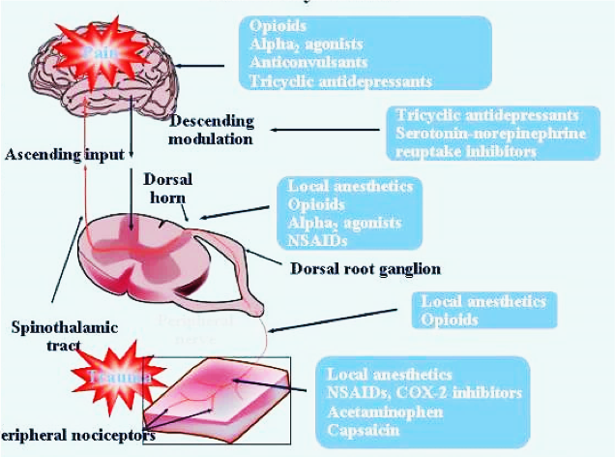
Acute pain management

Slide 15
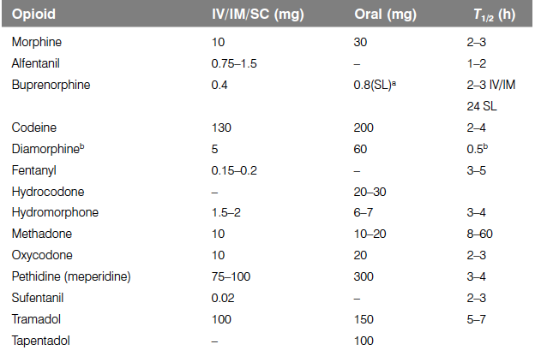
Acute pain management

Slide 16
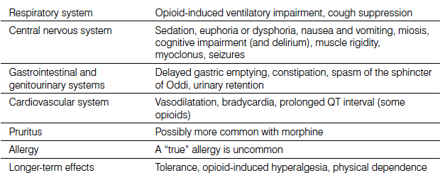
Acute pain management
Opioid side effects

Slide 17
Acute pain management
Non opioid medication
Gastrointestinal bleeding, renal impairment, major cardiovascular events, fracture healing delay, platelet function impairment,
Hepatotoxicity
Sedation

Slide 18
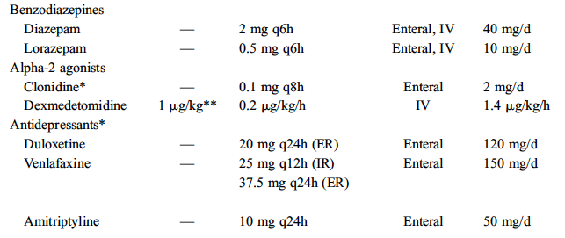
Acute pain management
Ventilatory impairment, sedation, delirium
Hypotension
Bradycardia
Sedation, Seizures, QT prologation
Sedation

Slide 19
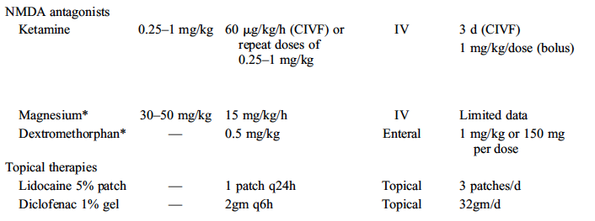
Acute pain management
Hallucinations, abuse

Slide 20
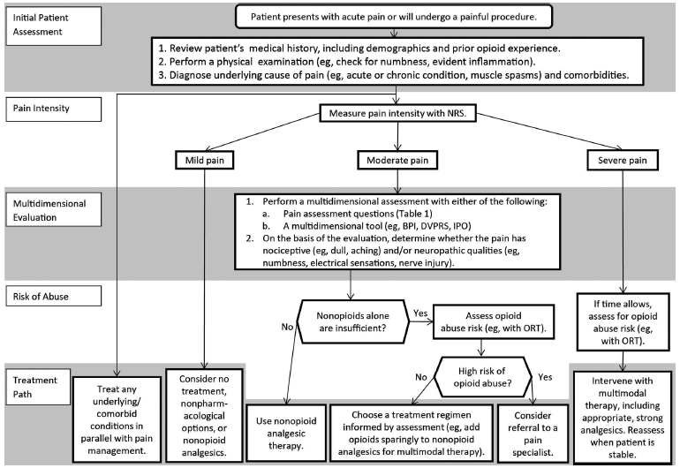
Acute pain management

Slide 21
Σας ευχαριστώ

