Slide 1

History
Types of pain
Pain Management Services
Pain Control Strategies
Sympathy is not enough

Slide 2
ΘΕΡΑΠΕΙΑ ΠΟΝΟΥ
Διδασκαλία στην Αίθουσα Σεμιναρίων της Αναισθησιολογικής Κλινικής κάθε Τρίτη 15:00-17:00 και παρουσία στα Ιατρεία Πόνου
Δικαίωμα στην εξέταση: 1 απουσία αδικαιολόγητη, 2 δικαιολογημένες
Διαφάνειες ανεβαίνουν στο e-class, στην αρχή κάθε διαφάνειας θα αναφέρεται ο στόχος του μαθήματος και στο τέλος θα υπάρχουν 5 ερωτήσεις MCQs που θα τις απαντούν οι φοιτητές
3 πρόοδοι, Εξετάσεις με 20 MCQ, παρόμοια με αυτά από τα μαθήματα
Οι διαφάνειες στα Αγγλικά
Sympathy is not enough

Slide 3
1^{η} εβδομάδα Ιστορία
13-2-1018 Ορισμός
Κλινικά σύνδρομα πόνου
Οργάνωση και δομή μιας μονάδας πόνου
Αρναούτογλου Ε, Φλωσσός Α
2^{η} εβδομάδα Τι πρέπει να γνωρίζω για την ανατομία του πόνου;
20-2-2018 Τι πρέπει να γνωρίζω για τη φυσιολογία πόνου;
Βρετζάκης Γ
3^{η} εβδομάδα Γενικές αρχές εκτίμησης πόνου και διαχείρισής του
27-2-2018 Αρναούτογλου Ε, Κοράκης Α
Sympathy is not enough

Slide 4
4^{η} εβδομάδα Τι πρέπει να γνωρίζω για τη φαρμακολογία του πόνου
6-3-2018 Μπουζιά Α
5^{η} εβδομάδα 1^{η} πρόοδος
13-3-2018 Αντιμετώπιση επιπλοκών θεραπείας πόνου
Λαού Ε
6^{η} εβδομάδα Επεμβατικές τεχνικές αντιμετώπισης πόνου
20-3-2018 Χαραλαμπίδου Α
7^{η} εβδομάδα Εναλλακτικές θεραπείες για τον πόνο. Βελονισμός.
27-3-2018 Ο ρόλος του ψυχολόγου
Λάσδα Ε
8^{η} εβδομάδα Οξύς πόνος. Αντιμετώπιση
17/4/2018 Σταμούλης Κ
Sympathy is not enough

Slide 5
9^{η} εβδομάδα 2^{η} πρόοδος
24/4/2018 Χρόνιος καλοήθης πόνος. Παραδείγματα. Αντιμετώπιση
Αρναούτογλου Ε, Κουτσοθύμιου Α
10^{η} εβδομάδα Νευροπαθητικός πόνος. Παραδείγματα. Αντιμετώπιση
8-5-2018 Αρναούτογλου Ε,
11^{η} εβδομάδα Καρκινικός πόνος. Αντιμετώπιση
22/5/2018 Σταματίου Γ
12^{η} εβδομάδα 3^{η} πρόοδος
Παρηγορική αγωγή σε ασθενείς τελικού σταδίου
29/5/2018 Σενάρια οξέος πόνου, Σενάρια χρόνιου πόνου
Αρναούτογλου Ε
Sympathy is not enough

Slide 6
«ΜΑΘΗΣΙΑΚΕΣ ΕΚΒΑΣΕΙΣ ΚΑΙ ΙΚΑΝΟΤΗΤΕΣ ΓΙΑ ΤΗΝ ΠΡΟΠΤΥΧΙΑΚΗ ΙΑΤΡΙΚΗ ΕΚΠΑΙΔΕΥΣΗ ΣΤΗΝ ΕΥΡΩΠΗ-ΠΡΟΓΡΑΜΜΑ MEDINE» οι τελειόφοιτοι θα πρέπει να είναι ικανοί να αντιμετωπίσουν τον πόνο και την ενόχληση ( 4.4 έκβαση 1^{ου} & 2^{ου} επιπέδου)
Σύμφωνα δε με την IASP (International Association for the Study of Pain)
εφόσον δεν υπάρχει αναγνωρισμένη ειδικότητα Ιατρικής Πόνου (Pain Medicine) θα πρέπει να γίνεται επαρκής, προπτυχιακή εκπαίδευση στις Ιατρικές σχολές, ώστε να καλυφθεί το γνωσιακό αντικείμενο

Slide 7
A Brief History of Pain HISTORY
MARC LALLANILLA, 2005
The Greek goddess of revenge, Poine, was sent to punish the mortal fools who had angered the gods
Poine also gave us our word "pain"
Many ancient cultures believed pain and disease were punishment for human folly. They tried to appease angry gods with rituals like votive offerings and scapegoats, sacrificial animals that carried the sins of people out into the wilderness
One of the first pain theories involved Homer (8th century BC) who described pain as “arrows shot by Gods”. Aristotle (384 BC – 322 BC) stated that Pain was due to evil spirits and that the gods entered the body during injury. The brain was not believed to have any direct influence and for years the liver or heart was considered to be the center for pain control. Many cultures and societies have developed their own theories regarding pain, including causations from deities, energy fields, the moon, and the stars
Notes:
Magic and ritual were very common in ancient cultures," Magic and ritual were very common in ancient cultures," Many ancient doctors apparently figured their patients needed a hole in the head. Hundreds of skulls with small holes that have partially healed over have been found worldwide, but especially in Incan archaeological sites in South America.

Slide 8
Holes in the Head
(Incan, South America, Hippocrates, the ancient Greek physician, trepanation,) willow bark and leaves from earlier cultures, and he prescribed chewing willow leaves to women in childbirth
His prescription was not without merit -- willow trees, members of the plant genus Salix, contain a form of salicylic acid, the active ingredient in aspirin
Notes:
Magic and ritual were very common in ancient cultures," Magic and ritual were very common in ancient cultures," Many ancient doctors apparently figured their patients needed a hole in the head. Hundreds of skulls with small holes that have partially healed over have been found worldwide, but especially in Incan archaeological sites in South America.

Slide 9
The Egyptians used to take electric eels out of the Nile and lay them over the wounds of patients
Transcutaneous electrical nerve stimulation, or TENS, is a popular treatment for lower back pain and arthritis aches
In the medieval era, pain relief came mainly from a wide variety of herbs popular concoction was known as theriac
It was usually prepared in a honey base with about 64 different compounds in it.
Some of those herbs contain opiates
Minerals were also used in the medieval pharmacopoeia: gold, ivory, unicorn horn
Early 1900s some physicians used gold salts injected into limbs to treat arthritis
Notes:
Magic and ritual were very common in ancient cultures," Magic and ritual were very common in ancient cultures," Many ancient doctors apparently figured their patients needed a hole in the head. Hundreds of skulls with small holes that have partially healed over have been found worldwide, but especially in Incan archaeological sites in South America.

Slide 10
Rene Decartes (1596 – 1650), the father of the Cartesian Model of Pain described pain as a stimulus created by the tissues as the origin of pain and the tissues send pain messages to the brain
Examples of treatments that are based on the Cartesian Model of pain include epidurals, other types of nerve blocks, and cortisone injections
Ronald Melzack knew that the Gate Control Theory was not complete because it does not explain various conditions including phantom limb pain One explanation involves the memory of pain that is stored in the brain. This memory can involve emotions, movements, even the time of year to trigger a painful response

Slide 11
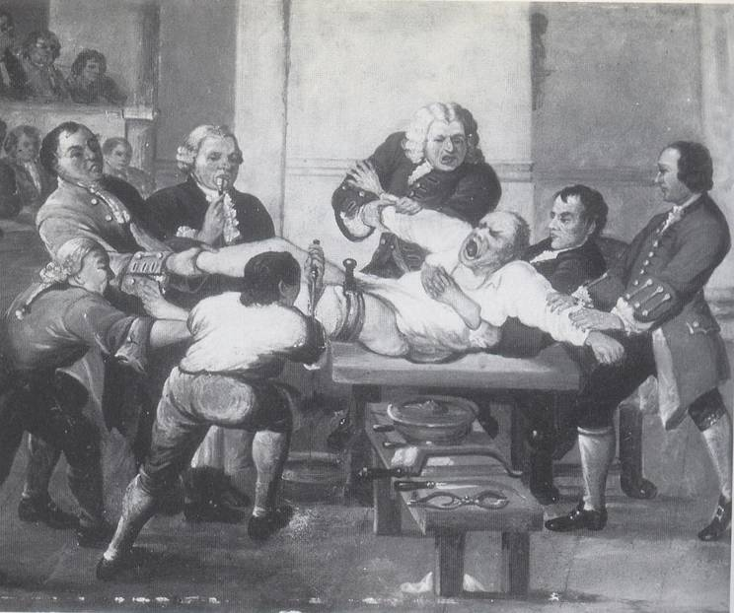
Pain Management in the late 18th century

Slide 12
The first new significant treatment for pain occurred in 1846 with the use of anesthesia for surgery
Queen Victoria was really the first one to have anesthesia for childbirth
In 2001 Ronald Melzack described the Neuromatrix Model of Pain
Treating the Whole Patient

Slide 13
Definition
IASP
“Pain is defined as an unpleasant sensory and emotional experience associated with
actual or potential tissue damage, or described in terms of such damage.”

Slide 14
TYPES OF PAIN
ACUTE
CHRONIC > 1-3 mts
Post-operative
Obstetric - Labor
Burns
Trauma
Infective / Inflammatory conditions
Ischaemic pain
Visceral pain
Cancer pain
  Cancer related
  From cancer therapy
  Cancer unrelated
Non-cancer
  Nociceptive
  Neuropathic
  Idiopathic
Causes

Slide 15
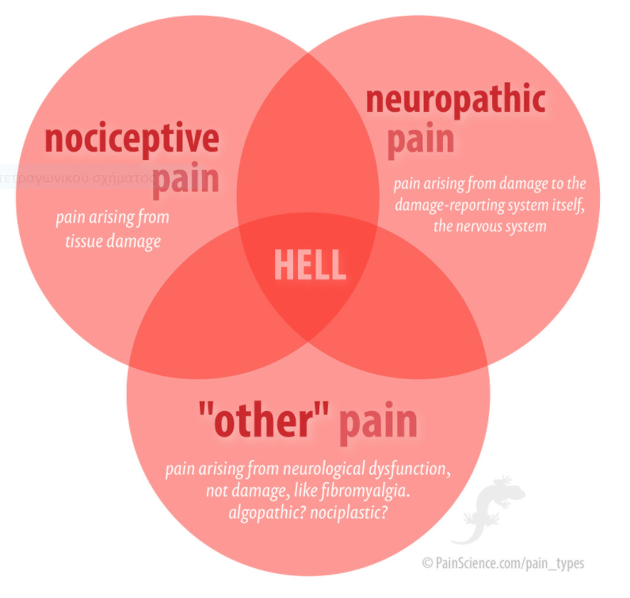
TYPES OF PAIN

Slide 16
TYPES OF PAIN
NOCICEPTIVE
NEUROPATHIC
Visceral
Somatic
Organs –
heart, liver,
pancreas, gut,
etc.
bones, joints
connective tissues
muscles

Slide 17
Nociceptive: Somatic Pain
Descriptors: aching, deep, dull, gnawing
Distribution/Examples:
  Well localized—patients can often point with one finger to the location of their pain
    bone mets, strained ankle, toothache
Analgesics: NSAIDS, acetaminophen opioids
Quality

Slide 18
Nociceptive: Somatic Pain
Aching, often constant
May be dull or sharp
Often worse with movement
Well localized
Eg/
Bone & soft tissue
chest wall

Slide 19
Nociceptive: Visceral Pain
Descriptors: cramping, squeezing, pressure
Distribution/Examples:
  Referred
    heart attack, kidney stone
  Colicky
    Bowel obstruction, gallstone
  Diffuse
    Peritonitis
Analgesics: opioids; acetaminophen
Quality

Slide 20
Nociceptive: Visceral Pain
Constant or crampy
Aching
Poorly localized
Referred
Eg/
CA pancreas
Liver capsule distension
Bowel obstruction

Slide 21

NEUROPATHIC PAIN
features
COMPONENT | DESCRIPTORS | EXAMPLES
Steady, Dysesthetic | Burning, Tingling Constant, Aching Squeezing, Itching Allodynia Hypersthesia | Diabetic neuropathy Post-herpetic neuropathy
Paroxysmal, Neuralgic | Stabbing Shock-like, electric Shooting Lancinating | trigeminal neuralgia may be a component of any neuropathic pain

Slide 22
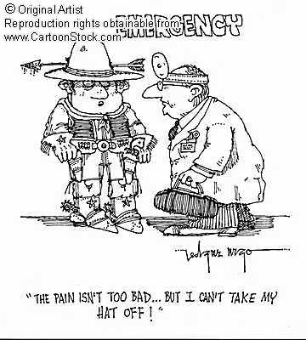

Slide 23

Pain Management Services
Teamwork
‘a distinguishable set of two or more people
who interact, dynamically, interdependently, & adaptively
toward a common & valued goal/objective/mission,
who have each been assigned specific roles or functions to perform, &
who have a limited life-span of membership’.
Salas & Colleagues 1992.
Notes:
Salas E, Dickinson T, Converse S, Tannenbaum S. Swezey R, Salas E. Towards an understanding of team performance and training, Teams, Their Training and Performance , 1992Norwood: Ablex Publishing Corporationpg
Salas and colleagues defined teamwork as ‘a distinguishable set of two or more people who interact, dynamically, interdependently, and adaptively toward a common and valued goal/objective/mission, who have each been assigned specific roles or functions to perform, and who have a limited life-span of membership’.

Slide 24

Multidisciplinary team (MDT) in the management of both acute and especially persistent pain
All facets of the pain are given equal importance in assessment and management
Research, audit, innovation, quality improvement attention to patient safety
High-quality pain services.

Slide 25

Multidisciplinary
a service that involves several members from various health care professional backgrounds, such as medicine, nursing, physiotherapy, occupational therapy, psychology, play therapy.
Notes:
Multidisciplinary: this indicates a service that involves several members from various health care professional backgrounds, such as medicine, nursing, physiotherapy, occupational therapy, psychology, play therapy.

Slide 26
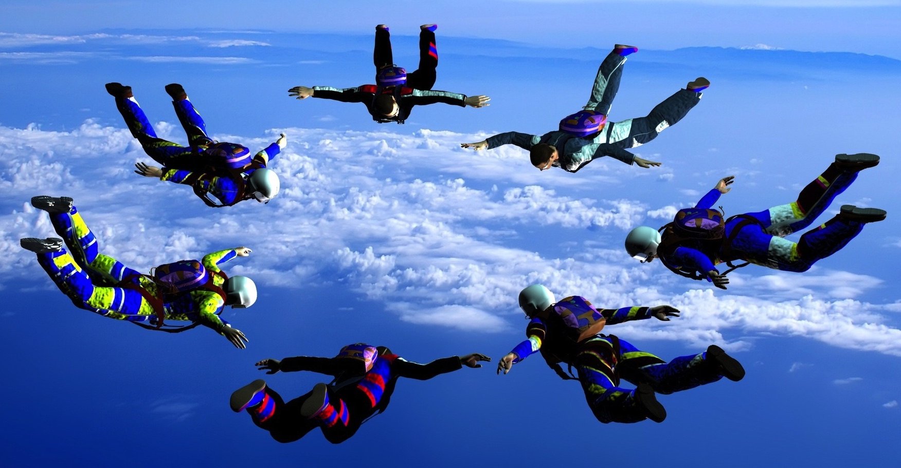
Multispecialty
a service with close collaboration and liaison between several medical specialities (for example, gynaecology, psychiatry, neurology, paediatrics) in assessing and managing a specific patient and usually joint clinics.

Slide 27


Consultants in pain management must work in environments
which encourage team working and effective communication.
Notes:
Consultants in pain management must work in environments which encourage team working and effective communication. Equipment and accommodation must be safe and appropriate. Planning for team interventions and feedback, scheduled MDT meetings, departmental business and governance meetings are some of the basic requirements necessary to support the multidisciplinary team.

Slide 28

Basic Requirements for the MDT
Planning for team interventions and feedback,
scheduled MDT meetings,
departmental business &
governance meetings

Slide 29
Standards for acute and postoperative pain
Acute pain teams must include adequate numbers of appropriately trained doctors and nurses.
Where not available within the core acute pain service, there must be access to expertise in regional anaesthesia.
Core Standards for Pain Management Services in the UK 2015
Notes:
Core Standards for Pain Management Services in the UK 2015

Slide 30
Standards for acute and postoperative pain
Close links with pharmacy services must be in place to ensure safe and appropriate prescribing of analgesics.
Pain Management services should have a unified governance and management structure to ensure that acute and chronic services work together in comfort.
Core Standards for Pain Management Services in the UK 2015
Notes:
Core Standards for Pain Management Services in the UK 2015

Slide 31
Recommendations for acute and postoperative pain
Formal MDT meetings are desirable when managing complex pain cases.
These meetings should involve representatives from the patient’s medical team, chronic pain specialists, physiotherapists or psychologists.
Close links with other teams involved in pain management, such as palliative care and oncology, can result in improved patient outcomes.
Core Standards for Pain Management Services in the UK 2015
Notes:
Core Standards for Pain Management Services in the UK 2015

Slide 32
Standards for persistent (chronic) pain
The multidisciplinary team must include;
medical consultants trained in chronic or acute pain medicine
nurses
physiotherapists,
psychologists,
pharmacists
occupational therapists,
suitably trained GPs with a special interest (GPwSI)
SAS doctors.
Core Standards for Pain Management Services in the UK 2015
Notes:
Core Standards for Pain Management Services in the UK 2015

Slide 33
Standards for persistent (chronic) pain
The multidisciplinary team must communicate regularly and effectively with the patient’s general practitioner.
Resources must be available in terms of space and time for regular team meetings.
Notes:
Core Standards for Pain Management Services in the UK 2015

Slide 34
Standards for persistent (chronic) pain
The multidisciplinary and multispecialty team must have adequate administrative support. Clinical governance requires ongoing audit and data collection.
No sole practitioner acting in isolation, whatever their profession, can claim to run a pain management clinic or service.
Any practitioner working single-handedly because of remote location must maintain formal links with colleagues/peers.
Pain management services should be staffed and operate to accommodate the local requirements of all patient groups:
children,
adolescents,
the elderly and
those with complex needs.
Notes:
Core Standards for Pain Management Services in the UK 2015

Slide 35
General Principles of Management
Pain Control Strategies
Set a goal of reduction of pain to tolerable levels, not a goal of complete relief
“Start low and go slow”
Make sure patient and family are aware of goals
Frequent clinic visits at first for assurance, validation, and monitoring of titration

Slide 36
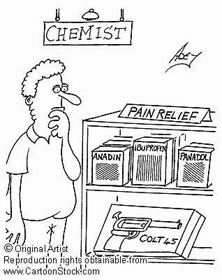

Slide 37
Pain Control Strategies
  Pharmacotherapy
  Invasive approaches:
  Anesthetic approaches
  Implantable devices
  Neurostimulation approaches
  Surgical approaches
  Alternative approaches
  Rehabilitative approaches
  Lifestyle changes
  Psychological approaches

Slide 38
  Pharmacotherapy
Pain Control Strategies
Non Opioid Analgesics:
  NSAA
  NSAIDs
    Non-selective COX inhibitors
    Selective COX-2 inhibitors
Opioids
  Weak Opioids.
  Strong opioids.
  Mixed agonist – antagonists
Adjuvants
  Antidepressants
  Anticonvulsants
  Substance P inhibitors
  NMDA inhibitors
  LA
  Drugs for Headache
  Drugs for Bone pain
  Others

Slide 39
Remember the common patient-related barriers to pain management
Pain Control Strategies
Drugs ..
  are addicting
  should be saved for when it is really needed
  have unpleasant or dangerous side effects
  pills are not as effective as a shot
  narcotics are only for dying people
  Pharmacotherapy

Slide 40


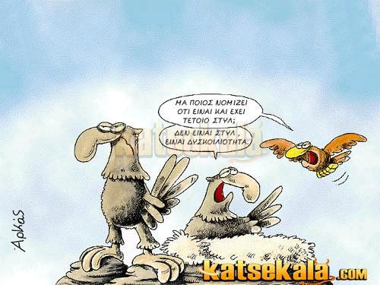

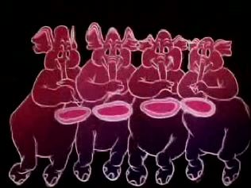
Adverse effects of opioids
Pain Control Strategies
Respiratory Depression
Sedation
Nausea and Vomiting
Pruritus
Urinary retention
Hallucinations
  Pharmacotherapy

Slide 41
Invasive approaches
Pain Control Strategies
Therapeutic neuroblockade
Peripheral
Central
neurolysis
Electrical stimulation
TENS
Spinal cord stimulation
Intracerebral stimulation

Slide 42
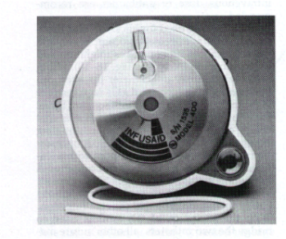
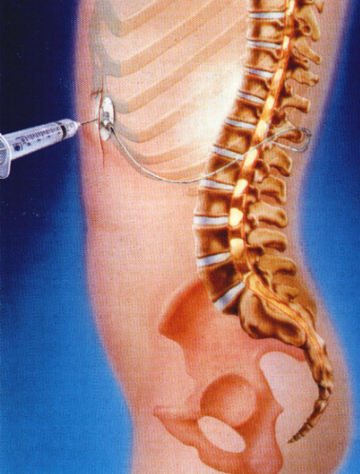
Pain Control Strategies
Invasive approaches
Implantable devises

Slide 43
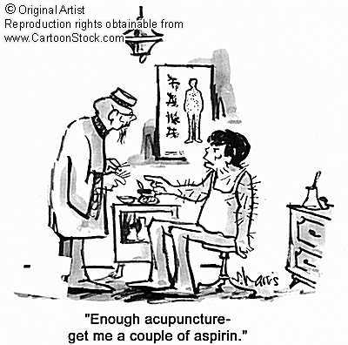
  Pain Control Strategies
  Alternative approaches
Alternative medicine:
  Acupuncture
  TENS
  Cupping
  Chiropractice
Physical Therapy
  ice, heat, massage
Exercise
Psychological therapy
  Cognitive-behavioral therapy
  Relaxation techniques
  Biofeedback
  Hypnosis

Slide 44
Pain Control Strategies
W.H.O. ANALGESIC LADDER
Invasive approaches
3
By the
Strong opioid
+/- adjuvant
2
Clock
Weak opioid
+/- adjuvant
Pain persists or increases
1
Non-opioid
+/- adjuvant

Slide 45
Questions what kind of pain? burn injury fracture phantom limb arthritis myocardial infarction bowel obstruction
Notes:
Magic and ritual were very common in ancient cultures," Magic and ritual were very common in ancient cultures," Many ancient doctors apparently figured their patients needed a hole in the head. Hundreds of skulls with small holes that have partially healed over have been found worldwide, but especially in Incan archaeological sites in South America.

