Slide 1
outline and objectives
VASCULAR ACCESS
establishment of a peripheral venous line
central venous catheterization
arterial canullation
FLUID MANAGEMENT
background
perioperative fluid management
keeping homeostasis “blindly” vs “monitored”
available solutions
BLOOD AND BLOOD PRODUCTS TRANSFUSIONS
what is and how we get Packed Red Cells (PRC) and other blood products ?
indications for transfusions
the ABO and Rh systems
transfusion reactions
perioperative PRC transfusion “threshold”

Slide 2
outline and objectives
VASCULAR ACCESS
establishment of a peripheral venous line
WHY ?
WHY
NOT ?
Indications:
Repeated blood sampling
IV administration of fluid
IV administration of medications
IV administration of chemotherapeutic agents
IV nutritional support
IV administration of blood or blood products
IV administration of radiologic contrast agents
to evaluate blood gas profile in infants
Contraindications:
No absolute contraindications for IV cannulation exist.
Peripheral venous access in an injured, infected, or burned extremity should be avoided if possible.
Some vesicant, or irritant, or sclerosing, or with chemotherapeutic agents, or with vasopressors solutions (low or high pH, high osmolarity) can cause tissue necrosis if they leak into the tissue. These solutions are more safely infused into a central vein, except for emergency situations.

Slide 3
VASCULAR ACCESS
establishment of a peripheral venous line
TECHNIQUE ?
seek information about
“where and what vein is suitable ”
“how to prepare the vein”
“what equipment is available”
“how to prepare a drip”
“how to avoid bubbles”
“what is the rhythm of administration”
“…”
in the operating room
Setting the rhythm of an intravenous infusion
(for common infusion sets)
Sets deliver drops of varying sizes from about 10 drops/ml up to 60 drops/ ml. The drop size or the number of drops per ml must be known. By mea-suring he time for 10 drops to fall , the volume delivered per unit time is obtained. Count 11 drops , the first falling at time zero.
Time (s) drops /min 10dr/ml 60dr/min
ml/min ml/h ml/min ml/h
5 120 12 720 2 120
10 60 6 360 1 60
20 30 3 180 0,5 30

Slide 4
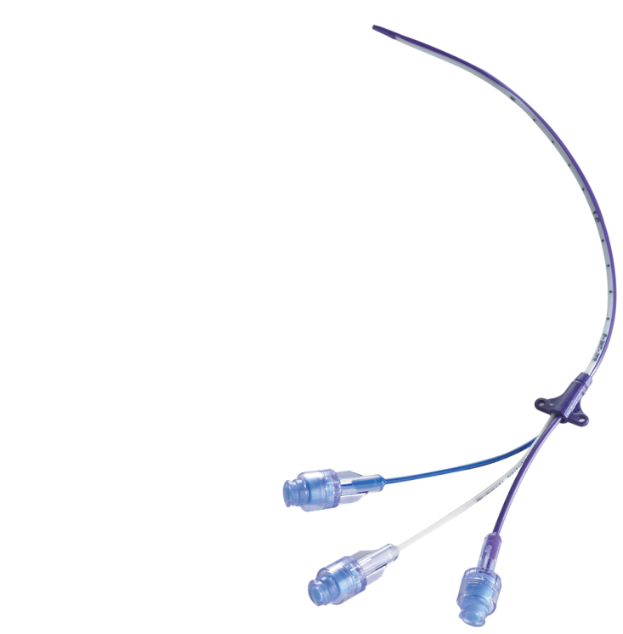
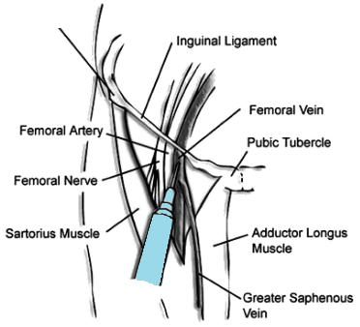
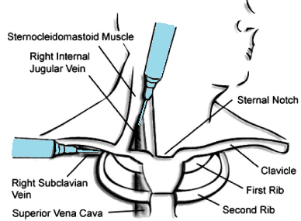
outline and objectives
VASCULAR ACCESS
central venous catheterization
WHAT IS ?
WHY WE USE IT ?
A central venous catheter, also called a central line, is a long, thin, flexible tube used to give medicines, fluids, nutrients, blood products, or for monitoring over a long period of time, usually several weeks or more.
The catheter may poses more than one individual-separated lines.
Catheters can be placed in veins in the neck (internal jugular vein), chest (subclavian vein or axillary vein), groin (femoral vein), or through veins in the arms (also known as peripheral-ly inserted central catheters).

Slide 5
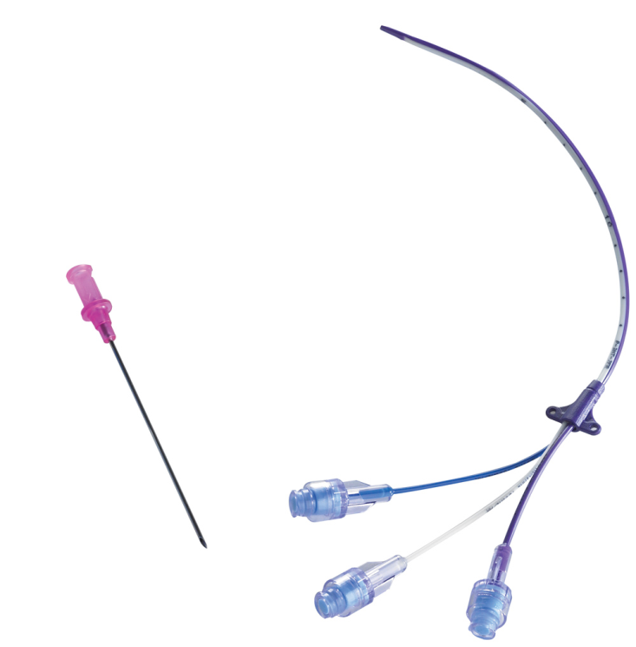
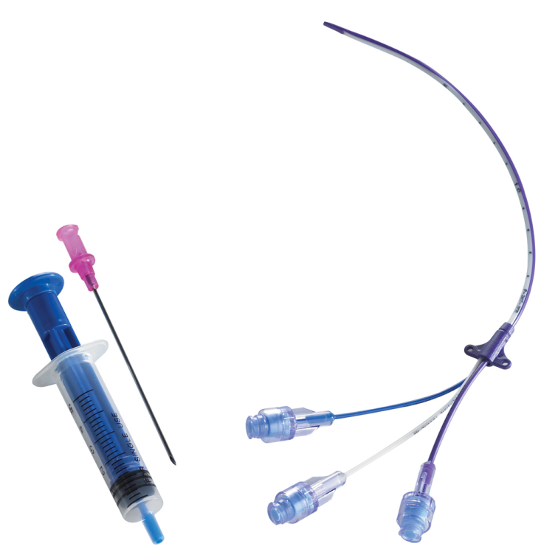
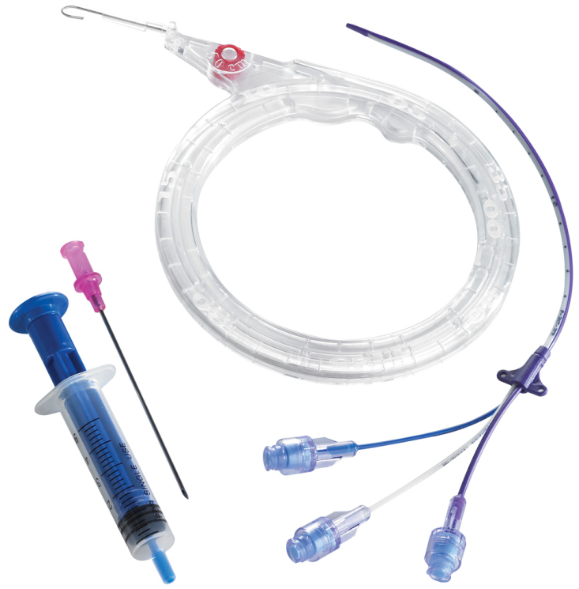
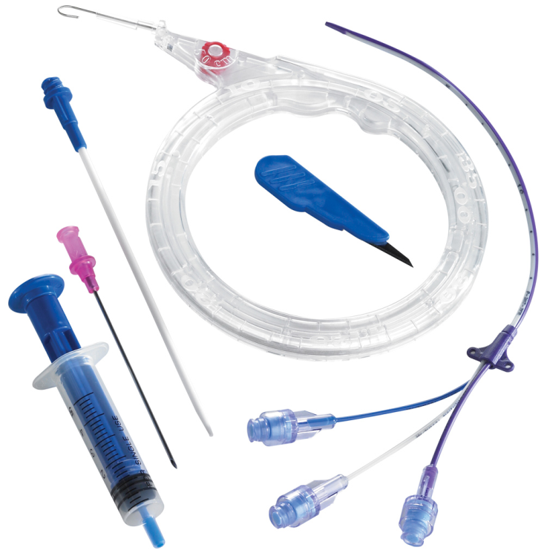
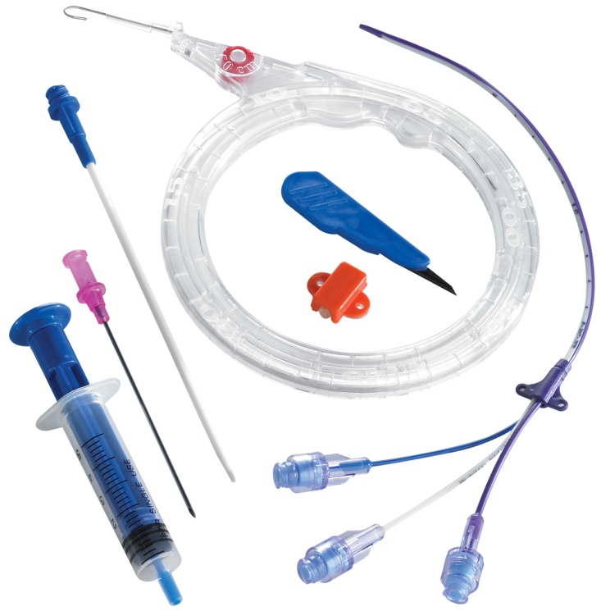
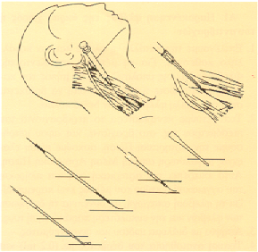
VASCULAR ACCESS
central venous catheterization
HOW IT IS
INTRODUCED?
By experienced physicians
in slight Trend. position
(better vein filling and avoidance of venous embolism)
using Seldinger’s technique
(landmarks or/and aided by sonography)
sterile conditions
needle insertion
venous blood aspiration
J-wire introduction
needle removal
tunneling
catheter insertion
wire removal
catheter secured
cover

Slide 6
VASCULAR ACCESS
central venous catheterization
INDICATIONS many
CONTRAINDICATIONS some
RISKS & COMPLICATIONS some,
but serious or even fatal
administration of fluids
administration of medications
administration of blood or blood products
CVP monitoring
PAc insertion (via sheath)
hemodynamic profile
continuous hemodynamic monitoring
pacemacer insertion
administration of chemotherapeutic agents
nutritional support
BALANCE BETWEEN BENEFITS vs RISKS

Slide 7
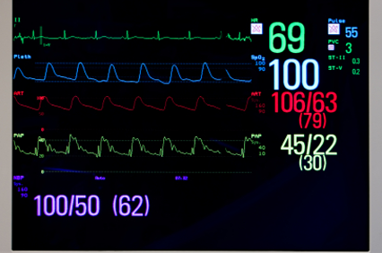
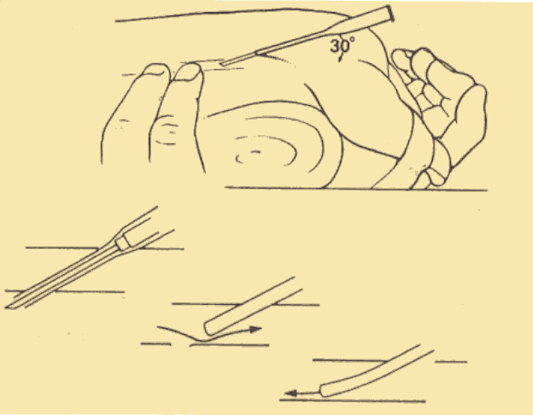
VASCULAR ACCESS
arterial canullation
INDICATIONS repeated blood sampling
blood pressure continuous monitoring
continuous monitoring of acid-base balance and gas analysis
(Paratrent 7)
TECHNIQUE Seldinger’s technique
CONTRAINDICATIONS some
RISKS & COMPLICATIONS some
important for Anesthesiologists
depending on patient’s history and underlying pathology, and on the kind of operation

Slide 8
outline and objectives
FLUID MANAGEMENT
homeostasis
volume stability
concentration stability
acid-base balance

Slide 9
FLUID MANAGEMENT
volume stability
concentration stability
acid-base balance
40%
INTRA-CELLULAR
20%
EXTRA-CELLULAR
controlling plasma
16%
INTERSTITIAL
control cellular “well-being”
4%
PLASMA
renal function
respiration
metabolic breakdown
skin, etc
input – output mechanisms
compensatory mechanisms
membranes function
water: loss, intake, addition and production
renal function
metabolic breakdown
etc
electrolytes: loss, intake,
and addition
CIRCULATORY SUPPORT
AUTONOMOUS system
ENDOCRINE system
specific ORGANS
tissue perfusion
tissue oxygenation
metabolic breakdown
buffering systems renal function
respiration
acid-base balance
proton production and loss
RESPIRATORY SUPPORT
diseases and conditions
influencing osmolarity

Slide 10
FLUID MANAGEMENT
volume stability
concentration stability
acid-base balance
40%
INTRA-CELLULAR
20%
EXTRA-CELLULAR
16%
INTERSTITIAL
4%
PLASMA

Slide 11
FLUID MANAGEMENT
volume stability
concentration stability
acid-base balance
fluids
water, electrolytes, osmotic molecules, colloid osmotic molecules, buffers, calories, packed red cells, plasma, cell salvage, others
give
monitor
take
4%
PLASMA
hemodynamics,
rhythm of urine production, biochemical,
other
renal function, diuretics, ventilator, aphaimaxis, draining, filtering, peritoneal, plasma dialysis, others

Slide 12
PERIOPERATIVE
FLUID MANAGEMENT
pre-operative “needs”
fasting hours
hemorrhage, sepsis
intestines and bowel preparation, diarrhea, increased urinary production, fever, sweating, burns, pleural or peritoneal collection
intestinal ileus
hypertension, diabetic pts
fluid and electrolytes translocation
relative hypovolemia, special treatment
“needs” due to the anesthetic technique
central block (spinal, epidural)
loss due to mechanical ventilation, normovolemic hemodilution (autologous transfusion), hypervolemic hemodilution, controlled hypotension
hypovolemia due to vasodilatation
“needs” due to the surgical procedure
time
[fasting hours, common losses, skin (temperature), renal, respiratory]
kind
site of operation, organ exposure, hemorrhagic or not, tissue trauma-injury, mass removal, organ or limb ischemia (clamping), intraoperati- ve organ perfusion (ex: renoplegia), special techniques (cell salvage), transurethral operations, cardiac operations

Slide 13
PERIOPERATIVE
daily needs (cals & water)
first 10 kg BW 4ml/kg/h
next 10 kg BW 2ml/kg/h
every kg above 20 1 ml/kg/h
FLUID MANAGEMENT
pre-operative “needs”
fasting hours
hemorrhage, sepsis
intestines and bowel preparation, diarrhea, increased urinary production, fever, sweating, burns, pleural or peritoneal collection
intestinal ileus
hypertension, diabetic pts
adult 72kgBW, 8h fasting
[10 X 4 X 8] + [10 X 2 X 8] + [52 X 8]
320 + 160 + 416 = 896 ml
“needs” due to the anesthetic technique
central block (spinal, epidural)
loss due to mechanical ventilation, normovolemic hemodilution (autologous transfusion), hypervolemic hemodilution, controlled hypotension
depending on kind of block
and pt’s characteristics
500-800ml
“needs” due to the surgical procedure
time
[fasting hours, common losses, skin (temperature), renal, respiratory]
kind
site of operation, organ exposure, hemorrhagic or not, tissue trauma-injury, mass removal, organ or limb ischemia (clamping), intraoperati- ve organ perfusion (ex: renoplegia), special techniques (cell salvage), transurethral operations, cardiac operations
depending on kind of procedure
and pt’s characteristics
10-15 ml/kg/h for laparatomy
5-7,5 ml/kg/h for thoracotomy
ex: pt 72kgBW, 5h laparatomy
[12 X 72 X 5] = 4320 ml
total = 6 L

Slide 14
PERIOPERATIVE
daily needs (cals & water)
first 10 kg BW 4ml/kg/h
next 10 kg BW 2ml/kg/h
every kg above 20 1 ml/kg/h
FLUID MANAGEMENT
pre-operative “needs”
fasting hours
hemorrhage, sepsis
intestines and bowel preparation, diarrhea, increased urinary production, fever, sweating, burns, pleural or peritoneal collection
intestinal ileus
hypertension, diabetic pts
adult 72kgBW, 8h fasting
[10 X 4 X 8] + [10 X 2 X 8] + [52 X 8]
320 + 160 + 416 = 896 ml
give
monitor
take
“needs” due to the anesthetic technique
central block (spinal, epidural)
loss due to mechanical ventilation, normovolemic hemodilution (autologous transfusion), hypervolemic hemodilution, controlled hypotension
depending on kind of block
and pt’s characteristics
500-800ml
4%
PLASMA
“needs” due to the surgical procedure
time
[fasting hours, common losses, skin (temperature), renal, respiratory]
kind
site of operation, organ exposure, hemorrhagic or not, tissue trauma-injury, mass removal, organ or limb ischemia (clamping), intraoperati- ve organ perfusion (ex: renoplegia), special techniques (cell salvage), transurethral operations, cardiac operations
depending on kind of procedure
and pt’s characteristics
10-15 ml/kg/h for laparatomy
5-7,5 ml/kg/h for thoracotomy
ex: pt 72kgBW, 5h laparatomy
[12 X 72 X 5] = 4320 ml
total = 6 L

Slide 15
Blood Components
General remarks
Gesetz zur
Regelung des Transfusionswesens
(Transfusionsgesetz)
___________________________________________________________________
vom
1. Juli 1998
(BGBl. I, S. 1752)
_________________________________________________________
Gesetzestext
und
Begründung der Bundesregierung
vom 13.01.1998
(BT Drcks. 13/9594)
Inhaltsverzeichnis Seite
Allgemeiner Teil der Begründung 3
§ 1 Zweck des Gesetzes 8
§ 2 Begriffsbestimmungen 9
§ 3 Versorgungsauftrag 10
§ 4 Anforderungen an Spendeeinrichtungen 11
§ 5 Auswahl der spendenden Personen 12
§ 6 Aufklärung, Einwilligung 14
§ 7 Anforderungen zur Entnahme der Spende 15
§ 8 Spenderimmunisierung 16
§ 9 Vorbehandlung zur Blutstammzellseparation 19
§ 10 Aufwandsentschädigung 19
§ 11 Spenderdokumentation, Datenschutz 20
§ 12 Stand der medizinischen Wissenschaft und Technik
zur Gewinnung von Blut und Blutbestandteilen 22
§ 13 Anforderungen an die Durchführung 23
§ 14 Dokumentation, Datenschutz 25
§ 15 Qualitätssicherung 27
§ 16 Unterrichtungspflichten 29
§ 17 Nicht angewendete Blutprodukte 30
§ 18 Stand der medizinischen Wissenschaft
und Technik zur Anwendung von Blutprodukten 31
§ 19 Verfahren 32
§ 20 Verordnungsermächtigung 35
§ 21 Koordiniertes Meldewesen 36
§ 22 Epidemiologische Daten 37
§ 23 Verordnungsermächtigung 38
§ 24 Arbeitskreis Blut 38
§ 25 Mitteilungspflichten der Behörden 39
§ 26 Bundeswehr 39
§ 27 Zuständige Bundesoberbehörden 40
§ 28 Ausnahmen vom Anwendungsbereich 40
§ 29 Verhältnis zu anderen Rechtsvorschriften 41
§ 30 Angleichung an Gemeinschaftsrecht 41
§ 31 Strafvorschriften 42
§ 32 Bußgeldvorschriften 43
§ 33 [Übergangsvorschrift] 44
§ 34 Änderung des Arzneimittelgesetzes 44
§ 35 Änderung der Betriebsverordnung für
pharmazeutische Unternehmer 49
§ 36 Änderung der Apothekenbetriebsordnung 50
§ 37 Änderung der Betriebsverordnung für
Arzneimittelgroßhandelsbetriebe 52
§ 38 Rückkehr zum einheitlichen Verordnungsrang 53
§ 39 Inkrafttreten 53
for the public:
education
recruitment
minimum age: 17 years
maximum age: 70 years
(60 for first time donations)
selection
donation
Human source
- no synthetics yet
- not risk free
Scarce resource
However: 1 donor can give 1 unit every 3-4 months
Use carefully!
Be a donor-give blood
Body recovers the blood very quickly:
blood plasma volume– within 24-48 hours
red blood cells –in about 3 weeks
platelets & white blood cells–within minutes
Why We Do not Donate our Blood?
But we demand blood/blood products from blood bank!
Balance between benefits vs risks
Doctor’s decision
Definite indication must be recorded in the patient’s medical records
Correct anaemia pre-operatively
Try to reduce unnecessary exposure to blood products
Medical selection process to protect both recipients and donors
Scientific guidelines
National legislation
Council of Europe. Guide to the preparation, use and quality assurance of blood components. Recommendation R(95)15,11th ed. Strasbourg, CE 2005, pp.1-266.

Slide 16
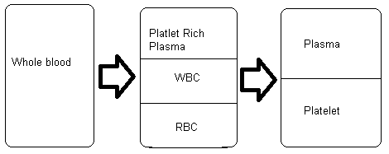
Blood Components Preparation
Source of product for all blood components is whole blood (WB) 400-500 ml.
Storage temperature :1-6 C
By using differential centrifugation, blood components separated into layers, based on different specific gravities
From a unit of whole blood, the centrifuged product settle out into RBC, WBC & platelet-rich plasma (PRP). After separating PRP from the bag, PRP again being centrifuge for a longer time & harder spin. Plt is heavier than plasma & will settled at the bottom of the bag.
Platelet Rich Plasma

Slide 17
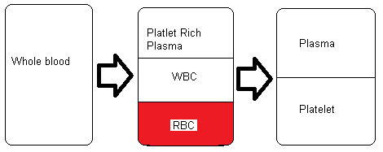
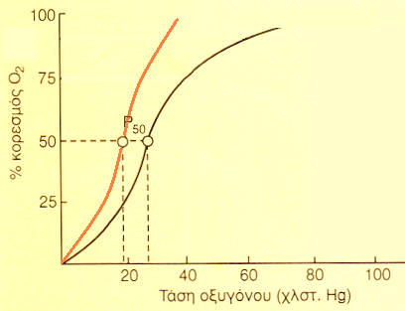
Blood Components Preparation
and Indication for use
Packed
Red
Cells
Prepared by removing 200ml of plasma from a unit of WB. Volume of approxima-tely 300 ml
Do not contain functional platelets
or granulocytes
Have the same O₂ carrying capacity
with WB
Platelet Rich Plasma
?
volume after centrifugation ≈ 250 ml
hematocrit after centrifugation ≈ 70-80 %
additives : volume ≈ 330 ml
hematocrit ≈ 60-65 %
pH (depending on storage days) ≈ 6
STANDARDS: percentage of viable red cells after transfusion to be at least 75 %
one unit PRC must have at least 45 gr Hg
free hemoglobin must be less than 1% of red cells mass

Slide 18
Blood Components Preparation
and Indication for use
Packed
Red
Cells
Prepared by removing 200ml of plasma from a unit of WB. Volume of approxima-tely 300 ml
Do not contain functional platelets
or granulocytes
Have the same O₂ carrying capacity
with WB
Platelet Rich Plasma
?
Conservation
citric Na
citric Na + dextrose
citric acid + dextrose (ACD)
citric + phosphoric + dextrose (CPD) [1-6ºC, 21-28 days]
citric + phosphoric + dextrose + adenine (CPD-A1) [35 days]
additives
ΑS-1 (Adsol) [42-45 days]
AS-3 (Nitricel) [42-45 days]
Erythro-Sol [28 ημ. →90% viable red cells]
Bicarbonate [84 ημ. →78% viable red cells]
Ammonium [4ºC, 131 ημ. →68,5% viable red cells]
deep cooling + glycerol [-80ºC →conservation for years]
important for Anesthesiologists
during mass transfusions
[hypothermia]
[acidosis]
[impaired clotting]
ANTI-
CLOTTING
(citric)
DECREASED
ENERGY
DEMAND
(cooling)
ENERGY
SUPPLY
(SUBSTRATE)
(glucoze)
pH
BUFFERING
(phosphoric)

Slide 19
Blood Components Preparation
and Indication for use
Packed
Red
Cells
Platelet Rich Plasma
Indication: to increase the O₂ carrying capacity in anaemic pt who require an increase in red cell mass
without increase in their blood volume
1 unit: increase Hb level about 1g/dL (10g/L) & Hct by 2-3%
Indication: to increase the O₂ carrying capacity in anaemic pt who require an increase in red cell mass
without increase in their blood volume
1 unit: increase Hb level about 1g/dL (10g/L) & Hct by 2-3%
important for Anesthesiologists
PRC is a “drug” for better O₂ carrying
PRC is not a “drug” for volume replacement

Slide 20
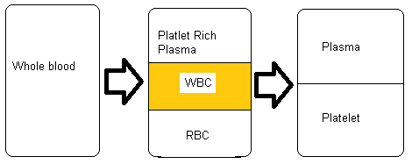
Blood Components Preparation
and Indication for use
Granulocytes
Prepared by leukoparesis technology
Contain of:
Large number of granulocytes
Other leucocytes
20-50ml of RBC
Indications:
Supportive treatment for pt
with severe neutropenia
and with documented sepsis unresponsive to antibiotic therapy.
Neonatal sepsis.
Very rarely used
Platelet Rich Plasma

Slide 21
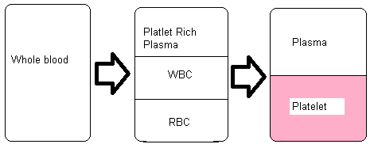
Blood Components Preparation
and Indication for use
Platelets
Prepared in two ways:
A.Pooled platelets from 4-5 single donations
by separating PRP from a unit of WB within 8h of collection & recentrifuge to remove plasma. B.Single donor platelets collected by cell separator machine (apheresis)
Stored at 20-24C. Keep agitated at room temperature. Self life=5 days.
Adult single dose (1 pool): 300 x 10⁹/L. OUTCOME: >10x10⁹/l increase
Each unit of plt expected to increase 5000-10000 plt. (check platelet count after)
Platelet Rich Plasma
Indications:
Prophylaxis
Dilutional thrombocytopenia
massive hemorrhage
cardiac surgery
Active bleeding due to thrombocytopenia/thrombocytopathy
platelet dysfunction :
(bone marrow failure (aplastic), post chemotherapy, CABG, aspirin)
important for Anesthesiologists

Slide 22
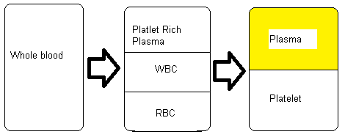
Blood Components Preparation
and Indication for use
Fresh Frozen Plasma
Prepared by removing plasma from WB within 8h of collection. Stored at ≤–18C. Stored frozen at –30ºC for up to 1 yr.
Not routinely virally inactivated.
Contains of:
Water, carbohydrates, fats, minerals
Proteins (all labile & stable clotting fx).
Each unit of FFP (200-225ml) increase the level of each clotting fx by 2-3% in adults.
Platelet Rich Plasma
Indications:
As a replacement for isolated coagulation factor deficiency.
For reversal of warfarin.
In the case of massive blood transfusion.
DIC.
Antithrombin III deficiency.
Correction of coagulopathy due to liver disease.
Thrombotic thrombocytopenic purpura.
important for Anesthesiologists
important for Anesthesiologists

Slide 23
Blood Components Preparation
and Indication for use
Fresh Frozen Plasma
Essential to give adequate volume
Dose: 10-15ml/kg
ABO compatible
FFP is a “drug” for clotting
FFP is not a “drug” for volume replacement
Platelet Rich Plasma
Indications:
As a replacement for isolated coagulation factor deficiency.
For reversal of warfarin.
In the case of massive blood transfusion.
DIC.
Antithrombin III deficiency.
Correction of coagulopathy due to liver disease.
Thrombotic thrombocytopenic purpura.
Response to FFP transfusions should be measured clinically and by post-transfusion coagulation tests

Slide 24
Blood Components Preparation
and Indication for use
Cryoprecipitate
Platelet Rich Plasma
The cold-insoluble portion of plasma that remains after FFP has been thawed at 1-6C.
Stored at ≤–18C & below. Contains of:
Factor VIII:C
Factor VIII:vWF
Factor XIII
Fibrinogen
About 10-15ml of plasma
Indications:
von Willebrand’s disease
DIC
Hemophillia A
Factor XIII def.
Cong./acquired fibrinogen def.

Slide 25
Blood Groups
1901: Karl Landsteiner: Discovered ABO blood grouping and was awarded’ Nobel Prize in 1930
can give to all
can take from all
A person with Rh- blood can develop Rh antibodies in the blood plasma if he or she receives blood from a person with Rh+ blood, whose Rh antigens can trigger the produ-ction of Rh antibodies.
A person with Rh+ blood can receive blood from a person with Rh- blood without any problems.

Slide 26
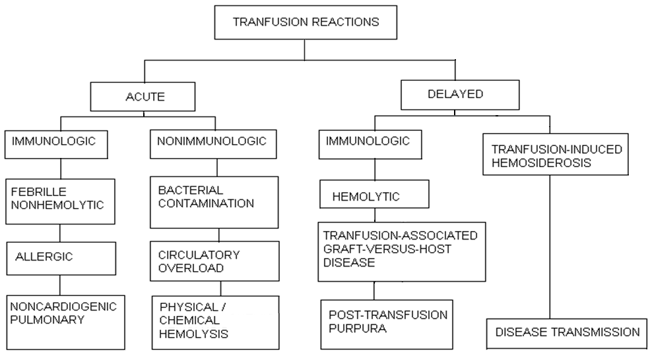

Slide 27
Red Cell Transfusion Guidelines
Washington State Clinical Laboratory Advisory Council (CLAC)
August 2003
adult hematocrit values
< 21 %
(hemoglobin < 7 g/dl)
transfusion
is
indicated
21 – 27 %
(hemoglobin 7-9 g/dl)
transfusion indicated
in case off
one or more of the following:
1 hemorrhage
progressive fall in hematocrit values (greater than 4% in 24 h)
(think and estimate if it is due to hemodilution)
3 history / risk of vascular brain insult / disease, oncologic pathology / diagnosis
in case of myocardial ischemia / infarction, think and estimate the need for higher hematocrit
> 27 %
(hemoglobin > 9 g/dl)
transfusion
is not
indicated

Slide 28
in the operating room
adult hematocrit values
< 21 %
(hemoglobin < 7 g/dl)
transfusion
is
indicated
21 – 27 %
(hemoglobin 7-9 g/dl)
transfusion indicated
in case off
one or more of the following:
1 hemorrhage
progressive fall in hematocrit values (greater than 4% in 24 h)
(think and estimate if it is due to hemodilution)
3 history / risk of vascular brain insult / disease, oncologic pathology / diagnosis
in case of myocardial ischemia / infarction, think and estimate the need for higher hematocrit
> 27 %
(hemoglobin > 9 g/dl)
transfusion
is not
indicated
estimate circulatory volume
estimate demand/supply [DO₂ / VO₂]
estimate oxygenation of specific organs

Slide 29
in the operating room
adult hematocrit values
< 21 %
(hemoglobin < 7 g/dl)
21 – 27 %
(hemoglobin 7-9 g/dl)
> 27 %
(hemoglobin > 9 g/dl)
estimate circulatory volume
estimate demand/supply [DO₂ / VO₂]
estimate oxygenation of specific organs
transfusion
transfusion
transfusion
monitoring
monitoring
misc. formulas
operation
operation
operation
patient
patient
patient

Slide 30
ΕΡΩΤΗΣΕΙΣ-ΑΠΑΝΤΗΣΕΙΣ
Οι ημερήσιες ανάγκες σε νερό ενός παιδιού 30 Kg σε συνθήκες ηρεμίας είναι:
Α. Περίπου 1700 ml
B. Περίπου 2100 ml
Γ. Περίπου 1500 ml
Σε μια ασθενή 38 ετών, 70 KgBW, με ελεύθερο ιστορικό που προσέρχεται για διαγνωστική επέμ-βαση (λήψη δερματικής βιοψίας υπό τοπική αναισθησία) τοποθετείται φλεβική γραμμή με διά-λυμα 1000 ml R/L. Η επέμβαση διαρκεί 30 λεπτά και, κατά τη λήξη της, η ασθενής έχει λάβει 30ml.
A. Σωστά, έτσι έπρεπε να γίνει.
Β. Λάθος, πρέπει να διορθωθεί στην άμεση μετεγχειρητική περίοδο.
Γ. Αδιάφορο για την ασθενή, που μπορεί να αποχωρήσει από το χειρουργείο.
Κυκλώστε τις σωστές εκφράσεις :
Α. Το διάλυμα Ringer’s Lactate περιέχει γαλακτικά ανιόντα και όχι χλώριο.
Β. Το διάλυμα D/W 5% είναι ισότονο (ΩΠ 300 ≈ mOsm/L).
Γ. Το διάλυμα ΝaCl 7,5% χρησιμοποιείται σε ειδικές συνθήκες.
Δ. Το διάλυμα Ringer’s Lactate περιέχει Na ίσο με τον φυσιολογικό ορό (N/S, NaCl 0,9%)
Ο αιματοκρίτης μιας μονάδας PRC είναι συνήθως περίπου :
Α. 35%
B. 45%
Γ. 60%

Slide 31
ΕΡΩΤΗΣΕΙΣ-ΑΠΑΝΤΗΣΕΙΣ
Σε ασθενή 50 ετών, 70 KgBW, χωρίς ιστορικό από το κυκλοφορικό και προεγχειρητικό αιματο-κρίτη Hct=40%, κατά τη διαδρομή επέμβασης κοιλίας 4 ωρών υπό γενική αναισθησία, χορηγή-θηκαν συνολικά 7,5 λίτρα κρυσταλλοειδών διαλυμάτων. Στο πέρας της επέμβασης ο ασθενής έχει Hct=23%, φυσιολογικό καρδιογράφημα και ρυθμό διούρησης 300 ml/h.
Α. Ο ασθενής πρέπει να λάβει συμπυκνωμένα ερυθρά.
Β. Ο ασθενής δεν πρέπει να λάβει συμπυκνωμένα ερυθρά.

