Slide 1
ΜαΘΗΜΑ ΦΟΙΤΗΤωΝ ΙΑΤΡΙΚΗΣ Αναισθησιολογια 4^{ο} ετοσ εντατικη θεραπεια
ΠΑΠΑΔΟΠΟΥΛΟΣ ΔΗΜΗΤΡΙΟΣ MD, PhD
Αναισθησιολόγος- Εντατικολόγος
Επιμελητής Ά
Μονάδα Εντατικής Θεραπείας
Γενικό Νοσοκομείο Λάρισας

Slide 2
Protocols in the management of critical illness

Slide 3
Protocols in the management of critical illness
Care of the critically ill patient is becoming increasingly complex.
Protocols, which standardize care of patients with similar diseases, represent a potential solution to managing multiple simultaneous problems in critically ill patients.
Because of the complexities of caring for the critically ill patient, the use of protocols in the ICU has become increasingly common.

Slide 4
Definitions
Guidelines: A systematic statement of policy rules, or principles
Morris AH. Curr Opin Crit Care 2003
Protocol: Sets of explicit, algorithmic rules, which direct clinical management or research.
Fessler HE, Brower RG. Crit Care Med 2005
Checklists: are lists of things to be completed or checked
A protocol may be implemented by the use of a checklist, and can be used to facilitate specific treatment guidelines. When protocols are properly used, clinicians more frequently treat similar patients in a similar fashion. Protocols have the potential to minimize medical errors, decrease the likelihood of injury, increase patient safety and improve patient outcomes

Slide 5
Advantages- Disadvantages
Advantages | Disadvantages
Reducing unnecessary variability in care | Use in inappropriate patient
Quick adoption of new information to the bedside | Loss of individualization of care
Streamlining of care | Potential to be obsolete if not kept current
Educational aids | May be designed around low quality evidence
Improved communication | May be oversimplified
Cost containment
Decrease errors and improve patient safety

Slide 6
Interventions/processes amenable to protocolization
Ventilator weaning | Stress ulcer prevention | Electrolyte replacement
Acute lung injury/lung protective ventilation | Rapid antibiotic administration | Acute coronary syndrome
Sepsis | Transfusion restriction | Acute brain injury
Nutrition | Massive transfusion | Stroke
Daily interruption of sedation | Hypothermia after cardiac arrest | Venous thromboembolism prophylaxis
Other sedation | Ventilator-associated pneumonia prevention | Glucose control
Catheter placement | Delirium assessment | Oral hygiene
Intracerebral hemorrhage | Palliative care/end of life | Critical care code/Advanced Cardiac Life Support (ACLS)
Early mobility | Delirium treatment

Slide 7
Outcomes of selected interventions
Disease/process | Intervention | Outcome | Study
ALI/ARDS | Low tidal volume ventilation with PEEP table | Decrease in mortality and unassisted breathing before discharge to home (39.8 to 31%), and increase in ventilator free days (10 ± 11 to 12 ± 11 days) | ARMA
Severe sepsis/septic shock | Early goal-directed therapy | Reduction in in-hospital mortality (46.5% to 30.5%) | Rivers et al.
Liberation from MV support | Spontaneous breathing trials | Reduction in length of MV support (6 days to 4.5 days), and more rapid extubation after meeting criteria (after 1 day rather than 3 days) | Ely et al.
Sedation | Daily awakenings | Reduction in length of MV support (7.3 days to 4.9 days), and reduction in ICU LOS (9.9 days to 6.4 days) | Kress et al.
Anemia | Restrictive transfusions | No change in 30-day mortality (18.7% for restrictive group and 23.3% for liberal group); reduction in hospital mortality for restrictive group (28.1% to 22.2%) | Hebert et al.
Ischemic stroke | tPA within 3 hours | Improved clinical outcome at 3 months as assessed by four outcome measures (Barthel index, modified Rankin scale, Glasgow outcome scale and NIHSS) | NINDS rt-PA
VT/VF arrest | Hypothermia | Favorable neurologic recovery (55% versus 39%) and decreased mortality at 6 months (55% to 41%) ; increased odds ratio for discharge to home or rehabilitation (5.25, 95% CI of 1.47 to 18.76) | Hypothermia After Cardiac Arrest Study Group; Bernard et al.

Slide 8
Conclusion
Because of the complexities of the critically ill patient, the ICU is a reasonable place in which to implement protocols.
Most patients are best served in ICUs that emphasize multidisciplinary, team-based care and conscientious application of protocols.
The advantages of protocols can be maximized by their careful development and implementation, by the proper identification of appropriate patient populations, and through incorporation of educational components.
We are not aware of reliable data showing worsening of outcomes with protocols, but we believe that more research is still necessary to fully understand their role in ICU patient care.

Slide 9
Literature- Suggested reading
Morris AH: Treatment algorithms and protocolized care. Curr Opin Crit Care 2003, 9: 236-240. 10.1097/00075198-200306000-00012
Weiss CH, Moazed F, McEvoy CA, Singer BD, Szleifer I, Amaral LA, Kwasny M, Watts CM, Persell SD, Baker DW, Sznajder JI, Wunderink RG: Prompting physicians to address a daily checklist and process of care and clinical outcomes: a single-site study. Am J Respir Crit Care Med 2011, 184: 680-686. 10.1164/rccm.201101-0037OC
Morris AH, Hirshberg E, Sward KA: Computer protocols: how to implement. Best Pract Res Clin Anaesthesiol 2009, 23: 51-67. 10.1016/j.bpa.2008.09.002
Ali NA, Gutteridge D, Shahul S, Checkley W, Sevransky J, Martin GS: Critical illness outcome study: an observational study of protocols and mortality in intensive care units. Open Access J Clin Trials2011, 3: 55-65.
Chang S.Y.,Sevransky J. and Martin G.S. Protocols in the management of critical illness Critical Care201216:306 https://doi.org/10.1186/cc10578

Slide 10
Questions

Slide 11
Multimodal monitoring in cerebral pathology and intracranial hypertension

Slide 12
Introduction
In the treatment of patients with CNS damage we use monitoring of parameters associated with the function and metabolism of the brain.
Although some of this monitoring is not widespread, the information it offers can be significant
The data obtained, are associated with prognosis and outcome and may influence our choice of treatment.

Slide 13
Intracranial hypertension is a potentially destructive, urgent medical condition.
It may be due to or cause damage to the brain parenchyma.
Persistent or increased intracranial pressure should be treated.

Slide 14
Causes
Mass lesions (tumor, ischemic injury with cerebral edema, brain hemorrhages, abscesses).
Generalized edema (ischemic anoxic brain injury. Acute fulminant hepatic failure, hypertensive encephalopathy, hypercapnia).
Increase of intracranial Venous pressure and decrease of venous return ( Venous sinuses thrombosis, Heart failure, occlusion of the jugular veins).
Occlusion of CSF Flow and reabsorption (hydrocephalus, infection, tumour bleeding of the meninges, Arnold Chiari sy).
Hydocephalus due to increased CSF production (meningitis, sah, choroid plexus tumor).
Idiopathic or unknown
Craniosynosteosis

Slide 15
The Monro- Kellie doctrine
The Monro-Kellie case states that the cranial compartment is uncompressed, and the volume inside it is unchanged.
The skull and its contents (blood, CSF, and cerebral parenchyma) create a state of equilibrium so that any increase in the volume of one of the cranial constituents should be offset by the decrease in the volume of the other.
The main factor in regulating volume growth is CSF and, to a lesser extent, blood content. Together they respond to increases in the volume of the remaining intracranial components.
The compensatory mechanisms are able to maintain a normal ICP for any volume change of less than 100-120 mL.

Slide 16
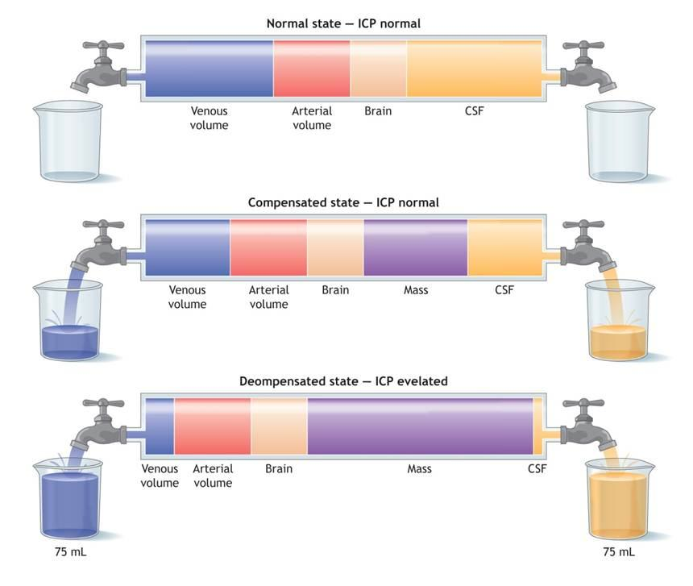
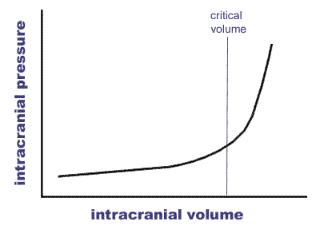
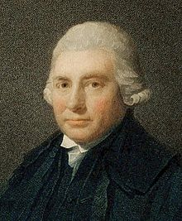

Slide 17
Pathophysiology
Cerebral Perfusion Pressure (CPP) is the pressure of blood that flows into the brain, and is quite stable due to cerebral auto-regulation,
CPP = MAP - ICP
One of the major dangers of elevated ICP is that it can cause ischemia by reducing CPP. The body's response to a fall in CPP is to increase blood pressure and dilate the cerebral blood vessels. Increased blood pressure can also make a destabilized intracranial hemorrhage increase, thereby leading to an increase in ICP.
If ICP elevation is caused by an accompanying invasive lesion (eg hematoma) it can lead to a midline shift
The midline shift can compress the ventricles and lead to hydrocephalus.
Another tragic consequence of elevated ICP due to an invasive mass lesion is the herniation of the brain at the tentorium, which can lead to compression of the brain stem. Compression of the brainstem can lead to respiratory depression and brain death.

Slide 18
Symptomatology
Symptoms of elevated ICP may include the following:
Headaches, usually non-specific and varying in kind, location, and frequency
Diplopia, usually horizontal
Pulsating tinnitus
Reflex rhizitic pain with distribution at the arms (unusual symptom)
Rarely, patients with elevated ICP with subsequent optic nerve edema may be otherwise asymptomatic.
Symptoms of optic papillary edema may include the following:
Transient ocular scotomata, often of orthostatic nature
Gradual loss of peripheral vision in one or both eyes
Blurring and distortion of central vision
Sudden loss of vision
Non-specific symptoms may include dizziness, nausea, vomiting, and retro-orbital pain.

Slide 19
Main points of Multimodal Monitoring
‘the simultaneous collection of data from multiple diverse sources associated with a single patient coupled with the ability to view the data in an integrated and time synchronized manner’
We will go through the advantages, disadvantages and the data offered at the bedside.
The single most important monitor is the doctor who has the knowledge, patience, physical and mental endurance to understand, interpret and intervene to the pathologic processes of the most complex organ in the human body.

Slide 20
The concept of secondary neuronal damage

Slide 21
Con
Guidelines for the Management of Severe Traumatic Brain Injury- BTF
Though many technologies including cerebral microdialysis, thermal diffusion probes, transcranial Doppler, Near- Infrared spectroscopy, and others hold promise in advancing the care of severe TBI patients, there is currently insufficient evidence to determine whether the information they provide is useful for patient management or prognosis

Slide 22
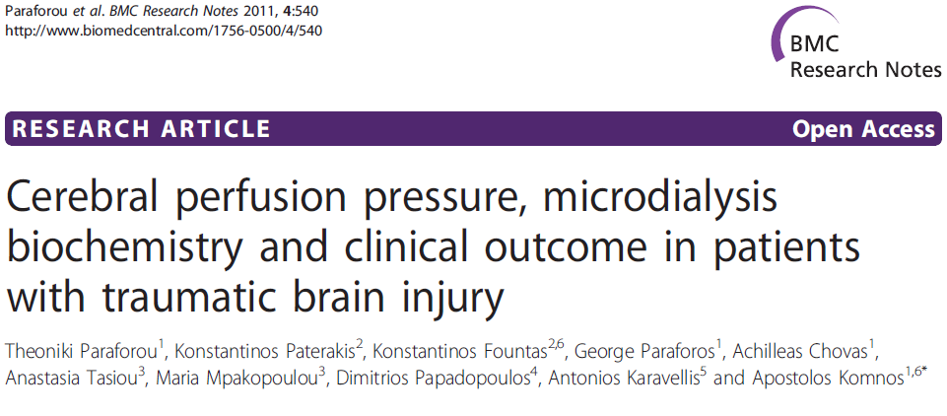
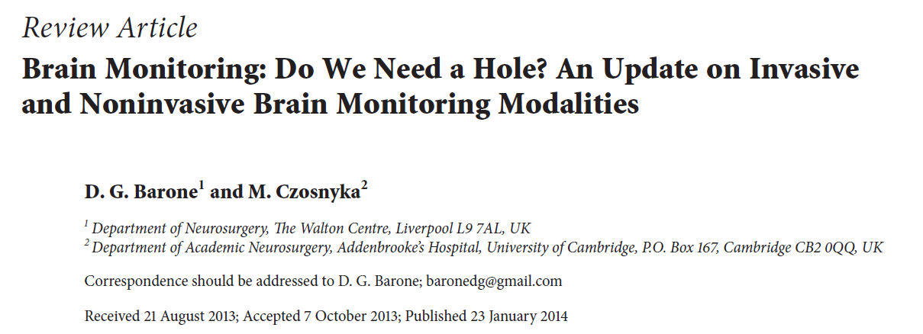
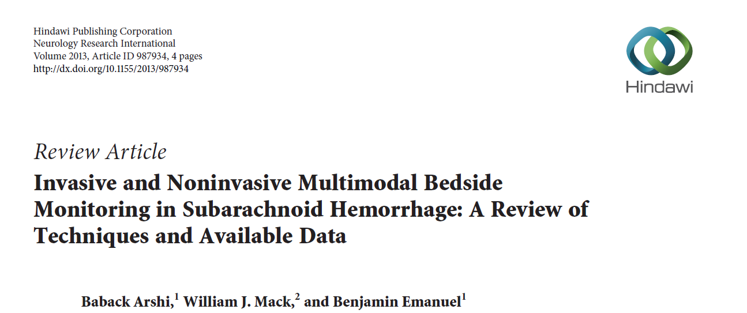
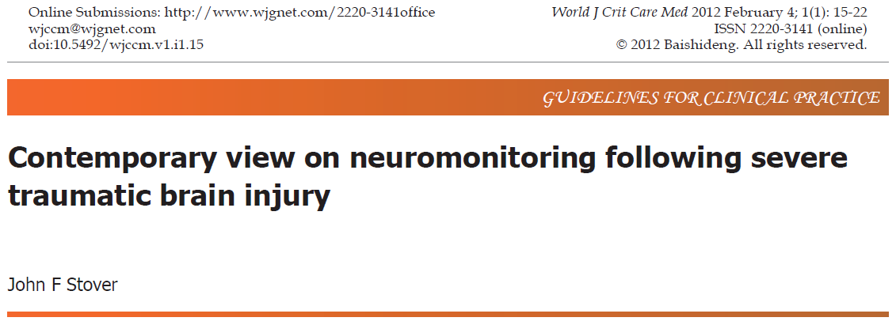
Pro

Slide 23
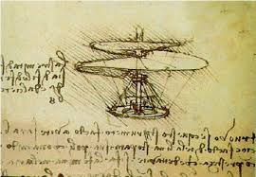
There are also no guidelines on “parachute usage in emergency evacuation from an aerial vehicle”

Slide 24
ICP monitoring
ICP catheters are the most common means to receive data on intracranial pressure.
They can be fiberoptic or piezometric.
In comparison to ventriculostomy catheters, their advantages is easier placement (intraventricular or intraparenchymal) even at the bedside, smaller in size, minimally traumatic and associated with very low rates of infection or bleeding.
Negative aspects are that they can not be “zeroed” after their placement and suffer from the phenomenon of "displacement of zero- zero drift» after 6-7 days.

Slide 25
Pressure Reactivity Index (PRx)
It correlates slow-rising angiogenic “B waves” with ABP.
It is a reflection of brain vasculature reactivity to ABP changes.
PRx<0 ➔ cerebral autoregulation is intact
PRx>0 ➔ cerebral autoregulation is damaged
Guendeling et al. Acta Neurochir 2006
When PRx<0,13 better outcome with CPP guided therapy.
When PRx>0,13 better outcome with ICP guided therapy.
Howells et al. J Neurosurgery 2005

Slide 26
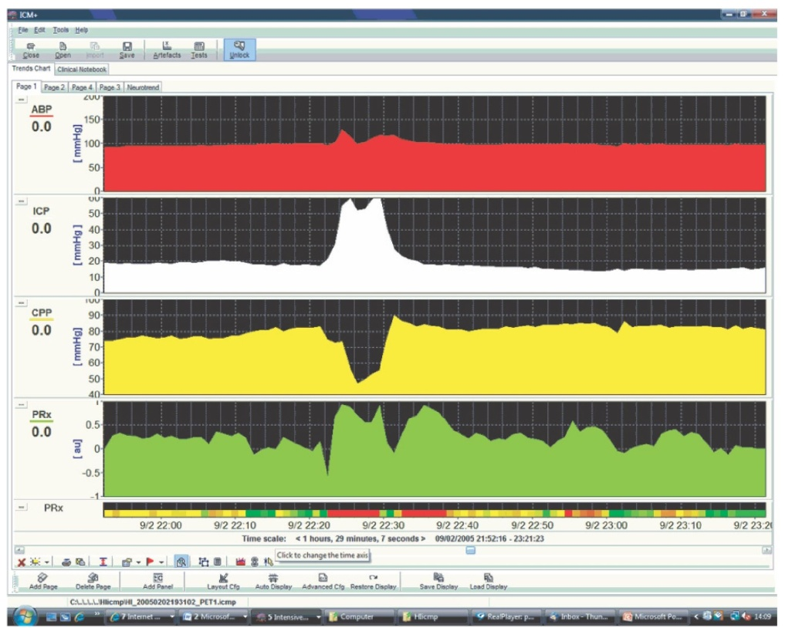
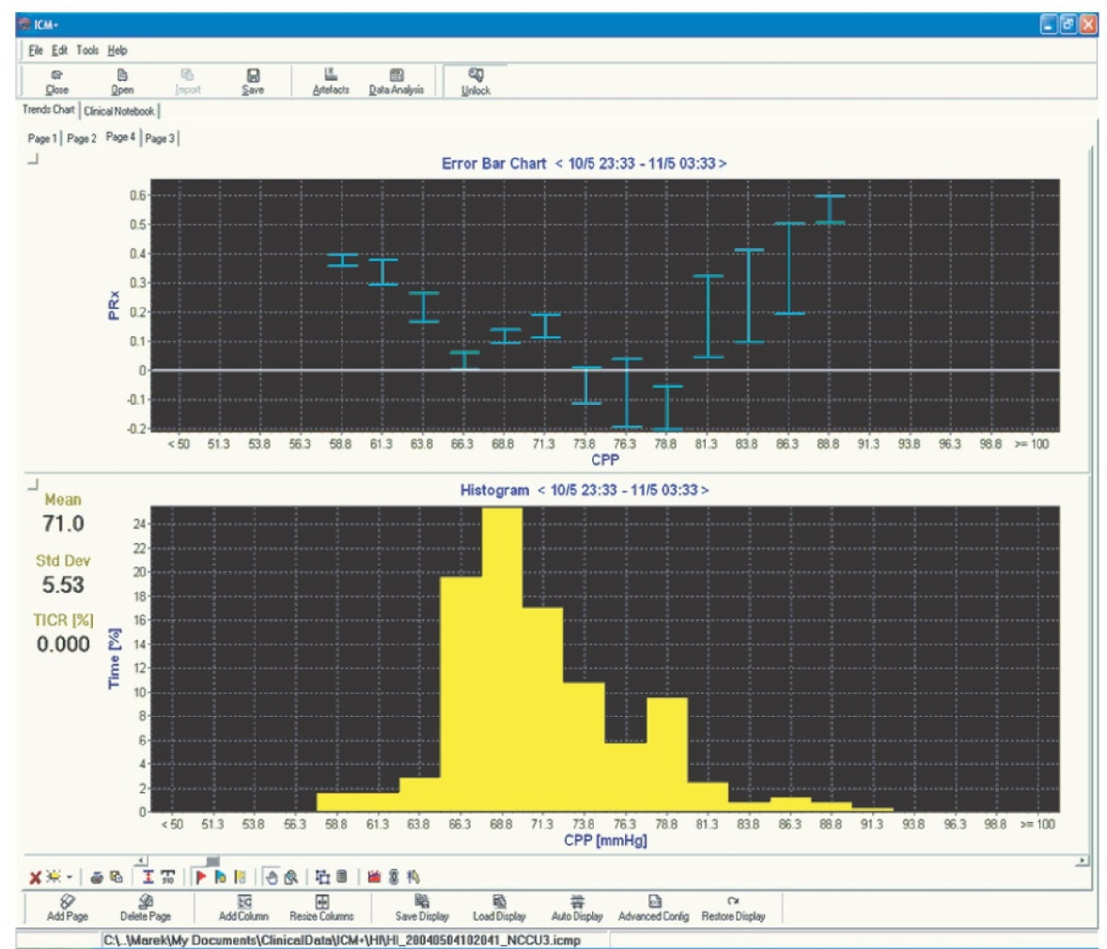

Slide 27
NICEM- ESICM 2008
General targets: ICP<20 mmHg, 50mmHg< CPP< 70mmHg.
CPP> 70 mmHg if Cerebral Vascular autoregulation is intact.
If damaged autoregulation then ICP guided treatment
Use PRx ( correlate ICP- MAP)
They are dynamic parameters with the need for continuous monitoring and individualization
We should use a combination of monitoring involving Cerebral Oxygenation and Metabolism
NICEM-ESICM consensus ICM 2008

Slide 28
Jugular Vein Oximetry
Jugular Vein Oximetry has the advantage and drawback of detecting "total and not local" brain oxygenation, something which is important in mass lesions such as trauma or hemorrhage.
Moreover, venous return uses both vertebral and jugular veins (a ratio of 5- 10% which may shift to the vertebral vasculature especially if the patient is in sitting position).
The blood sample represents approximately 66% of total venous return of the ipsilateral hemisphere and 33% of the opposite.

Slide 29
Samples from the jugular bulb are highly sensitive to isolated conditions and exact location of the probe. The catheter needs recalibration almost every 12 hours. More confusing is the fact that both high and low prices of SjVO2 (even though it is technically absolutely correct) are associated with good and bad outcomes.
Advantage of the method is the relatively simple placement technique, however, the accuracy of the technique depends on many factors that must be excluded before we change the treatment.

Slide 30
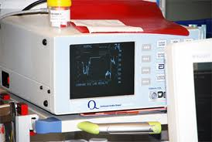
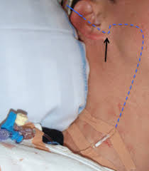
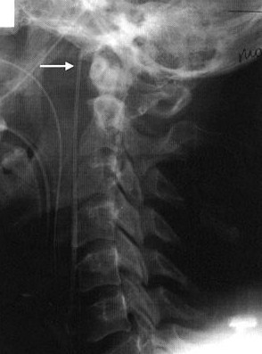
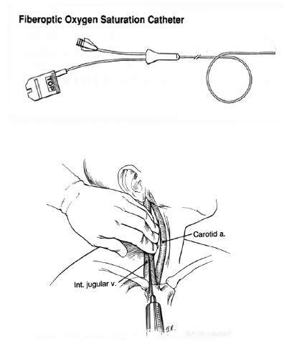
My opinion is that it is just like getting ABGs every half a day

Slide 31
NIRS
Near Infra-Red Spectroscopy (NIRS) is a safe, non-invasive quantification of regional (usually frontal lobe) oxygenation-rSO2.
Based on pulse Oximetry.
Therefore affected by environmental light.
The main disadvantage of the method is that, brain pathology has already occurred at the time of calibration.

Slide 32
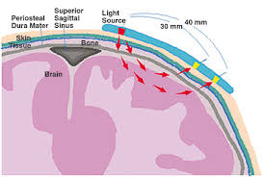
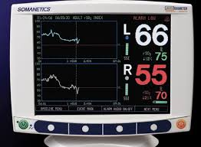
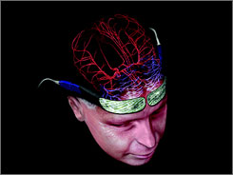

Slide 33
rCBF-TD
Local Cerebral Blood Flow with Thermodiachysis Catheter (rCBF-TD regional Cerebral Blood Flow-Thermal Dilution).
The method utilizes the Hemedex catheter in combination with the Bowman Perfusion 500 Monitor.
The catheter has a tip of two thermistors of which the distal is heated 2^{ο} C above the measured brain temperature. The proximal sensor "feels" this change in temperature, the speed that it occurs and sends data to the monitor which calculates CBF in ml/100gr (nervous tissue) / min.
Measurements are based on: CBF = K (1/V- 1/V0), where K is thermal conductivity constant of the brain, V is the potential difference between the two thermistors and V0 is the potential difference when the flow is zero.

Slide 34
Normal values ​​are 67-100 ml/100gr/ min for cortical areas, 35 ml/100gr/ min for subcortical and 18 -25 ml/100gr/ min for white substance.
Advantages of the method are:
Continuous stream of bedside data in real time,
Easy positioning (a similar technique to the parenchymal ICP catheter) the small diameter of the burr hole (minimally invasiveness)
Low rates of infection.
It requires no calibration in zero flow as earlier methods with mineral cortical plates. It has an automatic safety stop when Τ = 40^{ο}C to avoid iatrogenic thermal damage to nerve tissue while the Monitor assumes automatic recalibration, in vivo.

Slide 35
Disadvantages of this method are:
Difficulty of obtaining data from the deep structures of the brain.
The operation of the probe is affected by brain temperature and its rapid changes.
The proximity of the probe in structures with high conductivity (typically vessels) can change the values.
Strictly focal reading of the method.

Slide 36
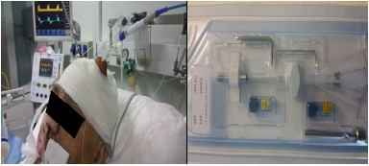
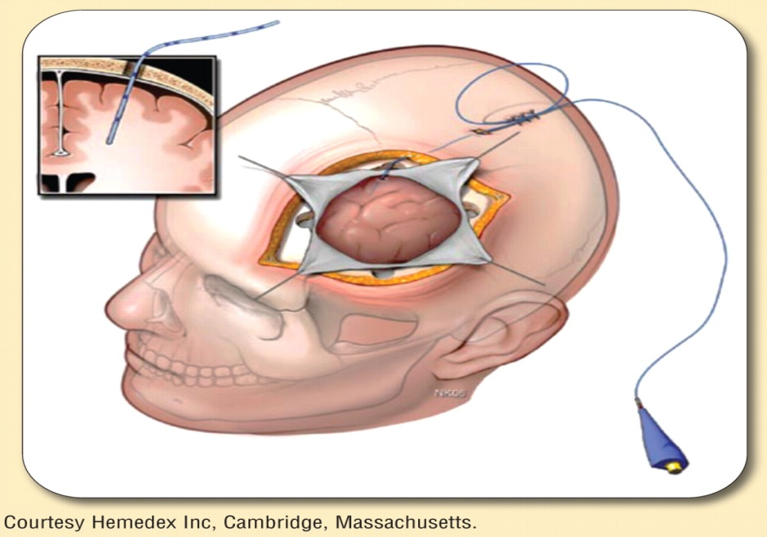
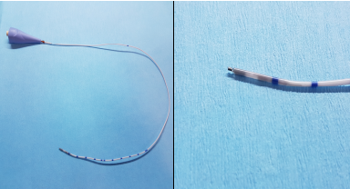
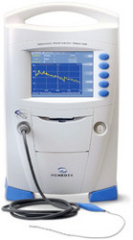
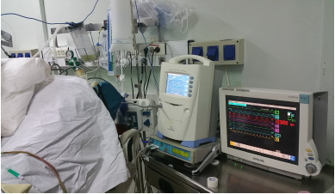

Slide 37
TCD
Transcranial Doppler (TCD) is a bedside, non-invasive method that provides real-time data on the speed and direction of cerebral blood flow.
Disadvantages of the method are:
It is local (essentially gives information on flow velocity for the ipsilateral hemisphere).
CBF may increase due to hyperemia or vasospasm .
Only allows indirect assessment of CBF by measuring flow velocity in the middle cerebral or carotid artery and does not measure absolute CBF.
Repeatability of the measurements is largely dependent on the angle of impact of the sound wave to the vessel, to the properties of the window used (osseous density) and on CO₂. Even when the system is fixed on external fixation rods it may show great variability.

Slide 38
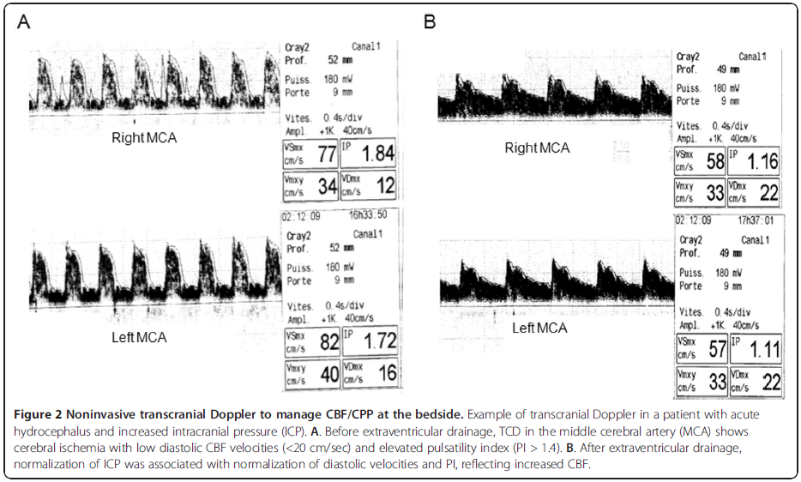
Bouzat et al. Annals of Intensive Care 2013

Slide 39
PbrO₂
The brain tissue oxygenation PbrO₂ is measured by two commercial probe offerings. The Neurovent-PTO which also measures ICP and temperature and the Licox .
Licox is a polarographic (Clark type) electrode which is positioned through a parenchymal 3-way introducer (bolt) which can be used also for other intraparenchymal probes (such as ICP, Hemedex of the CBF, the microdialysis probe or temperature probe) .
Advantages of this method are:
Continuous bedside real-time data.
Automatic calibration
Minimally invasiveness method
Low levels of contamination or clinical infection.

Slide 40
Disadvantages include:
Aprox. three hour waiting period to obtain reliable data
The fragility of the probe.
The lack of identified thresholds of ischemia (the Brain Trauma Foundation suggests lower limits of 15mmHg.
It also needs data on brain temperature to finalize the measurements. This is done either by the catheter located in the Licox pack or by deduction through Hemedex.
The probe measures PbrO₂ in a sphere of 15 mm radius so that the data are again local.

Slide 41
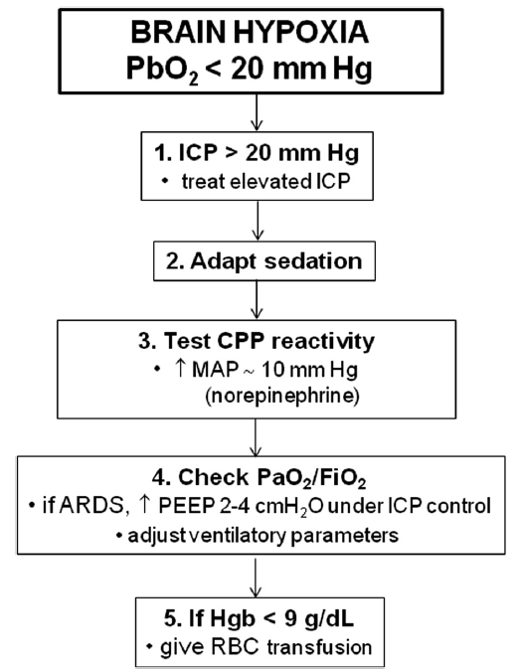
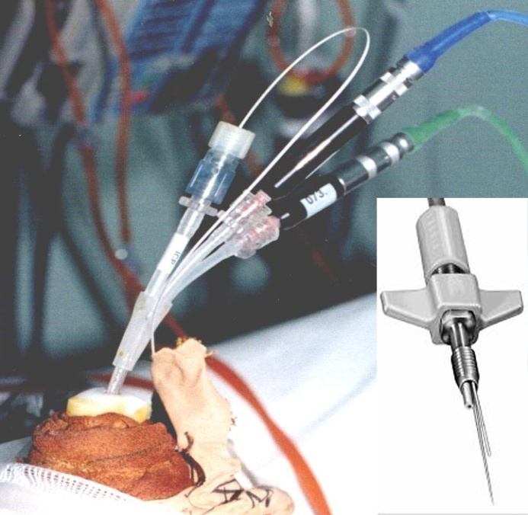
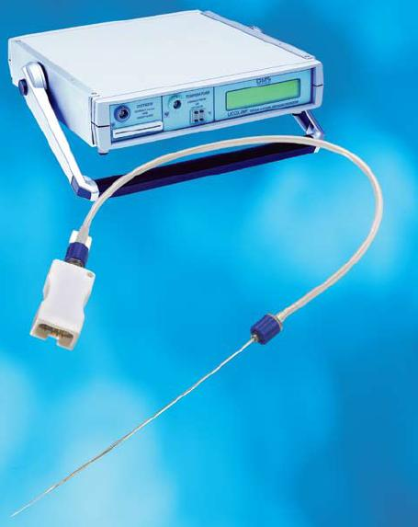
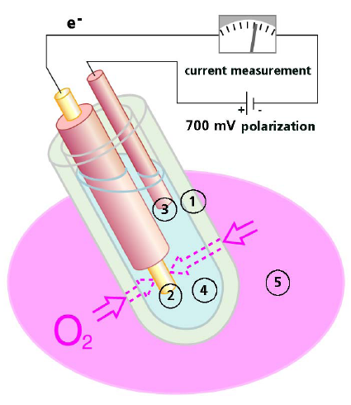
PbrO2 = CBF (PaO2 - PvO2)
It is not just an ischemia monitor
Rosenthal et al. CCM, 2008

Slide 42
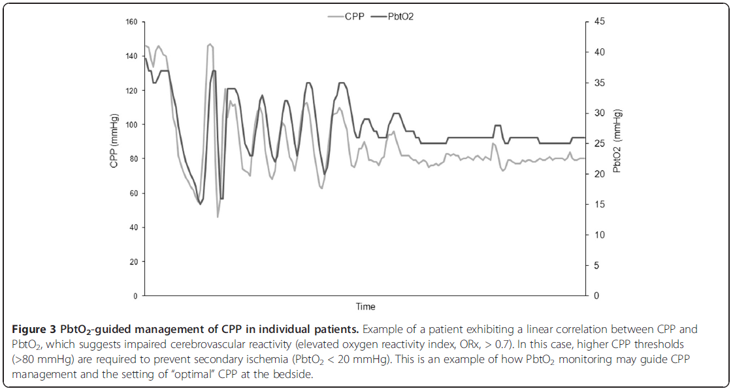
Bouzat et al. Annals of Intensive Care 2013

Slide 43
Microdialysis
Microdialysis is the method for continuous removal and biochemical analysis of interstitial fluid of tissues and organs. It is minimally invasive and simple in everyday clinical practice. Brain Monitoring uses the values of :
Lactate , pyruvate and L/P ratio as a metabolic index of the nervous tissue.
Glycerol as an index of cell destruction.
Glucose is used for tight glycemic control, and there is also correlation with CBF and vasospasm.
In severe brain trauma, biochemical changes where seen several hours before any changes in ICP-CPP.

Slide 44
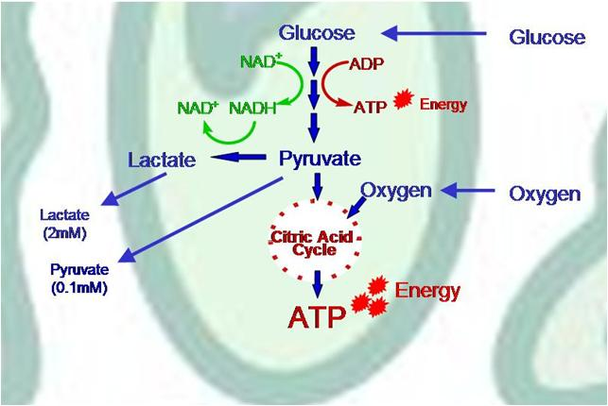
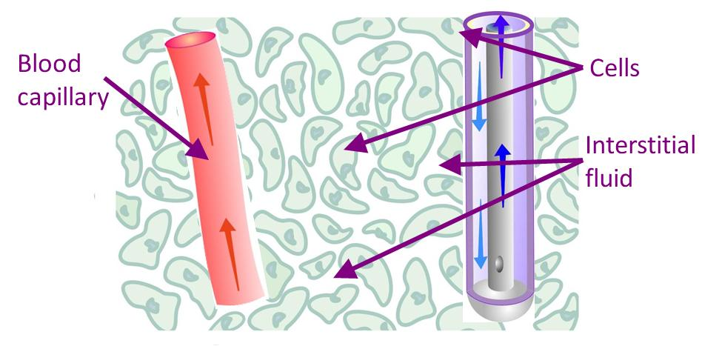
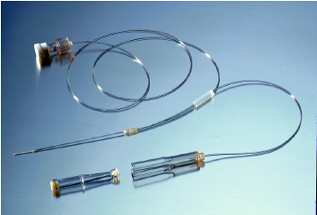
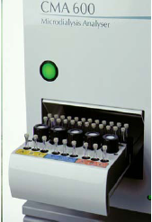
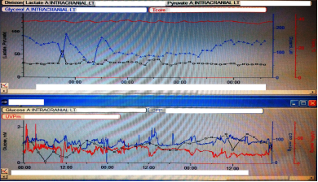

Slide 45
Any evidence?
The findings of this study support the maintenance of high CPP levels guided by the metabolic status of the brain tissue and suggest certain cut-off values for microdialysis parameters. The findings support the latest BTF guidelines, which suggest a more individualized approach in CPP regulation. However, optimal CPP values may vary from patient to patient and over time, as the physiological environment of the injured brain changes. Neurointensivists should not be discouraged to maintain high CPP levels, if the brain metabolic state allows so. We suggest a broader monitoring including PbtO2, microdialysis, and local cerebral blood flow measure. Interventions should be guided by each patient’s brain metabolic status, aiming for the best possible outcome.

Slide 46
EEG
EEG has been proven to be extremely sensitive in the detection of vasospasm in patients with SAH and was reported to precede diagnosis with TCD or angiography up to 2 days.
Disadvantages of the method are:
Difficulty in obtaining large streams of clean recordings because of the high electronic noise in the ICU
Difficulty in obtaining the correct reading and interpretation of the record at the right time by Nurses and Intensivists who are not familiar with the method.

Slide 47
Non-Convulsive and Convulsive Seizures
Epidemiologic data suggest that the epileptogenic period after TBI in humans may last longer than previously thought. Patients with PTE appear to have a higher mortality rate than patients with TBI without epilepsy.
Kharatishvili et al.Curr Opin Neurol 2010
In-hospital NCS are independently associated with a proinflammatory state following SAH as reflected in clinical symptoms and serum biomarkers of inflammation. Inflammation following SAH is associated with poor outcome and that this effect is at least in part mediated through in-hospital NCSz.
Claassen et al. Ann Neurol 2014

Slide 48
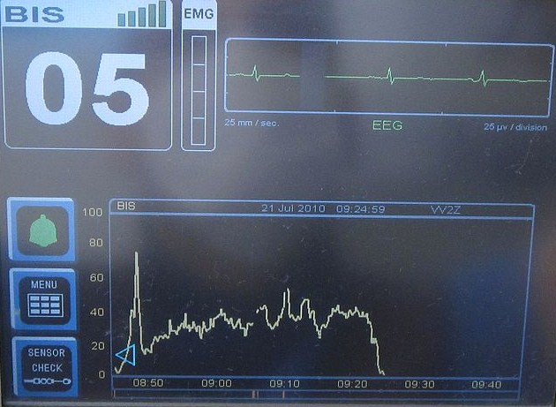
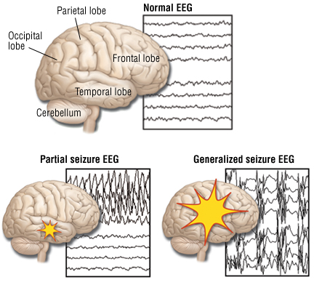
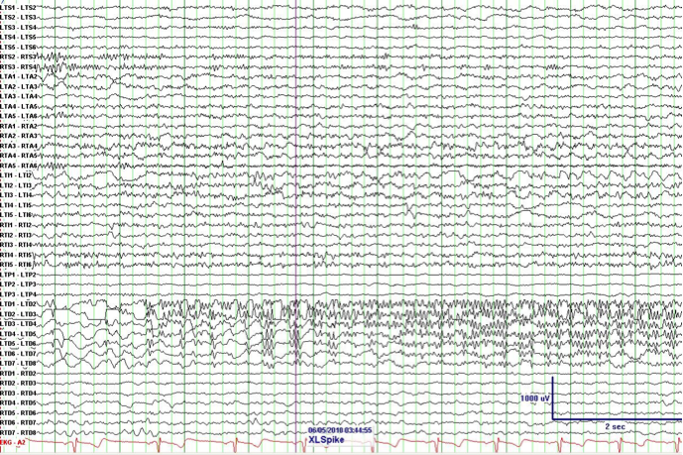
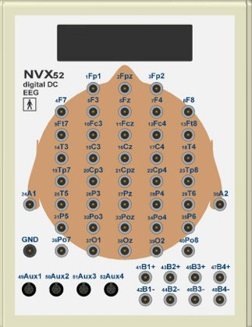

Slide 49
Somato- Sensory Evoked Potentials
Statistical analysis reveals a highly significant improvement in outcome prediction when the model includes SEP and Ct scan hypodensity values.
Bosko et al. J Neurosurg Anesth 2014
Significant correlations between SSEP grades (obtained on days 3 and 7) and information-processing speed, working memory, and the ability to attend to tasks 1 yr after TBI.
Day 3 SSEP grade was marginally better than that on day 1 in relating to functional outcome (GOS, Barthel) but no better than that on day 7
Houlden et al. CCM 2010

Slide 50
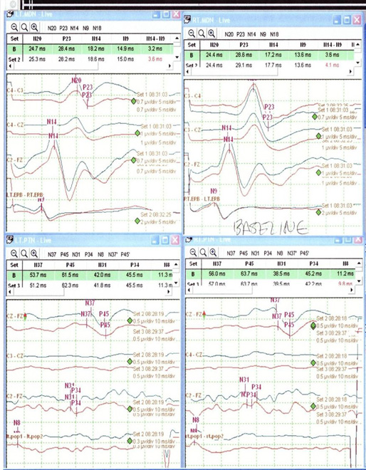

Slide 51
3M therapy: IS IT EFFICIENT?
Analysis suggests that combined ICP/CPP-based and PbtO2-based therapy is associated with better outcome after severe TBI than ICP/CPP-based therapy alone
Nangunoori R et al. Neurocrit Care 2012
The role of MMM and aggressive care using decision analysis: findings suggest that it is effective at all ages, although the effectiveness does diminish with advanced age.
However, the analysis states that when all costs of severe TBI are considered, aggressive treatment is a cost-effective option, even for older patients.
Whitmore RG et al. J Neurosurg 2012

Slide 52
Literature- Suggested reading
NICEM-ESICM consensus ICM 2008
Donnan GA, Fisher M, Macleod M, Davis SM. Stroke. Lancet 2008; 371(9624): 1612-1623 Review.PMID 18468545
European Stroke Organisation (ESO) Executive Committee; ESO Writing Committee. Guidelines for management of ischaemic stroke and transient ischaemic attack 2008. Cerebrovasc Dis 2008; 25(5): 457–507.PMID 18477843
Field JM and Baskett PJF. Basic airway management. In: Webb AR, Shapiro MJ, Singer M, Suter P (eds). The Oxford Textbook of Critical Care. Oxford: Oxford University Press; 1999. p. 2. ISBN-10 0192627376
Nancy Carney, Annette M. Totten, Cindy O'Reilly et al. Guidelines for the Management of Severe Traumatic Brain Injury 4th Edition 2016 available at braintrauma.org
E. Sander Connolly, Alejandro A. Rabinstein, J. Ricardo Carhuapoma et al Guidelines for the Management of Aneurysmal Subarachnoid Hemorrhage. Stroke. 2012;43:1711-1737 https://doi.org/10.1161/STR.0b013e3182587839

Slide 53
Questions

Slide 54
Brain death meaning and diagnosis

Slide 55
Definition
“Irreparable loss of the ability for consciousness in combination with the irreparable loss of the ability for spontaneous breathing”
(Central Health Board
no.9/20-03-1985)

Slide 56
Some History
1959 Mollaret & Goulon : criteria for the diagnosis of brain death
1968 Medical school of Harvard
1976 Commission of Minnesota
1976 Commission of the Medical colleges of UK
1981 commision by the US President for criteria holding until today. Uniform Determination of Death Act (UDDA)
2008 “Α code of practice for the diagnosis and confirmation of death” Academy of Medical Royal Colleges

Slide 57
In Greece
1985: Irreparable loss of the ability for consciousness in combination with the irreparable loss of the ability for spontaneous breathing” (Central Health Board)
2010: Advisory Committee: Updating the criteria of Brain Death.
2013: Consensus of the Greek Society of Intensive Care Medicine.
2016: Transplant Coordinator Training Seminars
Onassis Cardiac Surgery Center, Athens

Slide 58
What is the clinical implication of the definition?
Brain death is the condition of irreversible brain damage, with loss of all the functions of the brain stem.
It is universally accepted that if there is irreparable damage to the brain stem, the whole brain is considered dead and, therefore, the human being is dead. This is because the superior mental and cognitive functions (memory, thought, perception, etc.), as well as vital function control centers (automatic breathing, blood pressure, etc.) are dependant and regulated by the brain stem
For this reason, the death of the brain stem is inevitably and irreversibly followed by the death of the entire brain within a short period of time.

Slide 59
Brain death is followed by “somatic" death, that is, the death of all body organs within 48-72 hours. During this time, the deregulation of all the functions of the organization is gradually progressing.
If the deceased is being hospitalized in the ICU, only then, is it possible to preserve the biological life of the organs by artificial means, so that they can be taken for transplantation and give life to other people.

Slide 60
Death | is a process | not a singular event. It takes hours for all of the cells of the organism to die (decomposition)
 | is irreversible | Death means that the irreversible point has passed, not that the process has stopped Cardiac arrest is potentially reversible
 | 2 ways to die | Cardiac arrest leading to cerebral function cessation Primary brain insult
 | necessary condition | Cerebral function cessation
Brain death is DEATH So after the diagnosis of brain death there are TWO OPTIONS ONLY | Support of vital functions in case of organ donation Cessation of all medical support

Slide 61
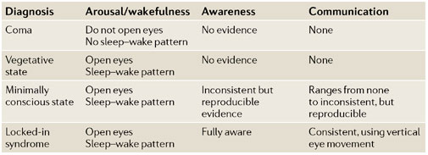
Algorithm of Diagnosis of Cerebral Death

Slide 62
Diseases that can lead to Brain Death
Severe TBI
Intracranial bleeding
Invasive lesions of the brain- Tumours
Cerebral Anoxia - Ischemia
Drowning

Slide 63
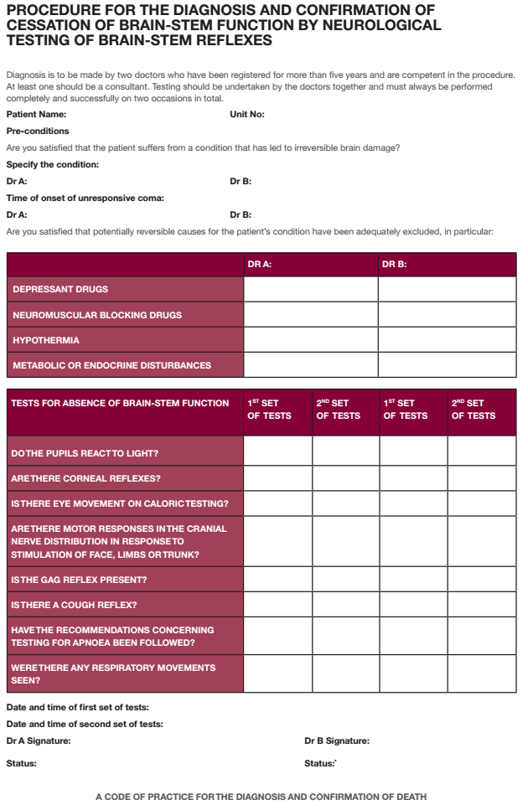

Slide 64
Reflex testing of Brain Conjugates II, III, IV, V, VI, VII, VIII, IX, X

Slide 65
Conditions during the Test of Apnea
This test is the final step in the confirmation of brain death after the finding of loss of all reflexes of the brain stem.
When testing for apnea we must
Avoid Hypoxemia during ventilator disconnection
Correction of possible Hypocapnia, so that PaCO2, at the time of disconnection, is at least 40mmHg
Over 18 hours have elapsed from any finding and correction of metabolic disturbance of the arterial pH, so as to balance with the pH of the CSF, which is crucial for the stimulation of the respiratory center.

Slide 66
Checklist during the Test of Apnea
Checking blood gases and matching ventilation to achieve normocapny (PaCO2 ≈40 mmHg)
Ventilation with 100% O2 for 10 minutes before withdrawal from the ventilator
Withdrawal from the ventilator for 10 minutes and administration of at least 6L / min O2 with a catheter placed inside the endotracheal tube above the carina(apnoic oxygenation)

Slide 67
During the test, it is necessary to continuously monitor the following vital functions:
Arterial Pressure
Heart Rate
SpO2
EtCO2
The cessation of automatic breathing is considered to be definitive as long as no respiratory movements are observed during the period of non-invasive oxygenation

Slide 68
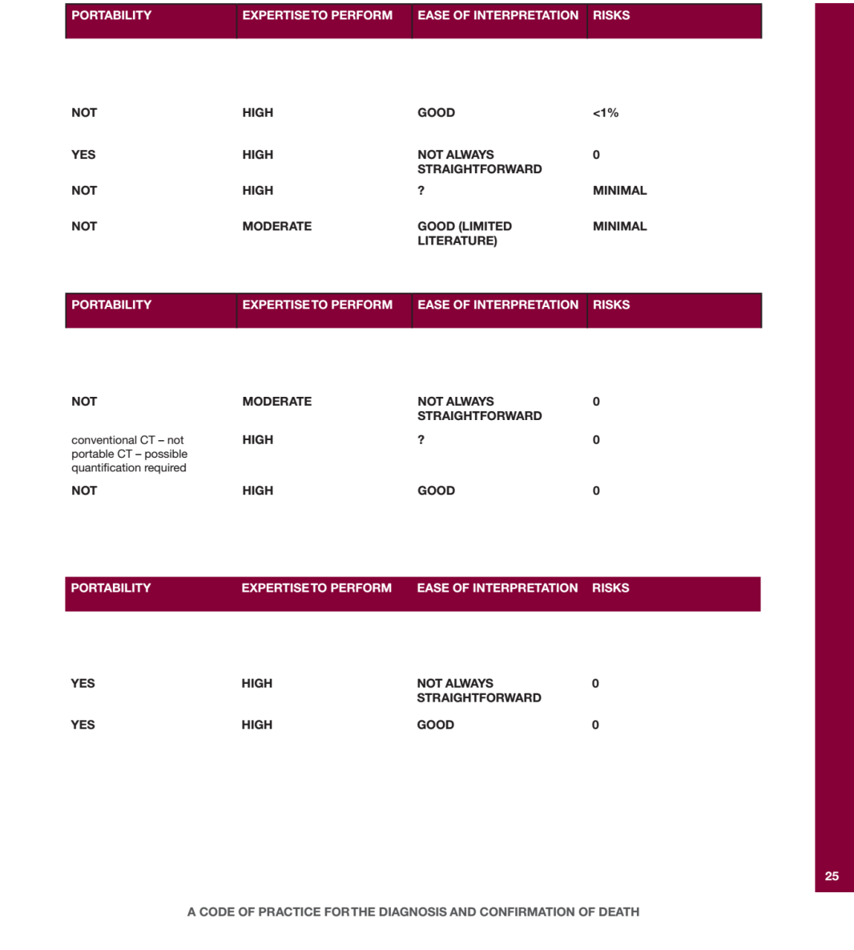
Adjuvant Testing

Slide 69
Literature- Suggested reading
Wijdicks EFM, et al. Evidence-based guideline update: Report of the Quality Standards Subcommittee of the American Academy of Neurology. Neurology 2010;74:1911-1918.
UK code of practice for diagnosis and confirmation of death. Αcademy of Medical Royal Colleges, 2008.
Canadian Council for Donation and Transplantation. Potential Ancillary Tests in the evaluation of brain death: the value of cerebral blood flow assessment, October 10, 2006.
Πρακτικά επιτροπής ΚΕΣΥ για την «Επικαιροποίηση κριτηρίων εγκεφαλικού θανάτου» Αθήνα 21/7/2010
Θέσεις ομοφωνίας της Ε.Ε.Ε.Θ. Αθήνα 16/12/2013
Γιαννάκου-Πεφτουλίδου . Η έννοια του εγκεφαλικού θανάτου. Ελληνικό Περιοδικό Περιεγχειρητικής Ιατρικής . 2005; 3: 27-40
Εκπαιδευτικά Σεμινάρια Συντονιστών Μεταμοσχεύσεων Ωνάσειο Καρδιοχειρουργικό Κέντρο, Αθήνα 10-11/10/2016

Slide 70
Questions

Slide 71
Nutrition in the ICU

Slide 72
Importance of nutrition
Progress in the ICU has allowed the prolonged survival of patients suffering from catabolic disease such as sepsis and multiple organ failure.
Dietary support is indicated for each patient in a critical condition in whom oral intake is not expected to fully meet the energy needs in the first three days after admission in the ICU.
There is increased awareness of the importance of optimal nutritional support.
The consequences of this support exceeds the energy supply and protein balance in the body.
It has a beneficial effect on the modulation of the host's immune response and the integrity of the gastrointestinal tract (GI)
Loris Pironi et al. Clinical Nutrition 35 (2016) 247-307

Slide 73
Assessment of the nutritional status of ICU patients
Nutritional evaluation is done with two goals
Detection of protein-calorie malnutrition (PCM) (or detection of patients at risk for PCM)
Monitor and modification of the nutritional support as needed.
30-50% of hospitalized patients suffer from PCM
The nutritional status is a main determinant of the response to the disease
Adequate nutrition offers resistance to infections, maintenance of intestinal, respiratory and healing functions
PCM may potentially
endanger rehabilitation
Related complications are thought to increase LOS, medical support, and total cost
Biolo G, Grimble G, Preiser JC et al. Intensive Care Med 2002; 28(11): 1512-1520.

Slide 74
General Nutritional Goals
Martindale RG et al. Crit Care Med 2009; 37(5): 1757-1761.

Slide 75
Nutritional Adequacy Indexes
The ideal indicator of the nutritional status should be widely available, nutritionally sensitive, modifiable, easily reproducible and economic.
Biological indicators:
Albumin, transthyretin, transferrin, retinol binding protein, fibronectin and insulin-like growth factor-1
The concentration of these factors mainly reflects the balance between hepatic synthesis, distribution and elimination-destruction.
Stress and trauma are associated with hormones and cytokines that interact with amino acids and micronutrients
Low levels of serum albumin correlate with poor prognosis in patients treated,
Transferrin, transthyretin, and fibronectin are sensitive to rapid changes in the dietary status and have a shorter half-life (7 days, 2 days and about 4 hours, respectively)
Their levels are also affected by acute stress, dilapidated escape and inflammatory reaction.
Somatometric indicators
Determination of body composition by measuring the thickness of skin and arm circumference, or analysis of bioelectric impendance suffer from various deficiencies in ICU patients and are generally not suggested.
Kyle UG, et al Clin Nutr 2004; 23: 1430-1453
Nutritional indicators
Since no parameter adequately determines PCM, nutritional indicators have been developed
Instant Nutritional Assessment / Prognostic Inflammatory and Nutritional Index
These are risk indicators
Clinical signs
Edema, cachexia, muscular atrophy and mucosal lesions (glossitis)
Sungurtekin H et al, Nutr Clin Pract. 2008;23(6): 635-41

Slide 76
Practical assessment of nutritional status
Patient history and clinical signs
Diseases associated with increased risk of malnutrition (eg chronic morbidity)
History of chronic low food intake, drug abuse, alcoholism, or chronic psychiatric disorders
Diseases associated with hypermetabolism and prolonged catabolism (eg history of multiple wounds, burns, persistent fever, sepsis, multiple organ failure)
Clinical and anthropometric assessment
Signs of malnutrition (eg cachexia, muscular atrophy, edema)
Recent severe body weight loss (≥ 5% of normal BW in one month or ≥ 10% in three months)
Body mass index (body weight in kg / (height in m2)) <18.5 kg / m2
Biochemical parameters
Hyperalbuminaemia <35g / L
Serum electrolyte levels (K, Mg, P, Ca)
Negative nitrogen balance (≤5 g (low stress), 5 to 15 g (moderate stress), ≥15 g (intense stress)
Jolliet P, et al. Clin Nutr 1999; 18: 47-56). ESPEN

Slide 77
Energy consumption
Baseline (energy expenditure) is derived from the Harris-Benedict equation:
• Men: EE (kcal / day) = 66 + (13.7 x W) + (5 x H) - (6.8 x A) x H) - (4.7 x A)
• Women: EE (kcal/day) = 655 + (9.6 x W) + (1.7 x H) - (4.7 x A)
W = Weight - weight in kg, H = Height - height in cm, A = Age - age in years.
In patients under Mechanical ventilation, the Faisy equation:
• EE (kJ / day) = 8 x W + 15 x H + 32 x MV + 94 x BT -4834 • MV = minute ventilation in L / min, BT = in ⁰C.
1kcal = 4.184 kJ.
Walker RN, et al. Respir Care 2009;54:509-21
In practice, a realistic estimate of all energy needs is 25-35 (20-30) kcal / kg / day for men and women.
10% should be added to energy needs for each degree of body temperature> 37 ° C.

Slide 78
Ways of administration
The Enteral Nutrition is recommended as a first-line nutritional support
In patients suffering from pre-existing PCM, parenteral nutrition should be started as soon as possible if EN is not feasible
Evidence:
Well-nourished patients in whom oral intake is not expected to fully meet energy needs within three days of introduction into the ICU.
Patients with prolonged fasting or inadequate oral intake.
Pre-existing malnutrition, irrespective of the cause.
Realistic indications
Severe stress in patients expected not to be able to feed - eat for 5-7 days
Severe injuries and burns
After resection of the small intestine (especially if it is extensive or complicated)
EN should be the preferred way of feeding whenever possible.
Complete bowel bypass leads to adverse structural and functional changes in the mucosa which can be reversed by EN
Singer P et al. Intensive care Clin Nutr. 2009;28(4): 387-400

Slide 79
Enteral- Parenteral Nutrition Advantages
Advantages of intestinal feeding
It favors intestinal villus integrity and functionality, and reduces intestinal permeability
Maintains the functions of Gut-associated Lymphoid Tissue (GALT) and Mucosa-associated Lymphoid Tissue (MALT), helps the production and secretion of IgA and hormones
It promotes intestinal motility by preparing for oral nutrition
It reduces bacterial displacement from the intestine
Reduces infectious and metabolic (hyperglycemia, insulin resistance, hypertriglyceridemia, fatty liver) complications associated with parenteral nutrition
Less expensive than parenteral nutrition
Advantages of parenteral feeding
Easy initiation during the initial phase of the disease.
Ensures full delivery of specific nutritional needs
Avoids the dangers of gastroesophageal reflux disease, ingestion pneumonia, intolerance and intestinal malabsorption
Thibault R, Pichard C. Curr Opin Clin Nutr Metab Care 2010; 13(2): 177-183.

Slide 80
Contraindications of ΕΝ & PN nutrition
Contraindications for intestinal feeding
Absolute
Sufficient oral intake (over 80% of the energy target)
Non-functional bowel (anastomosis rupture, ileus by occlusion, intestinal ischemia / necrosis)
Generalized peritonitis
Durable, irreversible Shock
Relevant
Expected fasting period ≤5 days, (except severely injured patients)
Abdominal distension / severe prolonged diarrhea
Local peritonitis, intra-abdominal abscess, active upper gastrointestinal bleeding
Coma with risk of reduction and intake
Short bowel (less than 70 cm) high production fistulas
Heart, liver, kidney deficiencies
Clerical illness
Dementia, agitation, confusion
Contraindications for parenteral feeding
Absolute
Sufficient ingestion by mouth
Intestinal diet feasible (over 60% of energy)
Durable, irreversible Shock;
Relevant
No central venous line or polynal catheters
Dyspnoea in feeding or in food support
Kidney, Heart, Liver deficiency)
Incompatibility between intravenous drugs and parenteral feeding
Dementia, agitation, confusion
Kreymann et al: Intensive care Clin Nutr. 2006;25(2): 210-23.

Slide 81
Conclusions
30-50% of hospitalized patients suffer from PCM
The nutritional status is the main determinant of the response to the disease
Biological, Somatometric, Nutritional Indicators, Clinical signs
In practice, a realistic estimate of all energy needs is 25-35 (20-30) kcal / kg / day for men and women.
The intestinal tract is recommended as a first-line nutritional support
Dietary intervention can start within 12-48 hours
Exclusive EN is difficult to optimize
PN should replace EN if patients develop significant intolerance
Dietary pharmacology, aiming at immunomodulation and / or anti-inflammatory action, are the main ambitions of the modern metabolic approach

Slide 82
Literature- Suggested reading
Downs JH, Haffejee A. Nutritional assessment in the critically ill. Curr Opin Clin Nutr Metab Care. 1998;1(3): 275-9. Review. PMID 10565360
Plank LD, Hill GL. Sequential metabolic changes following induction of systemic inflammatory response in patients with severe sepsis or major blunt trauma. World J Surg 2000; 24 (6): 630-638. Review.PMID 10773114
Singer P, Berger MM, Van den Berghe G, Biolo G, Calder P, Forbes A, et al, ESPEN. ESPEN Guidelines on Parenteral Nutrition: intensive care. Clin Nutr 2009; 28(4): 387-400. PMID 19505748
Thibault R, Pichard C. Nutrition and clinical outcome in intensive care patients. Curr Opin Clin Nutr Metab Care 2010; 13(2): 177-183.PMID 19996743
Walker RN, Heuberger RA. Predictive equations for energy needs for the critically ill. Respir Care 2009;54:509-21.PMID 19327188
Hinds CJ, Watson JD. Intensive Care: A Concise Textbook. 3rd edition. Saunders Ltd; 2008. ISBN: 978-0-7020259-6-9.p. 301.

Slide 83
Questions

Slide 84
renal replacement therapy in the ICU

Slide 85
Definition
RRT is a general term that refers to the various types of dialysis modalities used in the management of AKI
RRT mimics the functionality of the native kidney and is the cornerstone of treatment in patients with severe AKI.
Important consideration:
RRT does not correct endocrine abnormalities, such as decreased production of erythropoietin and vitamin D

Slide 86
Goals of RRT in patients with AKI
Maintain fluid, electrolyte,acid–base, and solute balance.
Prevent additional kidney damage.
Allow renal recovery
Allow other supportive interventions to proceed without complication or limitation.

Slide 87
Indications for RRT initiation RENAL
The main renal indications for the initiation of RRT include:
Hyperkalemia (serum potassium values ≥ 6.5 mmol/L).
Metabolic acidosis (pH < 7.15)
Volume overload
Uremia (blood urea level 56–112 mg/dL).1
An increase in serum creatinine 2.0–2.9 times baseline

Slide 88
Indications for RRT initiation NON- RENAL
Non-renal indications that are sometimes used to consider RRT initiation or an adjuvant role for RRT include:
Intoxication or overdose with some alcohols, salicylate, lithium, theophylline, or methotrexate.
Refractory septic shock.
Intractable hyperthermia.
Acute liver failure.
Severe tumor lysis syndrome

Slide 89
What is the optimal time to initiate RRT?
The decision about when to initiate RRT is complex and may be influenced by:
Patient-specific factors.
Clinician-specific factors.
Logistical issues.
Practical considerations

Slide 90
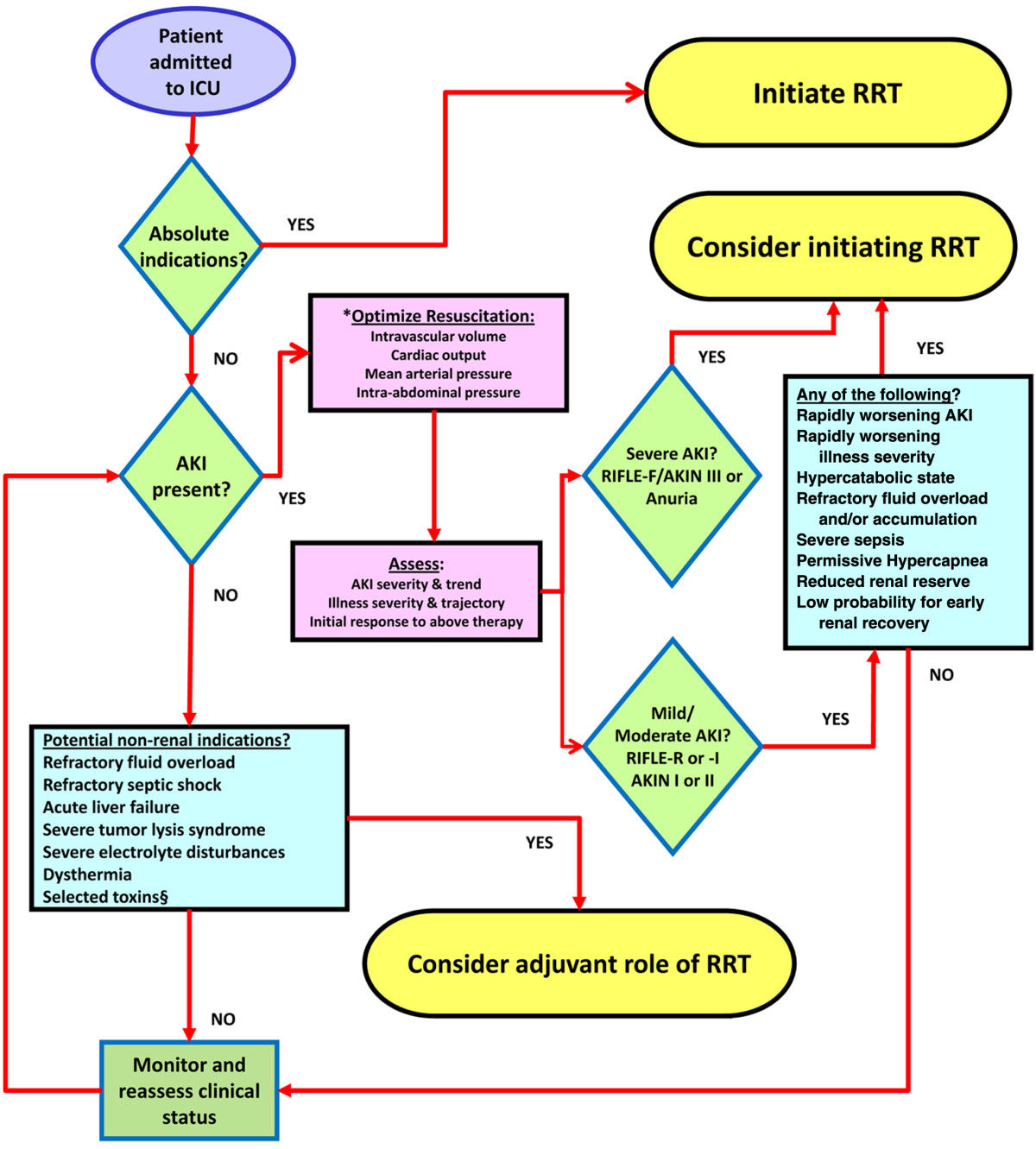
Protocol for RRT initiation

Slide 91
RRT modalities

Slide 92
RRT modalities – CRRT
CRRT.
CRRT is an extracorporeal blood purification therapy intended to substitute for impaired renal function continuously 24 hours per day.
CRRT is the preferred modality for AKI in ICUs throughout much of the world.
CRRT represents a spectrum of
modalities, including:
Slow continuous ultrafiltration (SCUF).
Continuous venovenous hemofiltration (CVVH).
Continuous venovenous hemodialysis (CVVHD).
Continuous venovenous hemodiafiltration (CVVHDF).

Slide 93
The CRRT dose – The KDIGO Guidelines state:
The findings of the ATN and RENAL studies provided strong evidence that effluent flow rates above 20–25 mL/kg/h do not improve survival in patients in the ICU
In addition, the studies provided strong circumstantial evidence to support the observations of Prowle JR and colleagues that CRRT doses of < 20 mL/kg/h are likely to be harmful and should be avoided.
To reach the levels of survival attained in the ATN and RENAL trials with a prescribed dose of 20 to 25 mL/kg/h, the prescribed dose probably needs to be 25–30 mL/kg/h and the number of interruptions to CRRT must be minimized.
The KDIGO Guidelines states:
We recommend delivering an effluent volume of 20–25 mL/kg/h for CRRT in AKI
This will usually require a higher prescription of effluent volume

Slide 94
What is the optimal time to stop RRT?
The KDIGO Guidelines states:
Discontinue RRT when it is no longer required, either because intrinsic kidney function has recovered to the point that it is adequate to meet patient needs, or because RRT is no longer consistent with the goals of care.

Slide 95
Benefits of CRRT
In particular, the use of CRRT in the treatment of critically ill patients with AKI is associated with the following potential benefits:
Hemodynamic tolerability
Solute clearance
Clearance of middle- and large-weight molecules
Control of acid–base balance
Minimal effect on intracranial pressure
Control of intravascular volume
Ability to perform treatment with simple, user-friendly machines
Facilitation of supportive measures (e.g. administration of parenteral nutrition)

Slide 96
Literature- Suggested reading
Joannidis M, Forni LG. Clinical review: timing of renal replacement therapy. Crit Care 2011; 15(3): 223. PMID 21672279
Kidney Disease: Improving Global Outcomes (KDIGO) Acute Kidney Injury Work Group. KDIGO Clinical Practice Guideline for Acute Kidney Injury. Kidney Int Suppl 2012; 2(1): 1–138
Kellum JA, Mehta RL, Angus DC, Palevsky P, Ronco C; ADQI Workgroup. The first international consensus conference on continuous renal replacement therapy. Kidney Int 2002; 62(5): 1855–1863. Review. PMID 12371989
Polderman KH, Herold I. Therapeutic hypothermia and controlled normothermia in the intensive care unit: practical considerations, side effects, and cooling methods. Crit Care Med 2009; 37(3): 1101–1120. PMID 19237924
Bellomo R, Ronco C, Mehta RL. Nomenclature for continuous renal replacement therapies. Am J Kidney Dis 1996; 28 (5 Suppl 3): S2-S7
Bellomo R, Cass A, Cole L, Finfer S, Gallagher M, Lo S, et al; RENAL Replacement Therapy Study Investigators. Intensity of continuous renal-replacement therapy in critically ill patients. N Engl J Med 2009; 361(17): 1627–1638. PMID 19846848

Slide 97
Questions

Slide 98
Which should be a threshold to actively treat?
CPP<50mm Hg
ICP Above 20mm Hg
PbrO2< 20mm Hg
All of the above

Slide 99
How much is the RRT proposed dose?
35-40 mL/kg/h
15-20 mL/kg/h
25-30 mL/kg/h and the number of interruptions to CRRT must be minimized
it depends on the patient

Slide 100
What is Brain death?
Irreparable loss of the ability for consciousness in combination with the irreparable loss of the ability for spontaneous breathing
Irreparable loss of the ability for consciousness
Brain death is the condition of irreversible brain damage, with loss of all the functions of the brain stem.
Loss of the ability to breath

Slide 101
Which is the Basal energy expenditure for a man?
25-35 kcal / kg / day
Calculated by : EE (kcal/day) = 655 + (9.6 x W) + (1.7 x H) - (4.7 x A)
Calculated by : EE (kJ / day) = 8 x W + 15 x H + 32 x MV + 94 x BT -4834
20-30 kcal / kg / day

Slide 102
Which is the main factor in regulating intracranial volume increase?
Intracerebral blood volume
Cerebral parenchyma
Cerebrospinal fluid
Brain edema

